Slide 1
Introduction to Python
P.1

Slide 2
Agenda
- The Zen of Python
- First steps
- Basic Python
- Fun :)

Slide 3
The Zen of Python
import this

Slide 4
The Zen of Python
Beautiful is better than ugly.
Explicit is better than implicit.
Simple is better than complex.
Complex is better than complicated.
Flat is better than nested.
Sparse is better than dense.
Readability counts.
Special cases aren't special enough to break the rules.
Although practicality beats purity.
Errors should never pass silently.
Unless explicitly silenced.
In the face of ambiguity, refuse the temptation to guess.
There should be one-- and preferably only one --obvious way to do it.
Although that way may not be obvious at first unless you're Dutch.
Now is better than never.
Although never is often better than *right* now.
If the implementation is hard to explain, it's a bad idea.
If the implementation is easy to explain, it may be a good idea.
Namespaces are one honking great idea -- let's do more of those!

Slide 5
First steps
Interpreter Prompt

Slide 6
First steps
<Interpreter Prompt>
REPL
Read-Eval-Print Loop

Slide 7
First steps
<Interpreter Prompt>
>>> print(“Hello World!”)

Slide 8
First steps
<Interpreter Prompt>
>>> print(“Hello World!”)
"The 'Hello World' example is the traditional incantation to the programming gods and will ensure your quick mastery of the language, so please make sure you actually do this exercise, instead of just reading about it."
–- said Simon Cozens in "Beginning Pearl"

Slide 9
First steps
<Interpreter Prompt>
>>> exit()

Slide 10
First steps
Editor and Source File

Slide 11

First steps
<Source File>
Interpreter
Source
file
Compiler
Byte
code
Virtual
Machine
Run
Modules

Slide 12
First steps
<Source File>
hello.py
touch this file

Slide 13
First steps
<Source File>
Interpreter
Source
file
Compiler
Byte
code
Virtual
Machine
Run
hello.cpython-38.pyc
hello.py
Hello World!
Modules

Slide 14
First steps
Getting Help

Slide 15
First steps
<Getting Help>
>>> help()

Slide 16
Basic Python 1
print()

Slide 17
Basic Python 1
Comments

Slide 18
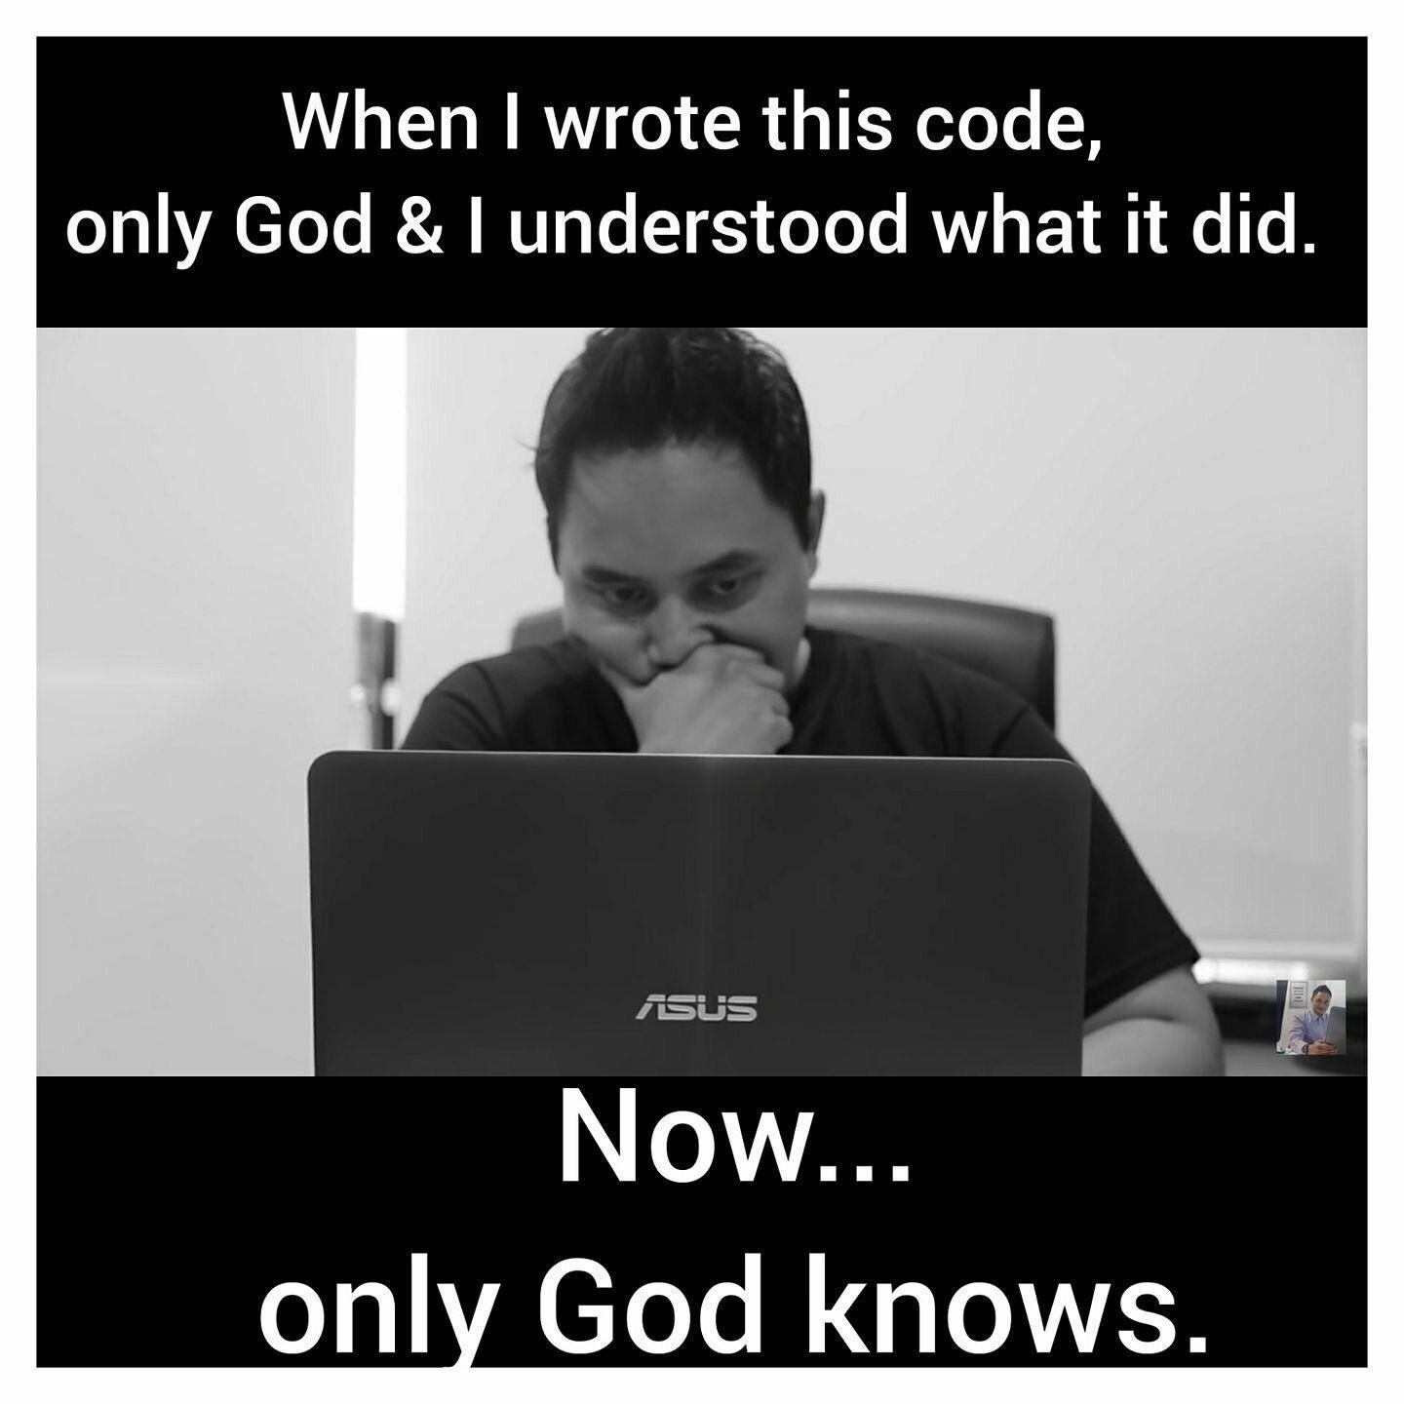
Basic Python 1
<Comments>

Slide 19
Basic Python 1
Literal Constants

Slide 20
Basic Python 1
Basic Operations with Numbers

Slide 21
Basic Python 1
<Basic Operations with Numbers>
>>> 1729**1729

Slide 22
Basic Python 1
<Basic Operations with Numbers>
>>> # loss-of-precision for float
>>> a = 1/10
>>> print(“{:.50f}”.format(a))

Slide 23
Basic Python 1
<Basic Operations with Numbers>
>>> # overflow
>>> 1.7e308
>>> 1.8e308

Slide 24
Basic Python 1
<Basic Operations with Numbers>
>>> # underflow
>>> 5e-324
>>> 1e-325

Slide 25
Basic Python 1
Basic Operations with Strings

Slide 26
Basic Python 1
rectangle.py
Given width and height of a triangle 5 and 3 respectively, print out its Perimeter and Area
Sample output:
>>> python3 rectangle.py
Perimeter: 16
Area: 15

Slide 27
Basic Python 1
Data Type

Slide 28
Basic Python 1
Casting

Slide 29
Basic Python 1
<Casting>
1729.0**1729
int( )
1729.0
1729

Slide 30
Basic Python 1
<Casting>
str(1729) → ‘1729’
<class ‘int’> <class ‘str’>
complex(‘1729’) → 1729+0j
<class ‘str’> <class ‘complex’>
int(‘10001’,2) → 17
<class ‘int’> <class ‘str’>
int(‘a’) → ?

Slide 31
Basic Python 1
Variable

Slide 32

Basic Python 1
<Variable>
Identifier
Memory
a = 300
Address | Value
0x7ff01136ff90
0x7ff01136ffd0
0x7ff01136ffb0
a
300
b = 400
c = a
c
b = 300
b
400
300
Garbage
Collector

Slide 33
Basic Python 1
rectangle.py
Modify the rectangle.py script, now use variable to represent width and height lengths
Sample output:
>>> python3 rectangle.py
Perimeter: 16
Area: 15

Slide 34
Basic Python 1
Built-in Functions

Slide 35
Basic Python 1
<Built-in Functions>
abs() delattr() hash() memoryview() set()
all() dict() help() min() setattr()
any() dir() hex() next() slice()
ascii() divmod() id() object() sorted()
bin() enumerate() input() oct() staticmethod()
bool() eval() int() open() str()
breakpoint() exec() isinstance() ord() sum()
bytearray() filter() issubclass() pow() super()
bytes() float() iter() print() tuple()
callable() format() len() property() type()
chr() frozenset() list() range() vars()
classmethod() getattr() locals() repr() zip()
compile() globals() map() reversed() __import__()
complex() hasattr() max() round()

Slide 36
Basic Python 1
rectangle.py
Modify the rectangle.py script, now use user input for width and height and they are both whole numbers.
Sample output:
>>> python3 rectangle.py
Type in width: 5
Type in height: 3
Perimeter: 16
Area: 15

Slide 37
Basic Python 1
square.py
Given the Perimeter of a Square as user input (can be real number), print out its Area.
Sample output:
>>> python3 square.py
Type in Square’s Perimeter: 4
It’s Area: 1

Slide 38
Basic Python 1
circle.py
Given the Circumference of a Circle as user input (can be real number), print out its Area, rounded to the 5th decimal point.
Sample output:
>>> python3 circle.py
Type in Circle’s Circumference: 1
It’s Area: 0.07958

Slide 39
Basic Python 1
regular_polygon.py
Given the Perimeter of a polygon (real number) and its number of vertices (whole number) as user input, print out the polygon's Area.
Sample output:
>>> python3 regular_polygon.py
Type in Polygon’s Perimeter: 6
Type in number of vertices: 6
It’s Area: 2.598076211353316

Slide 40
Basic Python 1
Queen Dido problem

Slide 41


