Slide 1
Visualization of Newton’s Laws of Motion
Group 2
Nguyen Manh Phuc - 20176845
Nguyen Thi Hong Anh - 20176679

Slide 2
Member’s Assignment:
Nguyen Manh Phuc
Menu package
Introduction package
First law package
GUI ideas
Nguyen Thi Hong Anh
Second law package
Third law package
Diagrams

Slide 3
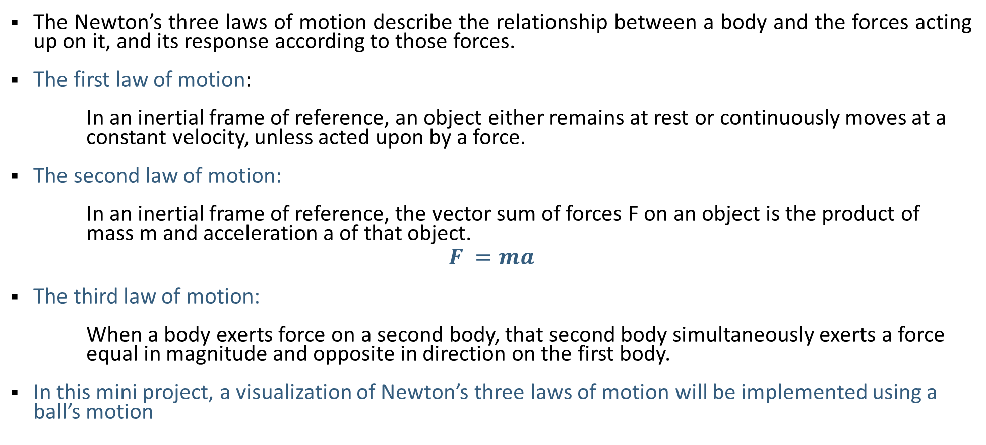
Problem Statement
The Newton’s three laws of motion describe the relationship between a body and the forces acting up on it, and its response according to those forces.
The first law of motion:
In an inertial frame of reference, an object either remains at rest or continuously moves at a constant velocity, unless acted upon by a force.
The second law of motion:
In an inertial frame of reference, the vector sum of forces F on an object is the product of mass m and acceleration a of that object.
$$F =ma$$
The third law of motion:
When a body exerts force on a second body, that second body simultaneously exerts a force equal in magnitude and opposite in direction on the first body.
In this mini project, a visualization of Newton’s three laws of motion will be implemented using a ball’s motion

Slide 4
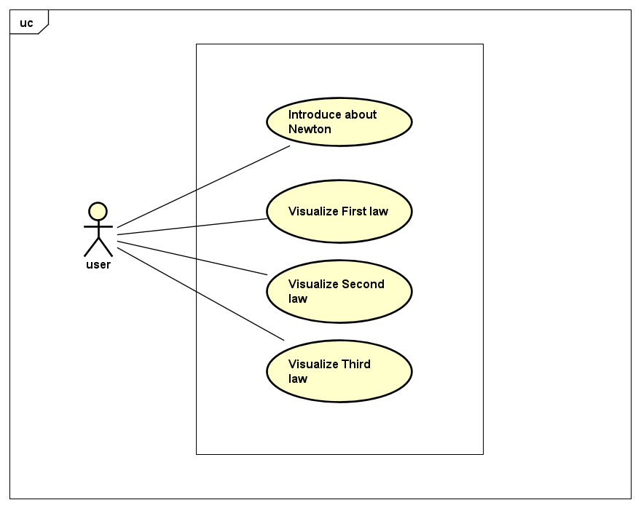
Use Case Diagram

Slide 5
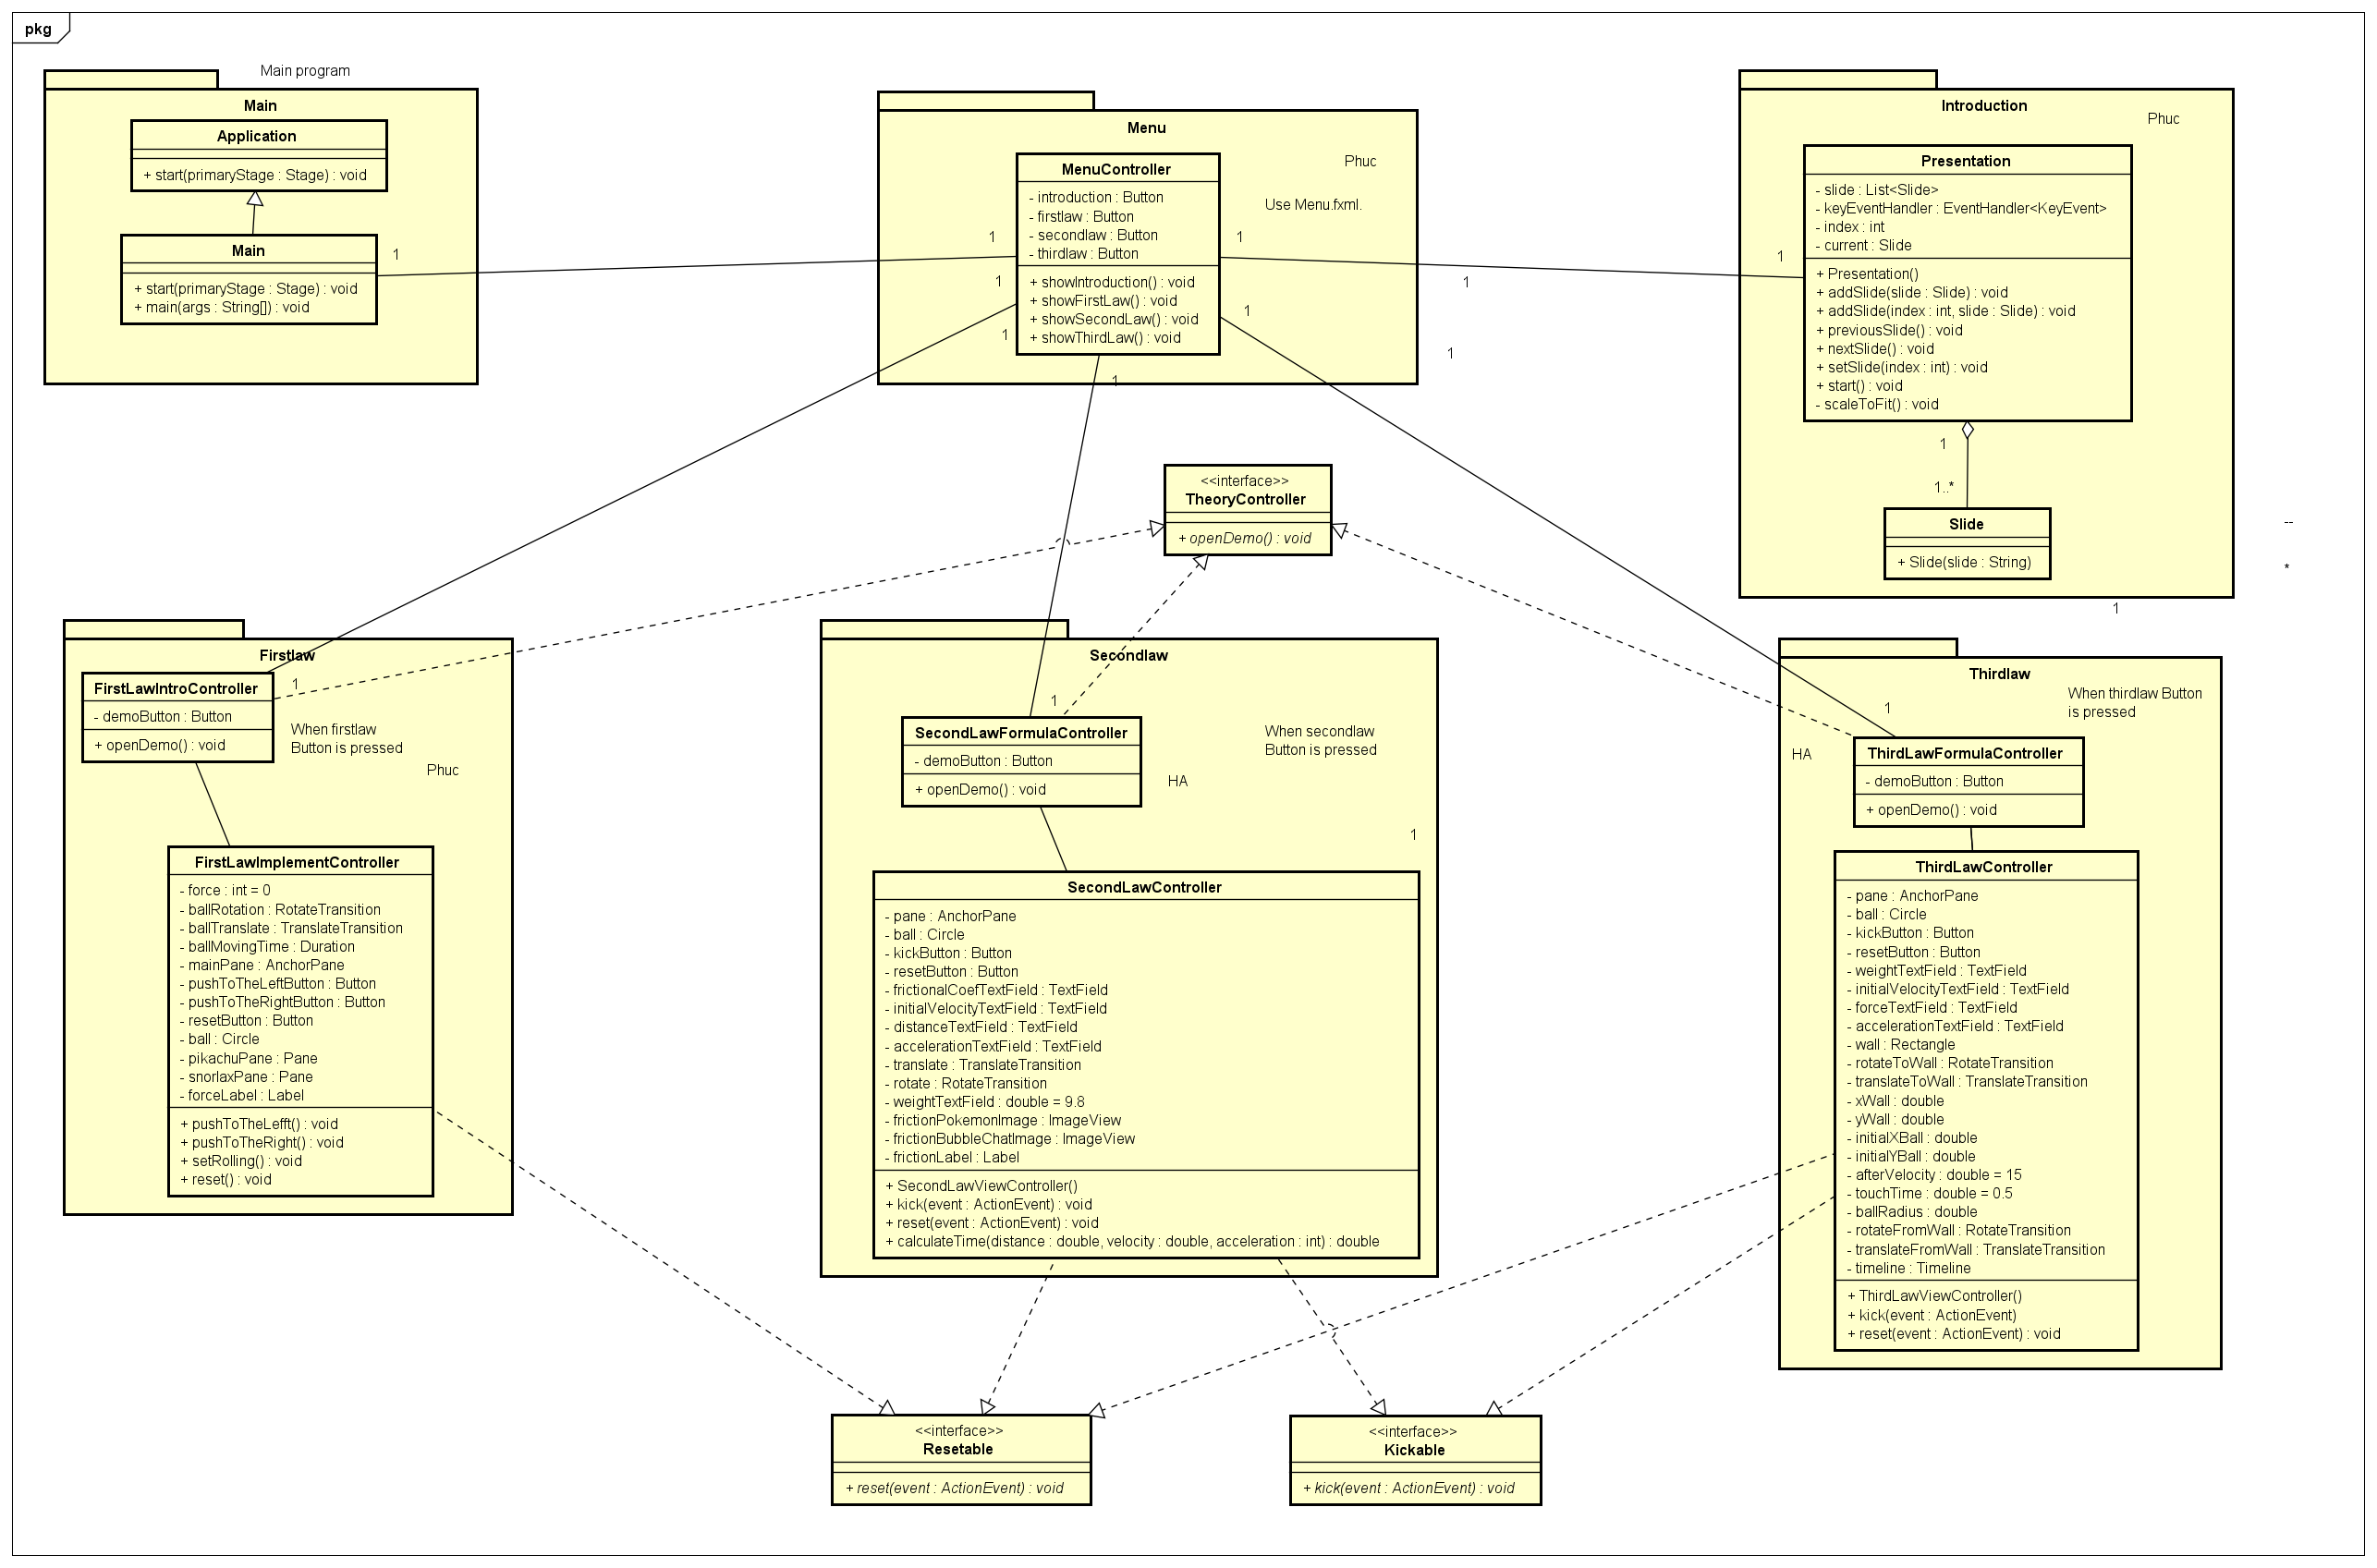
General Class Diagram

Slide 6
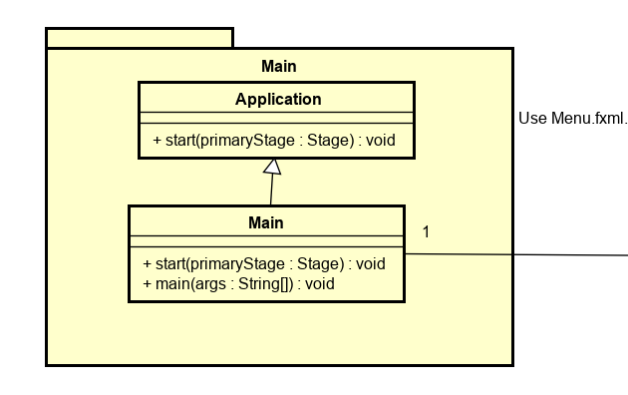
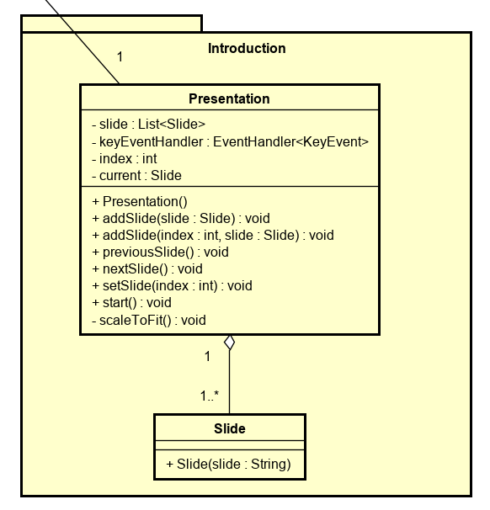
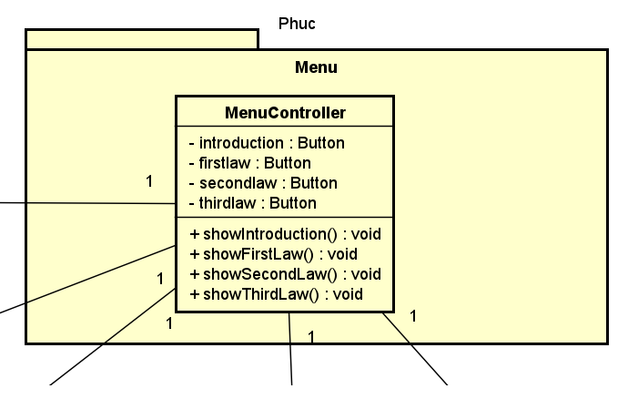
Class Diagram (cont.)

Slide 7
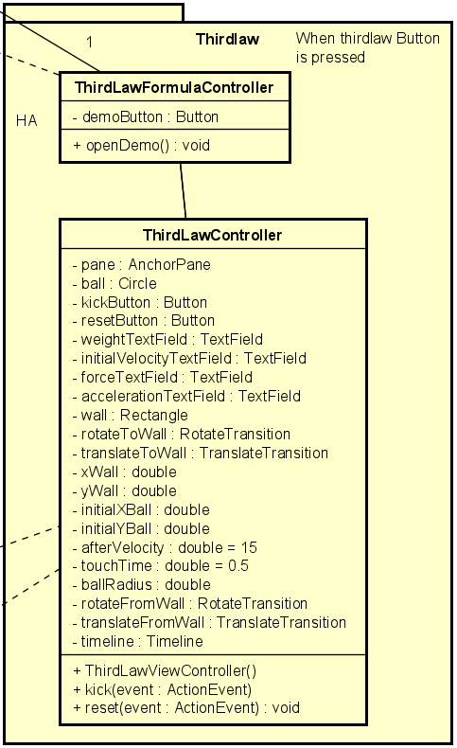
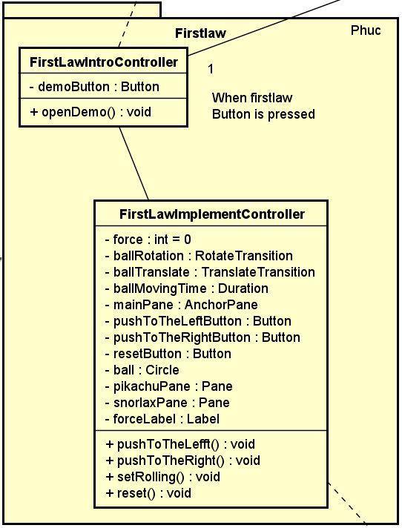
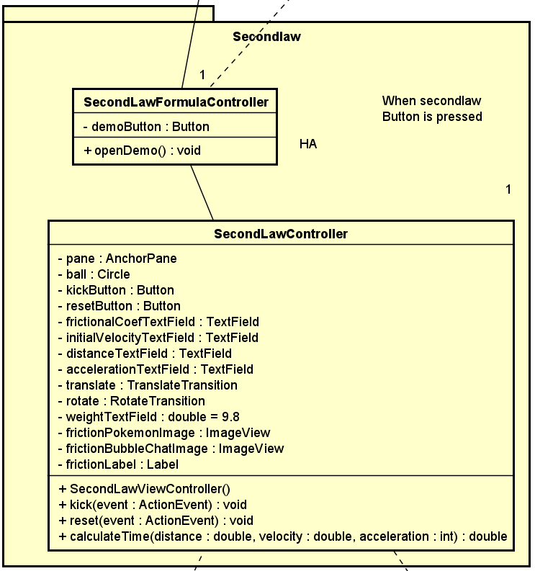
Class Diagram (cont.)

Slide 8
Demo Video
Youtube link: https://youtu.be/2MfByAaLbr4

