Slide 1
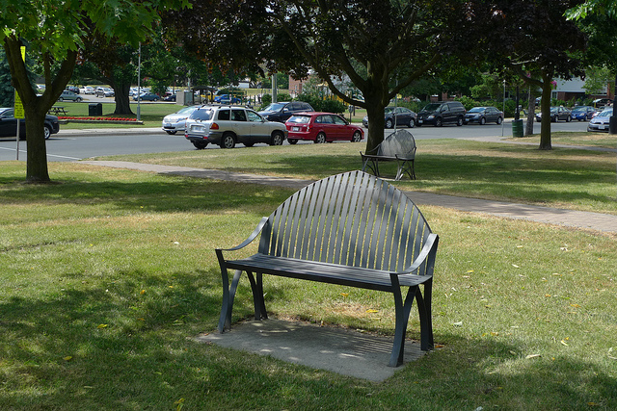
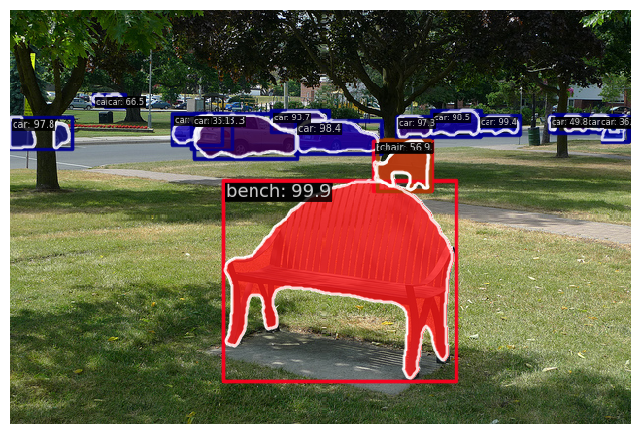
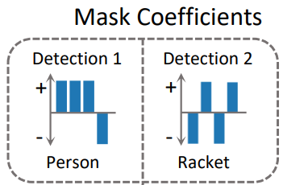
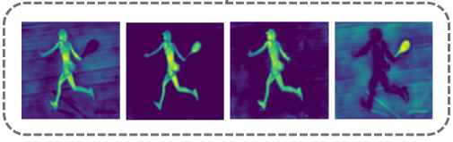

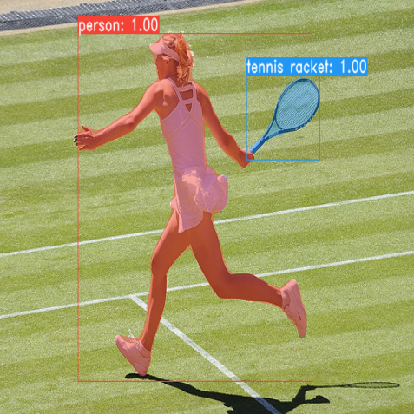
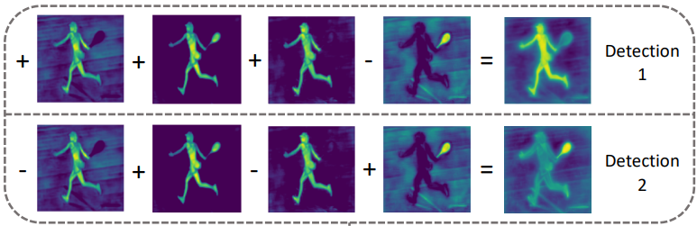
YOLACT: Real-time Instance Segmentation
Nguyễn Tấn Phúc
University of Information Technology
HCMC, Vietnam
What ?
Why ?
We introduce an instance segmentation algorithm, in which we have:
Instance segmentation is necessary as it provides detailed information about individual objects within an image. This fine-grained segmentation is essential for various applications, such as object tracking, scene understanding, and even medical imaging.
Prevailing two-stage methods have focus primarily on performance over speed. One-stage methods still have been far from real-time.
Proposed a innovative one-stage instance segmentation algorithm to delineate and identify objects within an image.
Proposed Fast NMS to trade a little performance off for speed.
Compare our model with competitive SOTA methods.
Overview
Input
YOLACT
Output
FPN
Prediction Head
NMS
Protonet
Description
1. Instance Segmentation
2. Prototype Generation
YOLACT breaks up instance segmentation (see Fig. 1) into two parallel tasks:
(1) generating a dictionary of non-local prototype masks over the entire image.
(2) predicting a set of linear combination coefficients per instance.
Then producing a full-image instance segmentation from these two components: for each instance, linearly combine the prototypes using the corresponding predicted coefficients and then crop with a predicted bounding box.
Uses an Fully Convolution Network to produce a set of image-sized “prototype masks” that do not depend on any one instance (see Fig. 2).
Figure 3. Mask coefficients
4. Mask Assembly
Figure 2. Prototype Generation
For each instance that survives NMS, we construct a mask for that instance by linearly combining the work of those two stages above (see Fig. 4).
3. Mask Coefficients
Adds an extra head to the object detection branch (RetinaNet backbone with ResNet-101 and FPN) to predict a vector of “mask coefficients” for each anchor that encode an instance’s representation in the prototype space (see Fig. 3)
Input
Output
YOLACT
Figure 4. Mask assembly
Figure 1. Input & Output illustration
Nguyễn Tấn Phúc – Trường Đại học Công nghệ Thông tin
TEL : 0941959027 Email : phucnt.17@uit.edu.vn
Notes:
1

