Slide 1
HOTEL BOOKING CANCELLATIONS
Nova ims business cases for data science project
Group f
Notes:
Hello Mr Manager, thank you for having us to day. We are group F from NOVA IMS AI consultancy company
We will present you our solution to solve your problem on the negative impact due to booking cancelations of your hotel

Slide 2

PROJECT SUMMARY
Business Understanding
Modelling and evaluation
Understand the business need and goals of the project
Apply and fine tuning different supervised machine learning algorithms and evaluate the result
Data Exploration
DEPLOYMENT
Prepare the data and some statistical concept of the business current performance
What factors affect the result of the predictive model?
An API is drafty designed to help business stakeholders in understanding the application of the model
Notes:
This is the summary of our process and also our presentation today
Firstly, we carry out analysis to better understand you problem and how our solution and help you achieve your business goals
Secondly, we explore the dataset and carryout some statistical description about your current business and cancelation rate
Thirdly, we design our predictive model and evaluate the result to best fit your business concept
And finally, we will present a draft API to help you better understand the application of the model in your business

Slide 3



Business goal
Identify the risk of high cancellation in customers booking
01
Identification
Strategically plan for
preventive actions and overbooking policies
02
The problem:
High booking cancelation rate
Strategy
Predictive
Model
OBJECTIVES
Lower the cancellation rate and cancellation costs
03
Deployment
Restrictive cancellation policies
Overbooking
Our solution
Notes:
From our understanding of the business, you are facing a problem of high booking cancelation rate. But since you can not correctly specify which bookings will be canceled or not. The methods to tackle the problem, the restrictive cancelation policies and overbooking is not really affective. And eventually brings negative impact to your business
Thus, we would like to provide a solution which is a predictive model. Our model will help you to correctly identify the booking that is likely to be canceled. Thus, effectively apply Strategically plan for preventive actions and overbooking policies. And eventually lower the cancellation rate and costs

Slide 4
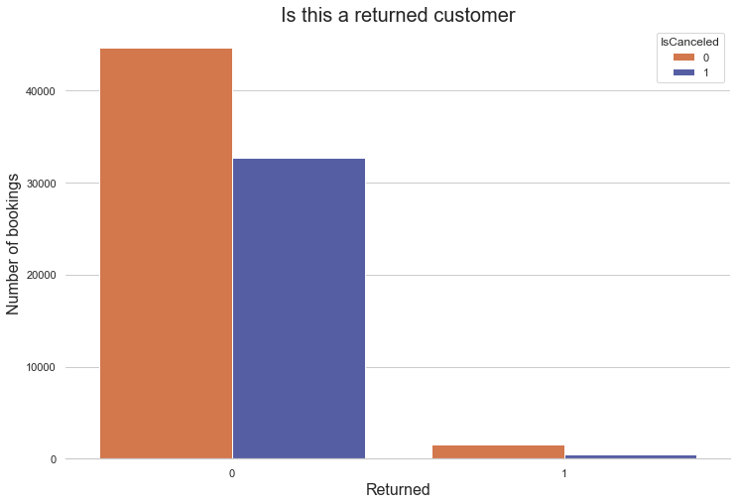
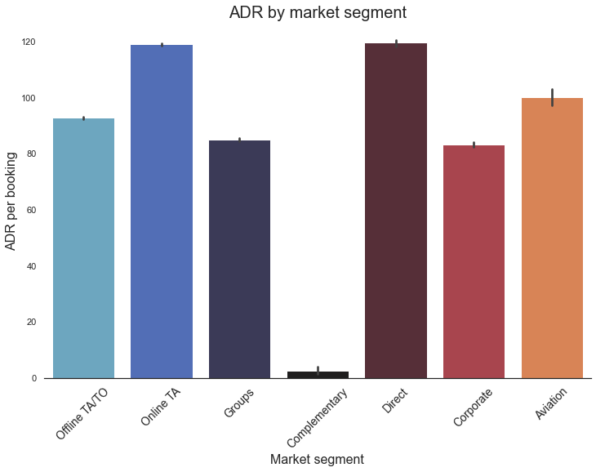

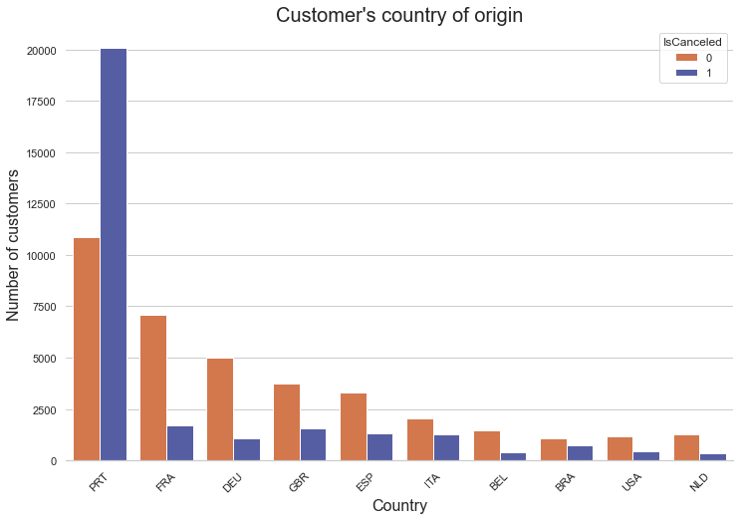
INSIGHTS GATHERED FROM DATA
97%
of the hotel customers are
new customers
Online Travel Agency and Direct customer have the highest ADR per booking.
38%
of customers are from Portugal
64%
of the bookings from Portugal
get cancelled
69%
of bookings made by Groups
were cancelled
17%
of bookings made by Direct
customers were cancelled

Slide 5


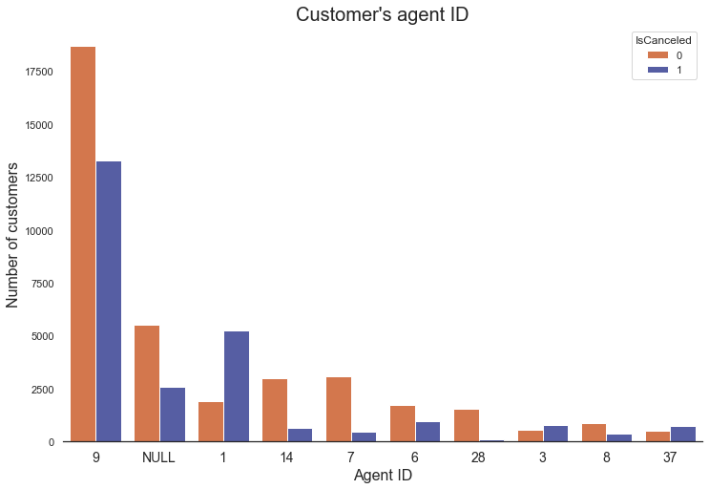
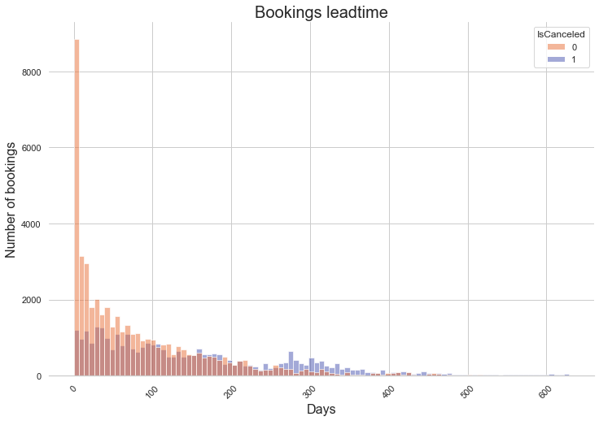
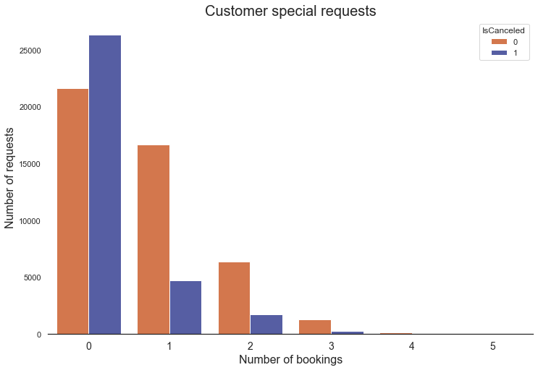

INSIGHTS GATHERED FROM DATA
Some Travel Agencies are performing significantly worse than the others
The closer the booking date, the higher probability of the customer not cancelling the bookings.
Customers with special requests are more serious about their bookings
72%
of the bookings made 250 + days
in advance were cancelled

Slide 6

87%
78%
RESULTS
>75k bookings
were reviewed
overall accuracy was reached
recall for cancellations was accomplished

Slide 7
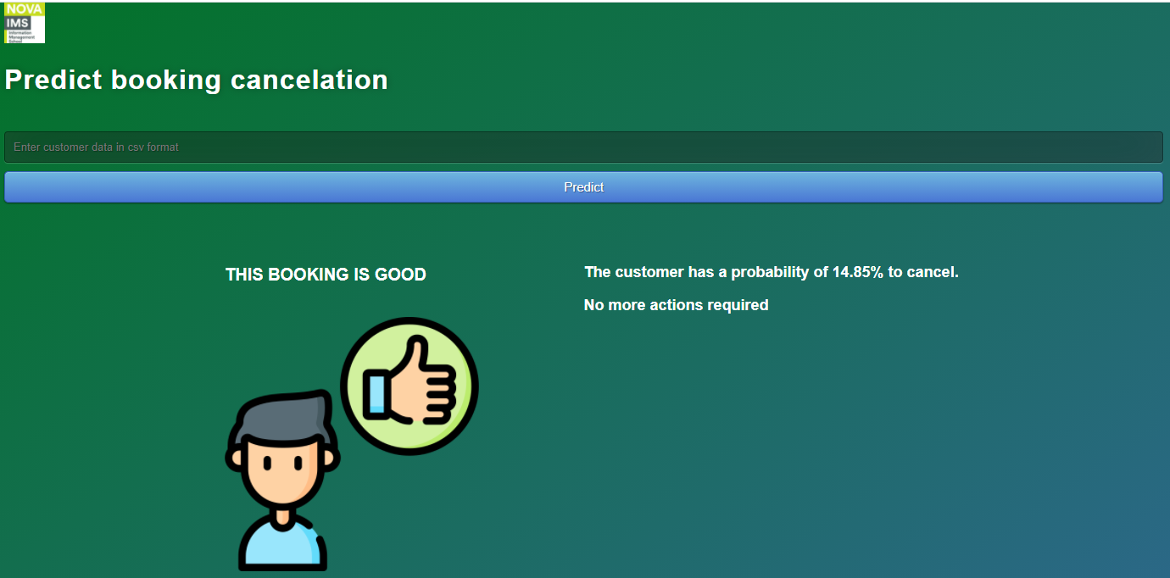
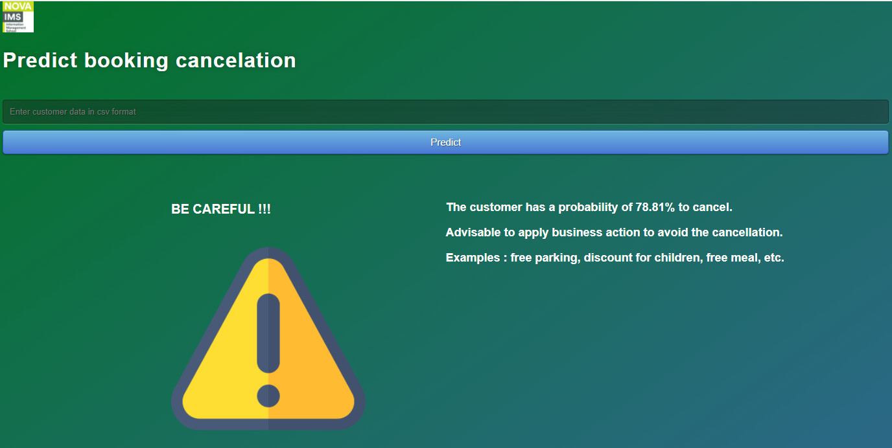
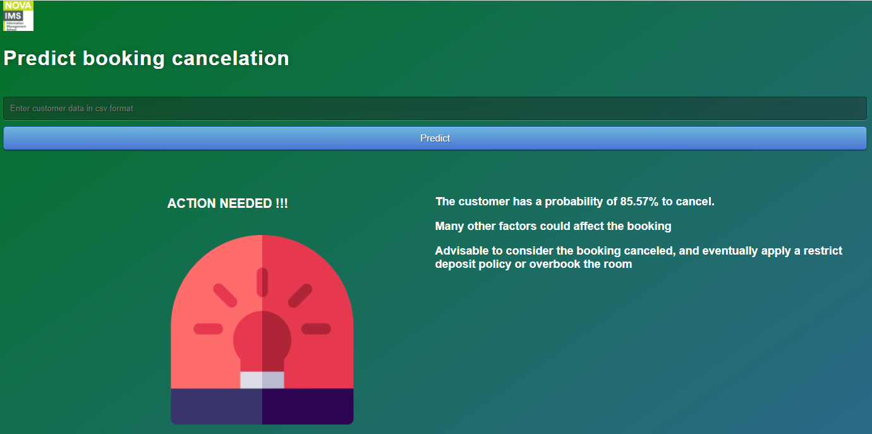
DEPLOYMENT
Code for the app can be found in GitHub repository: https://github.com/LorenzoPigozzi/Business_Cases/tree/main/Case%202

Slide 8
Thank you for your attention!
Lorenzo Pigozzi
Nguyen Huy Phuc
Ema Mandura

