Slide 1
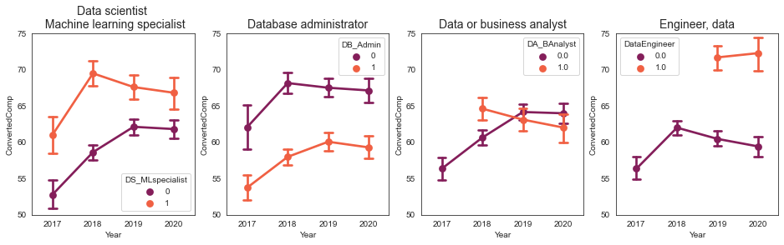
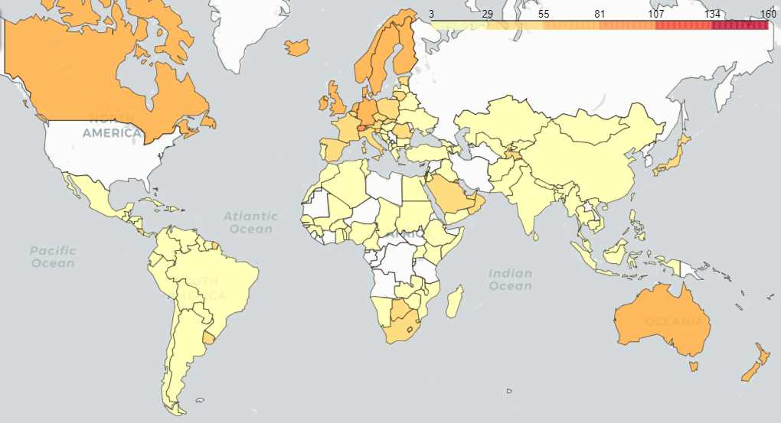
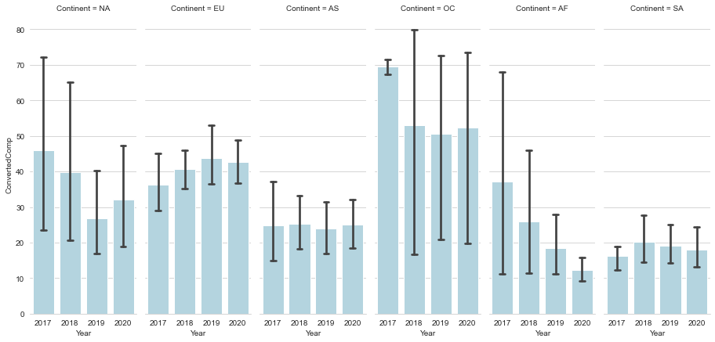
MDSAA – Statistic for Data Science project
Group members
ELEMENTS AFFECTING THE SALARY OF THE SEXIEST ROLE OF 21 CENTURY, DATA SCIENTIST
M
M
M
M
What is the impact of education major on salary
Martha
How different job titles
impacted salary?
Make a regression model on Salary ~ education
=> Test statistical significant
Visualize
Bar plot
Box plot
…. Try to be creative
Comments
~ Annual Salary (k$) | Coefficients | S.E
Data Scientist / ML Specialist | 2.876 | 0.409
Database Administrator | -3.092 | 0.475
Data /Business Analyst | -1.141 | 0.427
Data Engineer | 4.061 | 0.524
Salary of data jobs in the world
What is the impact of Year of Experience on salary
Natalia
What is the impact of programming language on salary
Mayu

