Slide 2




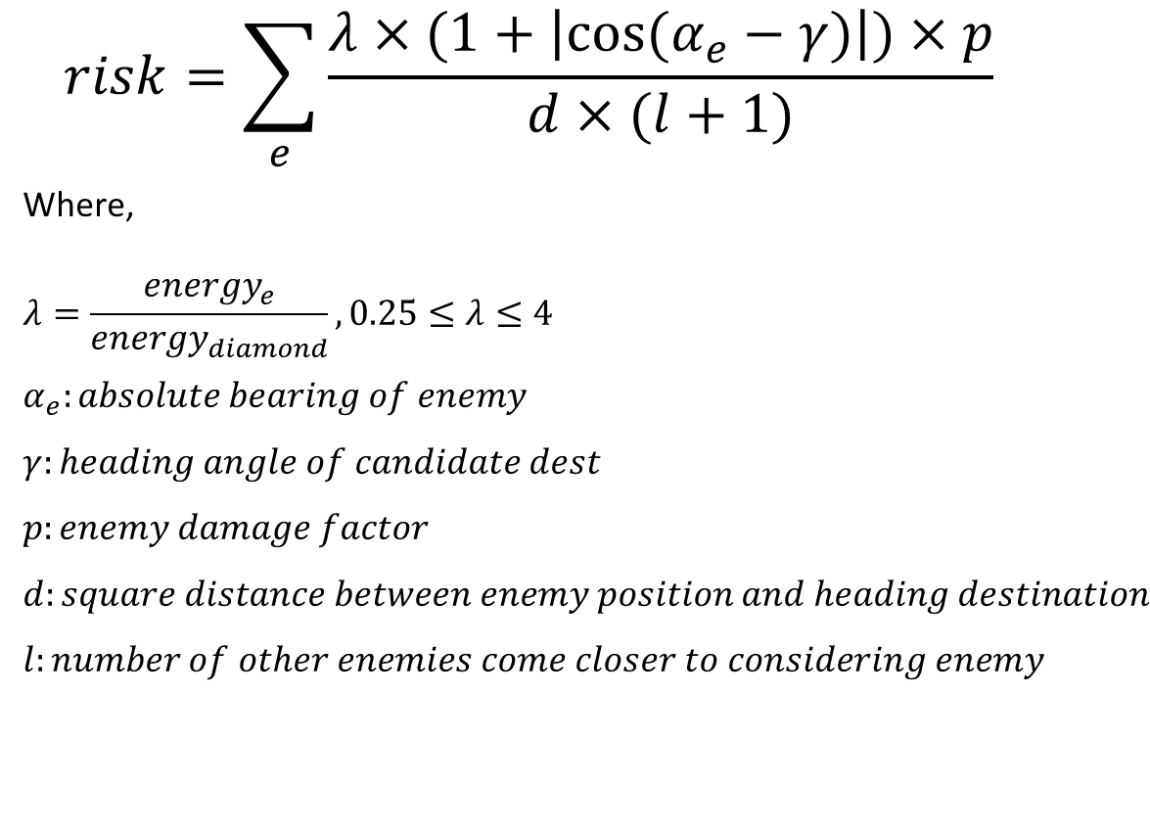




$$candidate dest$$
$$risk=\sum_{e}{\frac{λ×(1+\left|cos⁡(α_{e}−γ)\right|)×p}{d×(l+1)}}$$
Where,
$$λ=\frac{energy_{e}}{energy_{diamond}},0.25≤λ≤4$$
$$α_{e}:absolute bearing of enemy$$
$$γ:heading angle of candidate dest$$
$$p:enemy damage factor$$
$$d:square distance between enemy position and heading destination$$
$$l:number of other enemies come closer to considering enemy$$
$$d$$
$$enemy$$
$$γ$$
$$α_{e}$$
$$diamond$$

