Slide 1

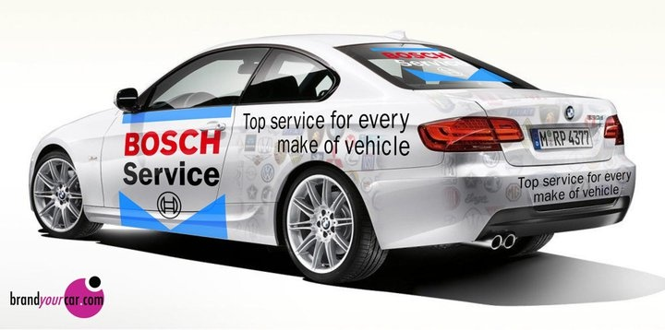
Báo cáo thực tập doanh nghiệp Car Multimedia
Nguyễn Phú Cường MSSV: 13520106
GVHD: Th.S Nguyễn Duy Xuân Bách

Slide 2

Giới thiệu về công ty Robert Bosch
ROBERT BOSCH ENGINEERING AND BUSINESS SOLUTIONS VIETNAM LTD
Một tập đoàn công nghệ của Đức
Thành lập năm 1886 bởi Robert Bosch ở Stuttgart, Đức
Là một nhà cung cấp thiết bị ô tô lớn nhất thế giới và có quan hệ kinh doanh với hầu hết các công ty ô tô trên Thế giới
390.000 cộng sự (*)
440 chi nhánh, công ty con tại 60 quốc gia (*)
Hoạt động tại Việt Nam từ năm 1994, có trụ sở chính tại TP. HCM và văn phòng chi nhánh tại Hà Nội và Đà Nẵng.
Lĩnh vực kinh doanh
Công nghệ ô tô
Thiết bị công nghệ
Thiết bị tiêu dùng và Dụng cụ công suất
Thiết bị giám sát
Địa chỉ liên hệ
Tòa nhà ETOWN 2, 364 đường Cộng Hòa, quận Tân Bình, TP. Hồ Chí Minh
Điện thoại: (84 28) 3812 8000
Email: bosch-infoteam@vn.bosch.com
(*) Tính đến 2016
Notes:
6 địa điểm tại việt nam
tập đoàn đạt doanh thu 73,1 tỷ euro trong năm 2016.
Hoạt động của Bosch được chia thành bốn lĩnh vực: Giải pháp Mobility, Công nghệ trong Công nghiệp, Hàng tiêu dùng, Kỹ thuật Xây dựng và Năng lượng. Là tập đoàn tiên phong về Internet Vạn Vật (IoT), Bosch cung ứng các giải pháp tiên tiến cho nhà ở thông minh, thành phố thông minh, giao thông kết nối và công nghiệp kết nối

Slide 3
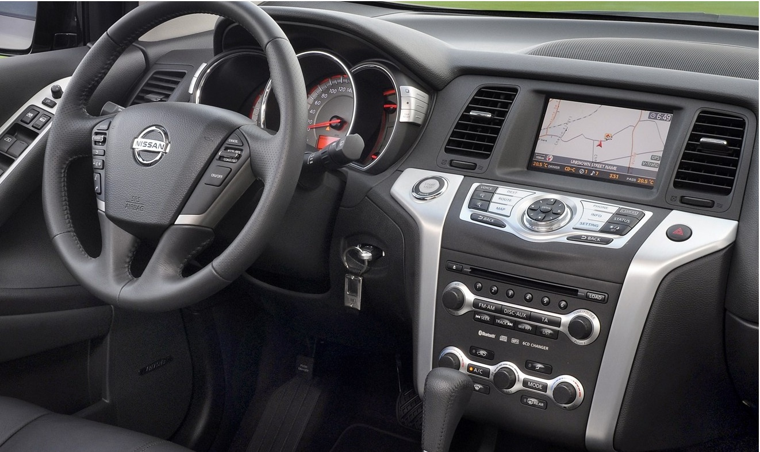
1.
Department Car Multimedia
Các giải pháp tích hợp trong ô tô
Media
Navigation
Telematic
System
Testmode
Tuner
SPI
Notes:
Số lượng người trong department: 57
Số team nhỏ cho từng feature: 7

Slide 4
2. WORKFLOW trong Project
Bring the attention of your audience over a key concept using icons or illustrations

Slide 5
THANKS!
Any questions?

Slide 6
HELLO!
I am Jayden Smith
I am here because I love to give presentations. You can find me at @username

Slide 7
Quotations are commonly printed as a means of inspiration and to invoke philosophical thoughts from the reader.

Slide 8
THIS IS A SLIDE TITLE
Here you have a list of items
And some text
But remember not to overload your slides with content
Your audience will listen to you or read the content, but won’t do both.

Slide 9
YOU CAN ALSO SPLIT YOUR CONTENT
White
Is the color of milk and fresh snow, the color produced by the combination of all the colors of the visible spectrum.
Black
Is the color of coal, ebony, and of outer space. It is the darkest color, the result of the absence of or complete absorption of light.

Slide 10
IN TWO OR THREE COLUMNS
Yellow
Is the color of gold, butter and ripe lemons. In the spectrum of visible light, yellow is found between green and orange.
Blue
Is the colour of the clear sky and the deep sea. It is located between violet and green on the optical spectrum.
Red
Is the color of blood, and because of this it has historically been associated with sacrifice, danger and courage.

Slide 11

A PICTURE IS WORTH A THOUSAND WORDS
A complex idea can be conveyed with just a single still image, namely making it possible to absorb large amounts of data quickly.

Slide 12

WANT BIG IMPACT?
Use big image.

Slide 13
USE CHARTS TO EXPLAIN YOUR IDEAS
WHITE
GRAY
BLACK

Slide 14
OR USE DIAGRAMS TO EXPLAIN COMPLEX IDEAS
Diagram featured by http://slidemodel.com
Sample Text
Sample Text
Sample Text
Sample Text

Slide 15
AND TABLES TO COMPARE DATA
 | A | B | C
Yellow | 10 | 20 | 7
Blue | 30 | 15 | 10
Orange | 5 | 24 | 16

Slide 16

MAPS
our office

Slide 17
89,526,124
Whoa! That’s a big number, aren’t you proud?

Slide 18
89,526,124$
185,244 users
100%
That’s a lot of money
And a lot of users
Total success!

Slide 19
OUR PROCESS IS EASY
First
Second
Last

Slide 20
LET’S REVIEW SOME CONCEPTS
Yellow
Is the color of gold, butter and ripe lemons. In the spectrum of visible light, yellow is found between green and orange.
Blue
Is the colour of the clear sky and the deep sea. It is located between violet and green on the optical spectrum.
Red
Is the color of blood, and because of this it has historically been associated with sacrifice, danger and courage.
Yellow
Is the color of gold, butter and ripe lemons. In the spectrum of visible light, yellow is found between green and orange.
Blue
Is the colour of the clear sky and the deep sea. It is located between violet and green on the optical spectrum.
Red
Is the color of blood, and because of this it has historically been associated with sacrifice, danger and courage.

Slide 21
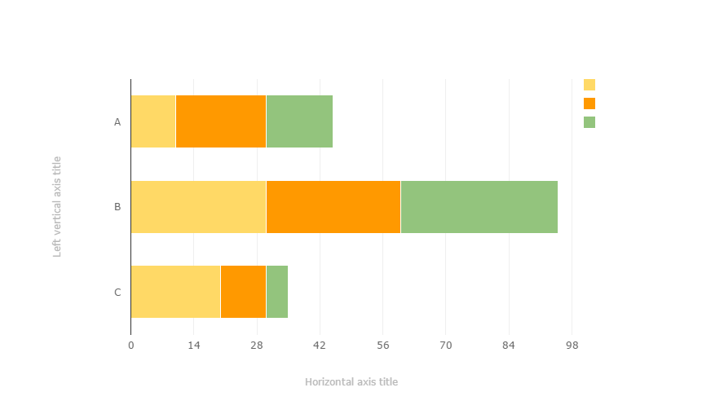
You can copy&paste graphs from Google Sheets

Slide 22
ANDROID PROJECT
Place your screenshot here
Show and explain your web, app or software projects using these gadget templates.

Slide 23
IPHONE PROJECT
Place your screenshot here
Show and explain your web, app or software projects using these gadget templates.

Slide 24
TABLET PROJECT
Place your screenshot here
Show and explain your web, app or software projects using these gadget templates.

Slide 25
DESKTOP PROJECT
Place your screenshot here
Show and explain your web, app or software projects using these gadget templates.

Slide 26
CREDITS
Special thanks to all the people who made and released these awesome resources for free:
Presentation template by SlidesCarnival
Photographs by Death to the Stock Photo (license)

Slide 27

PRESENTATION DESIGN
You don’t need to keep this slide in your presentation. It’s only here to serve you as a design guide if you need to create new slides or download the fonts to edit the presentation in PowerPoint®
This presentations uses the following typographies and colors:
Titles: Montserrat
Body copy: Karla
You can download the fonts on this page:
http://www.google.com/fonts/#UsePlace:use/Collection:Montserrat:400,700|Karla:400,400italic,700,700italic
Click on the “arrow button” that appears on the top right
Red #F44336 Deep orange #FF5722 Orange #FF9800 Amber #FFC107
Yellow #FFEB3B Lime #CDDC39 Green #8BC34A Dark green #4CAF50
Teal #009688 Cyan #00BCD4 Blue #03A9F4 Dark blue #2196F3
Indigo #3F51B5 Deep Purple #673AB7 Purple #9C27B0 Magenta #E91E63
Blue gray #607D8B

Slide 28
SlidesCarnival icons are editable shapes.
This means that you can:
Resize them without losing quality.
Change line color, width and style.
Isn’t that nice? :)
Examples:

Slide 29
😉
Now you can use any emoji as an icon!
And of course it resizes without losing quality and you can change the color.
How? Follow Google instructions https://twitter.com/googledocs/status/730087240156643328
✋👆👉👍👤👦👧👨👩👪💃🏃💑❤😂😉😋😒😭👶😸🐟🍒🍔💣📌📖🔨🎃🎈🎨🏈🏰🌏🔌🔑 and many more...

