Slide 1
PROGRESSIVE WEB APPS IN a FRIENDLY style
Qsr team
SEP 2018

Slide 2
Agenda
Introduction
CouchDB
PouchDB
Build a simple PWA
PROGRESSIVE WEB APPS IN a FRIENDLY style

Slide 3
Introduction
KMS Culture

Slide 4
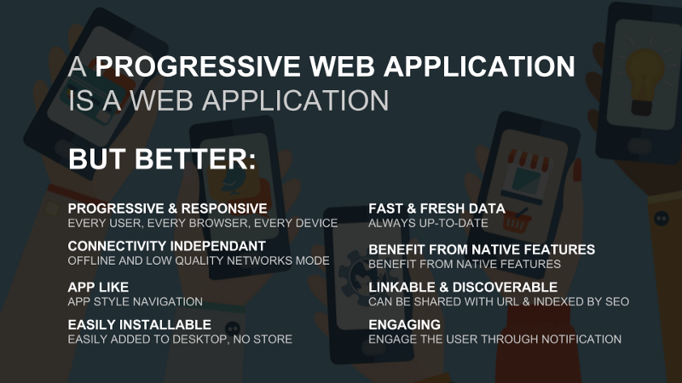
KMS Vision
KMS Culture
Notes:
FF: Fantastic Four

Slide 5
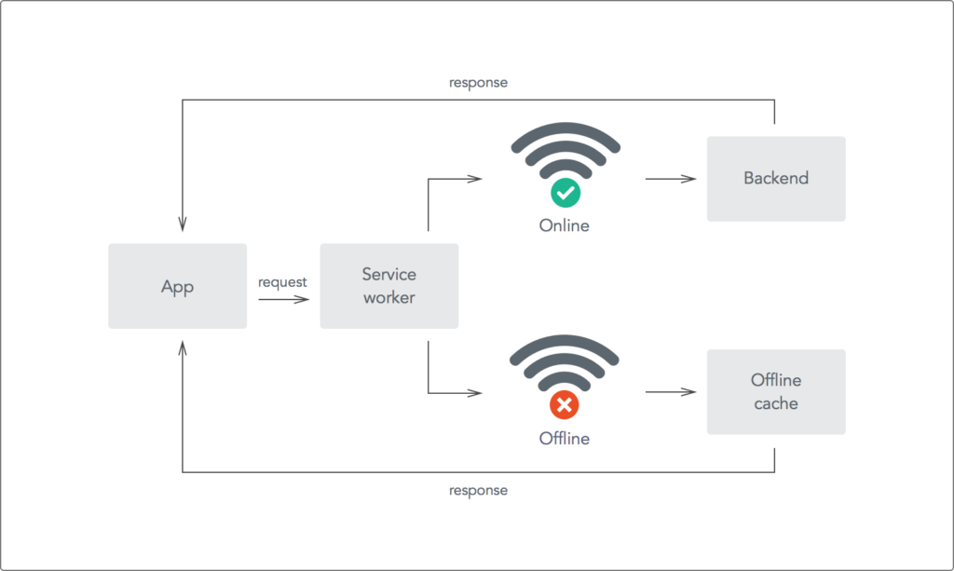
Introduction
Service workers
KMS Culture
Notes:
FF: Fantastic Four

Slide 6
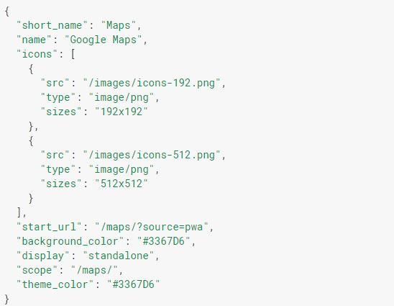
Introduction
Web App Manifest
KMS Culture
Notes:
FF: Fantastic Four

Slide 7
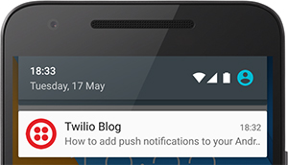
Introduction
Web Push Notifications API
KMS Culture
Notes:
FF: Fantastic Four

Slide 8
Core Values
App data storage
Performance optimization
App Shell Model
KMS Culture

Slide 9
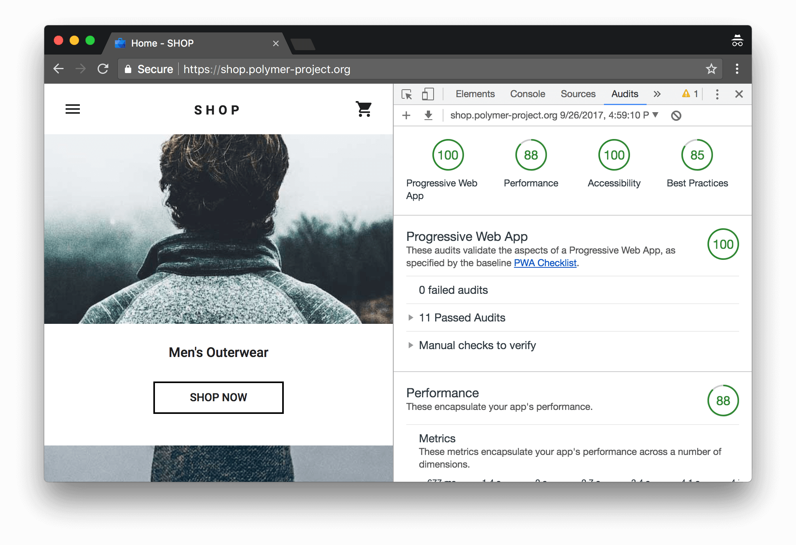
Introduction
Lighthouse in Chrome DevTools
KMS Culture
Notes:
FF: Fantastic Four

Slide 10
Professionalism
References:
https://developers.google.com/web/progressive-web-apps/
https://serviceworke.rs/
https://pwa.rocks/
https://tests.peter.sh/notification-generator/
KMS Culture
Notes:
Q 25

Slide 11
CouchDB
KMS Culture

Slide 12


KMS Vision
A NoSQL database
In 2005 by Damien Katz
Now maintained by the Apache Software Foundation.
KMS Culture
Notes:
FF: Fantastic Four

Slide 13
KMS Vision
HTTP
Talk to the database directly
No special protocol, no special drivers: just REST and HTTP
KMS Culture
Notes:
FF: Fantastic Four

Slide 14
KMS Vision
Sync
"The way I like to think about CouchDB is this: CouchDB is bad at everything, except syncing. And it turns out that's the most important feature you could ever ask for, for many types of software.“
- Jason Smith -
KMS Culture
Notes:
FF: Fantastic Four

Slide 15
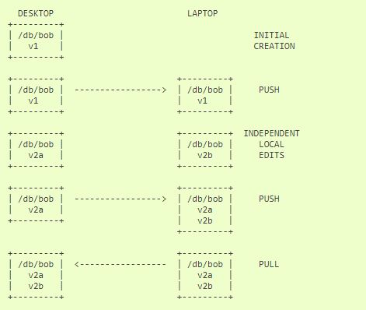
KMS Vision
Replication and conflict model
KMS Culture
Notes:
FF: Fantastic Four

Slide 16
Professionalism
References:
http://docs.couchdb.org/en/latest/ddocs/views/intro.html
https://github.com/pouchdb-community/pouchdb-authentication/blob/master/docs/recipes.md
https://couchdb.readthedocs.io/en/latest/maintenance/compaction.html#compaction
KMS Culture
Notes:
Q 25

Slide 17
PouchDB
KMS Culture

Slide 18

QUIZ TIME ….
KMS will only focus on US market?
Yes, US market is best fit for us
No, KMS started looking out to other countries
No, KMS is trying to get out of US market
Yes, US market is more than enough for us
KMS Culture

Slide 19
QUIZ TIME ….
Which word will best describe KMS
Fun
Creative
Professional
Technology
KMS Culture

Slide 20
QUIZ TIME ….
What KMS commits to each employee?
Career growth
High salary
Quality of life
Both 1 and 3
KMS Culture

Slide 21
QUIZ TIME ….
Q: If one KMSer is not working well, KMS will:
Stop working
Not working effectively
Working fine because KMS is big
Depending on who the person is
KMS Culture

Slide 22

Repeat
What is KMS vision?
Diverse global technology firm
Internally controlled
Supportive employee growth and quality of life
Positive impact to client success
Contribute to community
KMS Culture

Slide 23
KMS Core Values
KMS Culture

Slide 24
Core Values
Exceed Client Expectation
People
Innovation
Integrity
KMS Culture

Slide 25
QUIZ TIME ….
The workload has been normal for 1 year, but this month it increases and each team member have to work 24 extra hours. Select the appropriate thought:
It’s part of my job, no big deal.
KMS is law-abiding so there should be OT payment
It is a chance for our people to have extra money
Do OT and give each person three extra vacation days.
KMS Culture

Slide 26
Exceed Client Expectation
Work for the success of the client
Not for your compensation or recognition
Not “just enough” works
Put yourself into their shoes
KMS Culture
Notes:
Q 10, 11, Q 12

Slide 27
QUIZ TIME ….
A junior person is learning to create and deliver a technical presentation.
This is a good start
Another attempt to show off
Presentation is not for newbies
KMS is not a school so let’s not bother with presentations.
KMS Culture

Slide 28
Core Values – PEOPLE
Pay respect to everyone, to the differences
Share the knowledge and grow together
Create opportunities for others to shine
KMS Culture
Notes:
Q 13, Q 14, Q15

Slide 29
QUIZ TIME ….
I’m doing my job very well, I complete every tasks assigned with good quality. What else?
That’s outsourcing job, there’s no more can be done
There are a lot of things can be improved, including technical, process and features
I should find something to learn in free time
Both 2 and 3
KMS Culture

Slide 30
Core Values - Innovation
Each KMSer has to be a great technologist, not just an average worker
Each KMSer has to strive for improvement everyday
Better ways to do current things
Learning and doing new things
Help more people
KMS Culture
Notes:
Q 16

Slide 31
QUIZ TIME ….
The deadline is 5:00pm. At 7:45pm, the client sent me an email asking why I did not complete my code. I only can complete at 8:00pm
Tell them I submitted by 5:00 but it failed, I will submit again
Tell them I couldn’t make it, will submit by 8:00pm.
I should have told them before 5:00 that I could not make it
Tell them there is an unexpected issue and I need to extend deadline to 8:00pm
KMS Culture

Slide 32
Core Values - Integrity
Be honest with clients, with colleagues
And most important – with ourselves
Focus on building trusted relationships
Commit to going extra miles to keep promises
KMS Culture
Notes:
Q 17, 18, 19

Slide 33
To REMIND
Which is the list of KMS Core Values
People, Process, Tools, Infrastructure
People, Effectiveness, Innovation, Ethics
Client, People, Innovation, Integrity
KMS has many core values, there is no complete list
KMS Culture

Slide 34
KMS Expected Behaviors
KMS Culture

Slide 35
The List
Your Employment at KMS
Autonomy
Positive Thinking
Self Improvement
Professionalism
Contribution
Compensation
Communication
Outside of Work
KMS Culture

Slide 36
QUIZ TIME (employment)
I am not happy with something at work. What should I do?
There’s a hundred jobs out there, let’s find another one. Nobody forces me here
Let’s discuss with a Director and find a solution
Let’s share with other colleagues my feelings
Express my sadness on Facebook, but accept it as no company is perfect
KMS Culture

Slide 37
Your Employment at KMS
The semaphore: a marriage
Take care of each other
Build the family together
Be straight and open
When out of options – a divorce
KMS Culture
Notes:
Q 20

Slide 38
Case Discussion (Autonomy)
I am a junior developer, I have been working for only 1 year in this team. What does the company expect from me?
Be able to work on simple, repeated tasks
Good output quality
Can communicate to clarify or seek for help
Can report status and risks
Self improvement
KMS Culture

Slide 39
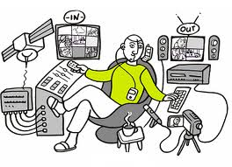
Autonomy
You are completely responsible for your assignment, regardless your level of expertise
KMS Culture
Notes:
Q 21

Slide 40
QUIZ TIME (Positive Thinking)
The training course is so boring. I only learned very little from it.
This is a bad trainer, we should not let him train
This is a waste of time, we should not join trainings
We should improve this course. I can give feedbacks
I will complain about this on FB in a very cool way
KMS Culture

Slide 41
Positive Thinking
Ask yourself: “what can I do to improve the situation” rather than blaming
Remember, we are friends, brothers and sisters
We are all working together to build a great KMS
Nothing is perfect and not everything happens the way you want it
KMS Culture
Notes:
Q 22

Slide 42
QUIZ TIME (Self-Development)
It’s been 5 years and I’m not promoted. What should I do?
Discuss with my coach or director to define what to do to get promoted
Discuss with my coach or director to define what to do to continue advancing my ability
Nothing, I have a bad coach or get in a bad project so my chance is very little.
Should show off more to get more recognition
KMS Culture

Slide 43
Self Improvement
It’s your responsibility – KMS fully supports
Maximize your value to maximize your success
You may not get promoted but it’s ok
As long as you do your best and be happy
KMS Culture
Notes:
Q 23

Slide 44
QUIZ TIME (Critical Thinking)
I receive a negative feedback from my manager
He really wants my improvements
I have to explain back otherwise my value will be low
He’s picking on my issues. He should also look at my contributions
He doesn’t like me, it’s time to move to another project
KMS Culture

Slide 45
Critical Thinking
Feedback if something doesn’t look right
And repeat it
If you get a feedback or suggestion
Respect it and work on it
Be reasonable, respectful and goal-focused
KMS Culture
Notes:
Q 24

Slide 46
Case Discuss (Professionalism)
My project is not charged by timesheet. I think I worked about 45-49 hours this week. Why do I have to log the exact number. Can I just put in 40 hours?
For project statistics
For decision making
For management negotiation
For individual performance measurement
KMS Culture

Slide 47
Professionalism
If there is a procedure, follow it
Timesheet, vacation planning, reporting …
Planned, be on-time, be prepared
Meetings, reviews, discussions
KMS Culture
Notes:
Q 25

Slide 48
QUIZ TIME (Contribution)
I prefers to work on Front-end but there is no Front-end position available. My director assigns me to a back-end position for 3 months.
At least it’s better than sitting do nothing
I only accept Front-end because it’s my choice
I only accept Front-end because I can contribute more with it
I will study new skills while waiting for Front-end assignment
KMS Culture

Slide 49
Contribution
Your career is measured by your contribution
Should do what would bring most value to KMS
Ability growing only helps if it brings value
Develop your career to align with KMS growth
KMS Culture
Notes:
Q 27

Slide 50
QUIZ TIME (Compensation)
I was smarter than A in school, I did something cooler than A recently. A told me his salary and it is higher than mine. What is going on?
He must have done good things that I don’t know about
It is not fair, I will find another job with higher pay.
I should ask the manager to increase my salary.
All are valid considerations.
KMS Culture

Slide 51
Compensation
KMS is searching for great employees
To promote, raise salary, bonus, opportunities …
KMS Management commits on fairness
Do not compare. Work on your own career
KMS Culture
Notes:
Q 28

Slide 52
Communication
Fun, respectful and friendly
Constructive and collaborative
Supportive
KMS Culture

Slide 53
NVC Practice
Your colleague often bring smelly foods to the work place. You don’t like that smell and want to complain directly with your colleague.
Split into pairs, one person complains using NVC
What you see
What you feel
What you need
Your request
KMS Culture
Notes:
Q 27

Slide 54
Outside of work
It’s not only work, KMSers are your friends
Treat each and everyone as friends
The atmosphere of the team should be
Fun - with laughter and smiles
Friendly with other activities than just works
Openness – without one person picking on others
Respect – without one person being attacked
Treat each other like they are your friends, they are your family, they are part of your life
KMS Culture

Slide 55
KMS How To Be Successful
KMS Culture

Slide 56
Actions
Do high quality work for your project
Take personal responsibility
Keep improving things for your project
Share knowledge, develop others
Continuously learning & applying new things
Contribute to company activities
Put it in the context of 10 years, not 6 months
KMS Culture

Slide 57
And Repeat
KMS Culture

Slide 58
Repeat
What is KMS vision?
Diverse global technology firm
Internally controlled
Supportive employee growth and quality of life
Positive impact to client success
Contribute to community
KMS Culture

