Slide 1

Finding Roots with
Optical Twinning Trees
Denys I. Bondar · Gerard McCaul · with Eigen
Tulane University · EigenEngine
01
Notes:
The title sounds like three metaphors in a trench coat. By the end, every word will be literal.
Open on the visual contradiction: the upper material is lattice-like, the lower is molecular, but the outgoing waveforms coincide. Do not define the mechanism yet; let the object create the question.
[Sources]
- Local manuscript: ../manuscript/main.tex (title and abstract).
- Generated visual: assets/twinning-materials-hero.png; prompt record in asset_prompts.md.

Slide 2
Different materials.
One optical response.
A twinning field is one drive Φ that makes one chosen response equal.
J₁[Φ] = J₂[Φ]
02
Notes:
A twinning field is one electromagnetic drive that induces the same chosen optical response in two distinct materials. The equality is observable-specific: here I write J, but the observable could be a current, polarisation, or emitted field.
The important word is one. We are not independently controlling the two materials into agreement; they share the field.
[Sources]
- Bondar et al., “Twinning Fields,” https://arxiv.org/abs/2103.01162
- Local manuscript: ../manuscript/S1.tex.
- Generated visual: assets/twinning-materials-hero.png.

Slide 3
The original proposal solves before it shines
The material models define the mismatch. An inverse solver removes it before either sample is illuminated.
1 · MATERIAL MODELS
2 · INVERSE SOLVE
3 · STORED PULSE
J₁[Φ] crystal
choose Φ to minimise
Φ⋆(t)
→
‖J₁[Φ] − J₂[Φ]‖²
→
J₂[Φ] fluid
The computation requires both response models.
replayed open loop
BEFORE THE EXPERIMENT
EXPERIMENT
Φ⋆ already exists
03
Notes:
The original construction is open loop. Given models of both materials, solve an inverse problem for a drive that makes their responses equal, then apply the stored field.
That is powerful—and it gives the model the first and last word. Denys’s prompt asks what happens if the experiment itself closes the inverse problem.
[Sources]
- Bondar et al., https://arxiv.org/abs/2103.01162
- Local manuscript: ../manuscript/S1.tex and ../manuscript/S2.tex.

Slide 4

Let the materials find the field
The experiment measures the mismatch and updates the same field that created it.
nonlinear material 1
field modulator
balanced detector
nonlinear material 2
measure
update after latency τ
↺
e(t) = J₁(t) − J₂(t)
Φ̇(t) = −κ σ e(t−τ)
04
Notes:
Walk clockwise once. A single modulator drives both samples. Their outputs meet at a balanced detector. The returned difference is integrated into the next value of the same common field.
This is deliberately close to optical feedback-loop practice: the novelty is not “feedback exists,” but what quantity is being nulled and retained.
[Sources]
- Local manuscript: ../manuscript/S2.tex and Fig. 1.
- Experimental optical feedback context supplied in the originating prompt: https://arxiv.org/abs/2603.05417
- Related optical feedback architecture supplied in the originating prompt: https://arxiv.org/abs/2301.12069
- Generated visual: assets/causal-feedback-loop.png.

Slide 5
The loop stops where the responses match
Matching becomes root finding when the measured difference controls the shared field.
THE TWO RESPONSES
THE MEASURED DIFFERENCE
−
schematic response curves
J₁[Φ⋆] = J₂[Φ⋆]
e(Φ⋆) = 0
Φ̇(t) = −κ σ e(t−τ)
e > 0: move one way e < 0: move the other e = 0: hold the field
05
Notes:
This is the reversal on which the paper turns. The loop has no target waveform in memory. It only measures the residual e and retains the field when e vanishes.
So the materials evaluate a function of the field, and the controller follows a signed root-finding flow. The root is a physical fixed point of the coupled optical dynamics.
[Sources]
- Local manuscript: ../manuscript/S2.tex, Eqs. (1)–(3).
- Generated visual: assets/matching-to-roots.png.

Slide 6
Latency turns a root into a stability problem
δΦ̇(t) = −κ |χΔ| δΦ(t−τ)
κ |χΔ| τ < π/2
simple root + signed integral feedback
numerical boundary: 1.5675
06
Notes:
Linearise the delayed loop around a simple root. The sign σ must oppose the differential susceptibility χΔ. With that choice, delay gives the standard first crossing at κ|χΔ|τ = π/2.
The small scalar test is deliberately austere: 134 runs place the measured boundary at 1.5675, within 0.0033 of π/2. On the left the residual envelope decays; on the right it grows.
[Sources]
- Local manuscript: ../manuscript/S3.tex and Fig. 2.
- Data: ../growth/numerics/data/scalar_delay_summary.json.
- Data: ../growth/numerics/data/scalar_delay_sweep.csv.

Slide 7
One field twins two interacting Hubbard rings
|J₁(t) − J₂(t)| under the causal controller
MODEL
two four-site rings · one Peierls phase Φ(t)
U₁ = 0.5
U₂ = 2.0
Hⱼ(Φ) = −t₀ Σℓσ (e⁻ⁱΦ c†ℓσ cℓ₊₁σ + H.c.)
+ Uⱼ Σℓ nℓ↑ nℓ↓
Jⱼ(t) = ⟨ψⱼ| −∂ΦHⱼ |ψⱼ⟩
The controller receives J₁−J₂—not Uⱼ or either wavefunction.
0.198
→
0.0119
initial mismatch
tail RMS
07
Notes:
Now replace the scalar toy with two exact four-site Hubbard rings, each in a 36-dimensional sector, with interactions U₁=0.5 and U₂=2. The common Peierls phase is the controlled field.
The differential current begins at 0.198. Under the causal loop its tail RMS falls to 0.0119. The best measured gain-delay product sits just below the scalar π/2 prediction, so the simple local argument remains informative in the many-body dynamics.
[Sources]
- Local manuscript: ../manuscript/S4.tex and Fig. 3.
- Data: ../growth/numerics/data/hubbard_common_field_summary.json.
- Data: ../growth/numerics/data/hubbard_common_field_trace.csv.

Slide 8
Kerr matching writes a quadratic into hardware
The response curves cross at the encoded roots
STEADY CAVITY MODEL
Pⱼ(n) = n [ γⱼ² + (Δⱼ − Kⱼn)² ]
required input power for intensity n
Kerr cavity
linear reference
K₁ = 1
K₂ = 0
P₁(n) − P₂(n) = n [ n² + bn + c ]
away from the empty-cavity root n=0
n² − 4n + 3 = (n−1)(n−3)
P₁ = P₂ ⇔ n = 1 or 3
n = 1 → s = 5
n = 3 → s = 15
08
Notes:
A driven Kerr cavity and a linear reference have input-output curves whose difference can be chosen proportional to n(n²−4n+3). Away from the trivial zero, equality therefore writes the quadratic into the hardware.
The two crossings occur at intensities n=1 and n=3. Under the chosen scaling these correspond to common input powers s=5 and s=15.
[Sources]
- Local manuscript: ../manuscript/S5.tex, Eqs. (8)–(13), and Fig. 4.
- Data: ../growth/numerics/data/kerr_encoded_polynomial.csv.
- Data: ../growth/numerics/data/kerr_polynomial_root_summary.json.

Slide 9
The controller sign selects an attracting root
Full cavity trajectories
ROOT-FINDING FLOW
same encoded equation · opposite restoring polarities
ṡ = −g σ [ n₁(s) − n₂(s) ]
σ supplies orientation; it does not contain either root.
σ = +1
→
3
5
σ = −1
→
8
15
Outside an attracting basin, the bounded drive reaches an imposed power limit.
09
Notes:
Signed feedback supplies the orientation that a root finder needs. With σ=+1, seeds in the lower basin move to s=5; with σ=−1, the upper basin moves to s=15.
The dashed lines mark the imposed optical power interval. Initial-condition and polarity choices outside an attracting basin do not hover mysteriously: the saturation sweep shows that they hit one of these physical limits. That is a hardware constraint, not a hidden numerical non-convergence.
[Sources]
- Local manuscript: ../manuscript/S5.tex and Fig. 4.
- Data: ../growth/numerics/data/kerr_feedback_traces.csv.
- Data: ../growth/numerics/data/kerr_feedback_runs.csv.
- Data: ../growth/numerics/data/kerr_saturation_sweep.csv.

Slide 10

A quadratic knows
only two places to stop.
e_q(s) ∝ (s−5)(s−15)
one measured residual · two physical zeros
Can a root condition become a component?
10
Notes:
Pause here. A quadratic solver is a pleasant demonstration, but it is not yet an architecture.
The compositional question is the capstone: can we treat a twinning residual as a leaf, combine leaves, and let one outer controller search the resulting zero set?
[Sources]
- Local manuscript: transition from ../manuscript/S5.tex to ../manuscript/S6.tex.
- Generated visual: assets/matching-to-roots.png.

Slide 11
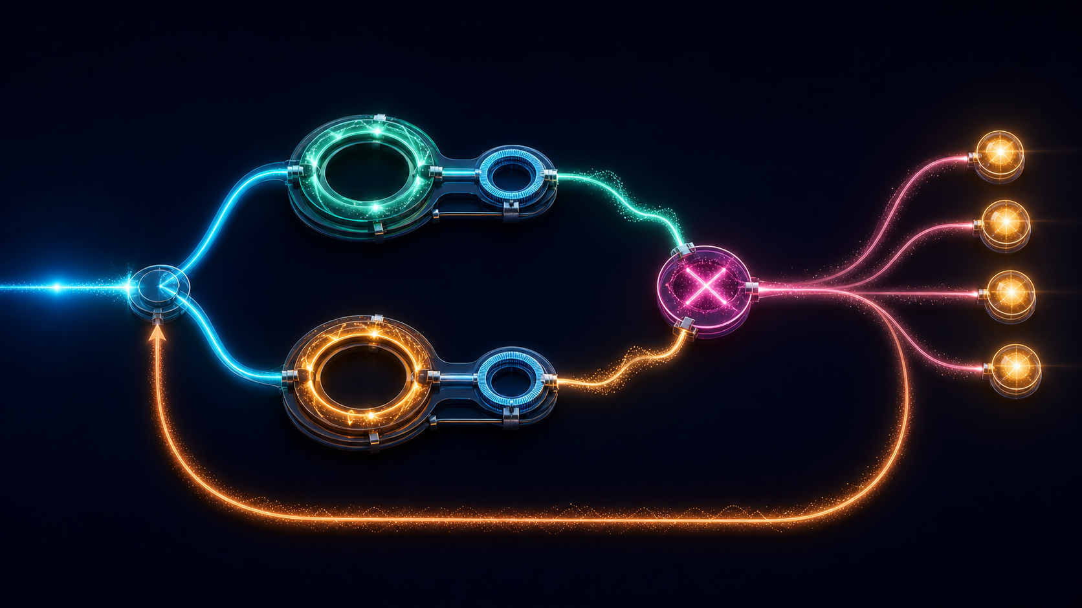
Multiply residuals, not explanations
Two Kerr leaves share one linear reference. The outer loop sees only their product.
eA = nA−n₀ eB = nB−n₀
Z(E) = Z(eA) ∪ Z(eB)
E = (eA/εA)(eB/εB) ṡ = −gσE
a zero of either quadratic leaf is a zero of the tree
11
Notes:
Each Kerr leaf compares one nonlinear cavity with the same linear reference. The two normalised residuals are multiplied. A zero of either leaf is therefore a zero of the tree.
For two quadratic leaves, the product residual carries four simple zeros. One signed outer integrator drives the common power. This is the shared-reference twinning tree: the only coined term on the slide, and the hardware earns it.
[Sources]
- Local manuscript: ../manuscript/S6.tex, Eqs. (14)–(17), and Fig. 6.
- Data: ../growth/numerics/data/twinning_tree_summary.json.
- Generated visual: assets/optical-twinning-tree.png.

Slide 12
A single optical circuit reaches all four roots
qA(s) qB(s) = (s−1)(s−2)(s−3)(s−4)
the plotted trajectories integrate the cavities and controller—not the quartic alone
3 complex amplitudes + 1 controller = 7 real variables
12
Notes:
These are full cavity-plus-controller trajectories, not a polynomial evaluated by a digital solver inside the loop. The system contains three complex cavity amplitudes and one real controller coordinate: seven real dynamical variables, below our n=8 local-computation cap.
Four representative seeds settle to s=1, 2, 3, and 4. Repeating the run at Δt=0.005 and 0.0025 changes the final power by at most 3.2×10⁻¹² for the fine pair.
[Sources]
- Local manuscript: ../manuscript/S6.tex and Fig. 7.
- Data: ../growth/numerics/data/twinning_tree_traces.csv.
- Data: ../growth/numerics/data/twinning_tree_summary.json.
- Data: ../growth/numerics/data/twinning_tree_convergence.csv.

Slide 13
Every run ends at a root or a declared power limit
42 initial-condition / polarity trials
s(t) is bounded to the imposed optical power interval
33
root acquisitions
9
imposed power limits
0
interior failures
13
Notes:
Across 42 initial-condition and polarity combinations, 33 acquire one of the four roots. The other nine all terminate at an imposed power limit: four at the lower limit and five at the upper limit. None remain unlocked in the interior.
That distinction is the point of this slide. A bounded optical actuator is not a failed equation; it is part of the physical domain on which the root finder is defined.
[Sources]
- Local manuscript: ../manuscript/S6.tex.
- Data: ../growth/numerics/data/twinning_tree_runs.csv.
- Data: ../growth/numerics/data/twinning_tree_summary.json.

Slide 14
A repeated root deletes one restoring direction
The measured slowing follows the collapsing slope
SIMPLE ROOTS
all seven simple-root cases settle; the repeated-root points require one-sided approach
q(s) = (s−r₋)(s−r₊)
q′(r±) = ±(r₊−r₋)
restoring sign survives
REPEATED ROOT
q(s) = (s−r)² ≥ 0 q′(r)=0
←
←
fixed polarity: one side attracts, one side escapes
14
Notes:
As two simple roots approach, the differential susceptibility shrinks and settling stretches. The regular-root family spans roughly 36 to 210 controller-time units in the measured set.
At a repeated root, both e and its first derivative vanish. The feedback loses its local restoring slope. From one side a chosen polarity approaches slowly—275 or 299 time units in these runs. From the opposite side the same polarity sends the drive to an imposed power limit. This is a physical conditioning obstruction, not merely a smaller convergence rate.
[Sources]
- Local manuscript: ../manuscript/S7.tex and Fig. 5.
- Data: ../growth/numerics/data/kerr_root_conditioning.csv.
- Data: ../growth/numerics/data/kerr_repeated_root.csv.
- Data: ../growth/numerics/data/kerr_root_conditioning_summary.json.

Slide 15
Light can solve where materials agree
field = variable
mismatch = residual
feedback = iteration
Which equations can we factor into matter?
15
Notes:
Return to the title. The common optical field is the computational variable. Material mismatch is the evaluated residual. Causal feedback supplies the root-finding dynamics. A tree composes low-order physical residuals into a higher-order zero set.
The demonstrated object is modest and honest: a two-leaf, factorised quartic in a seven-real-variable cavity model. The research programme is larger. Which equations admit useful optical factorisations once noise, delay, finite bandwidth, and power are treated as part of the computation rather than engineering afterthoughts?
The paper was generated and closed through EigenEngine; the public generation record accompanies the manuscript and this talk.
[Sources]
- Local manuscript: ../manuscript/S8.tex and conclusion.
- Bondar et al., https://arxiv.org/abs/2103.01162
- EigenEngine: public project page to be linked in the featured-generation release.
- Generated visual: assets/optical-twinning-tree.png.

