Slide 1
Web programming
Module 1. Introduction and Background

Slide 2
Content
Historical perspective
What is a web application?
Web 1.0,2.0,3.0 Application Architectures
Design Patterns
Setup your development environment
Final project

Slide 3
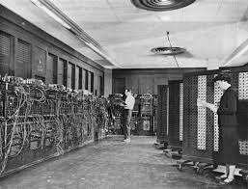
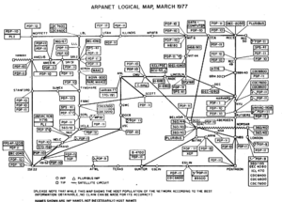
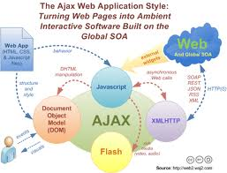


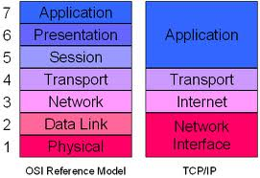










Historical Perspective
1945
1970
1980
1990
2000
2010
Notes:
Arpanet: 1963 stand for Advance Research Projects Agency Network
TCP/ IP: 1985
World Wide Web: 1989
Amazon: 1995
Google: 1996
Facebook: 2004
Ajax: 2005: asynchronous Javascript+ XML
Amazon EC2: 2006: web services and cloud computing
HTML5: 2012

Slide 4
Web 1.0, 2.0, 3.0
Web 1.0 – Creation of static website
Web 2.0 – Interactivity (Ajax), social network, lightweight collaboration, …
Web 3.0 – The web intelligence, semantic web, NLP, recommender system

Slide 5
Enabler of Web 2.0, 3.0
JavaScript, XML, JSON (Ajax)
Web service Interoperability
Infrastructure, platform, and software as a service capabilities, cloud computing
Mobile platform and app
Metadata, linked data and machine learning

Slide 6
Content
Historical perspective
What is a web application?
Web 1.0,2.0,3.0 Application Architectures
Design Patterns
Setup your development environment
Final project

Slide 7
What is a web application?
This course is about modern web architecture
We will consider, as a high level, the architectural model
The course will conduct based on this model
Based upon the models, we can begin to consider the most basic web protocols and standards

Slide 8
Client – Server Model
Client – Server architecture is the most fundamental model for describing the relationship the cooperating programs in a web application
The two parts of this model:
Server component – listen for request and provides the services or resources accordingly
Client component – establishes the connection to server and request services or resource from it

Slide 9
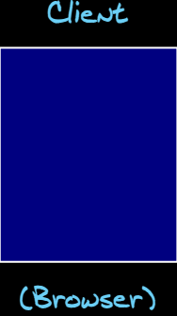
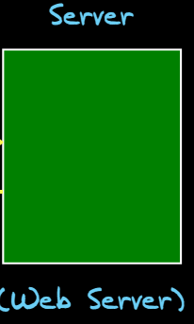
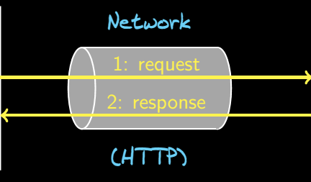
Client – Server Model
There is a request/ response protocol associated with any client – server architecture

Slide 10
Web application
Definition (Web application)
A web application is accessed by users over a network, uses a browser as a client, and consists of a collection of client- and sever- side scripts, HTML pages, and other resources that may be spread across multiple servers. This application itself is accessed by users with a specific path within a web server
Ex. Webmail, blog, wikis, forums, online banks, online retails, …

Slide 11
Web application
There is a bit more to it:
Network-
The internet, a global system of interconnected computer network
Uses the standard Internet protocol suite (TCP/IP)
Web (World Wide Web)
A system interlinked documents accessed via the Internet using HTTP
Web pages contain hypermedia along with hyperlinks to others
Hyperlinks give the Web its structure
The structure of Web is what makes it useful and gives it value

Slide 12
Web application
Advantages
Ubiquity and convenience of using web browser as a client
Inherent cross-platform compatibility
Ability to update and maintain web applications without distributing and installing software on potentially thousands of client computers
Reduction in IT costs
Disadvantages
User experience is not as good as standalone applications
Private and security issues associated with your data
From a developer perspective, it is difficult to develop and debug
Notes:
There is a lot of scenarios, moving parts

Slide 13
Content
Historical perspective
What is a web application?
Web 1.0,2.0,3.0 Application Architectures
Design Patterns
Setup your development environment
Final project

Slide 14
Web 1.0, 2.0, 3.0 Application Architectures

Slide 15
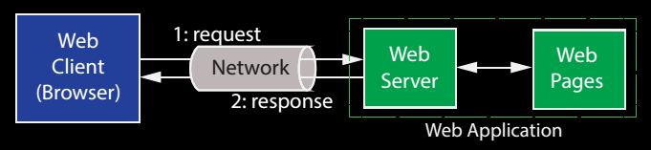
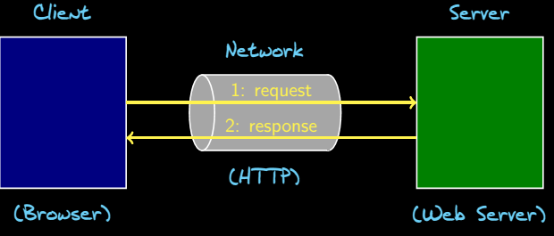
Web 1.0 Applications
A web 1.0 is not much more complicated than the client – server model we previously considered:
The web server is primarily fetching static web pages – not much interactivity
No separation of data from its presentation
The browser is very simple – it only needs to render HTML

Slide 16



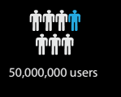
Web 1.0 Context

Slide 17
Web 1.0 applications
As applications became richer, server-side script became more complicated, web 1.0 applications became very difficult to maintain
The “Browser War” led to more functionality on client side, along with compatibility issues
Developers began creating applications that were more interactive – requires saving state
Technology that improved performance emerged – client side scripts, faster browsers, web caching, …

Slide 18
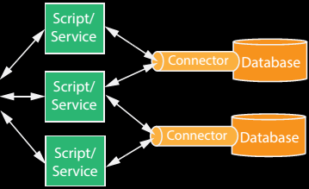
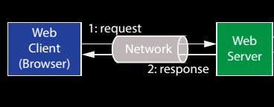
Web applications
Web 2.0 and 3.0 application architectures are better organized to deal with this complexity
Server side functionality is partitioned more intelligent
The browser is more capable, with better standards support

Slide 19
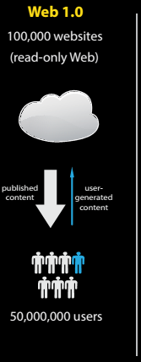



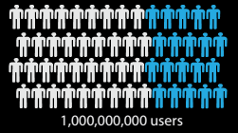
Web 2.0 Context

Slide 20

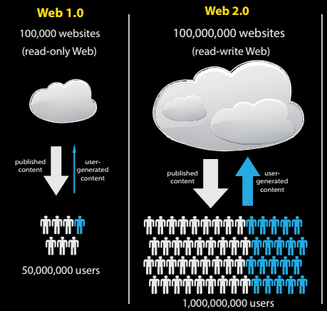


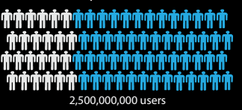
Web 3.0 Context

Slide 21
Content
Historical perspective
What is a web application?
Web 1.0,2.0,3.0 Application Architectures
Design Patterns
Setup your development environment
Final project

Slide 22
Design Patterns

Slide 23
Web application architectures
We have seen that modern web applications involve a significant amount of complexity, particularly on the server side
A typical web application involves numerous protocols, programming language, and technologies
Developing, maintaining, and extending a complex web application is extremely difficult – but building it using a foundation of solid design principles can simplify each of these tasks
Software engineers use abstraction to deal with this type of complexity
Design patterns provide useful design abstractions for object-oriented systems

Slide 24
Design Patterns
Definition
A design pattern is a description of interacting objects and classes that interact to solve a general design problem within a particular context
A design pattern is an abstract template that can be applied over and over again
This idea is apply abstract design patterns in order to solve specific design problems that occur while building real systems
Design patterns provide a way to communicate the parts of a design, it’s the vernacular software engineers use to talk about designs

Slide 25
Client – Server Model
The whole point of a client – server model architecture is to distribute the components of an application between the client and server in some way. This makes sense if you trying to share a database or files among some users, printers, …
What gets put where determines the particular type of the client – server architecture
In order to build complex web applications, we’re going to make use of numerous design patterns that will help us organize how pieces are placed within the client – server architecture

Slide 26
n – Tier Architecture
n – Tier architecture is highly useful design pattern that maps to the client – server model.
This design pattern is based on the concept of breaking a system into different pieces or tiers that can be physically separated:
Each tier is responsible for providing a specific functionality
A tier only interacts with the tiers adjacent to it through a well-defined interface
Examples
Print server – 2-tier architectural pattern
Each web applications – 2- tier client – server architecture:
User interface
Server provided static web pages (HTML)
Interact between 2 tiers via HTTP
Notes:
HTTP: hypertext transfer protocol

Slide 27
3 – Tier Architecture
One of the most common is 3- tier architecture:
Presentation tier – The user interface
Application (logic) tier – Retrieves, modifies and/or delete data in the data tier, and send the results to the presentation tier. Also responsible for processing the data itself
Data tier – The source of data associated with the application
A modern web application is often deployed over the internet as a 3- tier architecture:
Presentation tier – user’s browser
Application tier - The web server and logic associated with generating dynamic content, collecting and formatting the result of a search
Data tier – A database

Slide 28
6- Tier Web Application Architecture
The Application tier is often divided into 2 tiers:
Business logic tier – Models the business objects associated with the application, and captures the business rules and workflows associated with how the process can be processed and manipulated
Data access tier – Responsible for accessing data, and passing it to the business logic tier, account balances, transactions
The Presentation is often divided into 2 tiers:
Client tier – client-side user interface components
Presentation logic tier – server-side scripts for generating web pages
Finally, web server is often separated out into its own Web tier

Slide 29
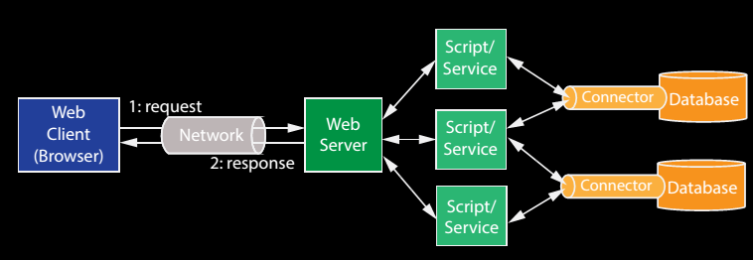






Web application architecture tiers

Slide 30
Content
Historical perspective
What is a web application?
Web 1.0,2.0,3.0 Application Architectures
Design Patterns
Setup your development environment
Final project

Slide 31
Setup development environment

Slide 32
Final project

Slide 33
Question and Answer

Slide 34
Choose one answer
1. How do you differentiate between the Internet and the World Wide Web
A. They are just different names for same thing
B. The World Wide Web is built on top of the networking infrastructure provided by the Internet
C. The Internet is built on top of the networking infrastructure provided by the World Wide Web
D. They are same thing but the Internet is restricted for government and military use only

Slide 35
Choose one answer
2. What gives the World Wide Web its structure?
A. TCP/IP and HTTP protocols
B. The Internet
C. Hyperlinks to other web pages and resources
D. ASP.NET

Slide 36
3. What is the best description of Web 1.0
A. Creation of static web sites, the first web business models
B. Interactivity (Ajax), social networking, mash-ups, media sharing, online commerce, lightweight collaboration, wikis
C. The intelligent web, machine facilitated understanding of information, semantic web, machine learning, recommender systems

Slide 37
4. What best describes Web 2.0
A. Creation of static web sites, the first web business models
B. Interactivity (Ajax), social networking, mash-ups, media sharing, online commerce, lightweight collaboration, wikis
C. The intelligent web, machine facilitated understanding of information, semantic web, machine learning, recommender systems

Slide 38
5. What best describes web 3.0
A. Creation of static web sites, the first web business models
B. Interactivity (Ajax), social networking, mash-ups, media sharing, online commerce, lightweight collaboration, wikis
C. The intelligent web, machine facilitated understanding of information, semantic web, machine learning, recommender systems

Slide 39
(choose multiple answers)
6. What of the following were enablers of web 2.0, 3.0
A. the client-server architecture
B. TCP/IP
C. HTML
D. Web service interoperability
E. JSON
F. HTTP
G. JavaScript

Slide 40
(give your answer)
7. For a web application, what acts as the client in the client-server model?
…………………………………

Slide 41
(give your answer)
8. What protocol is used to transfer the information between client and server in a web application
……………………………

Slide 42
(choose multiple answers)
9. What are the advantages of web applications over the traditional applications
A. Cross- platform
B. Convenience
C. Easy to maintain
D. Easy to develop
E. Security

Slide 43
(Give your answer)
10. Name the three tiers in a modern 3-tier web application architecture
…………………………..

Slide 44
(Choose the best answer)
11. What was the “Browser Wars”
A. It’s a competition that took place in 1990s between Netscape and Microsoft and Microsoft with IE ended up wining the browser wars
B. It’s a competition that took place in 1990s between Netscape and Microsoft and Netscape with Netscape’s Navigator ended up winning the browser wars
C. The process gave new protocols for web development
D. Web 3.0 was born in 2010 that led the new trend in web application

Slide 45
(Choose the best answer)
12. A basic website created based on Web 1.0 has the architecture of:
A. 2- Tier
B. 3- Tier
C. 6- Tier
D. 12- Tier

