Slide 1
CODING SKILL
Spanning Tree
& Shortest Path
Presenter:
Trần Lê Hoàng - hoangtl1
Hoàng Tuấn Anh Văn - vanhta2

Slide 2
CONTENT
Tree
Spanning Tree
Shortest Path in Weighted Graph
Exercises

Slide 3
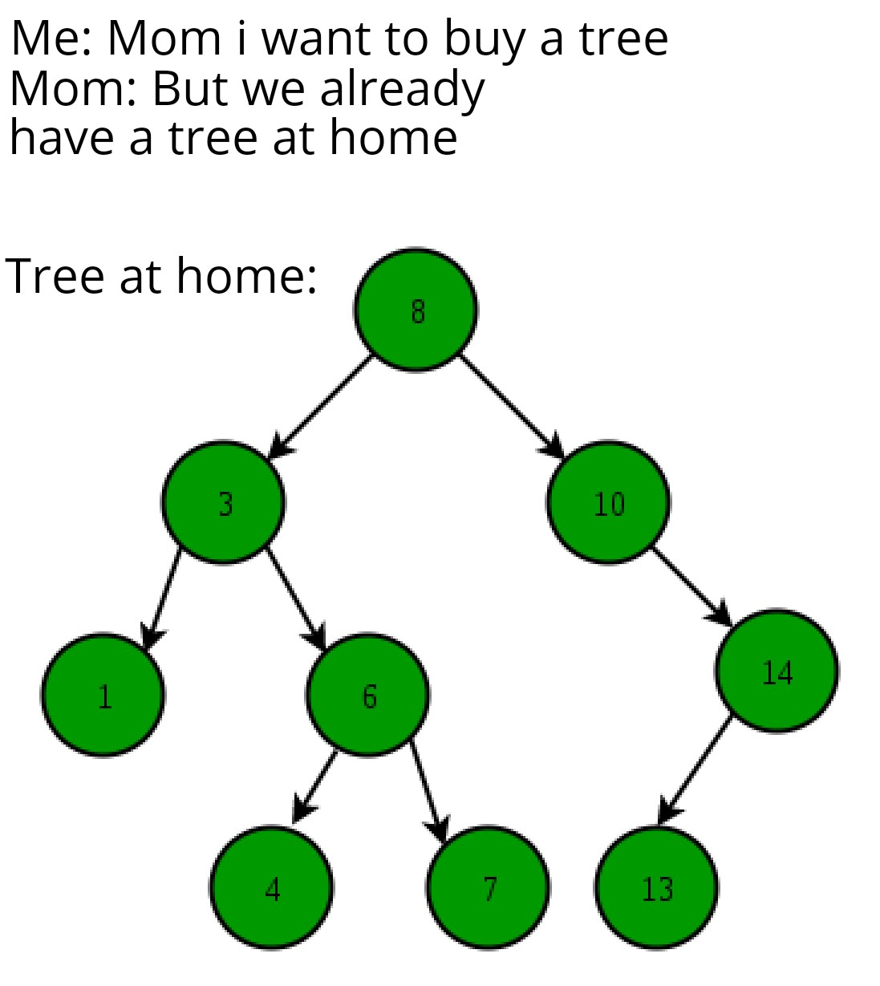
CONTENT
Tree
Spanning Tree
Shortest Path in Weighted Graph
Exercises

Slide 4
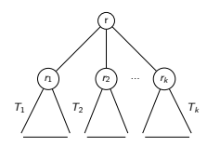
I. Tree
Definition
An abstract model of hierarchical structures
A tree consists of nodes with a parent-child relation with a special node called root of the tree
Recursive data structure:
A node r is a tree with root r
Suppose T₁, …, T_{k} are tree with root r₁, …, r_{k}, and a node r
A tree is constructed with r as the parent of r₁, …, r_{k}
r as root

Slide 5


I. Tree
Example
File systems
Organization charts

Slide 6
I. Tree
Terminologies
Path: sequence of nodes x₁, …, x_{k} where x_{i} is parent of x_{i+1}, is called path of length k-1
Ancestor: node u is ancestor of node v if there exists a path from u to v
Descendant: node u is descendant of node v if v is ancestor of u
Sibling: node u and v are sibling if they have the same parent
Leaf: node has no children
Level of a node: The count of edges on the path from the root node to that node
Subtree: Any node of the tree along with its descendants
Height: the number of edges from the root node to the deepest leaf node

Slide 7
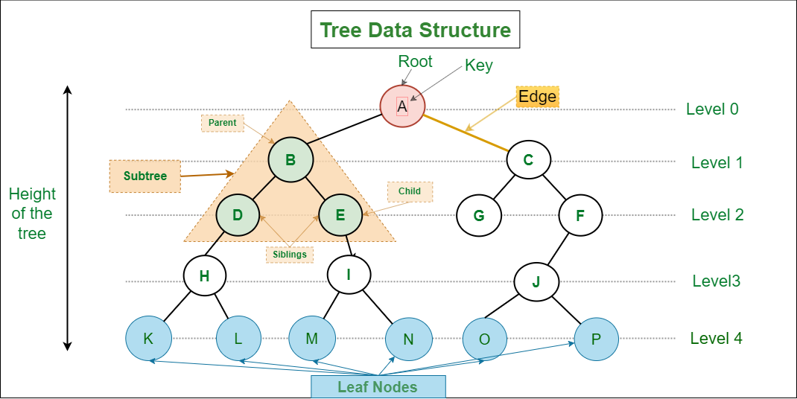
I. Tree
Terminologies

Slide 8
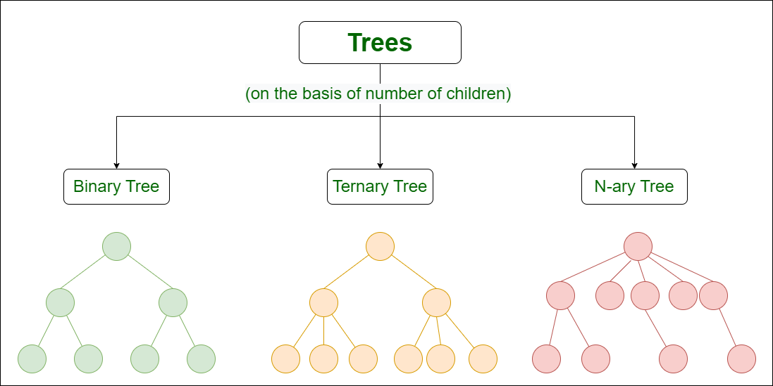
I. Tree
Types of tree
Based on the number of childrens

Slide 9
I. Tree
Binary Tree
A Tree data structure where each node has at most 2 childrens
Properties:
The maximum number of nodes at level x of a binary tree is 2^{x}
The maximum number of nodes in a binary tree of height h is 2^{h}–1
A Binary Tree with N nodes, the minimum possible height or the minimum number of levels is log₂(N+1)

Slide 10
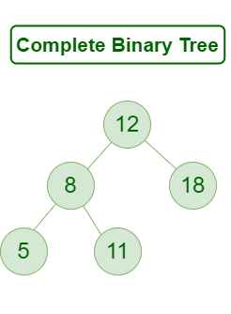
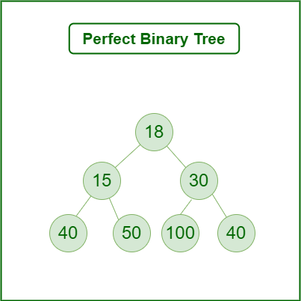
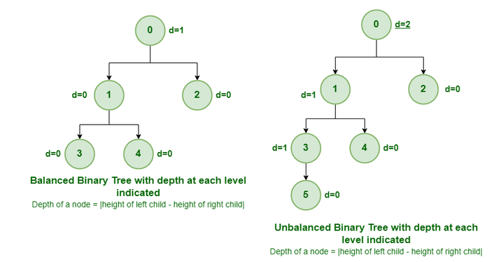
I. Tree
Types of Binary Tree
Based on the completion of levels

Slide 11
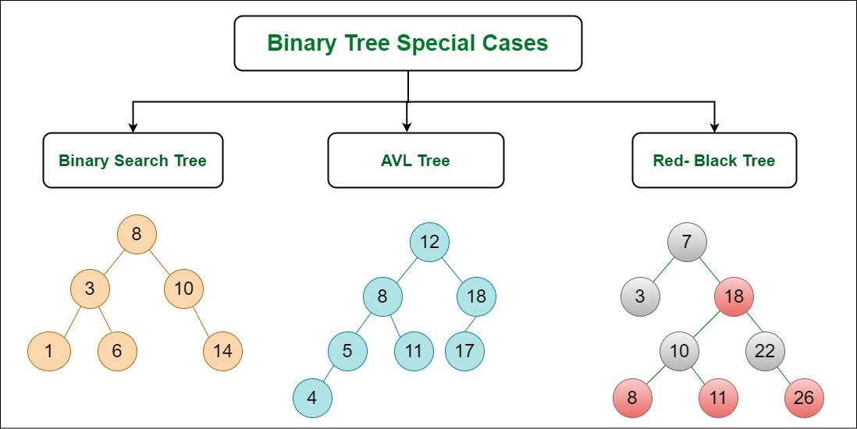
I. Tree
Types of Binary Tree
Special types

Slide 12
I. Tree
Tree Representation
Class TreeNode
# binary tree
class TreeNode:
int data
TreeNode left
TreeNode right
int level
# general tree
class TreeNode:
int data
TreeNode[] childs
int level

Slide 13
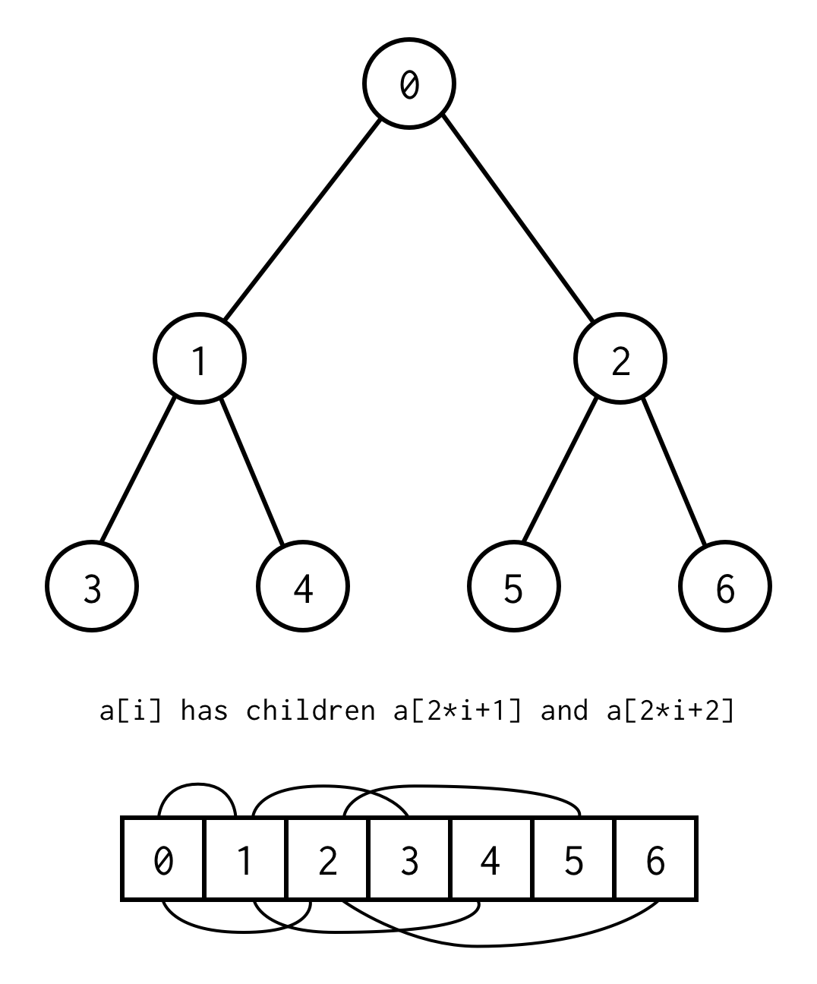
I. Tree
Binary Tree Array Representation
Root: a[0]
Parent: a[i]
Left child: a[2*i + 1]
Right child: a[2*i + 2]

Slide 14
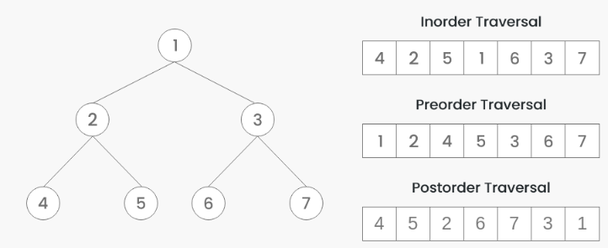
I. Tree
Binary Tree Traversal
DFS
Inorder traversal: visit left subtree -> root -> right subtree
Preorder traversal: visit root -> left subtree -> right subtree
Postorder traversal: visit left subtree -> right subtree -> root
Level order traversal (BFS)
Boundary traversal
Diagonal traversal

Slide 15
I. Tree
Tree Traversal
https://leetcode.com/problems/binary-tree-inorder-traversal/
https://leetcode.com/problems/binary-tree-preorder-traversal/
https://leetcode.com/problems/binary-tree-postorder-traversal/

Slide 16
I. Tree
Heap Data Structure
A Heap is a Tree-based data structure in which the tree is a complete binary tree
Two types of heap:
Max-Heap: The value at root node is greater than its childrens value. The same property must be recursively true for all sub-trees in that Binary Tree.
Min-Heap: The value at root node is greater than its childrens value. The same property must be recursively true for all sub-trees in that Binary Tree.

Slide 17
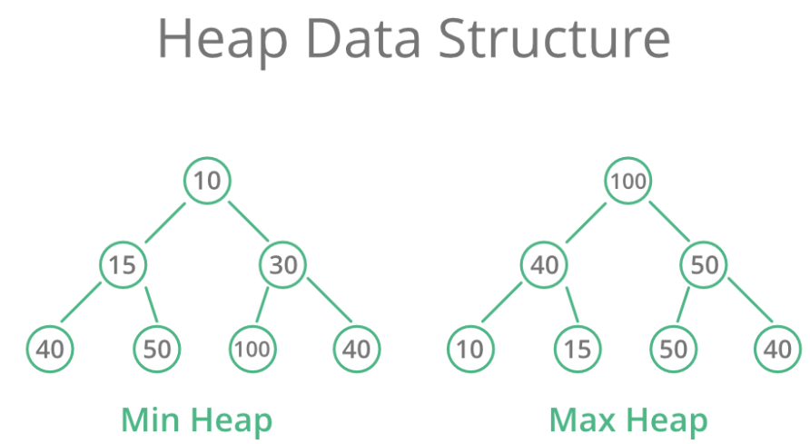
I. Tree
Heap Data Structure

Slide 18
I. Tree
Operations of Heap Data Structure
getMin(): It returns the root element of Min Heap. The time Complexity of this operation is O(1). In case of a maxheap it would be getMax().
extractMin(): Removes the root element from MinHeap, takes O(log N) as this operation needs to maintain the heap property
decreaseKey(): Decreases the value of the key, takes O(log N) as this operation needs to maintain the heap property
insert(): Inserting a new key takes O(log N) time. We add a new key at the end of the tree then traverse up to fix the violated heap property.
delete(): Deleting a key takes O(log N) time. We replace the key to be deleted with the minimum infinite by calling decreaseKey() then call extractMin()

Slide 19
I. Tree
Heap Data Structure
Heap implementation in Java → class java.util.PriorityQueue
Heap implementation in python → from heapq import heappush, heappop, heapify
https://ideone.com/gw5aBd
Notes:
Exercise: Heap Sort
Exercise: Kth Largest Element in an Array

Slide 20
CONTENT
Tree
Spanning Tree
Shortest Path in Weighted Graph
Exercises

Slide 21
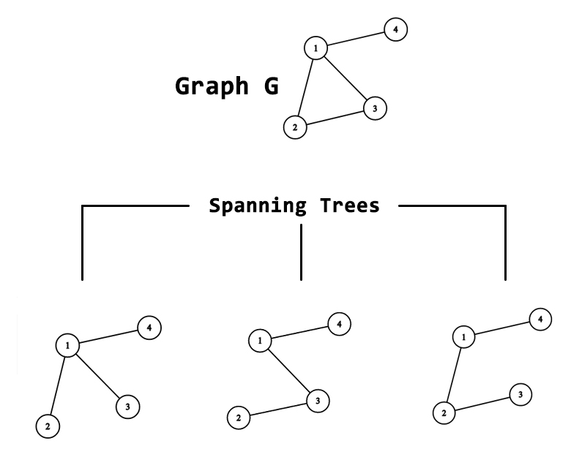
II. Spanning Tree
Definition
Given an undirected graph G = (V, E)
A spanning tree T is a subgraph of G, where T:
Is connected
Is acyclic
Include all of the vertices
These properties make it a tree
This makes it “spanning”
⇒ Applications:
Computer Network Routing Protocol
Cluster analysis

Slide 22
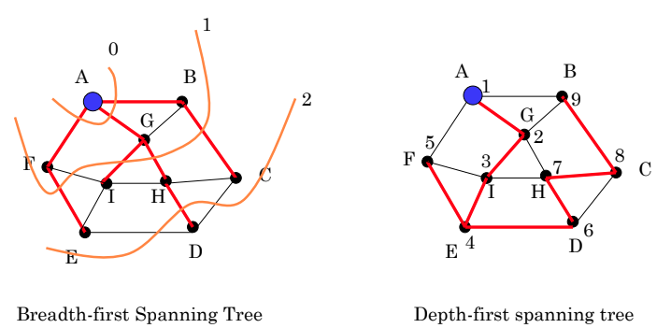
II. Spanning Tree
Definition
Given an undirected graph G = (V, E)
A spanning tree T is a subgraph of G, where T:
Include all of the vertices
Is connected
Is acyclic

Slide 23
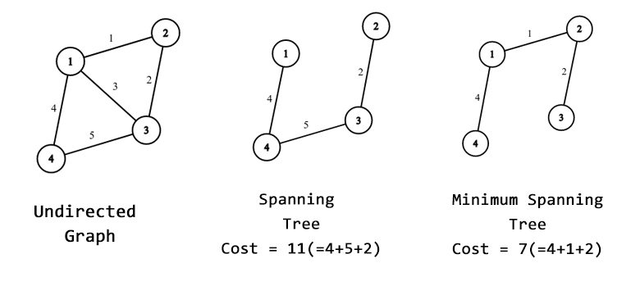
II. Spanning Tree
Definition
Given an undirected graph G = (V, E)
A minimum spanning tree (MST) is a spanning tree of minimum total weight
→ MST is useful when attempting to minimize the cost of connecting all the nodes.
Notes:
transportation networks, water supply networks, and electrical grids

Slide 24
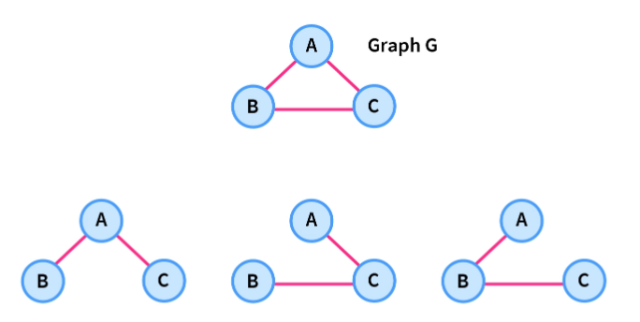
II. Spanning Tree
Properties
For any spanning tree T = (V, E) → | E | = | V | - 1
For minimum spanning tree (MST):
Cycle property: For any cycle C, if an edge e of C has largest weight → e cannot belong to MST
Uniqueness: If each edge has distinct weight → exists only one unique MST
If e is the smallest-weight edge of graph G, and no other edge has same weight as e → e is in every MST of the graph
(*) Prove: https://vnoi.info/wiki/algo/graph-theory/minimum-spanning-tree.md
Notes:
1. Tính chất chu trình: Trong một chu trình C bất kỳ, nếu e là cạnh có trọng số lớn nhất tuyệt đối (không có cạnh nào có trọng số bằng e ) thì e không thể nằm trên bất kỳ cây khung nhỏ nhất nào.
2. Tính duy nhất: Nếu tất cả các cạnh đều có trọng số khác nhau thì chỉ có duy một cây khung nhỏ nhất. Ngược lại, nếu một vài cạnh có trọng số giống nhau thì có thể có nhiều hơn một cây khung nhỏ nhất.
3. Tính chất cạnh nhỏ nhất: Nếu e là cạnh có trọng số nhỏ nhất của đồ thị, và không có cạnh nào có trọng số bằng e thì e nằm trong mọi cây khung nhỏ nhất của đồ thị.
4. Đường đi hẹp nhất: Xét 2 đỉnh u , v bất kỳ trong đồ thị. Nếu w là trọng số của cạnh lớn nhất trên đường đi từ u đến v trên cây khung nhỏ nhất của đồ thị thì ta không thể tìm được đường đi nào từ u đến v trên đồ thị ban đầu chỉ đi qua những cạnh có trọng số nhỏ hơn w .

Slide 25
II. Spanning Tree
Disjoint Set Union (DSU)
Problems: Given a graph with n vertices, initially with no edges, we need to process 2 type of query as follows:
Add an edge between vertex u and vertex v in the graph.
Print YES if vertices u and v are in the same connected component. Print NO otherwise.
(*) A connected component is a subgraph where any two vertices have a path between them

Slide 26
II. Spanning Tree
Disjoint Set Union (DSU)
Consider each vertex = an element, each connected component = a set
→1st query = merge 2 sets into new set
→2nd query = check if u and v belong to the same set
Construct a DSU with basic operations:
make_set(v): Create a new set containing only element v.
union_sets(u, v): merge the set containing u and the set containing v into 1 set
find(v): Find the representative of the set containing element v (root node)

Slide 27
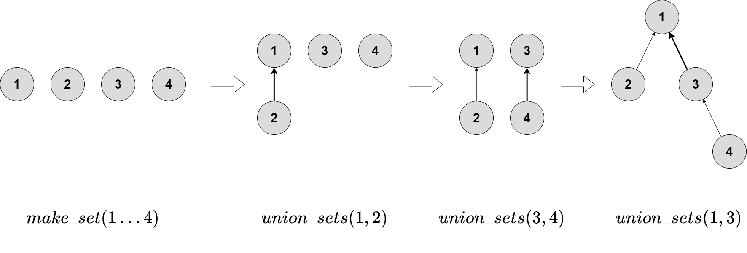
II. Spanning Tree
Disjoint Set Union (DSU)

Slide 28
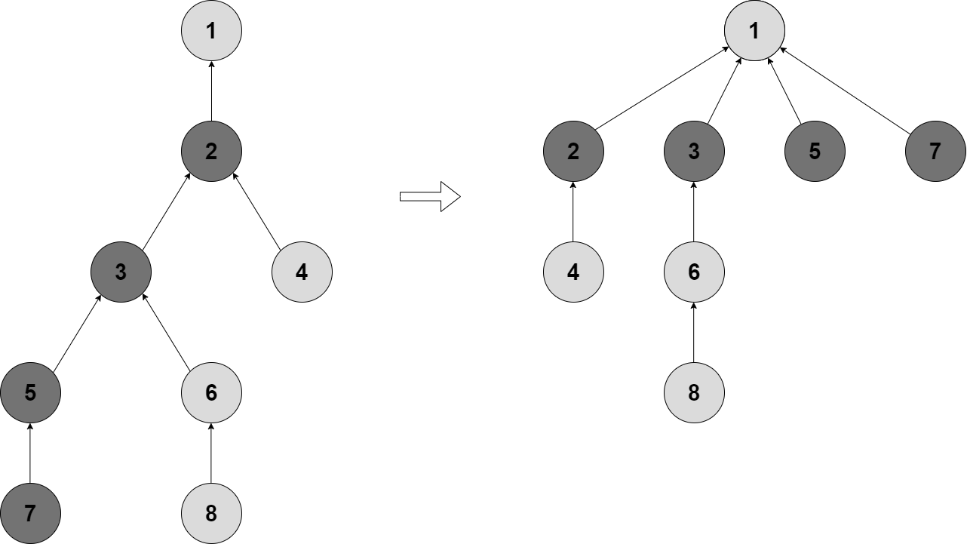
II. Spanning Tree
Disjoint Set Union (DSU) pseudo code
void make_set(int v):
parent[v] = v;
void union_sets(int a, int b):
a = find_set(a);
b = find_set(b);
if (a != b)
parent[b] = a;
int find(int v):
Return v == parent[v] ? v : (parent[v] = find(parent[v])); // Path compression
Path compression

Slide 29
II. Cây khung
class DisjointSet {
private final int[] parent;
public DisjointSet(int n) {
parent = new int[n];
// Initially, each element is its own set
for (int v = 0; v < n; v++) {
parent[v] = v;
}}
public int find(int v) {
return v == parent[v] ? v : (parent[v] = find(parent[v]));
}
public void union(int u, int v) {
int rootU = find(u);
int rootV = find(v);
if (rootU != rootV)
parent[rootV] = rootU;
}
}
Disjoint Set Union (Java)
Notes:
Number-of-provinces

Slide 30
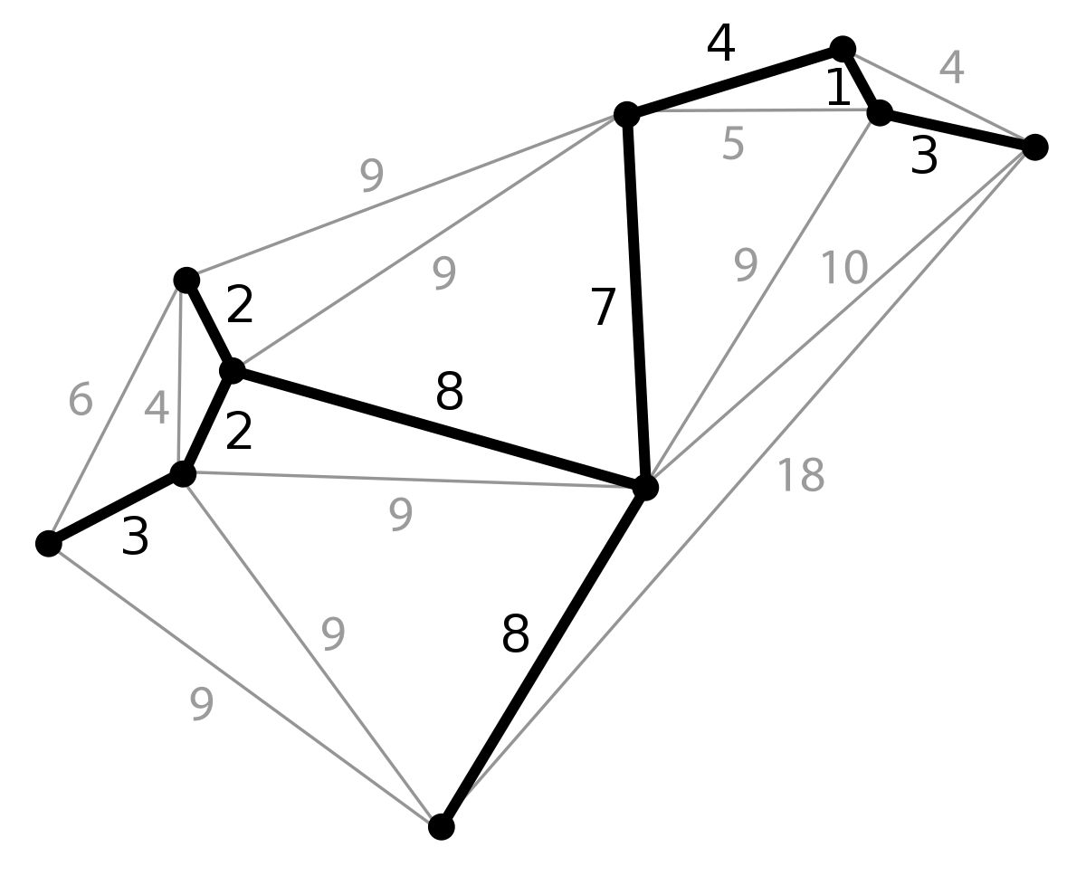
II. Minimum Spanning Tree
Kruskal algorithm
Strategy:
Start with no edges and successively insert edges from E in order of increasing weight
If an edge makes cycle when added
→ Skip this edge
Notes:
If the graph is already in memory in adjacency list format, then DFS is slightly simpler and faster (O(n) versus O(n alpha(n)), where alpha(n) is inverse Ackermann), but union-find can handle the edges arriving online in any order, which is sometimes useful (e.g., there are too many to fit in main memory).

Slide 31
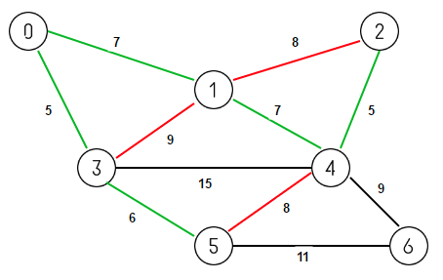
II. Minimum Spanning Tree
Kruskal algorithm
1. Pick the cheapest edge available e₀ and add it to the MST. A = { e₀ }
2. Choose next cheapest edge e = (u, v)
3. If adding e to A makes a cycle, skip e
4. Repeat the above 2) and 3) until |V -1| edges reach

Slide 32
II. Minimum Spanning Tree
Kruskal algorithm conceptual demo
https://docs.google.com/presentation/d/1RhRSYs9Jbc335P24p7vR-6PLXZUl-1EmeDtqieL9ad8/edit#slide=id.g375bbf9ace_0_645

Slide 33
II. Minimum Spanning Tree
Kruskal algorithm pseudo code
def MST-KRUSKAL (G, w)
// Graph G with set of nodes G.V, weight matrix w.
// MST is the edges set A={}
A = empty
for each v in G.V:
MAKE-SET(v)
Sort edges of G.E into increasing order by weight w
for each edge (u, v) in sorted G.E:
if FIND(u) != FIND(v):
A += {(u, v)} // add edges to MST
UNION-SET(u, v)
return A

Slide 34
II. Minimum Spanning Tree (Java)
class DisjointSet {
private final int[] parent;
public DisjointSet(int n) {
parent = new int[n];
// Initially, each element is its own set
for (int v = 0; v < n; v++) {
parent[v] = v;
}}
public int find(int v) {
return v == parent[v] ? v : (parent[v] = find(parent[v]));
}
public void union(int u, int v) {
int rootU = find(u);
int rootV = find(v);
if (rootU != rootV)
parent[rootV] = rootU;
}
}
class Edge {
int src, dest, weight;
public Edge(int src, int dest, int weight) {
this.src = src;
this.dest = dest;
this.weight = weight;
}
}
Notes:
min-cost-to-connect-all-points

Slide 35
II. Minimum Spanning Tree (Java)
static int kruskal(int n, List<Edge> edges) {
int result = 0;
edges.sort(Comparator.comparingInt(e -> e.weight));
DisjointSet ds = new DisjointSet(n);
for (Edge e : edges) {
int rootSrc = ds.find(e.src);
int rootDest = ds.find(e.dest);
if (rootSrc != rootDest) {
result += e.weight;
ds.union(rootSrc, rootDest);
}
}
return result;
}
class Solution{
static int spanningTree(int V, int E, int edges[][]){
// Code Here.
List<Edge> lst = new ArrayList<>();
for (int[] edge : edges) {
lst.add(new Edge(edge[0], edge[1], edge[2]));
}
return kruskal(V, lst);
}
. . .
}
Notes:
min-cost-to-connect-all-points

Slide 36
II. Minimum Spanning Tree
Exercises
https://www.geeksforgeeks.org/problems/minimum-spanning-tree/1
https://leetcode.com/problems/min-cost-to-connect-all-points/description/

Slide 37
CONTENT
Tree
Spanning Tree
Shortest Path in Weighted Graph
Exercises

Slide 38
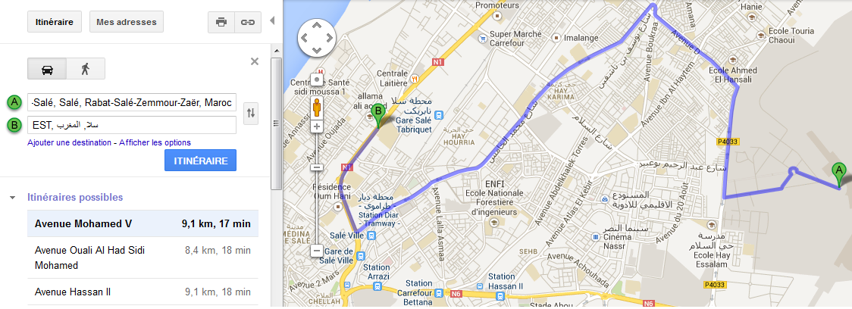
III. Shortest Path in Weighted Graph
Shortest Path
Google Maps - Directions
→ How to find the shortest path from A to B?
Notes:
Map routing.
Robot navigation.
Texture mapping.
Typesetting in TeX.
Urban traffic planning.
Optimal pipelining of VLSI chips.
Routing of telecommunication messages.
Network routing protocols - OSPF, BGP, RIP.

Slide 39
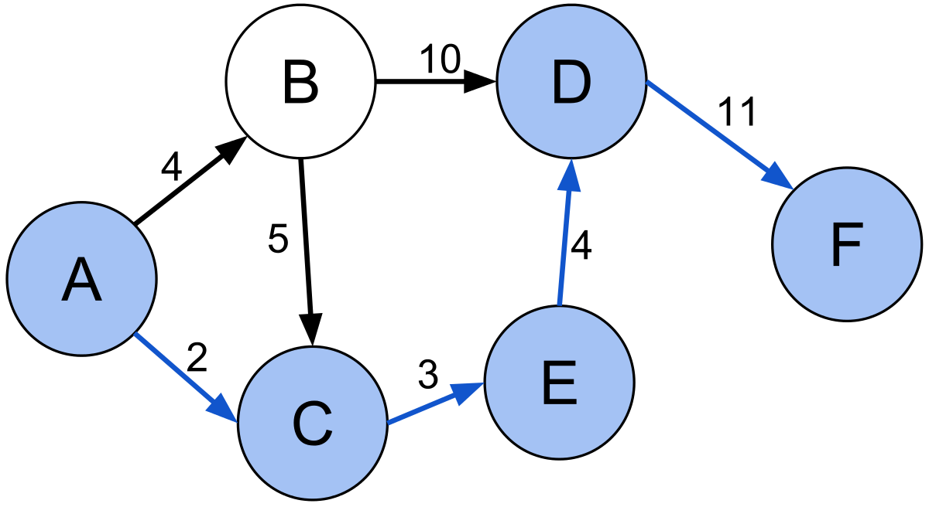
III. Shortest Path in Weighted Graph
Shortest Path
Given a weighted graph, show to find the shortest (directed) path from node s to t ?

Slide 40
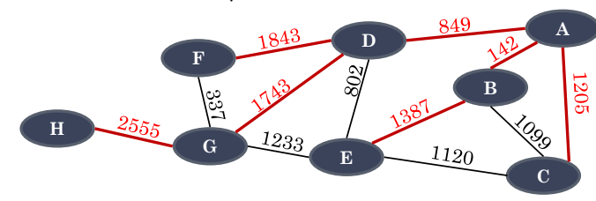
III. Shortest Path in Weighted Graph
Shortest Path properties
A subpath of a shortest path is itself a shortest path
Shortest paths from start vertex to all other vertices form a tree of shortest paths
Shortest paths tree have no cycles and maximum |V - 1| edges
Ex: Tree of shortest path from A

Slide 41
III. Shortest Path in Weighted Graph
Shortest Path problem
Given a graph G = (V, E), each edge e is associated with a weight w(e)
Shortest path = a path with the minimum sum of weight
Problems?
Single-source shortest paths problem: Find the shortest paths from a given source to all other nodes in G
All-pairs shortest paths problem: Find shortest paths between every pairs of vertices u, v in G
Notes:
BFFFS

Slide 42
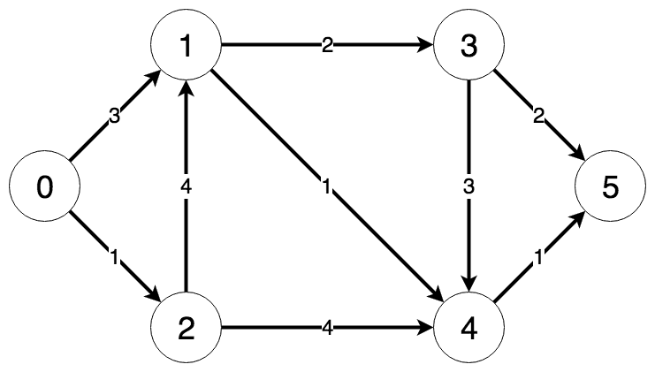
III. Shortest Path in Weighted Graph
Dijkstra Algorithm
Single-source shortest paths, graph without negative edge weights.
If all weights = 1 ⇒ BFS
Strategy
Maintain a set S of solved vertices
At each step select "closest" vertex u, add it to S,
and relax all edges from u

Slide 43
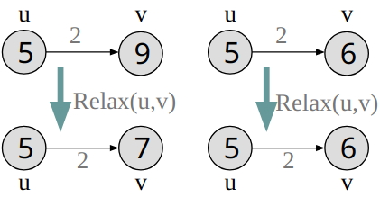
III. Shortest Path in Weighted Graph
Dijkstra Algorithm
Relaxing edge (u,v) = testing whether going through u can improve shortest path to v so far
v.d() = estimate of shortest path from src node, initialized = +INF
Relax(u,v,G)
if v.d() > u.d() + G.w(u,v) then
v.d = u.d() + G.w(u,v)
v.setparent(u)

Slide 44
III. Shortest Path in Weighted Graph
Dijkstra Algorithm pseudo
1 function Dijkstra(Graph, source):
2 dist[source] ← 0
3 for each vertex v in Graph:
4 if v ≠ source
5 dist[v] ← infinity
6 prev[v] ← undefined
7 Q.add_with_priority(v, dist[v])
8
11 while Q is not empty:
12 u ← Q.extract_min()
13 for each neighbor v of u:
14 alt = dist[u] + length(u, v)
15 if alt < dist[v]
16 dist[v] ← alt
17 prev[v] ← u
18 Q.decrease_priority(v, alt)
21 return prev[]

Slide 45
III. Shortest Path in Weighted Graph
Dijkstra Algorithm demo
https://docs.google.com/presentation/d/0ByoYId-KG3HUSnN6UDQxODlMdWs/edit?resourcekey=0-rDUIqZrmz7kGUk9EP8izYg#slide=id.p19

Slide 46
III. Shortest Path in Weighted Graph
Dijkstra Algorithm
Exercise
Basic Dijkstra: https://leetcode.com/problems/network-delay-time/description/
Advanced applied Dijkstra: https://leetcode.com/problems/reachable-nodes-in-subdivided-graph/description/
Dijkstra using maxHeap: https://leetcode.com/problems/path-with-maximum-probability/description/

Slide 47
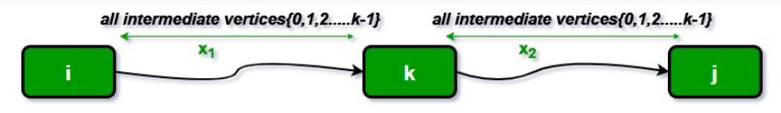
III. Shortest Path in Weighted Graph
Floyd–Warshall algorithm
All-pairs shortest path, graph can contains negative edge weights.
Idea
Follow the dynamic programming approach
Consider every node k, check whether node k is in the shortest path between any pair of nodes.

Slide 48
III. Shortest Path in Weighted Graph
Floyd–Warshall pseudo code
// let dist be a |V| × |V| array of minimum distances initialized to ∞
for each edge (u, v) do
dist[u][v] ← w(u, v) // The weight of the edge (u, v)
for each vertex v do
dist[v][v] ← 0
for k from 0 to |V| - 1:
for i from 1 to |V| - 1:
for j from 1 to |V| - 1:
if dist[i][j] > dist[i][k] + dist[k][j]
dist[i][j] ← dist[i][k] + dist[k][j]
end if

Slide 49
III. Shortest Path in Weighted Graph
Floyd Algorithm
Find the City With the Smallest Number of Neighbors at a Threshold Distance

Slide 50

THANK YOU!

