Slide 1
Preprocessing
Limma package in R to generate differential gene expression tables.
2. Gene selection
Gene ranking based on Fisher score.
Generating gene combinations based on Sequential forward feature selection (SFS) algorithm.
3. Gene validation
split the gene dataset into 5 parts, 4 parts for training and 1 part for testing.
5-folds CV and two DL models used are CNN, LSTM for estimation of the DL diagnosis performance using different gene combinations.
The obtained result is to find the model with the highest accuracy coefficient and the corresponding gene combination was used.
4. Gene testing
- experiment using the optimal gene combinations found in the above step.

Slide 2
Gene selection
The Fisher score is a statistical measure used to rank features based on their ability to discriminate between two classes in a binary classification problem.
It is calculated as the ratio of the between-class variance to the within-class variance.
Formula for calculating the Fisher score:
Fisher score = (mean1 - mean2)^2 / (var1 + var2)
- mean1 and mean2 are the means of the feature values for the two classes.
- var1 and var2 are the variances of the feature values for the two classes.

Slide 3
Steps to rank feature using Fisher score:
Calculate the mean and standard deviation of each feature for each class (i.e., the mean and standard deviation of the feature values for the samples in each class).
Calculate the between-class variance for each feature as the square of the difference between the means of the two classes.
Calculate the within-class variance for each feature as the sum of the variances of the feature values for each class.
Calculate the Fisher score for each feature as the ratio of the between-class variance to the within-class variance.
Rank the features based on their Fisher score.
This ranking can be used to select the most informative features for a machine learning model or to gain insight into the most important factors that contribute to the classification problem.

Slide 4
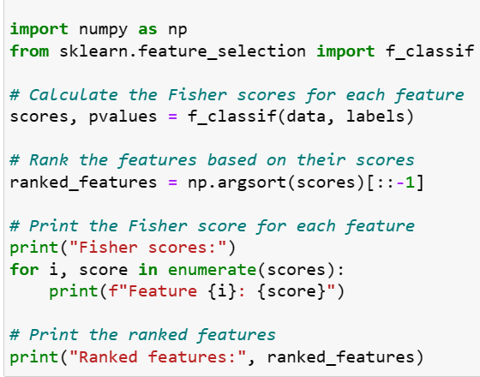
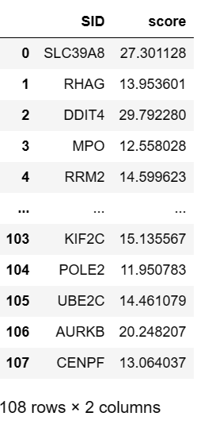
“f_classif” is a function from the sklearn.feature_selection module that computes the Fisher scores for each feature.
The function returns two arrays: scores containing the Fisher scores for each feature, and pvalues containing the p-values associated with the scores.
Then give a fisher score sheet for each gene

Slide 5
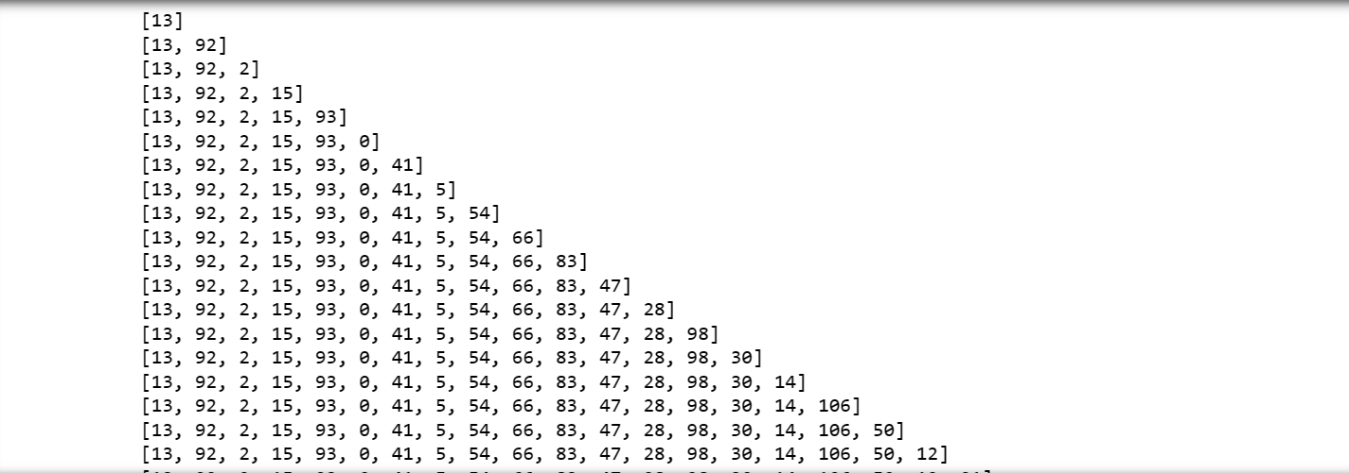
Ranking the genes based on their Fisher scores in descending order, starting from the gene with the highest score.
Generate a list total_comb containing all possible combinations of ranked genes, starting from the first all the way up to all 108 genes

Slide 6
Next mission:
Create a CNN model and put the genomes into these 2 models

