Slide 1
FINAL REPORT
NHẬP MÔN THỊ GIÁC MÁY TÍNH
SV1 : Tống anh quân – 16520985
SV2 : Nguyễn lương duy khánh - 16520584

Slide 2
OVERVIEW AND HOW DOES IT WORKS
Using an embedded computing Raspberry Pi 3B+ to recognize VietNam polime currency
Concept:
Taking all pictures of money and save to a folder (Dataset)
Get and save all features dataset to a file
Detecting
Operating:
Display LCD to indicate or inform some information when START
Opening and saving all features to an array from features dataset file
Putting money into the box
Press the button to start detecting
The system will take a picture of money then get it’s features
Compare one by one this feature with features dataset
Which feature return HIGHEST match point is the money we want to detect

Slide 3
Start
Start
SIFT Detect dataset
Get features from dataset
F
End dataset[]?
F
Button?
T
T
Capture online data
feature.npy
Get online data feature
Match feature
Get max matching
Show result “That is…”

Slide 4
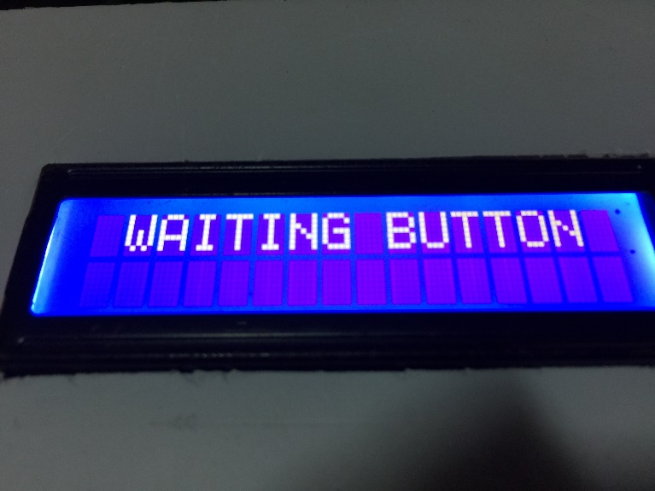
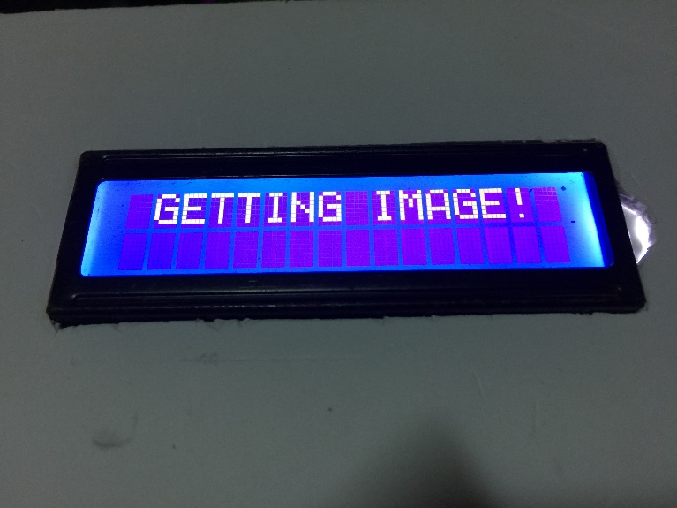
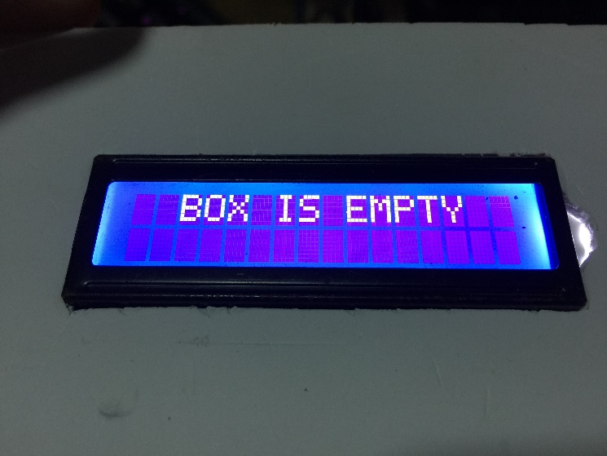
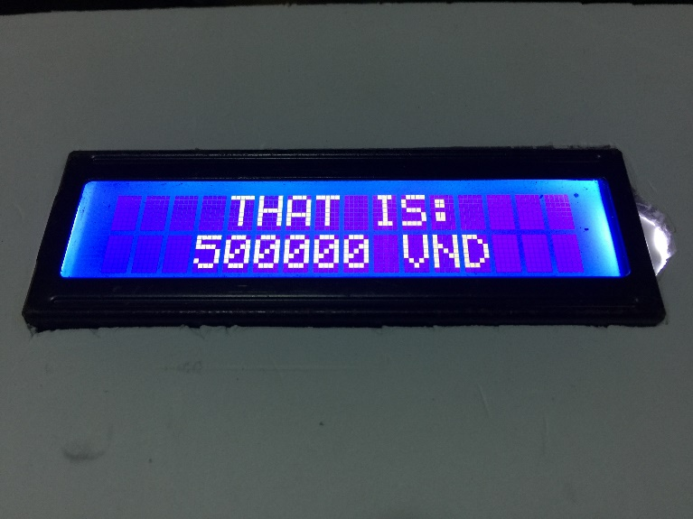
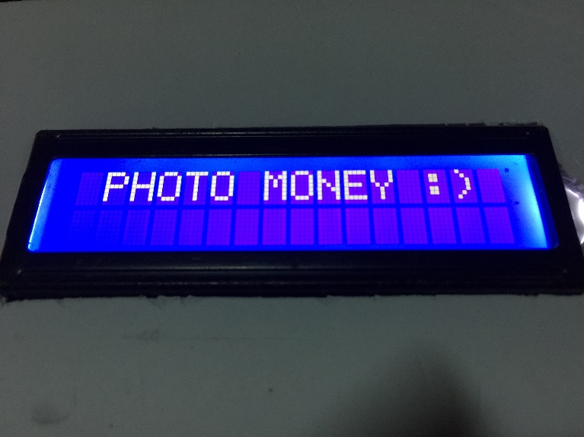

Slide 5
TOOLS AND SETUP
HARDWARE
Raspberry Pi 3B+
Camera Pi 5MP
LCD 16x02 (I2C support)
Accessories (Carton, button , wires,…)
Software
OpenCV 3.4.3
Python3
Sift/Suft library
Numpy,Time,…
Raspberry library (GPIO,I2C,Camera,..)

Slide 6
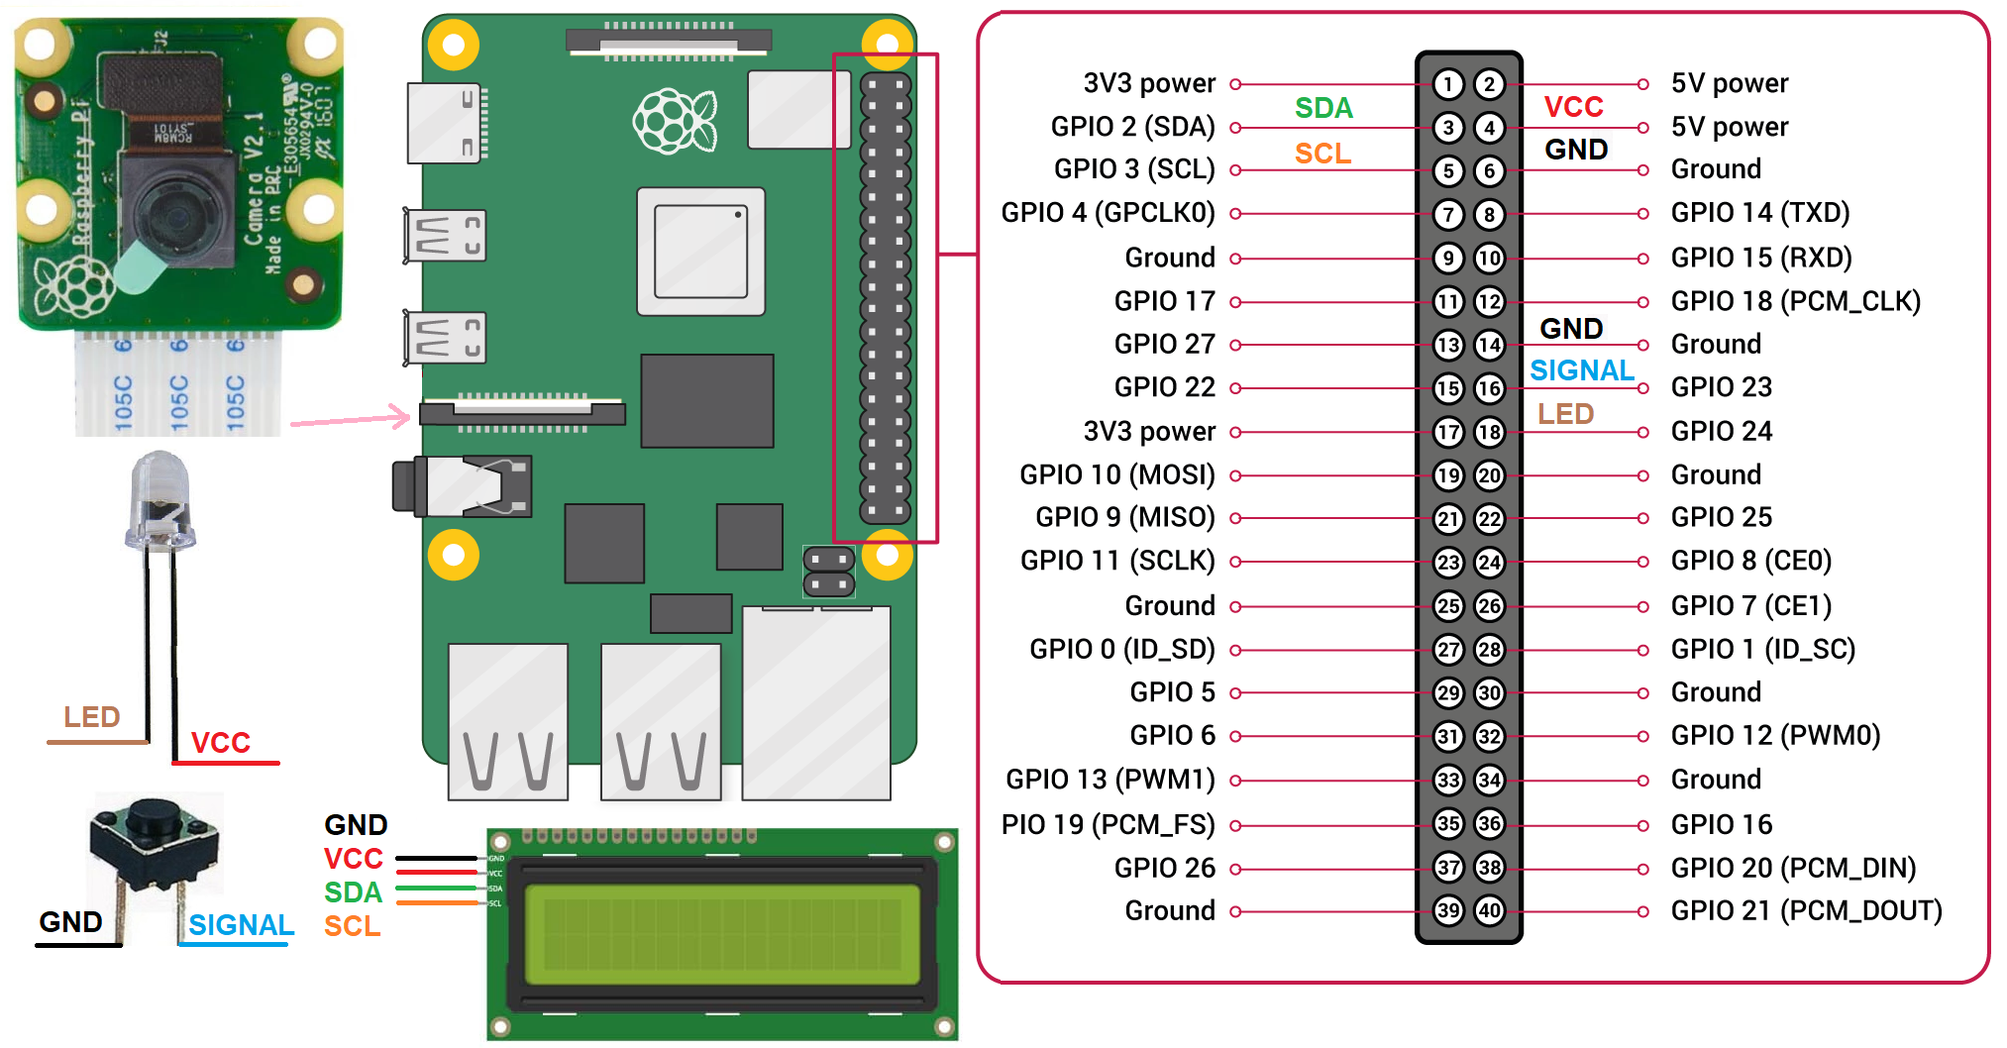
CONNECTION DIAGRAM

Slide 7
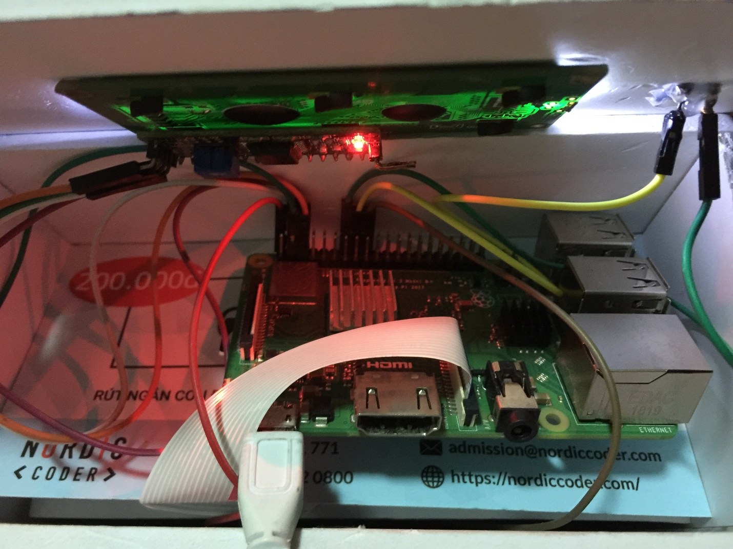
Notes:
https://www.raspberrypi.org/products/raspberry-pi-3-model-b-plus/

Slide 8
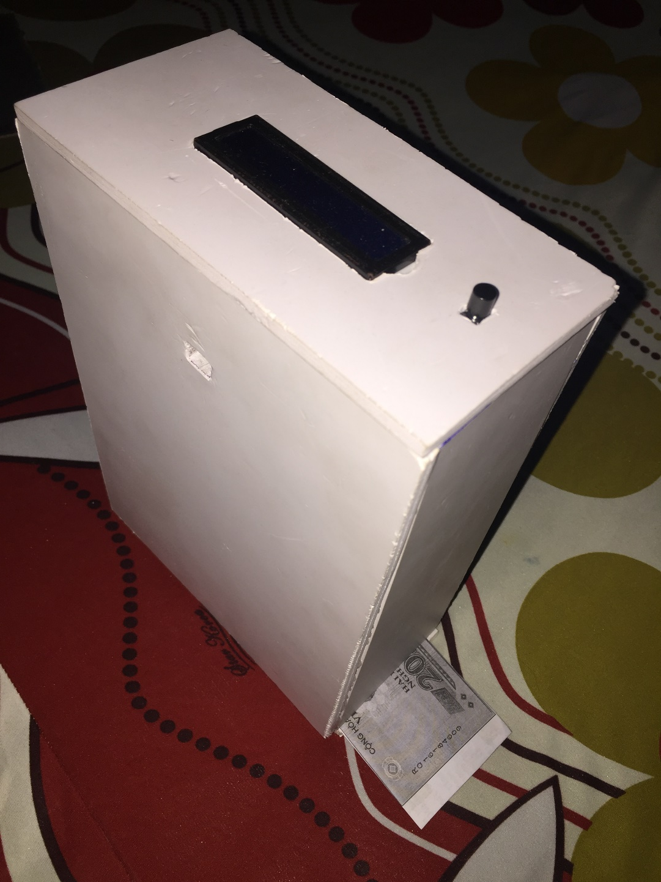

Slide 9
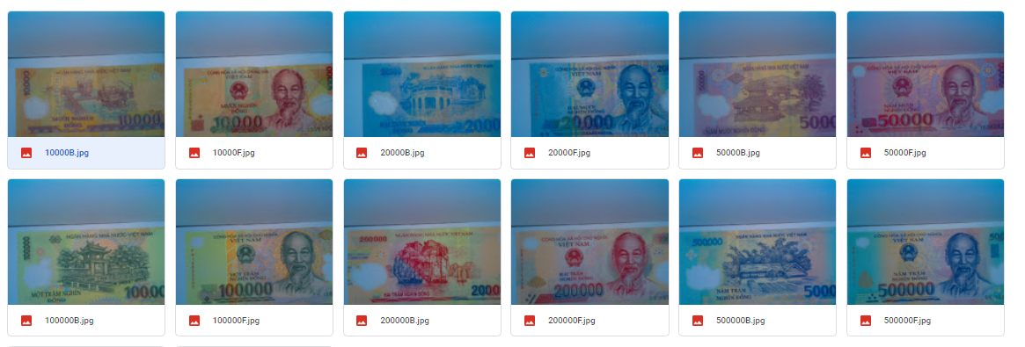
DATASET

Slide 10
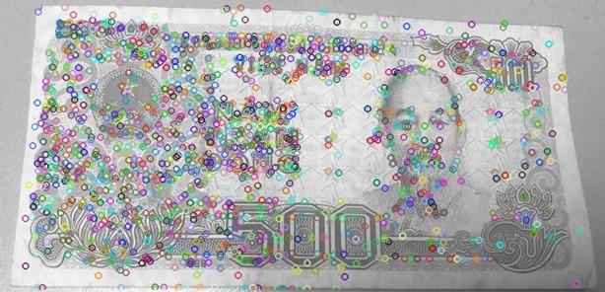



SIFT
SURF

Slide 11
SIFT
SURF
Both are copyright
4 step (use gaussion) | 2 step (use a box filter)
Hight cost | Low cost
Give lest keypoints (in most case) | Give more keypoints (in most case)
Less accuracy | More accuracy *
* Check by match function to get match keypoints between dataset and online data.
Notes:
https://medium.com/@shehan.a.perera/a-comparison-of-sift-surf-and-orb-333d64bcaaea
https://pdfs.semanticscholar.org/5405/981f5ed9b16f1440476699793f09d874d123.pdf

Slide 12
COMPARISION TIME TO RECOGNIZE AND GET FEATURE

Slide 13
Thanks for watching and listening!

