Slide 1

THE 6TH INTERNATIONAL CONFERENCE ON FUTURE DATA AND SECURITY ENGINEERING 2019
FDSE 2019 (LNCS 11814 - SPRINGER VERLAG)
Telecommunications University, Nha Trang City, Vietnam, November 27 to 29, 2019

Slide 2

Evaluating Session-Based Recommendation Approaches on Datasets from Different Domains FDSE 2019. Lecture Notes in Computer Science, vol 11814. pp 577-592 Authors: Tran Khanh Dang, Quang Phu Nguyen, Van Sinh Nguyen
Presenter: Quang Phu Nguyen

Slide 3

CONTENTS
Introduction
Features of The Evaluated Methods
Experiment
Results
Conclusion & Future Work

Slide 4
Introduction
Session-based recommendation is a recently proposed approach for recommender system to overcome the user profiles dependency.
In practice, solution was converted to item-to-item recommendation with the item of the user's last event while the rest of the session is ignored.
Heavily non-personalized (all users get same items on a given item page) and less accurate, since it does not consider earlier events from the session.
Deep learning revitalized session-based recommendations by applying Recurrent Neural Networks (RNNs) for session data.

Slide 5
Introduction
Perform a comparison between a number of comparably simple approaches and a more sophisticated algorithm called GRU4rec on datasets from various domains.
There are still some case of datasets that the simpler method gets better accuracy.
However, our method suggests that there is still room for improving deep learning session-based recommendation algorithm.

Slide 6
Features of The Evaluated Methods
Baseline Approaches
POP
Popularity predictor that always recommends the most popular items of the training set.
Despite its simplicity it is often a strong baseline in certain domains.
S-POP
Recommends the most popular items of the current session
Recommendation list changes during the session as items gain more events
Ties are broken up using global popularity values
Strong in domains with high repetitiveness

Slide 7
Features of The Evaluated Methods
Baseline Approaches
Item-KNN
Items similar to the actual item are recommended
“Others who viewed this item also viewed these ones”
Bayesian Personalized Ranking (BPR-MF)
One of the commonly used matrix factorization methods
Optimizes for a pairwise ranking objective function via SGD
Average the similarities of the feature vectors between a recommendable item and the items of the session so far

Slide 8
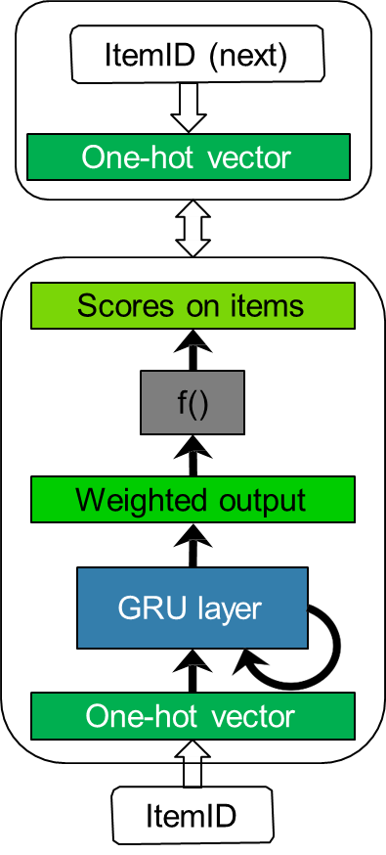
Features of The Evaluated Methods
Gated Recurrent Unit Neural Networks Model – GRU4REC
The GRU4Rec algorithm [1] is a GRU based network adapted to the recommendation domain.
Sessions here are represented as sequences of item IDs.
Items IDs are represented by one-hot vectors.
The network architecture consists of one or more GRU layers followed by a feed-forward layer that predicts the likelihood of each item to be the next in the session.

Slide 9
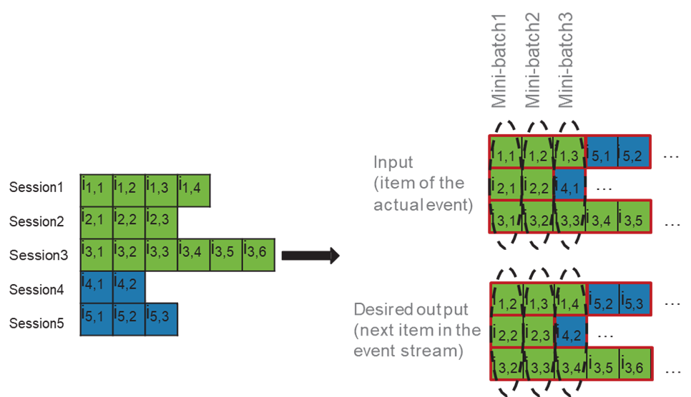
Features of The Evaluated Methods
Session-Parallel Mini-Batches
Create an order for the sessions.
First event of the first X sessions to form the input of the first mini-batch
The desired output is the second events of the active sessions.
The second mini-batch is formed from the second events and so on.
If any of the sessions end, the next available session is put in its place.

Slide 10
Features of The Evaluated Methods
Mini-Batch Based Negative Output Sampling
Motivation
Number of items is high → bottleneck
Model needs to be trained frequently (should be quick)
Sampling negative items
Popularity based sampling
Missing event on popular item → more likely sign of negative feedback
Pop items often get large scores → faster learning

Slide 11
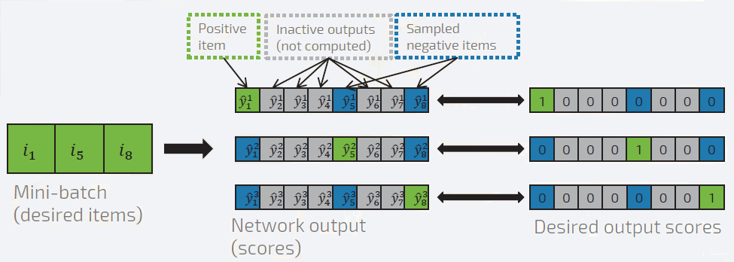
Features of The Evaluated Methods
Mini-Batch Based Negative Output Sampling
Negative items for an example: examples of other sessions in the minibatch
Technical benefits
Follows data distribution (pop sampling)

Slide 12
Features of The Evaluated Methods
Ranking Loss Function
Motivation
Goal of recommender: ranking
Pairwise and pointwise ranking (listwise costly)
Pairwise often better
Pairwise loss function
Positive items compared to negatives
Unexpected behavior
Several negative samples → good results
Many negative samples → bad results

Slide 13
Features of The Evaluated Methods
Ranking Loss Function
Irrelevant negative sample
Doesn’t contribute to optimization
Number of irrelevant samples increases as training progresses
Averaging with many negative samples → gradient vanishes
Target will be pushed up for a while
Slows down as approaches the top
More samples: slows down earlier
The target score should be higher than the maximum score amongst the negative samples → BPR-max

Slide 14
Features of The Evaluated Methods
Extra Negative Samples
Motivation
Number of samples is tied to the batch size
Sampling probability is always the same
Add extra samples
Shared between mini-batches
Implementation trick
Sampling interrupts GPU computations
More efficient in parallelization capabilities of the GPU
Sample store (cache)
Pre-compute 10-100M samples

Slide 15
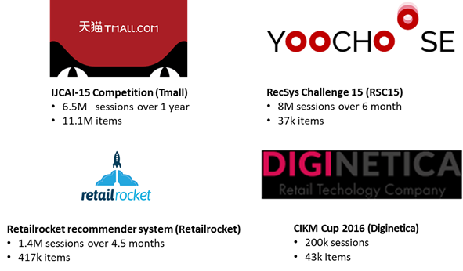
Experiment
Datasets for evaluation
E-Commerce

Slide 16
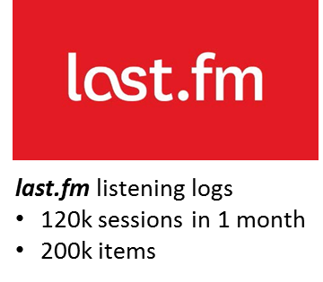

Experiment
Datasets for evaluation
• Music • News

Slide 17
Experiment
Evaluation Metrics
Recall
A wide-use measurement applied in top-N recommendation
Obtains the long-term predictions proficiency of an algorithm
Measures how many of the relevant items actually made it into the top-N list
$$Recall@20= \frac{number of top 20 recommended items that are relevant}{total of relevant items}$$

Slide 18
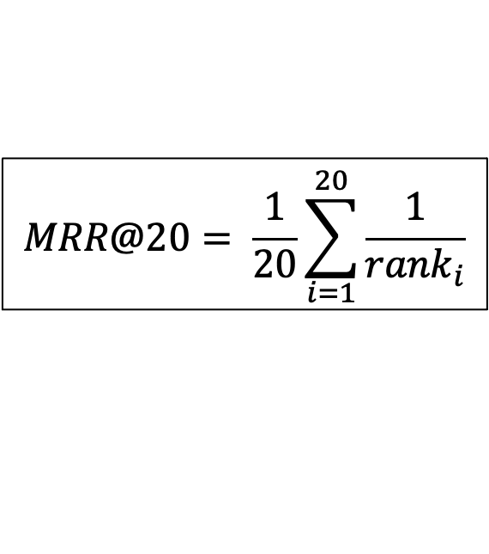
Experiment
Evaluation Metrics
Mean reciprocal rank
A statistic measure for evaluating any process that produces a list of possible responses
Multiplicative inverse of the rank of the first correct answer
Consider the position of the relevant elements
$$MRR@20= \frac{1}{20}\sum_{i=1}^{20}{\frac{1}{{rank}_{i}}}$$

Slide 19
Results
E-commerce Datasets
Dataset | YOOCHOOSE |  | RETAIL_ROCKET |  | DIGINETICA |  | TMALL
Metric | R@20 | MRR@20 | R@20 | MRR@20 | R@20 | MRR@20 | R@20 | MRR@20
POP | 0.005 | 0.001 | 0.016 | 0.003 | 0.010 | 0.003 | 0.066 | 0.038
S-POP | 0.267 | 0.176 | 0.363 | 0.288 | 0.232 | 0.125 | 0.448 | 0.265
Item-KNN | 0.498 | 0.201 | 0.282 | 0.122 | 0.376 | 0.118 | 0.074 | 0.025
BPR-MF | 0.035 | 0.012 | 0.267 | 0.127 | 0.093 | 0.040 | 0.166 | 0.090
GRU4rec | 0.718 | 0.314 | 0.541 | 0.258 | 0.477 | 0.142 | 0.230 | 0.129

Slide 20
Results
Music Dataset
Dataset | LAST.FM
Metric | R@20 | MRR@20
POP | 0.006 | 0.002
S-POP | 0.187 | 0.082
Item-KNN | 0.374 | 0.156
BPR-MF | 0.044 | 0.011
GRU4rec | 0.402 | 0.272

Slide 21
Results
News Dataset
Dataset | CLEF
Metric | R@20 | MRR@20
POP | 0.025 | 0.025
S-POP | 0.120 | 0.070
Item-KNN | 0.717 | 0.260
BPR-MF | 0.000 | 0.000
GRU4rec | 0.902 | 0.393

Slide 22
Results
Improving Tmal dataset result
Due to the fact that the large number of items in TMALL dataset led to prohibitively high computational costs for the GRU4rec method.
A large number of items have only few interactions.
The items were sorted by popularity and a minimum item popularity threshold was set to keep only the items above the threshold accounted for 1% of the entire dataset.

Slide 23
Results
Improving Tmal dataset result
Improved Result:

Slide 24
Results
Improving Tmal dataset result
Improved Result:

Slide 25
Results
Examine Discovered Method
Applying the same proposed sampling and preprocessing method on another dataset which has same aforementioned characteristics with TMALL named IJCAI16 from IJCAI-2016 Competitions which contains 2.3 million items.

Slide 26
Results
Examine Discovered Method
Result:

Slide 27
Results
Examine Discovered Method
Result:

Slide 28
The experimental analysis on various domains datasets shows that in case of numerous unpopular items dataset, simpler method can be more effective than the most recent method based on recurrent neural networks when it comes to accuracy of prediction.
GRU4rec’s performance is significantly increased after applying our proposed sampling method. Our results therefore suggest that there is still room for improving deep learning session-based recommendation algorithm.
Conclusion & Future Work

Slide 29
For future work, we will create a deeper investigation on some datasets which have same characteristics with TMALL since the issue on this kind of dataset is common in real world e-commerce system. We hope that we can explore a compromise approach to overcome this issue on our next investigation.
Conclusion & Future Work

Slide 30
Thank you!
Any questions?

