Slide 1


Danang University of Science and Technology
Faculty of Information Technology
Graduation project thesis defense
Text Classification using Long - Short Term Memory and Convolutional Neural Network
by
Ho Quang Phuoc
Instructor: PhD. Dang Hoai Phuong
Danang, 03.2022

Slide 2
Table of content
Introduction
Text representation
Convolutional Neural Network
Long – Short Term Memory
Implementation
Results and evaluation
Summary

Slide 3
1. Introduction
Text Classification
- Text classification is important:
+ Majority of data (80% to 90%) is unstructured information [1], with text being one of the most common types of unstructured data.
+ It’s a huge untapped resource with the potential to create competitive advantage for companies.
- Deep learning has made significant progress in the fields of computer vision and speech recognition [2], [3], but it is still advancing in natural language processing.
-> Text classifiers can automatically structure all manner of relevant text in a fast and cost-effective way.
Notes:
Text classification is important:
+ Majority of data (80% to 90%, according to multiple analyst estimates) is unstructured information [1], with text being one of the most common types of unstructured data.
+ It’s a huge untapped resource with the potential to create competitive advantage for companies that figure out how to use it
- Deep learning has made significant progress in the fields of computer vision and speech recognition [2], [3], but it is still advancing in natural language processing.
-> Text classifiers can automatically structure all manner of relevant text, from emails, legal documents, social media, chatbots, surveys, and more in a fast and cost-effective way.

Slide 4
1. Introduction
Objective
- Do a research about Long - Short Term Memory (LSTM) and Convolutional Neural Network (CNN).
- Combinations can be divided into three types:
input
CNN
LSTM
classification
output
input
LSTM
CNN
classification
output
LSTM
input
concatenate
classification
output
CNN

Slide 5
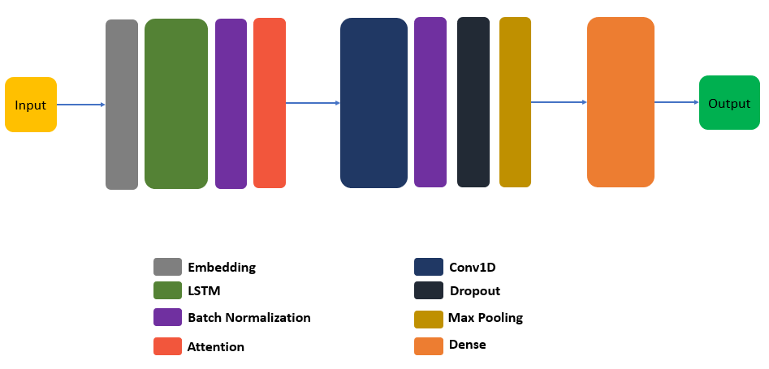
1. Introduction
Proposed model
The architecture of proposed model

Slide 6
2. Text representation
- Converting words into numbers for machines to understand
-> This step plays a significant role for the machine learning model.
Text representation can be classified into two types [4]:
One-hot encoding
Discrete
Bag-of-words
Text representation
Word2vec
Distributed/Continuous
GloVe

Slide 7
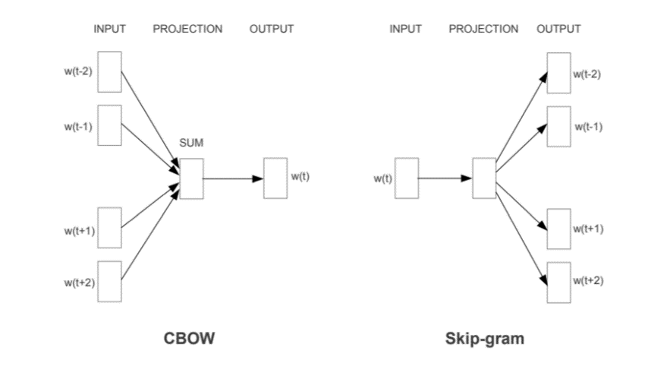
2. Text representation
Word2vec
The vector representation is created by Word2vec using 2 techniques: CBOW and Skip-gram.
Sentence:
w(t-3) | w(t-2) | w(t-1) | w(t) | w(t+1) | w(t+2) | w(t+3)

Slide 8
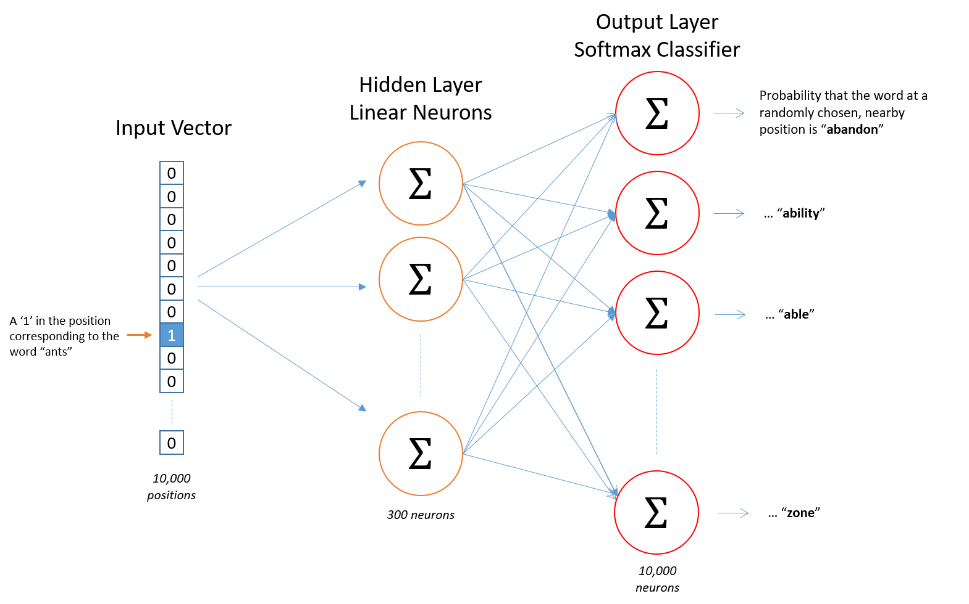
2. Text representation
Skip-gram model [5]

Slide 9
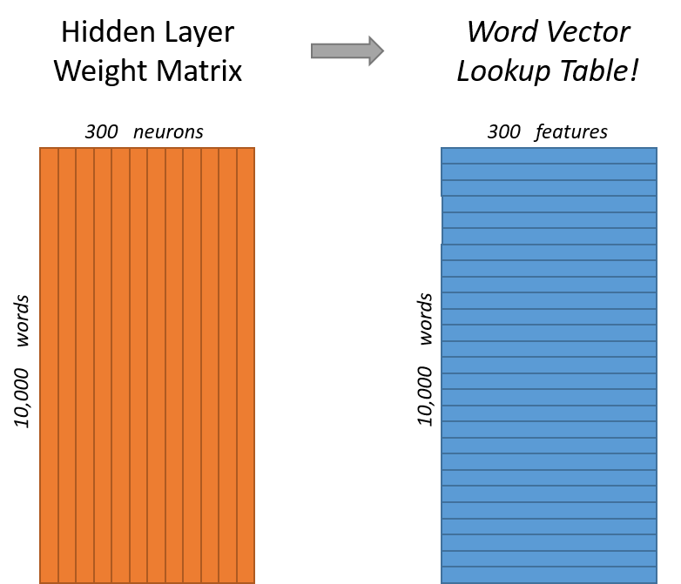
2. Text representation
I utilized pre-trained vectors that were trained on a portion of the Google News dataset (about 100 billion words) for my project. For 3 million words and phrases, the model has 300-dimensional vectors [6].
Notes:
The word embeddings are the weights of the hidden layer, which is a conventional fully linked layer.

Slide 10
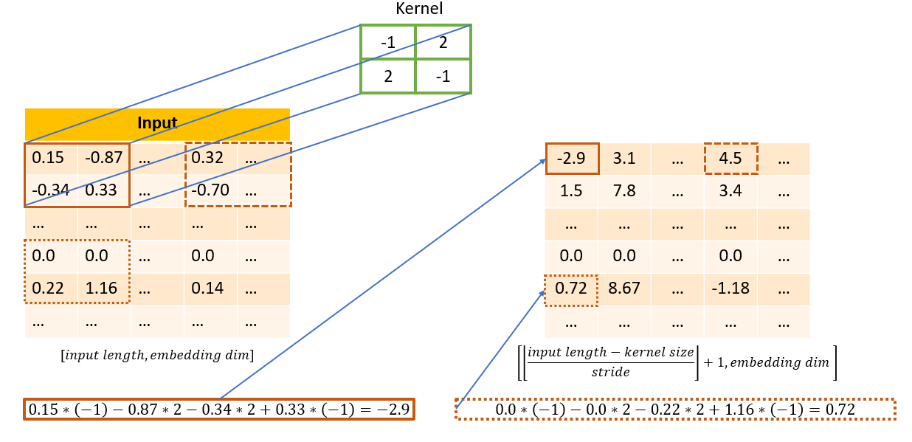
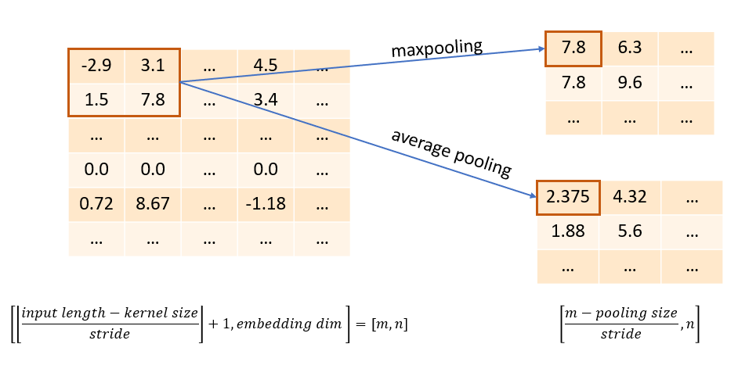
3. Convolutional Neural Network
The greatest advantage of CNNs is that they reduce the number of parameters in Artificial Neural Networks (ANN).
- Kernel: a filter that extracts features from the input data.
- Stride: the number of pixels the kernel travels over the input matrix.
- Pooling: reduces dimensionality by reducing the number of parameters in the input.

Slide 11
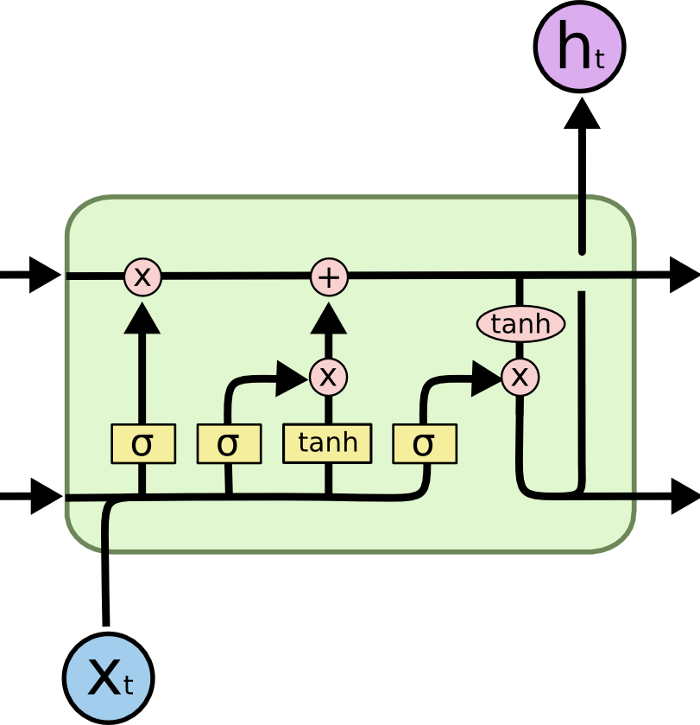
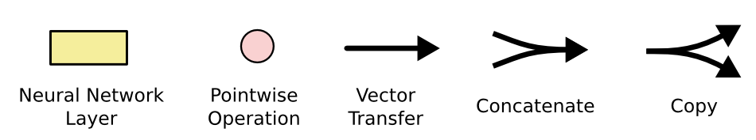
4. Long – Short Term Memory
Xt: the input at timestamp t
Ht: the hidden state
LSTM cell [8]

Slide 12
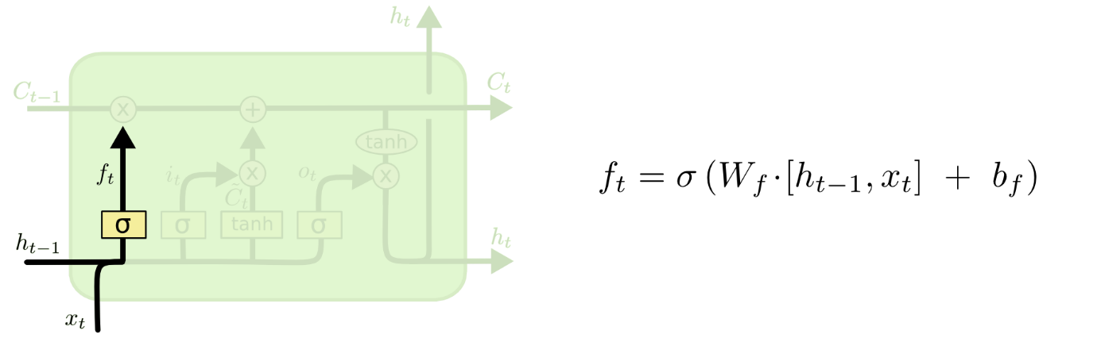
4. Long – Short Term Memory
Forget gate
The forget gate layer determines what information is discarded from the cell state.
1 indicates that the information is kept totally.
0 indicates that the information is completely removed.
Forget gate [8]
Notes:
Using a sigmoid layer, the forget gate layer determines what information is discarded from the cell state.
It examines $h_{t−1}$ and $x_{t}$ and returns a number between 0 and 1 for each number in the cell state $C_{t−1}$.
A 1 indicates that the information should be kept totally, whereas a 0 indicates that is should be completely removed.

Slide 13
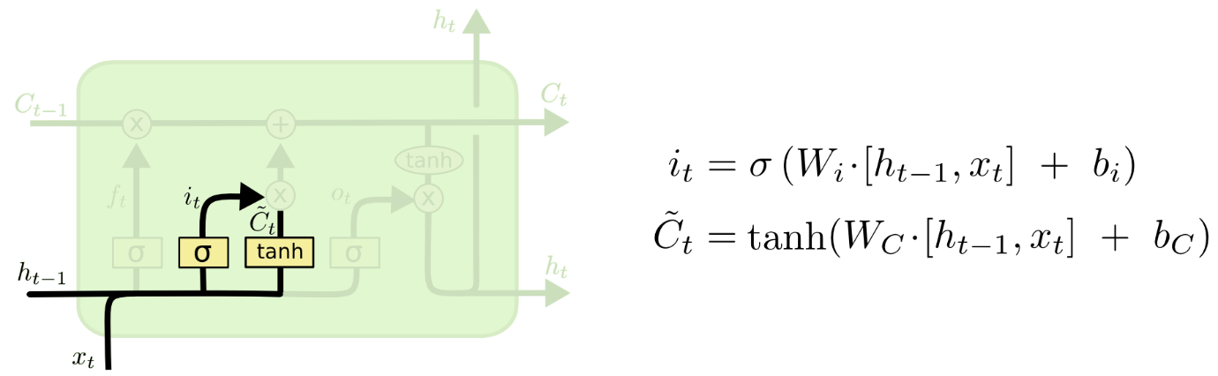
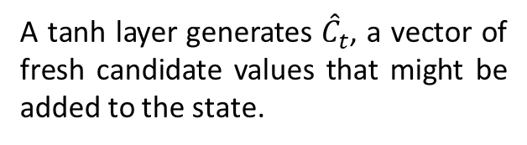
4. Long – Short Term Memory
Input gate
There are 2 components:
A sigmoid layer chooses which values will be updated.
A tanh layer generates ${\hat{C}}_{t}$, a vector of fresh candidate values that might be added to the state.
Input gate [8]
These 2 values are then concatenated.
Notes:
In the next step is to assess new information to see if it can be stored in the cell state.
There are two components to this. The input gate layer, a sigmoid layer, chooses which values will be updated.
After that, a tanh layer generates ${\hat{C}}_{t}$, a vector of fresh candidate values that might be added to the state.
These two values are then concatenated in the following step to form a state update.

Slide 14
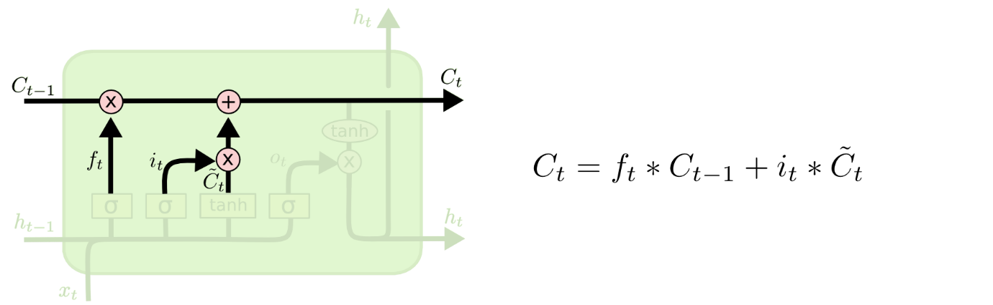
4. Long – Short Term Memory
Cell state
This step will simply process the values that have been previously computed.
Cell state [8]
Notes:
The previous cell state, $C_{t−1}$, is replaced with the new cell state $C_{t}$.
Because the preceding phases have already chosen what to do, this step will simply process the values.
The former state is multiplied by $f_{t}$ in order to forget the items that were previously determined to be forgotten.
Then use $i_{t}∗{\hat{C}}_{t}$ to combine it. This is the new set of candidate values, scaled by how much each state value was updated.

Slide 15
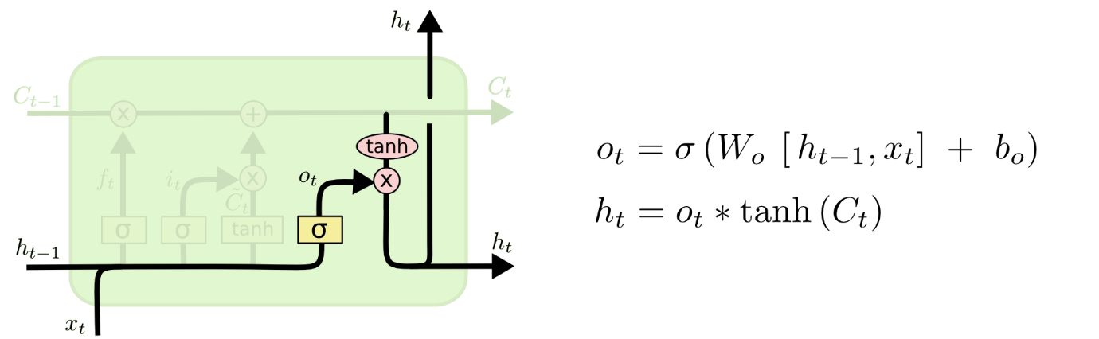
4. Long – Short Term Memory
Output gate
A sigmoid layer is first utilized to determine which elements of the cell state are output.
The cell state is then placed via tanh function, and then multiplied by the output of the sigmoid layer.
Output gate [8]
Notes:
The output gate is where the process ends.
This output will be filtered and will be dependent on the cell status. A sigmoid layer is first utilized to determine which elements of the cell state are output.
The cell state is then placed via $tanh$ activation to push the values between -1 and 1, and then multiplied by the output of the sigmoid gate, ensuring that only the sections we choose to output are output.

Slide 16
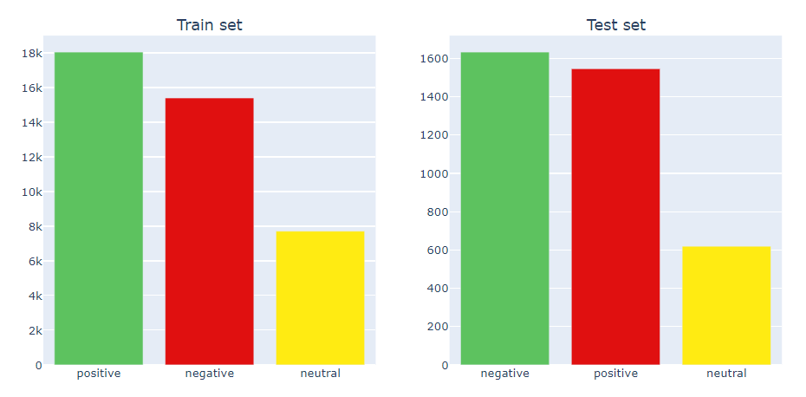
5. Implementation
Data set’s information
Training set shape | (41157, 6)
Training set memory usage | 1.88 MB
Test set shape | (3798, 6)
Test set memory | 0.17 MB
Class distribution on the whole dataset (train+test)
Sentiment | Number of tweets | Proportion
Negative | 17031 | 38%
Neutral | 8332 | 18%
Positive | 19592 | 44%

Slide 17
5. Implementation
Preprocessing data
Preprocessing
1. Clean emojis
2. Remove punctuations, links, mentions
3. Clean hashtags
4. Filter special characters (&, $,…)
5. Remove multiple spaces
6. Check misspelling words
7. Balance class using RandomOverSampler
90% for training
Data set
Clean data
Training data set
10% for validation

Slide 18


5. Implementation
The layer structure of proposed model
LSTM-CNN
LSTM (128 neurons, activation=’relu’)
Dropout(0.2)
Conv1D (5x5, @64), activation=”relu”
Global max pooling
Softmax (3-class)
Library support: Tensorflow
Train on Google Colab

Slide 19
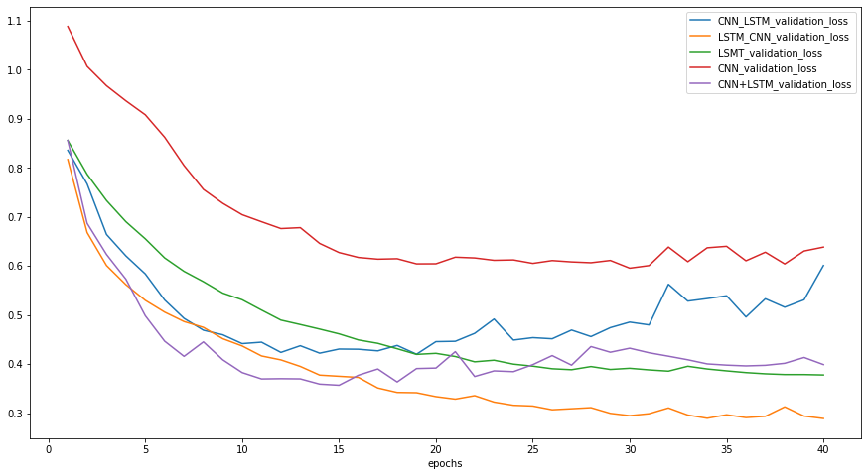
6. Results and evaluation
A comparison of five models' validation loss

Slide 20
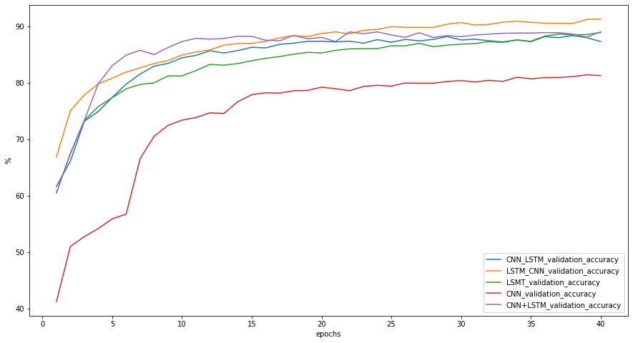
6. Results and evaluation
A comparison of five models' validation accuracy

Slide 21




6. Results and evaluation
I employ accuracy (A), precision (P), recall (R), and F1-score (F) as assessment measures to compare and evaluate models.
$$A=\frac{Number of correct predictions}{Total predictions}$$
$$P=\frac{True Positive}{True Positive+False Positive}$$
$$R=\frac{True Positive}{True Positive+False Negative}$$
$$F1=2∗\frac{Precision∗Recall}{Precision+Recall}$$

Slide 22
6. Results and evaluation

Slide 23
6. Results and evaluation

Slide 24
7. Summary
- This work evaluates and summarizes predecessors' theoretical and practical experience and presents a text categorization approach based on the LSTM-CNN hybrid model.
- The suggested approach produces much better performance.
- It may differ from reality. Multiple data sets will be gathered for experimentation in the future, bringing the study closer to its intended use.
Notes:
Through an experimental comparison analysis, this work evaluates and summarizes predecessors' theoretical and practical experience, and presents a text categorization approach based on the LSTM-CNN hybrid model. When compared to employing simply the CNN or LSTM model, the suggested approach produces much better results and reduces the number of parameters in the LSTM model. In comparison to the CNN-LSTM and CNN+LSTM models, the accuracy and F score of the LSTM-CNN model is somewhat enhanced, despite the suggested model having less parameters.
Because the data set utilized in the experiment is somewhat small, and cleaning data is difficult to achieve 100% accuracy, it may differ from reality. Multiple data sets will be gathered for experimentation in the future, bringing the study closer to its intended use. Simultaneously, continue to research the use of deep learning and other technologies in the field of text categorization.

Slide 25
References
[1] Tam Harbert, “Tapping the power of unstructured data”, MIT Management Sloan School. [Online]. Available: https://mitsloan.mit.edu/ideas-made-to-matter/tapping-power-unstructured-data#:~:text=In%20fact%2C%20a%20majority%20of,out%20how%20to%20use%20it. [Accessed: February 12, 2022].
[2] A. Schmidt and M. Wiegand, ‘‘A survey on hate speech detection using natural language processing,’’ in Proc. 5th Int. Workshop Natural Lang. Process. Social Media, 2017, pp. 1-10.
[3] X. Xue-Feng and Z. Guo-Dong, ‘‘A survey on deep learning for natural language processing,’’ Acta Autom. Sinica, vol. 42, no. 10, pp. 1445–1465, 2016.
[4] Sundaresh Chandran, “Introduction to Text Representations for Language Processing – Part 2”, Towards Data Science. [Online]. Available: https://towardsdatascience.com/introduction-to-text-representations-for-language-processing-part-2-54fe6907868. [Accessed: November 11, 2021].
[5] Julian Gilyadov, “Word2Vec Explained”, Hacker’s Blog. [Online]. Available: https://israelg99.github.io/2017-03-23-Word2Vec-Explained/. [Accessed: November 10, 2021].
[6] Google, “word2vec”. [Online]. Available: https://code.google.com/archive/p/word2vec/. [Accessed: November 25, 2021].
[8] Christopher Olah, “Understanding LSTM Networks”, Colah’s blog. [Online]. Available: https://colah.github.io/posts/2015-08-Understanding-LSTMs/. [Accessed: December 13, 2021].

Slide 26
Thank you!

