Slide 1
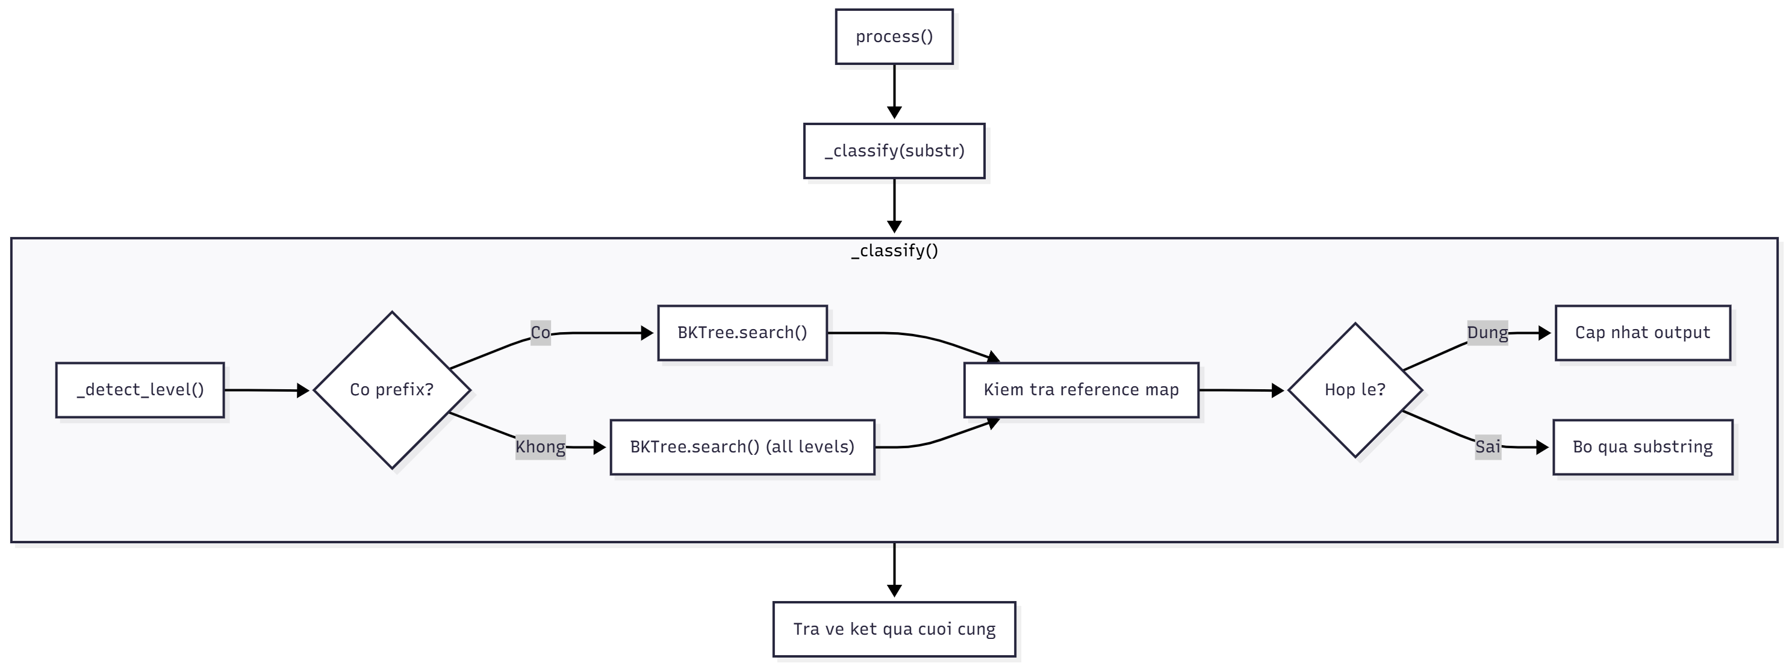
A.Phuoc
FLOWCHART
Notes:
Think about the questions listed above and answer them.
Can you think of anything else in regards to economy and trade that you would like to add?

Slide 2
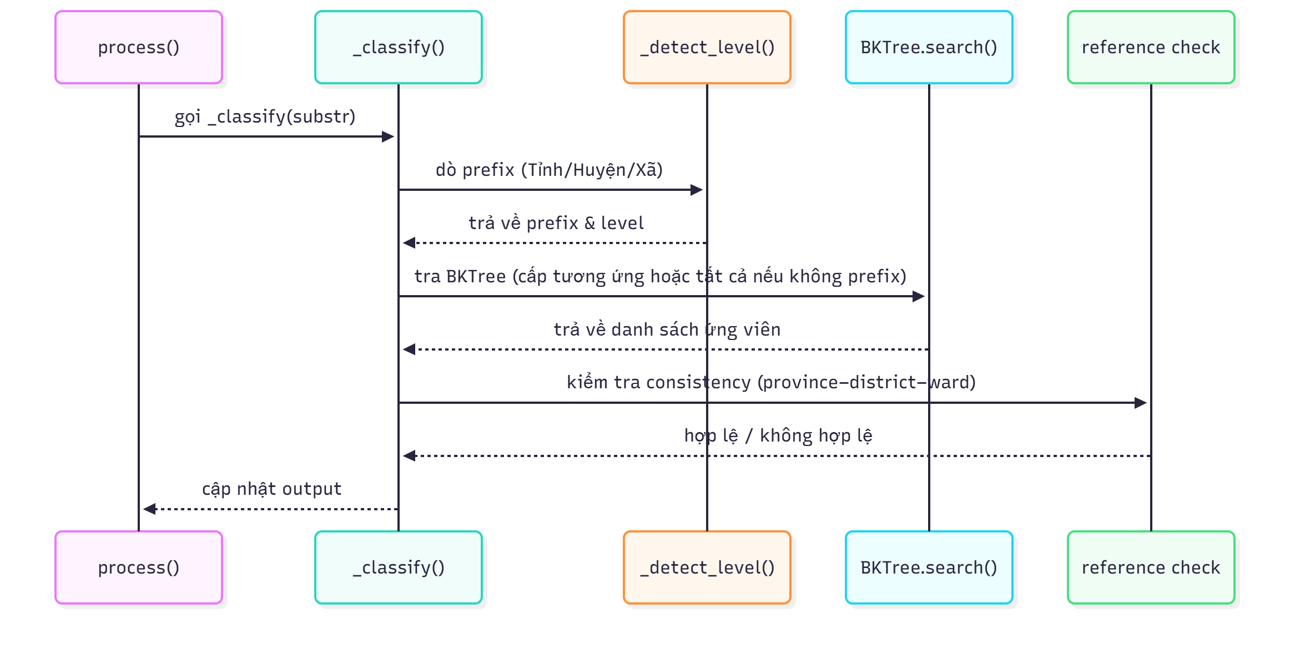
A.Phuoc
SEQUENCE DIAGRAM
Notes:
Think about the questions listed above and answer them.
Can you think of anything else in regards to economy and trade that you would like to add?

Slide 3
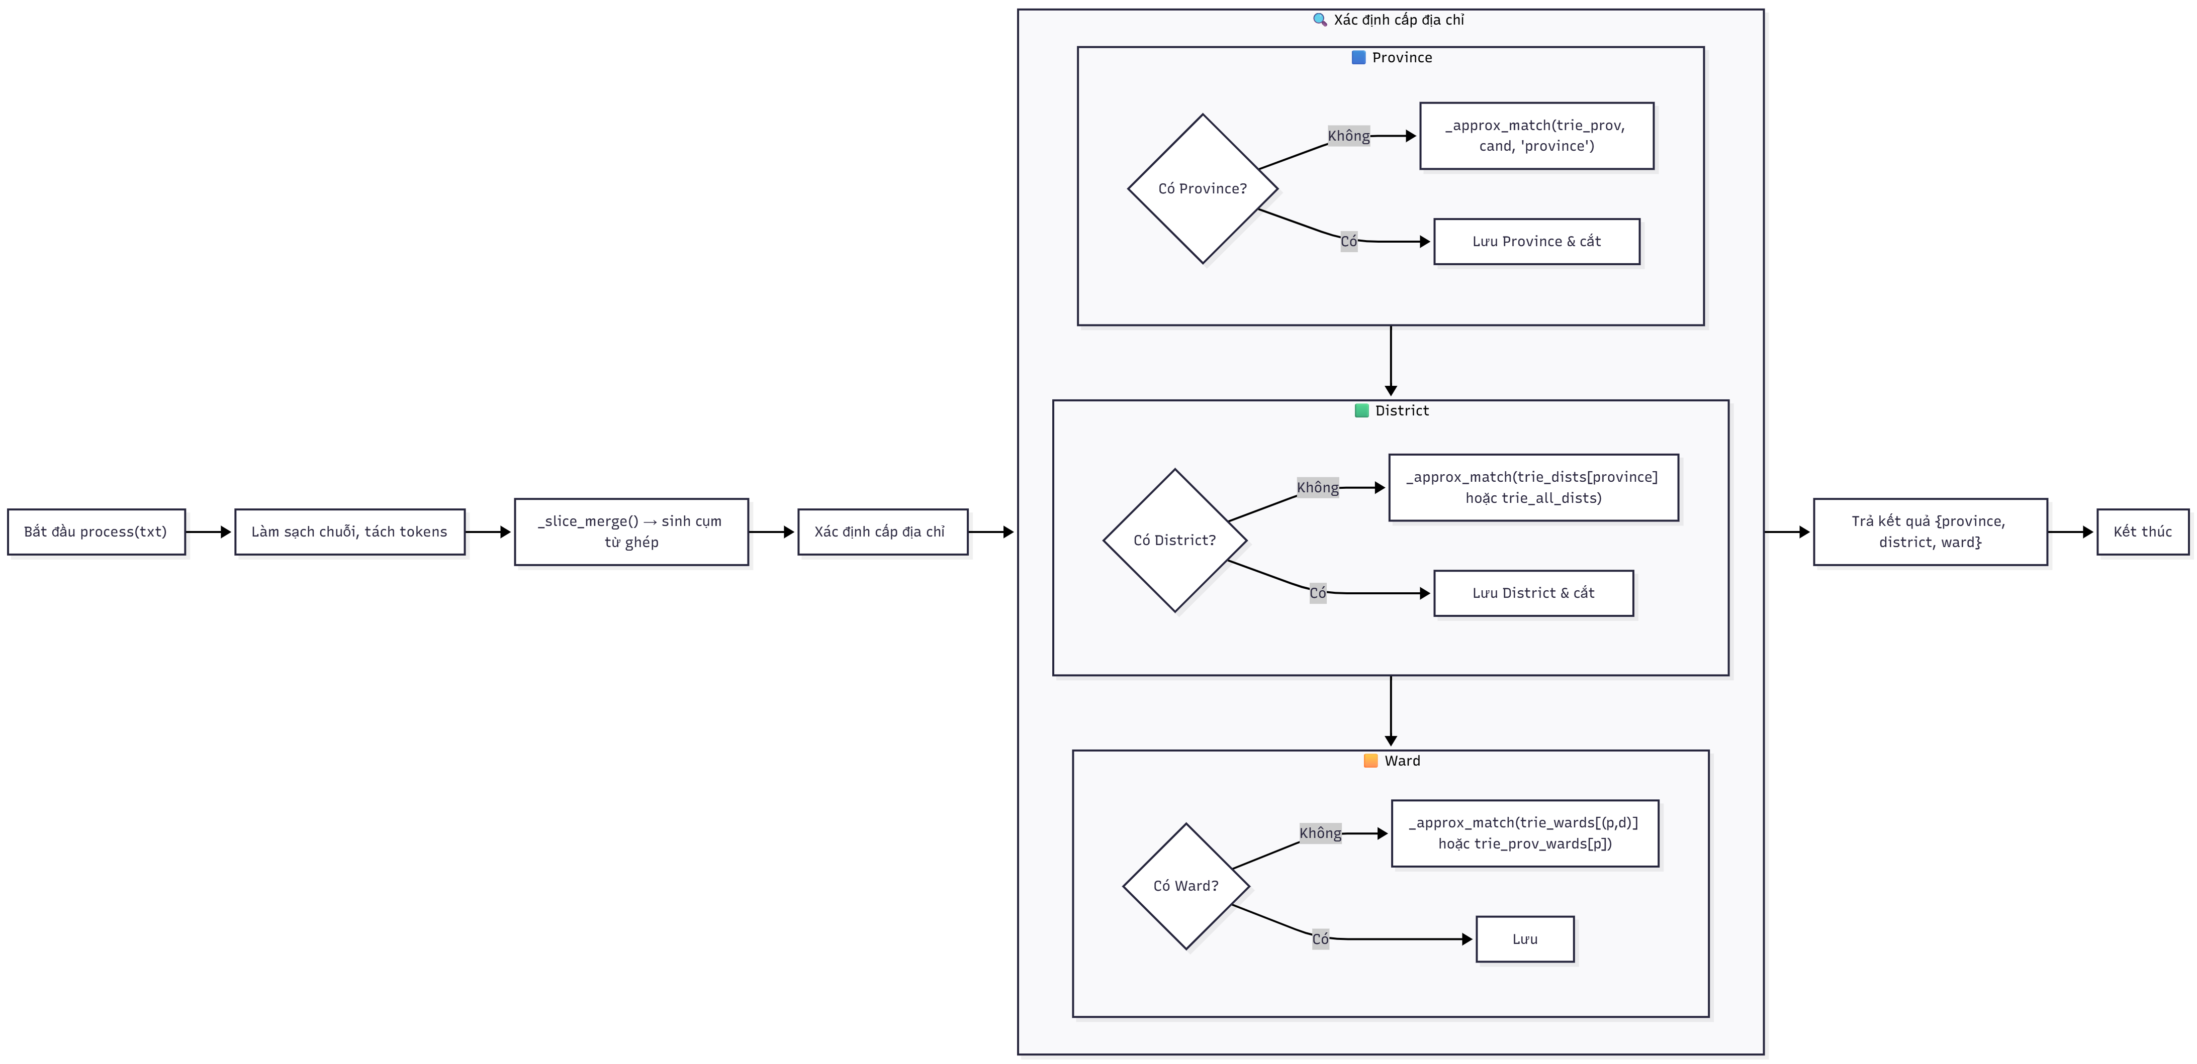
C.Thuong
FLOWCHART
Notes:
Think about the questions listed above and answer them.
Can you think of anything else in regards to economy and trade that you would like to add?

Slide 4
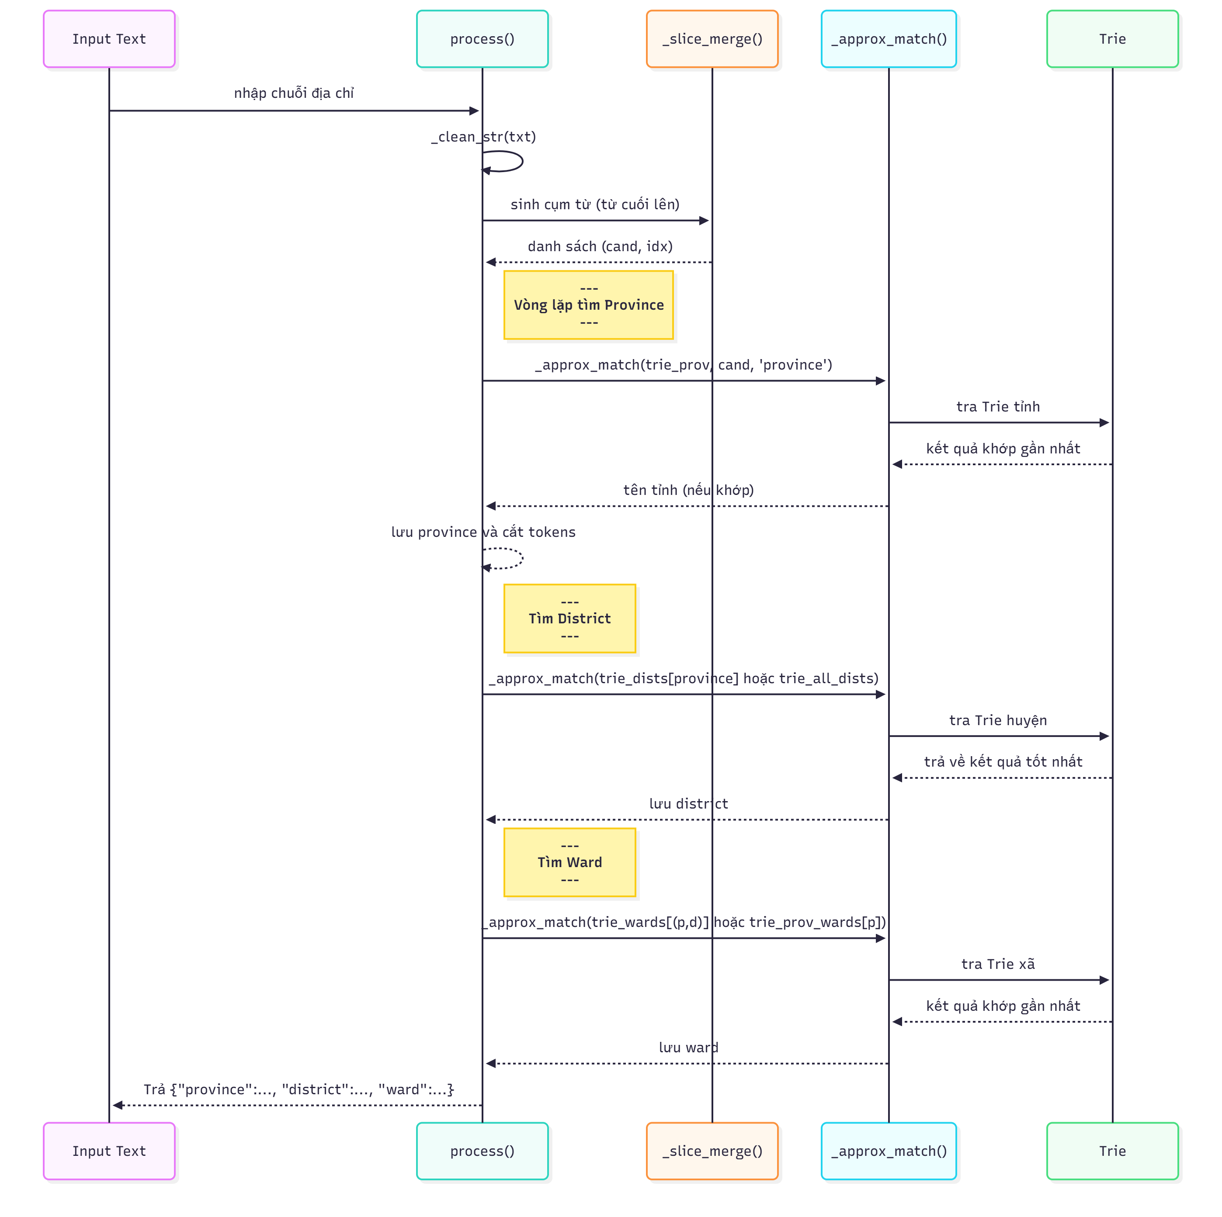
C.Thuong
SEQUENCE DIAGRAM
Notes:
Think about the questions listed above and answer them.
Can you think of anything else in regards to economy and trade that you would like to add?

Slide 5
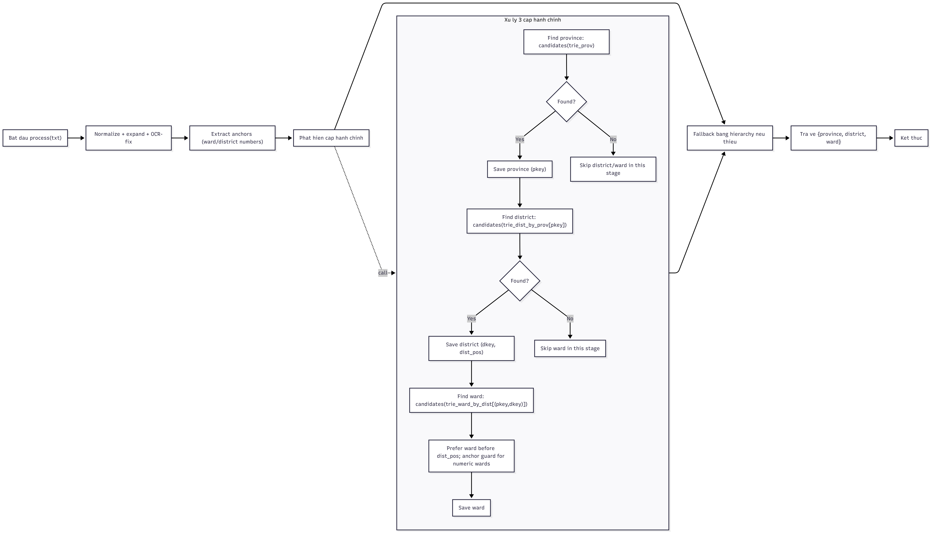
Mine
SEQUENCE DIAGRAM
FLOWCHART
Notes:
Think about the questions listed above and answer them.
Can you think of anything else in regards to economy and trade that you would like to add?

Slide 6
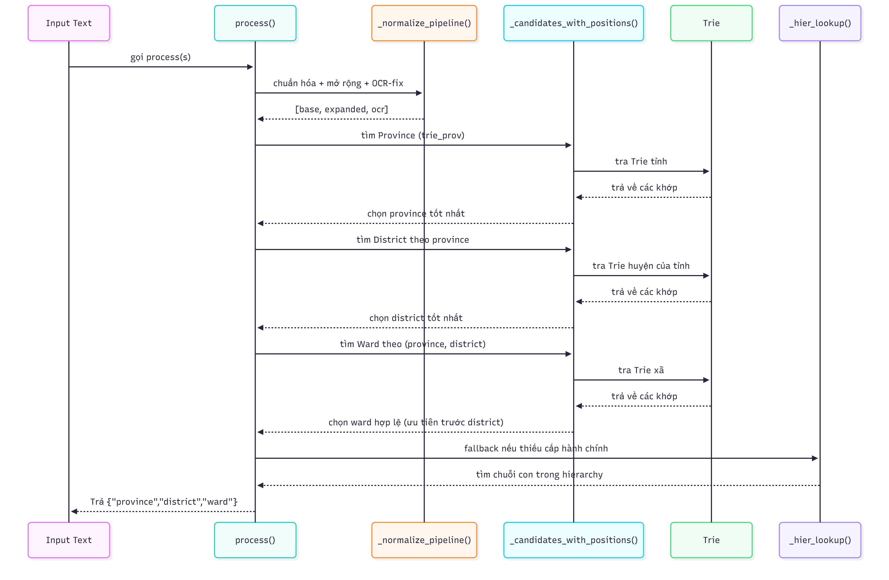
Mine
SEQUENCE DIAGRAM
Notes:
Think about the questions listed above and answer them.
Can you think of anything else in regards to economy and trade that you would like to add?

