Slide 1

THE UNIVERSITY OF DANANG
DANANG UNIVERSITY OF SCIENCE AND TECHNOLOGY
FACULTY OF INFORMATION TECHNOLOGY
PROJECT TITLE :
BUILDING A FANPAGE-STYLED APPLICATION FOR FOOD AND BEVERAGE PROVIDERS
Instructor : Ph.D HUYNH HUU HUNG
Student : Nguyen Phuoc Hung
Student ID : 102140210
Class : 14TCLC2

Slide 2
agenda
Introduction
Project Overview
Technologies
Implementation
Conclusion
Demonstration

Slide 3


Introduction
I think I should sell products on the facebook
Where is this idea from?
Over 2.27 billion monthly active users at the third quarter of 2018
About 4.5 million businesses use facebook pages
Service Providers

Slide 4
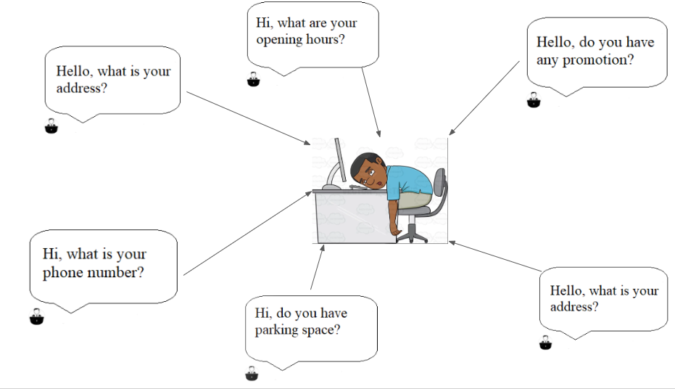


Introduction
So boring
Service Providers

Slide 5
Introduction
My application will resolve some issues:
- Replace a staff to respond to users’ input.
- Users can request a delivery easily.
- Avoid a boring job.

Slide 6
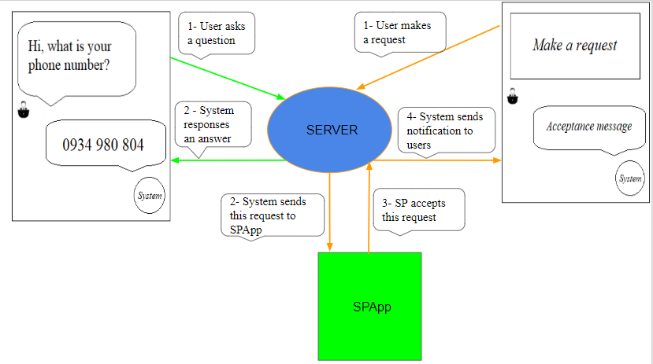
Project overview
Fanpage inbox
Fanpage inbox

Slide 7
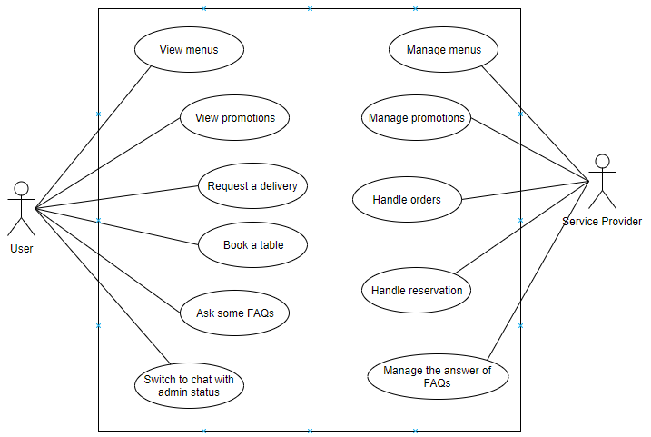
Project overview
Notes:
illustrative images

Slide 8
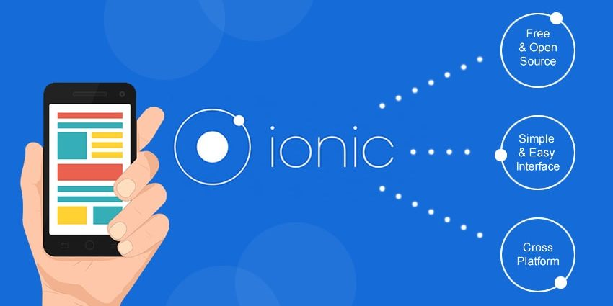


Technologies
Ionic framework
Node Js
MongoDB

Slide 9
Implementation
Ask some FAQs feature
Dialog Flow
2. Send a request
Azure bot service
3. intent
What is your phone number?
1. Users’ input
Server
User
6. An answer
4. Query answer
0934 980 804
5. An answer
System
Database
Fanpage Inbox

Slide 10
Implementation
Database
Request and handle orders feature
Open Menu webview
Choose foods or drinks
Input Information
Confirm orders
5. insert an order
“Giao Hàng” button
6. An order
User
Server
9. An acceptance message
An acceptance message
7. This order
System
8. An acceptance
SPApp
Fanpage Inbox

Slide 11
conclusion
Achieve results:
Create an application met requirements.
New technologies: NodeJs, Mongo database, Ionic framework
Soft skill.

Slide 12
conclusion
Disadvantages:
Don’t have a notification to SPApp.
Can’t respond all right answers.

Slide 13
FUTURE WORK
Send a notification to SPApp.
Improve ability to understand users’ input

Slide 14
demonstration

Slide 15
QUESTION & ANSWER

Slide 16
THANK YOU

