Slide 1



/Dynamics365CommunityVietnam
Dynamics 365 & Power Platform Vietnam
How I write code faster and better with DynamicsCrm.DevKit
Phuoc Le
Microsoft Teams
25 Sep 2021 19:00 – 20:00 GMT+7
#D365PPVN
#ASEANSMSBizAppsUG

Slide 2



About me
Title: Dynamics 365 CRM Solutions Architect
Company: Hitachi Solutions Asia Pacific
Experience & skills: >13 years working on Dynamics 365
Connect with me
Phuoc Le
/in/levanphuoc
@phuocle
https://phuocle.net
#D365PPVN
#ASEANSMSBizAppsUG

Slide 3
What is DynamicsCrm.DevKit
With more than 13 years develop model-driven apps (from CRM 4.0). I got a lot of issues, problems, …
Decided build a tool to help my personal tasks from 2012. This tool have some names
CrmTools
DynamicsCrmTools
PL.DynamicsCrm.DevKit
DynamicsCrm.DevKit
DynamicsCrm.DevKit contains
14 Visual Studio projects template
14 Visual Studio items template
Integrated with Visual Studio to deploy WebResources, Reports.
DynamicsCrm.DevKit.Cli to deploy plugins, workflows, custom actions, custom apis, data providers, webresources, download webresources, download reports.
DynamicsCrm.DevKit.Analyzers to help check some invalid C# code at design-time
#D365PPVN
#ASEANSMSBizAppsUG

Slide 4
Install DynamicsCrm.DevKit
DynamicsCrm.DevKit is a Visual Studio extension, install by search DynamicsCrm.DevKit (Only support from VS2019)
DynamicsCrm.DevKit.Cli is a NuGet packages, install by search DynamicsCrm.DevKit.Cli in NuGet
DynamicsCrm.DevKit.Analyzers is a NuGet packages, install by search DynamicsCrm.DevKit.Analyzers in NuGet
Project home page: https://github.com/phuocle/Dynamics-Crm-DevKit
#D365PPVN
#ASEANSMSBizAppsUG

Slide 5
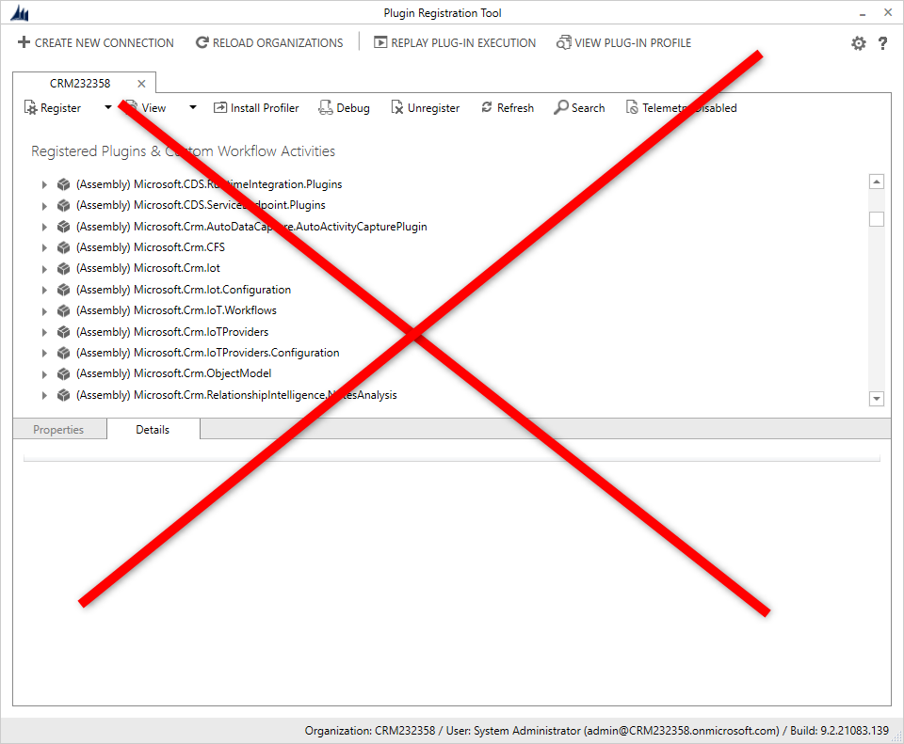
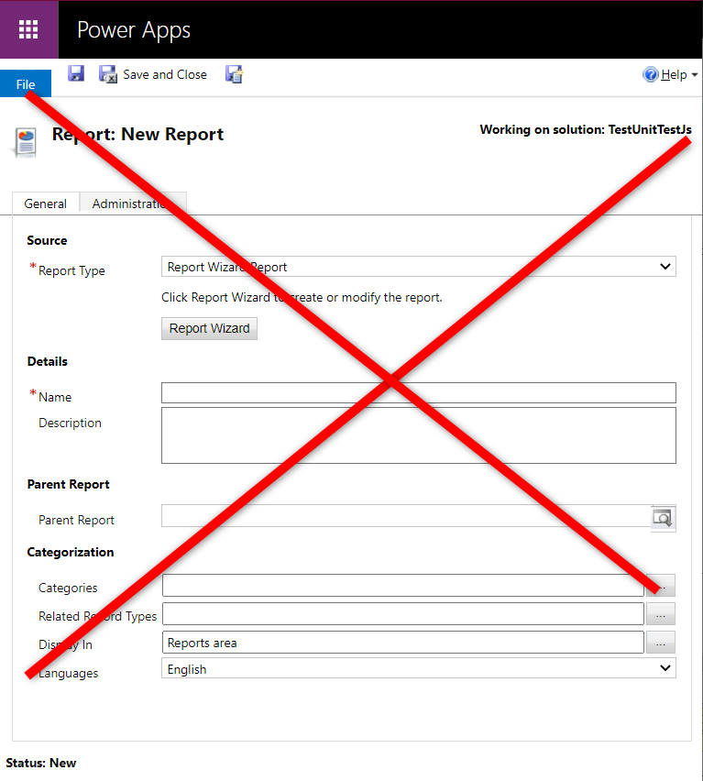
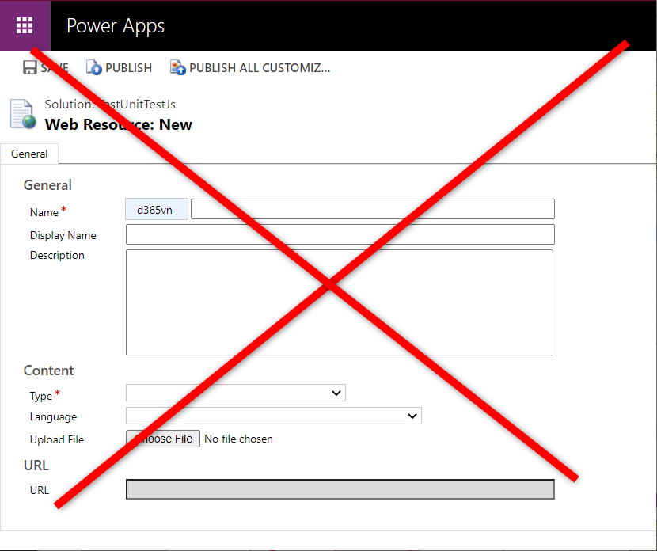
When you used DynamicsCrm.DevKit
#D365PPVN
#ASEANSMSBizAppsUG

Slide 6
When you used DynamicsCrm.DevKit
100% convert your current server projects (plugins, workflows, custom action, …) to work with DynamicsCrm.DevKit
100% convert your current client projects (*.js, *.resx, …) to work with DynamicsCrm.DevKit
A form object contains 100% OOB javascript (https://docs.microsoft.com/en-us/powerapps/developer/model-driven-apps/clientapi/reference) code access on form
OOB code
var value = formContext.getAttribute(“name”).getValue();
formContext.getControl(“name”).setDisabled(true);
DynamicsCrm.DevKit code
var value = form.Body.Name.Value;
form.Body.Name.Disabled = true;
DynamicsCrm.DevKit.Analyzers show the errors before you build
Easy deploy WebResources dependencies
Easy deploy Reports
Easy debug server projects (plugins, workflows, …) with FakeXrmEasy
An UI project template test with EasyRepro
#D365PPVN
#ASEANSMSBizAppsUG

Slide 7
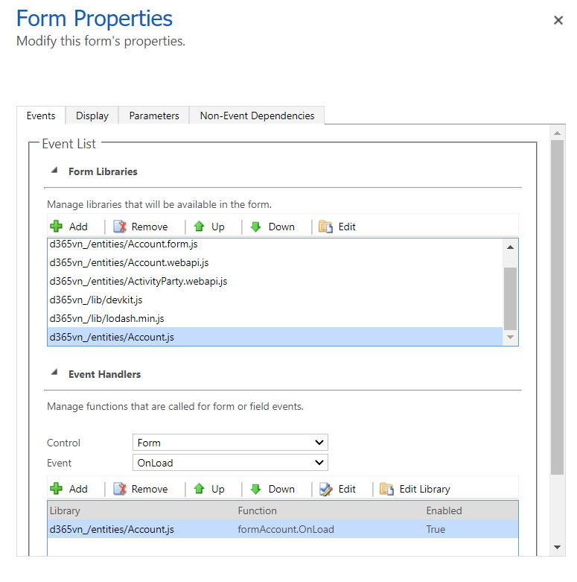
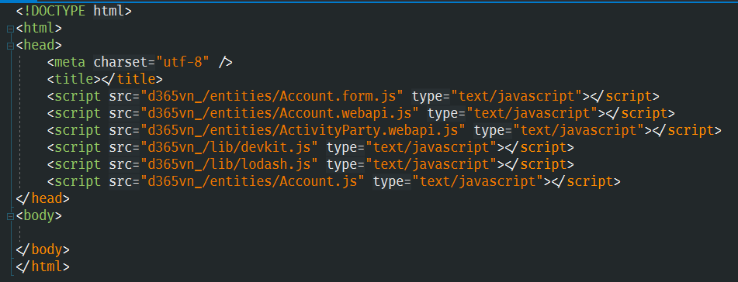
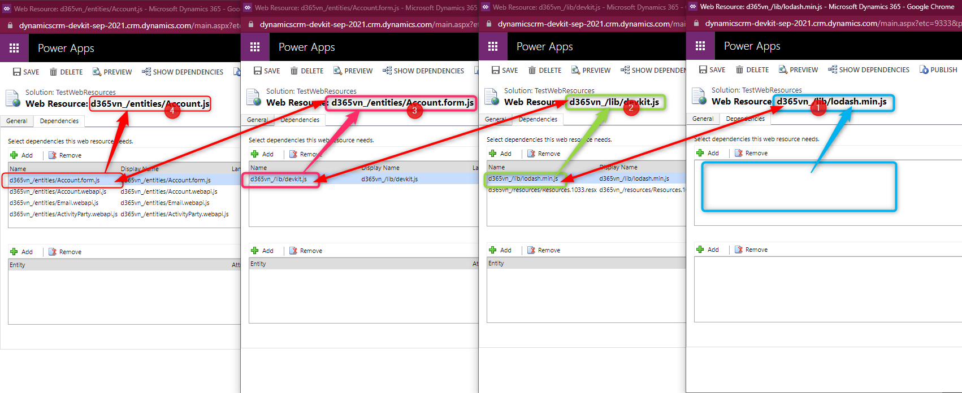
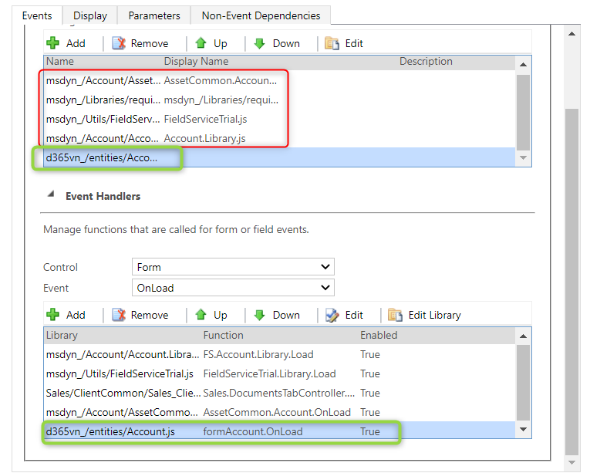


WebResources dependencies
2
3
5
4
1
#D365PPVN
#ASEANSMSBizAppsUG

Slide 8
/Dynamics365CommunityVietnam
DEMO
#D365PPVN
#ASEANSMSBizAppsUG

Slide 9
/Dynamics365CommunityVietnam
Q & A
#D365PPVN
#ASEANSMSBizAppsUG

Slide 10
/Dynamics365CommunityVietnam
THANK YOU!
#D365PPVN
#ASEANSMSBizAppsUG

