Slide 1







Dynamics 365 & Power Platform Community Vietnam
/Dynamics365CommunityVietnam
Virtual Event
11 Jul 2020 08:30 AM – 11:30 AM GMT+7
Speakers
Phuoc Le
Nghia Nguyen
Tuan Vu
Organizers
Khoa Nguyen
Pha Huynh
#D365PPVN
#ASEANSMSBizAppsUG

Slide 2
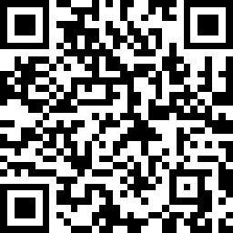
/Dynamics365CommunityVietnam
Community Introduction –
Dynamics 365 Technical Deep Dive
Virtual Event | Microsoft Teams
11 Jul 2020 08:30 AM – 11:30 AM GMT+7
CRM DIALOG SOLUTION
Are you looking for a replacement of deprecated dialog in CRM?
Check this powerful CRM DIALOG out!
PLUGIN WORKSPACE AND BEST PRACTICES
Accelerate your server-side code development environment from hands-on demonstrations
CRM USERS BACKUP AND RESTORATION
Tired of replicating users setup between environments?
Stress no more with simple tricks
Phuoc Le
Nghia Nguyen
Tuan Vu
REGISTER HERE
https://cutt.ly/D365PPVNJul20
#D365PPVN
#ASEANSMSBizAppsUG

Slide 3
/Dynamics365CommunityVietnam
Dynamics 365 & Power Platform Vietnam
CRM DIALOG SOLUTION
Microsoft Teams
11 Jul 2020 08:30 AM – 09:30 AM GMT+7
Phuoc Le
REGISTER HERE
https://cutt.ly/D365PPVNJul20
#D365PPVN
#ASEANSMSBizAppsUG

Slide 4
/Dynamics365CommunityVietnam
Dynamics 365 & Power Platform Vietnam
11 Jul 2020 Virtual Event
CRM DIALOG SOLUTION
by Phuoc Le
#D365PPVN
#ASEANSMSBizAppsUG

Slide 5



About me
Title: Dynamics 365 Technical Consultant
Company: Hitachi Solutions Asia Pacific
Experience & skills: >10 years working on Dynamics 365
Connect with me
Phuoc Le
/in/levanphuoc
@phuocle
https://www.phuocle.net
#D365PPVN
#ASEANSMSBizAppsUG

Slide 6
Overview a custom dialog
Community ask questions to build a custom dialog
how to create dialog in UCI (https://community.dynamics.com/365/sales/f/dynamics-365-for-sales-forum/385647/how-to-create-dialog-in-uci)
Edit popup for create Order from quote (https://community.dynamics.com/crm/f/microsoft-dynamics-crm-forum/388617/edit-popup-for-create-order-from-quote/1041365#1041365)
Solutions
Replacing a Dynamics 365 Dialog with an Embedded Canvas PowerApp (https://readyxrm.blog/2019/02/24/replacing-a-dynamics-365-dialog-with-an-embedded-canvas-powerapp/)
Development of custom Html/JS Webresources with help of modern frameworks (https://butenko.pro/2020/04/22/development-of-custom-html-js-webresources-with-help-of-modern-frameworks/)
Replace dialogs with business process flows or canvas apps (https://docs.microsoft.com/en-us/power-automate/replace-dialogs)
alertjs (https://github.com/PaulNieuwelaar/alertjs)
#D365PPVN
#ASEANSMSBizAppsUG

Slide 7
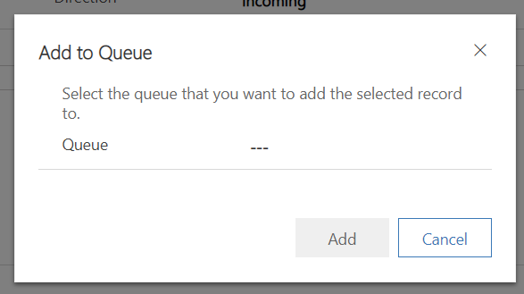
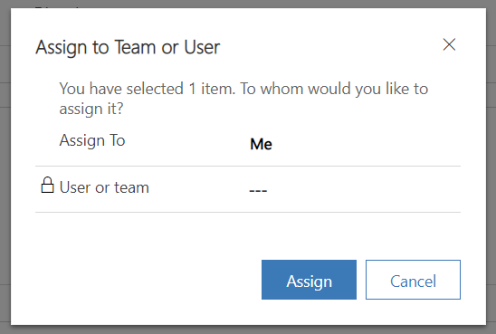
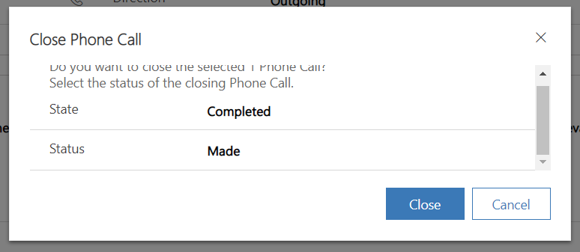
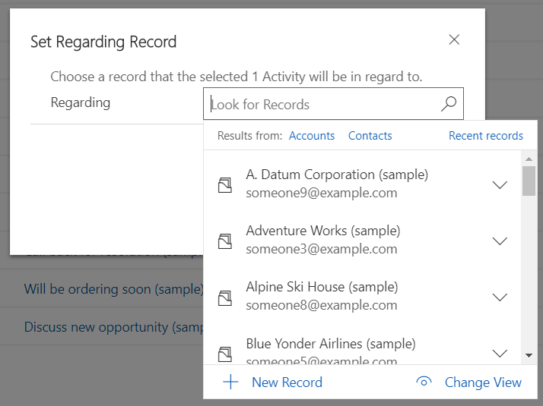
Dynamics 365 OOB Dialogs
#D365PPVN
#ASEANSMSBizAppsUG

Slide 8
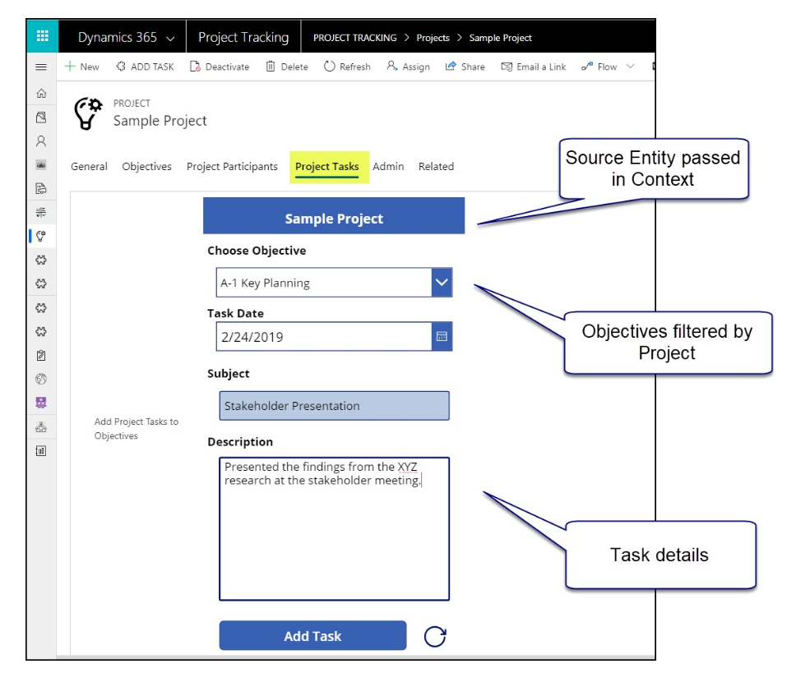
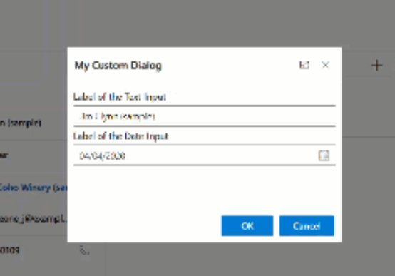
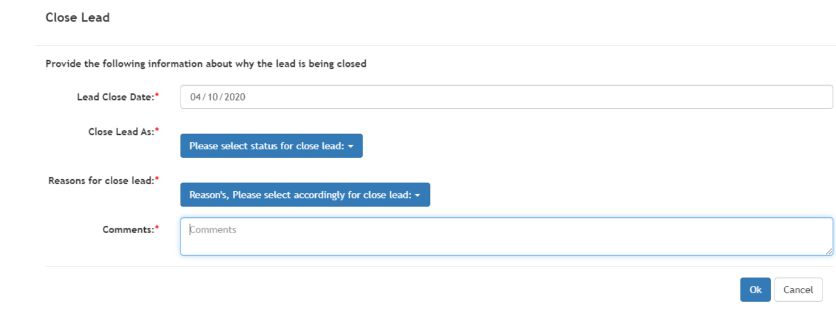
User build a custom dialog
#D365PPVN
#ASEANSMSBizAppsUG

Slide 9
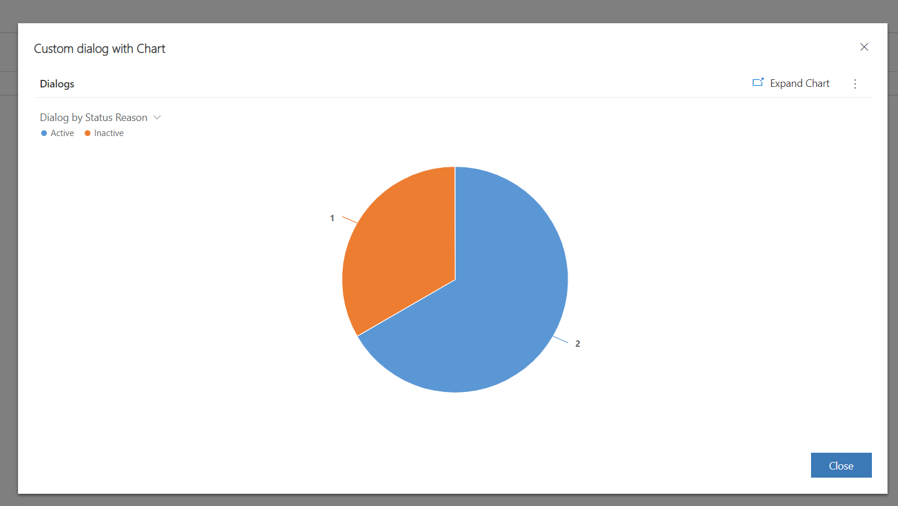
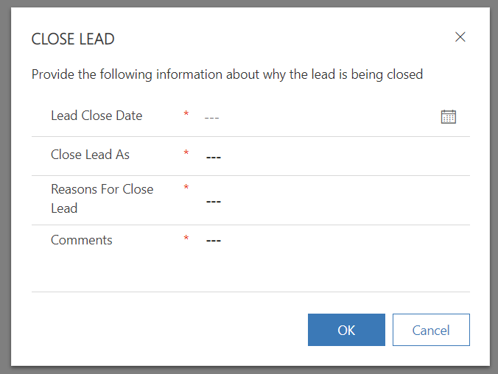
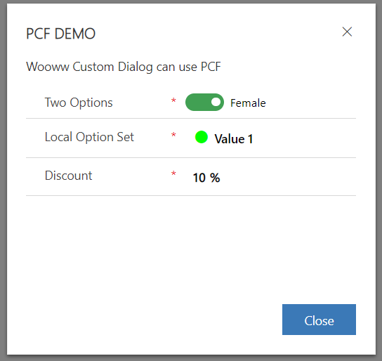
crmdialog can build a dialog like …
#D365PPVN
#ASEANSMSBizAppsUG

Slide 10
crmdialog features
☹ Unsupported ☹ ( until now … )
Easy to use
Focus to UCI only
No need to know FormXml ☺
Help you export an unmanaged solution
Access controls by OOB javascript code (https://docs.microsoft.com/en-us/powerapps/developer/model-driven-apps/clientapi/reference)
http://crmdialog.phuocle.net
#D365PPVN
#ASEANSMSBizAppsUG

Slide 11
Why unsupported
Because we use 2 JavaScript functions that not document
Xrm.Navigation.openDialog(...) (https://docs.microsoft.com/en-us/powerapps/developer/model-driven-apps/clientapi/reference/xrm-navigation) (before Microsoft use: Xrm.Internal.openDialog(…)
formContext.ui.moveTo(...) (https://docs.microsoft.com/en-us/powerapps/developer/model-driven-apps/clientapi/reference/formcontext-ui)
#D365PPVN
#ASEANSMSBizAppsUG

Slide 12
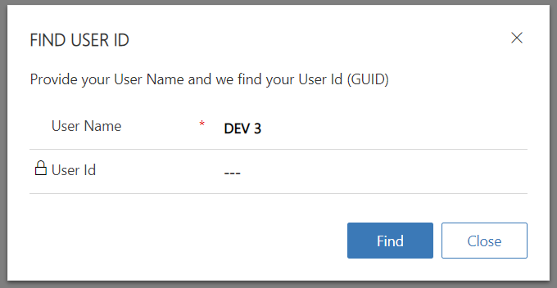
Demo
Requirements: Find UserId (GUID) by User Name
Solution with crmdialog
Design a dialog with crmdialog app
Create dialog.js webresource and deploy to CDS
Import solution (downloaded from crmdialog app) to CDS
Test
#D365PPVN
#ASEANSMSBizAppsUG

Slide 13
/Dynamics365CommunityVietnam
Dynamics 365 & Power Platform Vietnam
11 Jul 2020 Virtual Event
Q & A
#D365PPVN
#ASEANSMSBizAppsUG

Slide 14
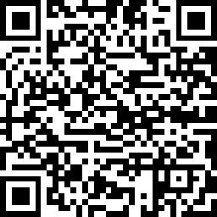
/Dynamics365CommunityVietnam
Dynamics 365 & Power Platform Vietnam
11 Jul 2020 Virtual Event
THANK YOU!
WE VALUE YOUR FEEDBACK!
https://cutt.ly/D365PPVNJul20Feedback
#D365PPVN
#ASEANSMSBizAppsUG

