Slide 1


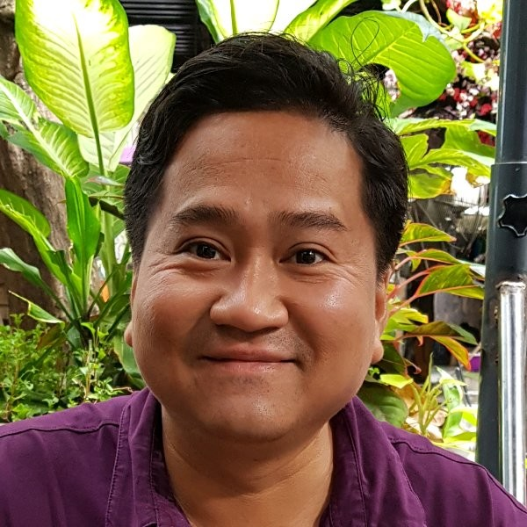
/Dynamics365CommunityVietnam
Dynamics 365 & Power Platform Vietnam
Dynamics 365 with Azure DevOps
Phuoc Le
Microsoft Teams
02 Jul 2022 18:00 – 19:00 GMT+7
#D365PPVN
#ASEANSMSBizAppsUG

Slide 2



About me
Title: Dynamics 365 CRM Solutions Architect
Company: Hitachi Solutions Asia Pacific
Experience & skills: >14 years working on Dynamics 365
Connect with me
Phuoc Le
/in/levanphuoc
@phuocle
https://phuocle.net
#D365PPVN
#ASEANSMSBizAppsUG

Slide 3
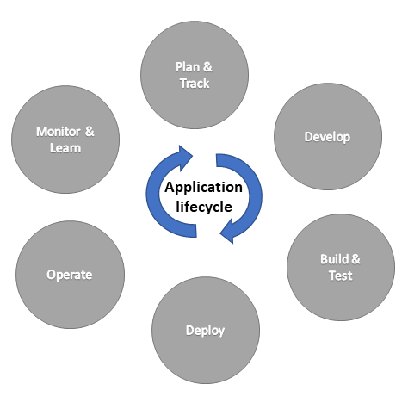
ALM = Application lifecycle management
#D365PPVN
#ASEANSMSBizAppsUG

Slide 4
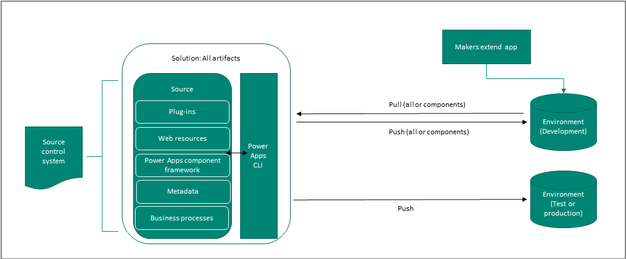
CI/CD = Continuous Integration/Continuous Deployment
#D365PPVN
#ASEANSMSBizAppsUG

Slide 5
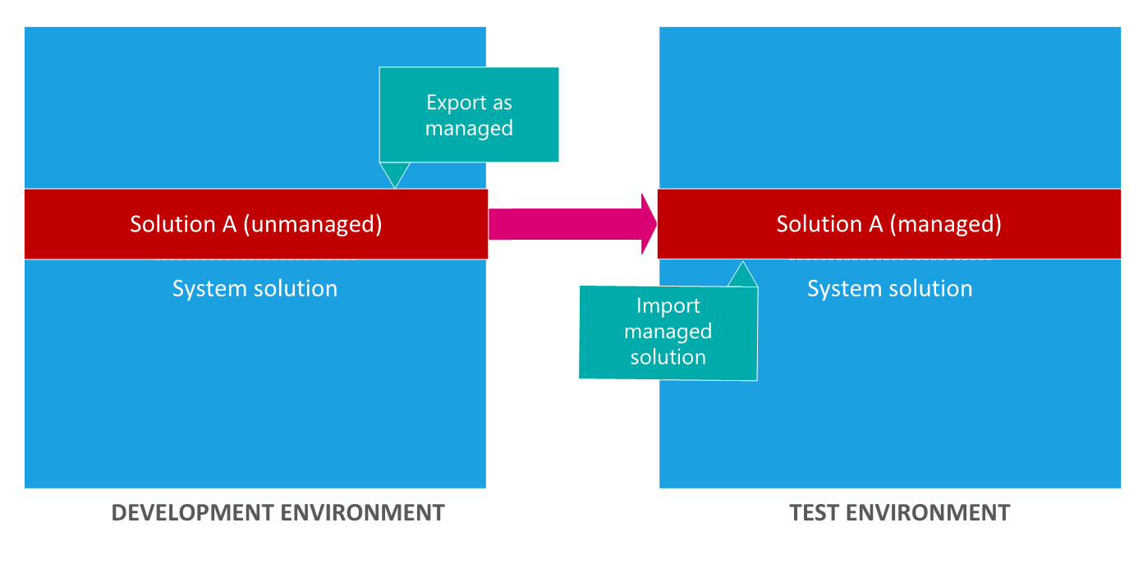
Export/Import solution to another instance
#D365PPVN
#ASEANSMSBizAppsUG

Slide 6
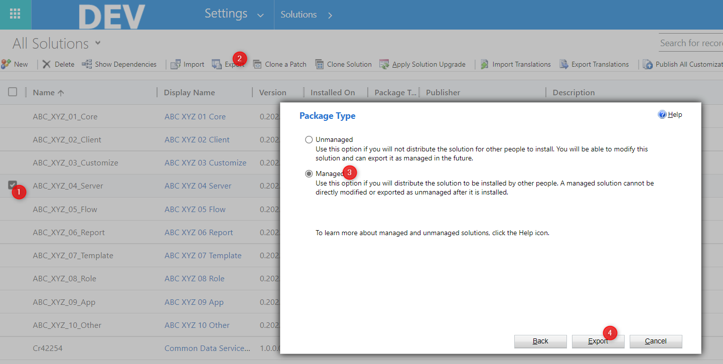
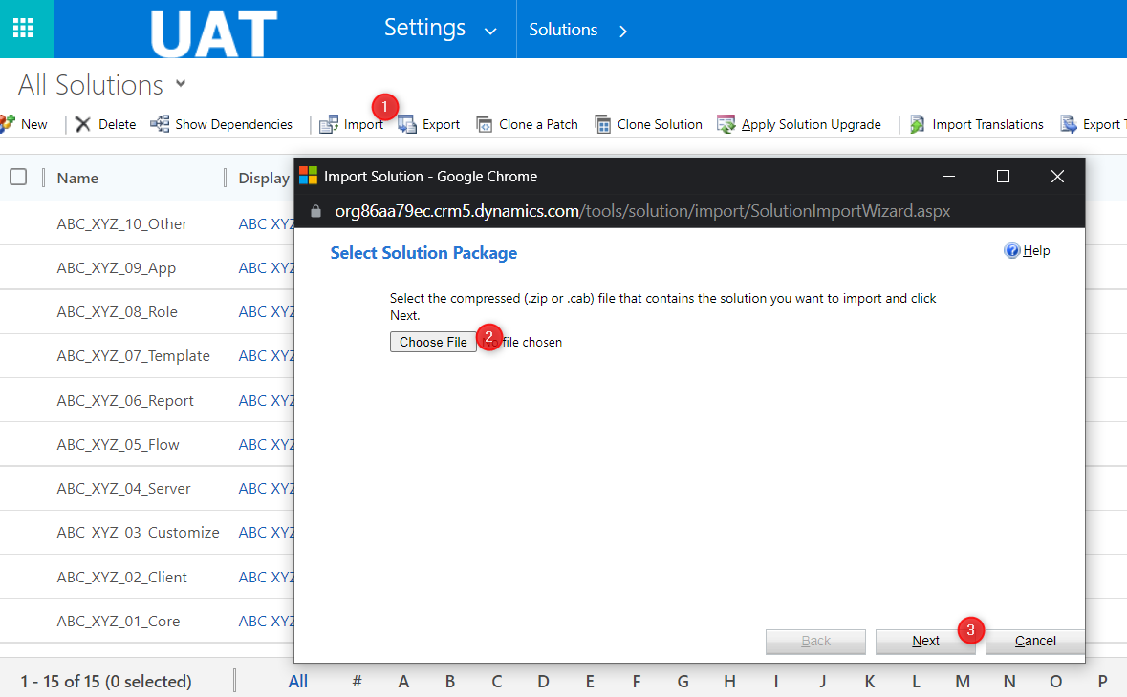
The hard way
Update solution version
Manually export solution
Read and following the import check-list documents
Manually import solution
Repeat step 1 until you finish all solutions
#D365PPVN
#ASEANSMSBizAppsUG

Slide 7
Results
Take a lot of human time doing
Always remember a lot of tasks in the check-list that should do
Boring … because the task repeat … repeat … and waiting time when see the process importing
No way that we can check the solution from the last deployment
Mistake deploy to PRODUCTION (because there are no process approval)
…
#D365PPVN
#ASEANSMSBizAppsUG

Slide 8
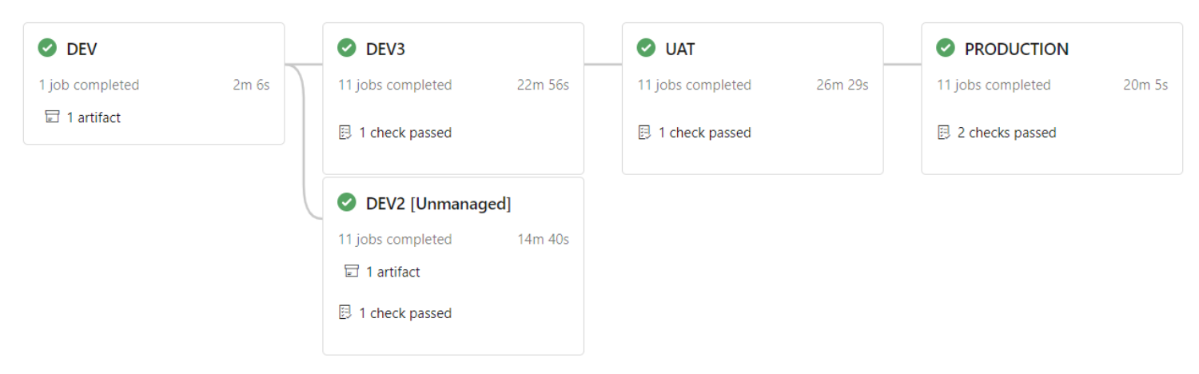
The easy way – Dynamics 365 with Azure DevOps
#D365PPVN
#ASEANSMSBizAppsUG

Slide 9
Results
You don’t need to remember the tasks in the check-list
You can select solution(s) you want deploy to the instance(s)
You can check the changed between the last deployment with current deployment of the solution by GIT pull request
You can reject the deployment by reject the GIT pull request, or continue deployment by completed GIT pull request
When deploy PRODUCTION, the process approval trigger and need someone to approve to continue process deployment. (and you can reject the deployment to PRODUCTION)
Solution zip files saved for ever in the Azure DevOps
#D365PPVN
#ASEANSMSBizAppsUG

Slide 10
/Dynamics365CommunityVietnam
DEMO
https://dev.azure.com/phuocle2/CrmDevOps
#D365PPVN
#ASEANSMSBizAppsUG

Slide 11
/Dynamics365CommunityVietnam
Q & A
#D365PPVN
#ASEANSMSBizAppsUG

Slide 12
/Dynamics365CommunityVietnam
THANK YOU!
#D365PPVN
#ASEANSMSBizAppsUG

