Slide 1



/Dynamics365CommunityVietnam
Dynamics 365 & Power Platform Vietnam
Dynamics 365 Unit Testing with FakeXrmEasy
Phuoc Le
Microsoft Teams
19 Mar 2022 19:00 – 20:00 GMT+7
#D365PPVN
#ASEANSMSBizAppsUG

Slide 2



About me
Title: Dynamics 365 CRM Solutions Architect
Company: Hitachi Solutions Asia Pacific
Experience & skills: >14 years working on Dynamics 365
Connect with me
Phuoc Le
/in/levanphuoc
@phuocle
https://phuocle.net
#D365PPVN
#ASEANSMSBizAppsUG

Slide 3
What is FakeXrmEasy
It an open-source automated testing framework and a mocking library designed for Dynamic CRM/CDS projects from version 2011, 2013, 2015 and 2016 and Dynamics 365.
It also helps by giving you already mocked objects, like an IOrganizationService, or a plugin context, or a code activity context, which use the In Memory context above. It is, more precisely, a mocking library for Dynamics CRM you can use with your test framework of choice (XUnit, NUnit, etc...).
https://github.com/jordimontana82/fake-xrm-easy
#D365PPVN
#ASEANSMSBizAppsUG

Slide 4
Why I used FakeXrmEasy
Because I want to debugging my Plugins/Workflows code. I don’t want to use Plugin Profiles to debugging with the real CRM/CDS database.
Because I want to check my Plugins/Workflows code by CI/CD.
Because I want to make project more stable.
Because when I wrote the unit test, mean I provide the technical documents.
Because FakeXrmEasy easy (as the name mention) to write the unit test.
#D365PPVN
#ASEANSMSBizAppsUG

Slide 5
How to use with Visual Studio
Create Visual Studio Unit Test project
Add FakeXrmEasy from Nuget to your project
Generator an early-bound classes to used with FakeXrmEasy as the DB Model
(Learn) Write your first unit test
#D365PPVN
#ASEANSMSBizAppsUG

Slide 6
How to use DynamicsCrm.DevKit
Create ProxyTypes project from DynamicsCrm.DevKit
Create Test project from DynamicsCrm.DevKit
Create class from the plugin project from DynamicsCrm.DevKit
(Learn) Write your first unit test
#D365PPVN
#ASEANSMSBizAppsUG

Slide 7
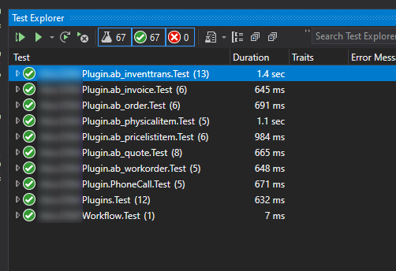
Screenshots
#D365PPVN
#ASEANSMSBizAppsUG

Slide 8
/Dynamics365CommunityVietnam
DEMO with DynamicsCrm.DevKit
#D365PPVN
#ASEANSMSBizAppsUG

Slide 9
/Dynamics365CommunityVietnam
Q & A
#D365PPVN
#ASEANSMSBizAppsUG

Slide 10
/Dynamics365CommunityVietnam
THANK YOU!
#D365PPVN
#ASEANSMSBizAppsUG

