Slide 1

Reservation Homestay
Web Application
GVHD: ThS. Trần Công Tú
Nhóm 11:
Nguyễn Duy Phước 16146172
Nguyễn Trần Thanh Trúc 17110245

Slide 2
I - Introduction
What is Reservation Homestay Web Application ?
why you need it ?
II - System
How many Actors, Use case of each ?
MVC Architecture ?, Build Web Reservation Homestay MVC
Database Design ?
III - Summary
1

Slide 3
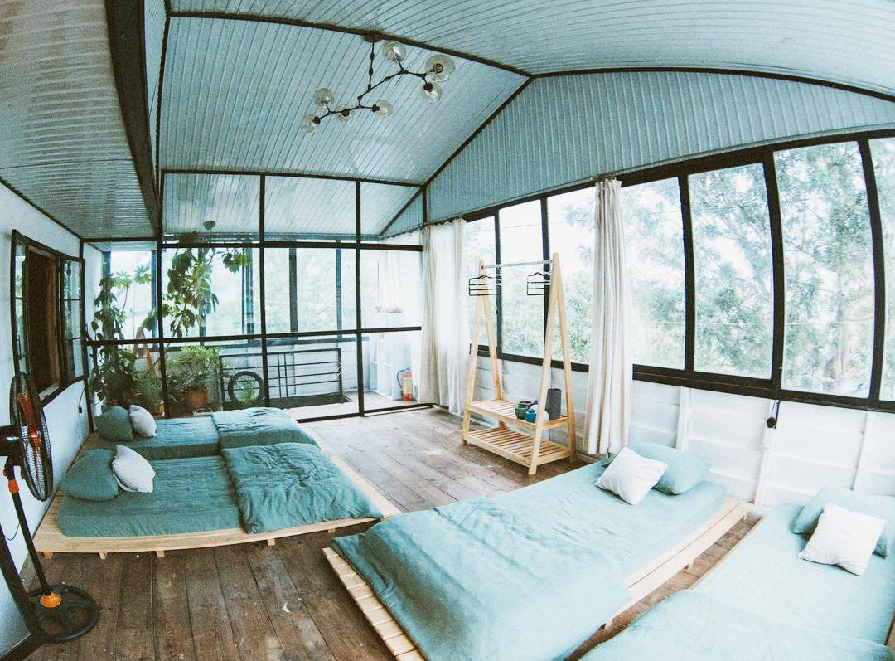
I - Introduction
What is Reservation Homestay
Web Application ?
why you need it ?
2

Slide 4
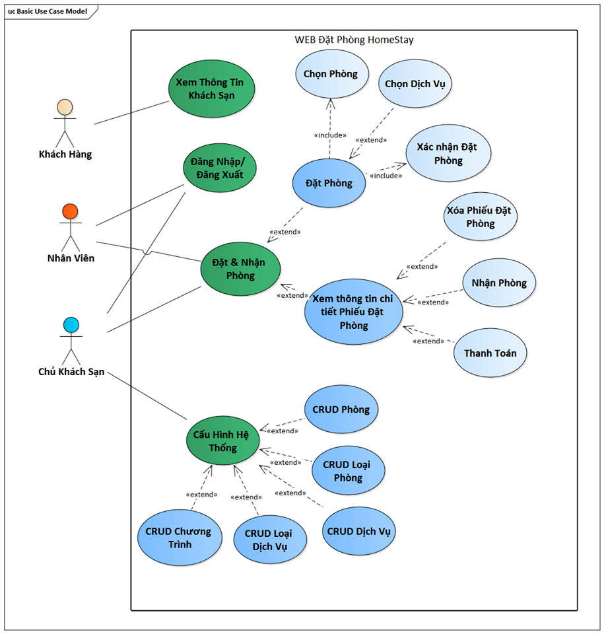
I - Introduction
How many Actors ?
Use case of each ?
3

Slide 5
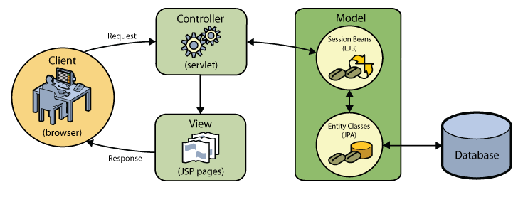
II - System
MVC Architecture ?
4

Slide 6
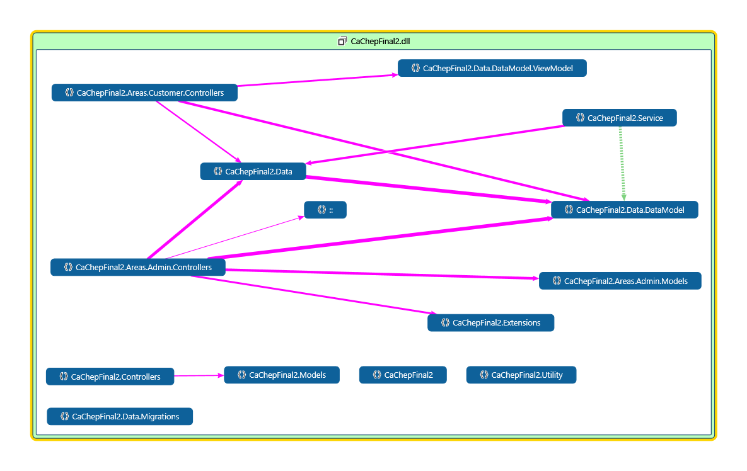
II - System
My Web
5

Slide 7
II - System
Database Design
6

Slide 8
II - System
Database Design
7

Slide 9
THANK YOU FOR YOUR LISTENING!!

