Slide 1
Verification
Sub
FPT Semiconductor | August 11th , 2023

Slide 2
Introduction

Slide 3
1. Introduction
AES (Advanced Encryption Standard) is a widely used block cipher algorithm for data security. Verifying the AES IP ensures that it functions correctly.
key features
Encryption
Decryption
Reset
Methodology
UVM with SystemVerilog.
Tools: Xcelium
Random Testing + Directed Testing

Slide 4
2
Environment

Slide 5
Environment
2
2.1 Interface and Transaction
2.2 Driver
2.3 Monitor
2.4 Scoreboard

Slide 6
2. Environment
Testbench
: Transaction
Test
: Signal
Env
Sequence
Scoreboard
Model
Sequencer
Driver
Monitor
Interface
DUT

Slide 7
2.1 Interface and Transaction
Interface
No | Signal name | Width
1 | clk | 1 bit
2 | rst_n | 1 bit
3 | data_input | [127:0]
4 | key | [127:0]
5 | data_output | [127:0]
6 | finished | 1 bit
Transaction
No | Signal name | Width | Using
1 | data_input | [127:0] | Control data_input signal in interface
2 | key | [127:0] | Control key signal in interface
3 | data_out | [127:0] | Control data_out signal in interface

Slide 8
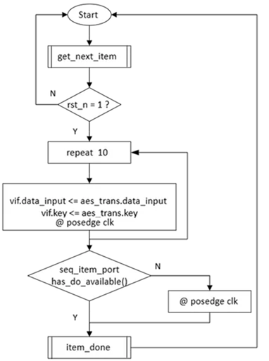
2.2 Driver
Task: drive_transaction
Get transaction from the sequencer and transmit data to the DUT.

Slide 9
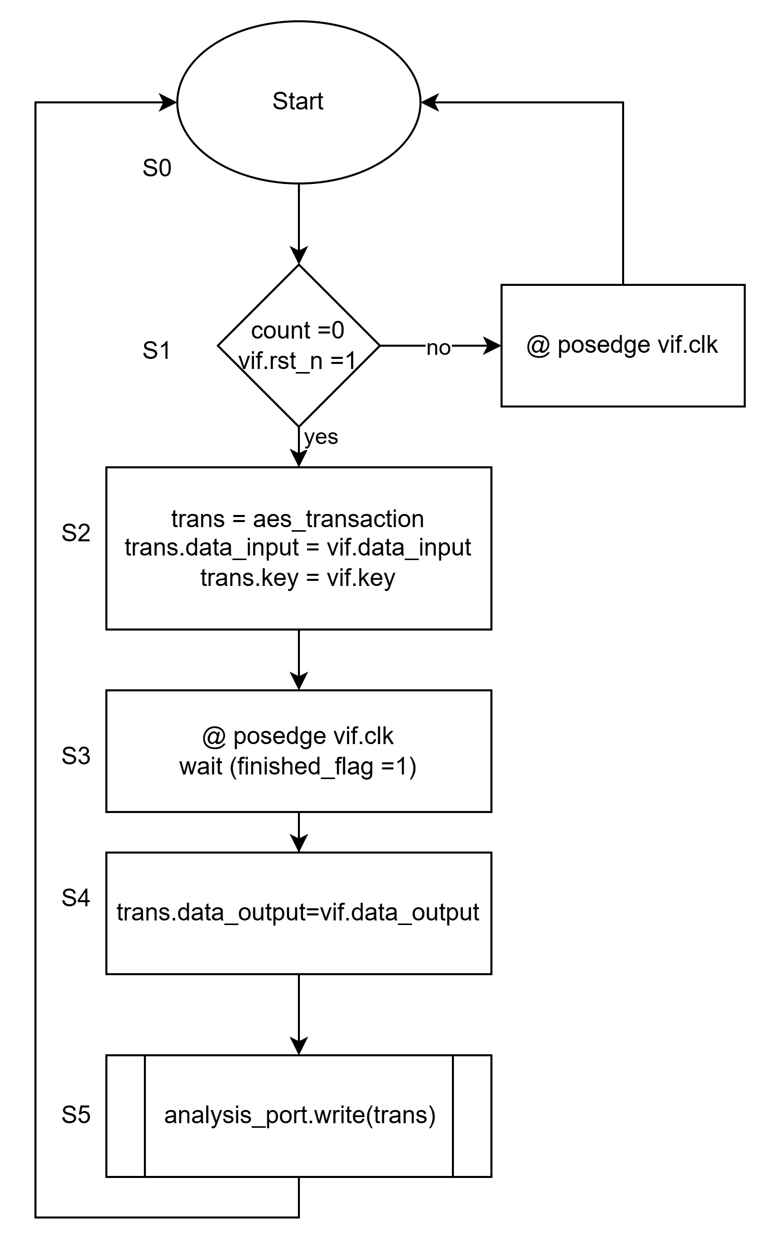
2.3 Monitor
Task: collect_send_data
Collect data from the DUT and send it to the scoreboard (scb) through the analysis port.

Slide 10
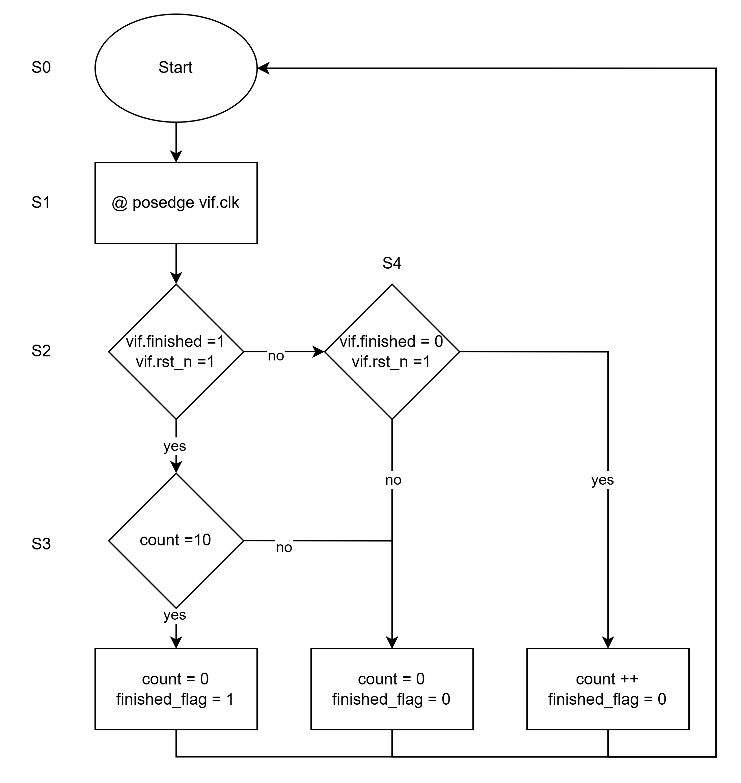
2.3 Monitor

Slide 11
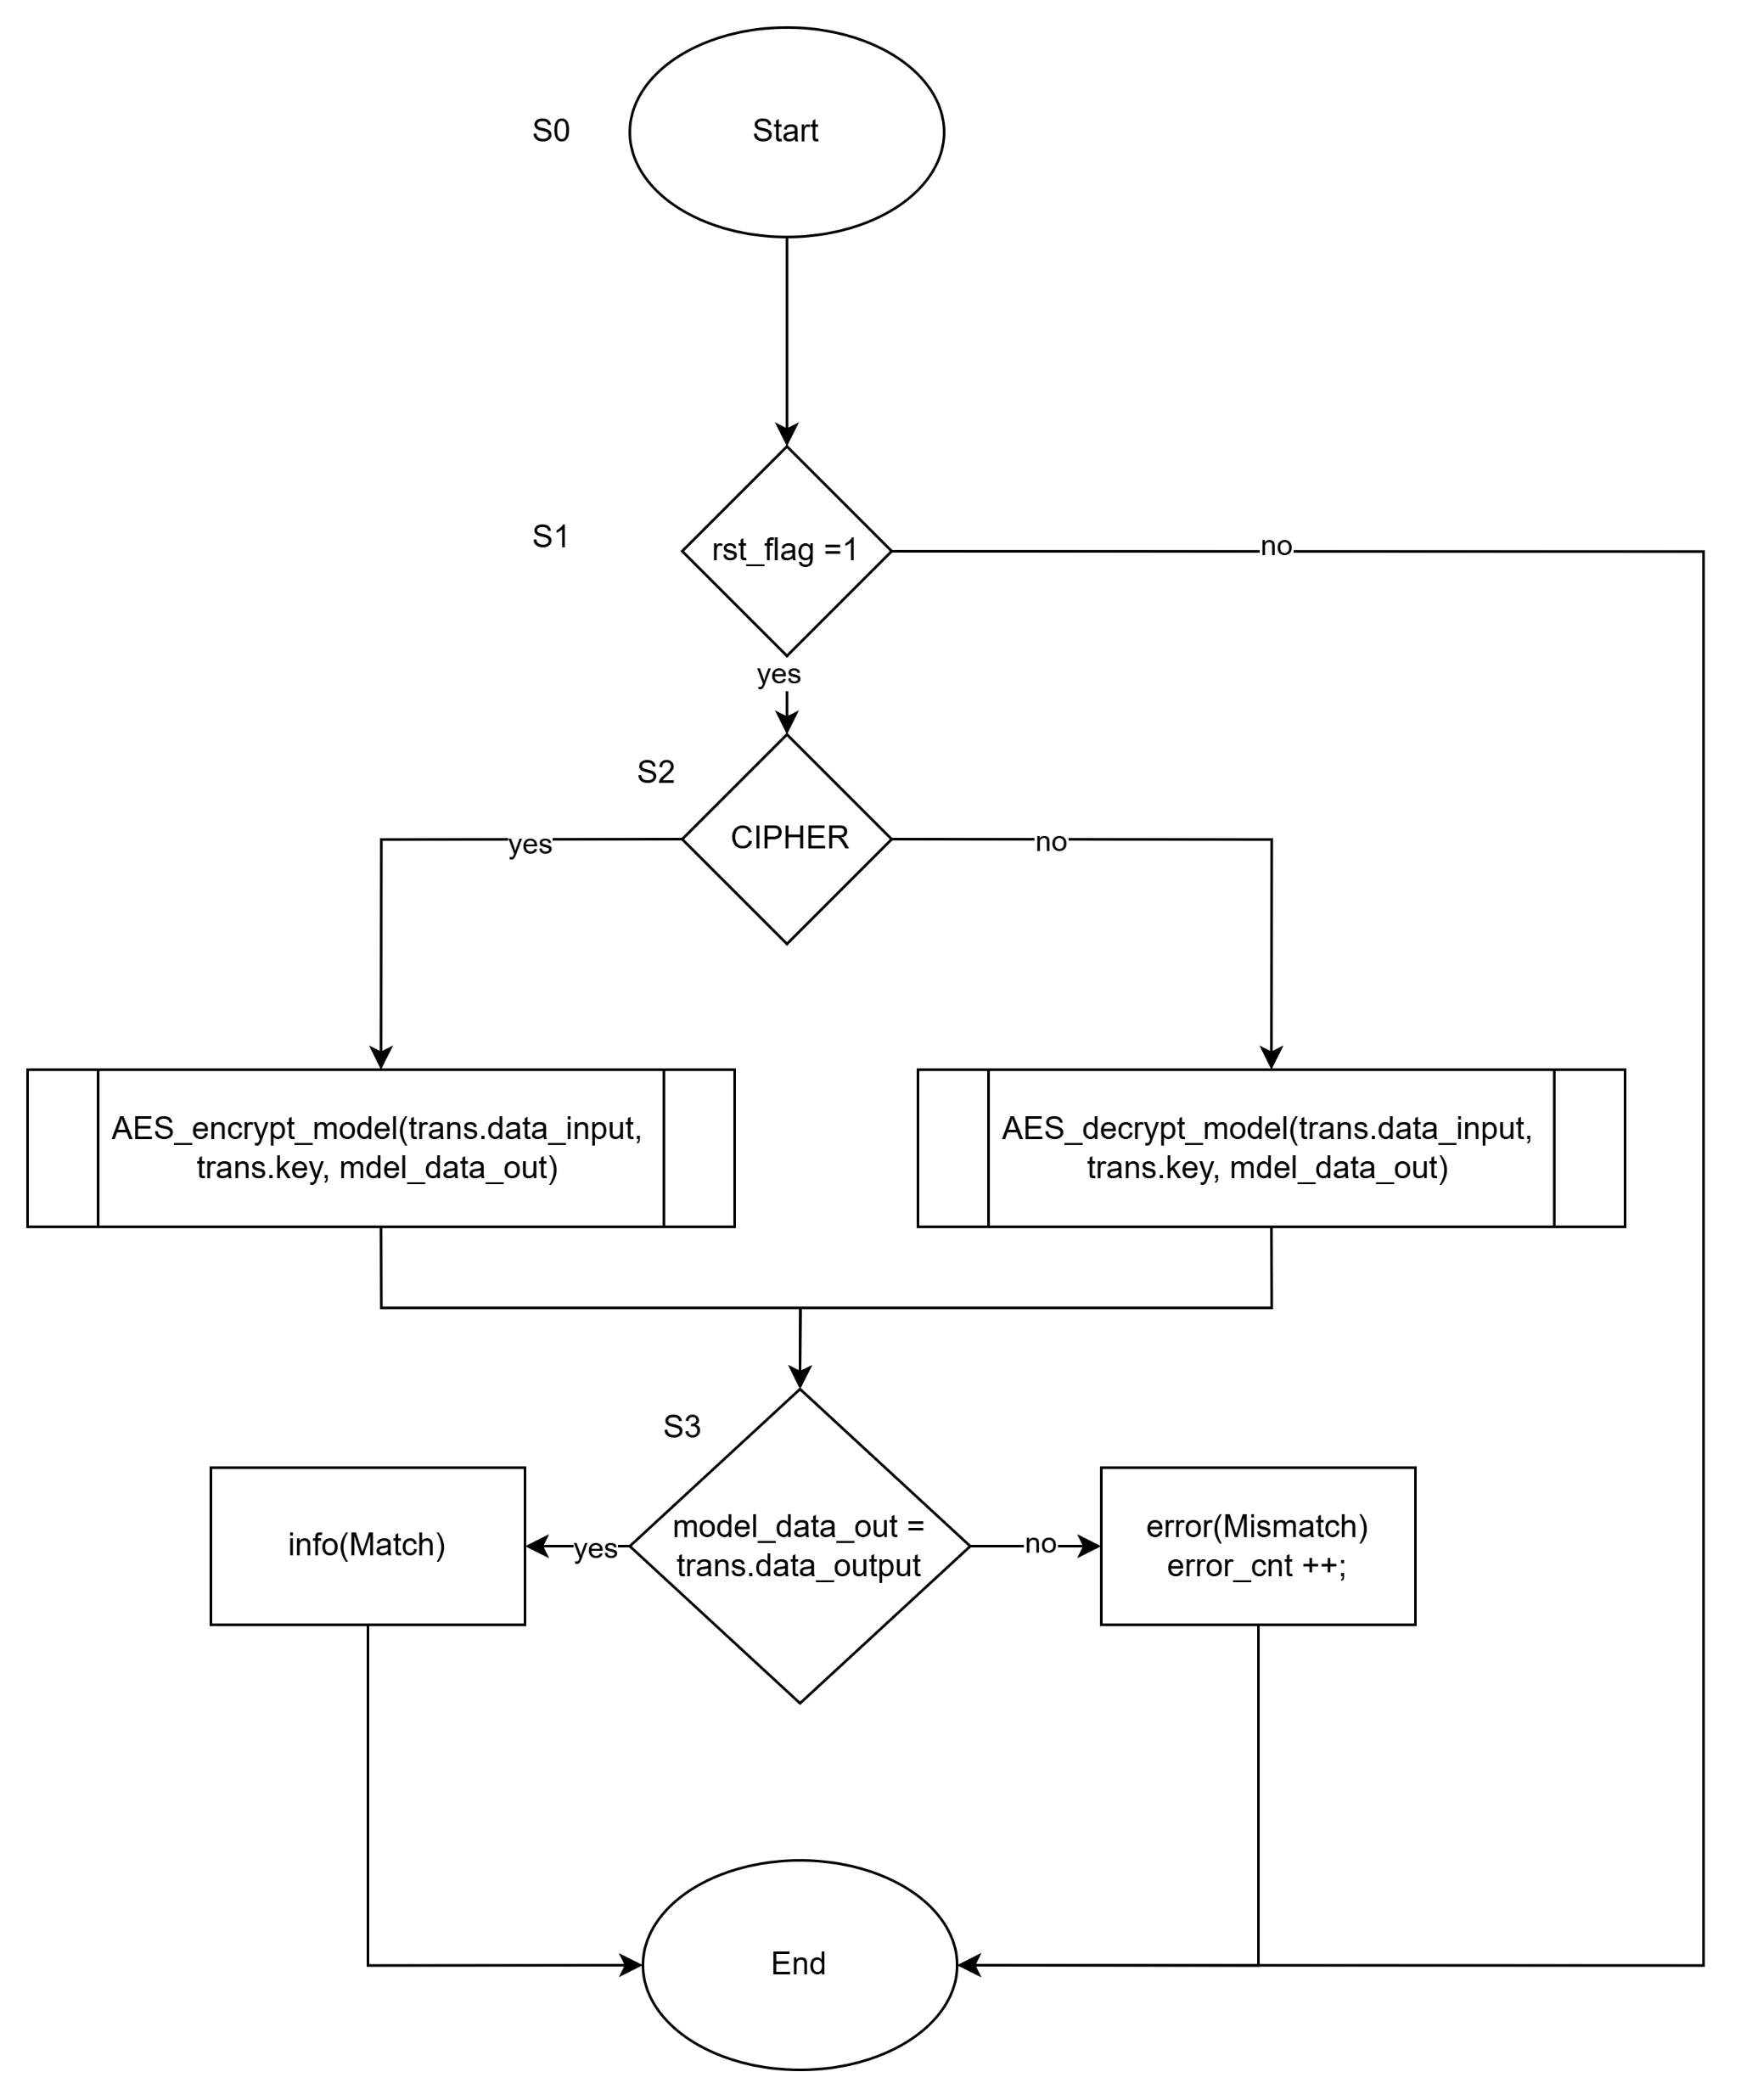
2.4 Scoreboard

Slide 12

THANK YOU

