Slide 1
Cache Overview
Cache:
(1) Wiki dictionary defines a cache as “a store of things that will be required in future, and can be retrieved rapidly.” A cache is a collection of temporary data that either duplicates data located elsewhere or is the result of a computation.
(2) Caching is a cheap and effective way to improve the performance of a Web application. By storing relatively static data in cache and serving it from cache when requested, we save the time needed to generate the data/reduce the load on a web server.
Which data are suitable for caching? (only for cache server).
1) liveness—how live the data needs to be. The less live, the more it can be cached. Contents are not changed frequently, ex: static pages/, web page caching, for pages generated from databases (CMS).
2) Persistent Object Relational Caching (reduce time to go back to the database to load each object).
Notes:
(1): refer to :http://www.ehcache.org/documentation/2.8/get-started/introduction.html
(2): refer to: http://www.yiiframework.com/doc/guide/1.1/en/caching.overview
More: http://www.computerhope.com/jargon/c/cache.htm

Slide 2
Introduce EhCache
Ehcache is a open-source cache library introduced in 2003 to improve performance by reducing the load on underlying resources. Ehcache is not for both general-purpose caching and caching Hibernate (second-level cache), data access objects, security credentials, and web pages. It can also be used for SOAP and RESTful server caching, application persistence, and distributed caching. Currently latest version of EhCache is 3.1 & only support for Java.
EhCache consists of a CacheManger, which manages caches (create/access and remove caches). All caches implement the Ehcache interface. A cache has a name and attributes. Each cache contains Elements. Cache elements are stored in the MemoryStore.
An element is a atomic entry in a cache. It has a key, a value and a record of accesses. Elements are put into and removed form caches. They can also expire and be removed by the Cache, depending on the Cache settings.
Notes:
Refer to: http://www.ehcache.org/documentation/2.8/get-started/key-classes-methods.html

Slide 3
EhCache Configuration
Caches are configured in xml file called ehcache.xml to tell Ehcache how and where to cache the data. (if ehcache.xml file is not available, a default ehcache-failsafe.xml will be used).
Some notes:
By default, Ehcache store the cached files in temp folder, ask it to store file in specific path.
2) Some setting parameters:
maxEntriesLocalheap: cache contain a maximum in memory of n elements.
timeToIdleSeconds: time for an element to expire.
timeToLiveSeconds: time for an element to live.
& many more other parameters, refer to link 2 below.
Notes:
1. http://www.ehcache.org/documentation/2.8/configuration/index.html
2. Refer to file to get more information at http://www.ehcache.org/ehcache.xml

Slide 4
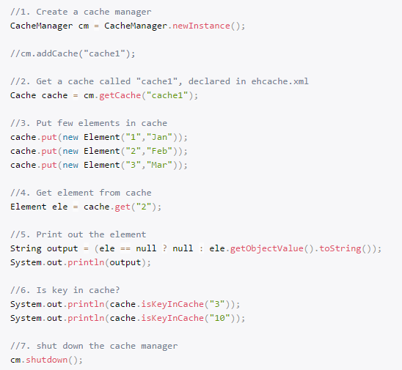
EhCache Demo
Source code: Refer to slide 6 to try on Eclipse.
Some notes:

Slide 5
Question Discussion
[1] How to do when data is new on DB to update on GUI?
[2] How many Cache level does Hibernate support?

Slide 6
Reference
[1] http://www.ehcache.org/documentation/2.8/get-started/introduction.html
[2] Ehcache hello world example
https://www.mkyong.com/ehcache/ehcache-hello-world-example/
[3] Spring Caching and EhCache example
https://www.mkyong.com/spring/spring-caching-and-ehcache-example/ (only load Persistent object once)
Notes:
1. Refer more cache tool like MenCache.
2. Hibernate Cache – next topic,
3. Design Patterns – next topic (Command & Observer)

