Slide 1
Microservices Architecture
with ASP.NET Core
Building Scalable, Resilient Distributed Systems

Slide 2
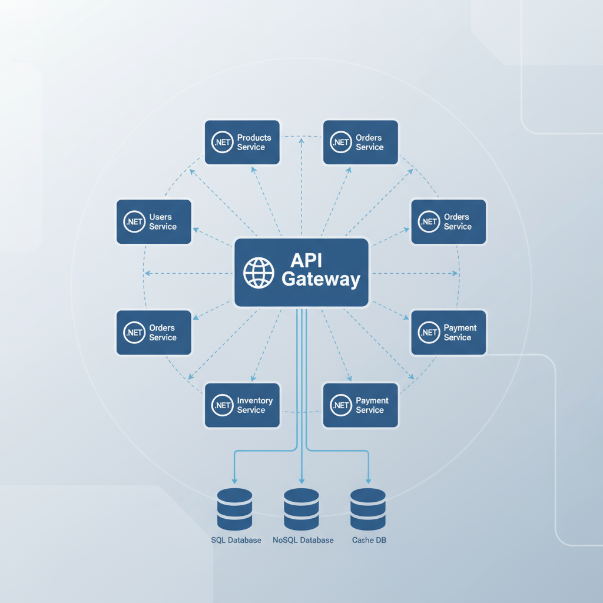
Table of Contents
1
What are Microservices?
2
ASP.NET Core for Microservices
3
Communication Patterns
4
API Gateway Pattern
5
Data Management Strategies

Slide 3
Core Concepts
& Architecture

Slide 4
What are Microservices?
Service Autonomy
Failure Isolation
Independent development, deployment, and scaling of each service.
One service failure doesn't cascade to the entire system.
Decentralized Governance
Decentralized Data
Technology diversity and independent decision-making per service.
Each service owns its database and data management strategy.
Microservices architecture decomposes monolithic applications into small, autonomous services that communicate over well-defined APIs. Each service focuses on a specific business capability, enabling faster development cycles, better scalability, and improved fault tolerance.

Slide 5
ASP.NET Core for Microservices
1
Cross-Platform Excellence
Lightweight runtime with exceptional performance characteristics.
2
Built-in Dependency Injection
Native support for loose coupling and testability.
3
Comprehensive Health Checks
Built-in monitoring and orchestrator integration capabilities.
Native Containerization
.NET Core
4
Seamless Docker support and cloud-native deployment.
Modern Foundation
Performance: Benchmarks show up to 8x faster processing than traditional ASP.NET, making it ideal for high-throughput scenarios.

Slide 6
Communication Patterns
Synchronous
Asynchronous
Event-Driven
REST APIs
Message Queues
Event Sourcing
HTTP/JSON simplicity
RabbitMQ, Azure SB
Immutable event log
gRPC
Kafka
CQRS
High-performance binary
Event streaming
Command/Query separation

Slide 7
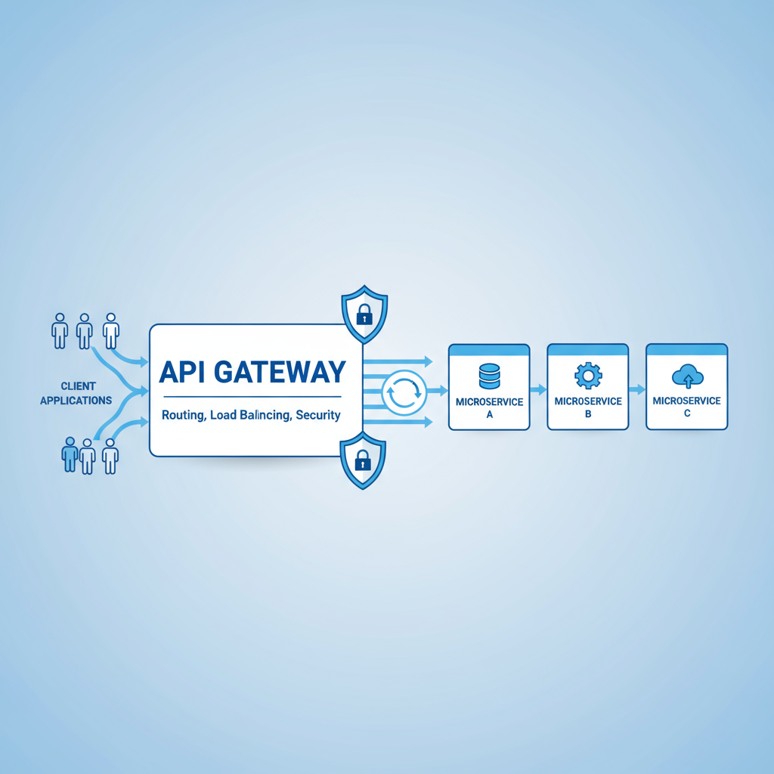
API Gateway Pattern
1
Single Entry Point
Centralized access for all client requests.
2
Cross-Cutting Concerns
Authentication, rate limiting, and monitoring.
3
Request Aggregation
Combine multiple service responses into one.
4
Backend for Frontend
Dedicated gateways for mobile, web, and other clients.
Ocelot: A lightweight .NET library providing API Gateway functionality with dynamic routing, load balancing, and caching.

Slide 8
Data Management Strategies
Database-per-Service
CQRS
Complete data autonomy and loose coupling
Polyglot persistence (SQL, NoSQL)
Independent scaling and optimization
Command Query Responsibility Segregation
Optimized read/write operations
Separate data stores for scaling
Saga Pattern
Event Sourcing
Manages distributed transactions
Choreography vs Orchestration
Ensures eventual consistency
Complete audit trail of all changes
Immutable event store
Enables temporal queries

Slide 9
The Future is Distributed
Microservices with ASP.NET Core represent the future of scalable application development, combining the power of distributed architecture with modern .NET capabilities.
Scalability
Flexibility
Resilience
Independent scaling of services
Technology diversity and autonomy
Fault tolerance and recovery
Success requires careful planning of communication, data management, and operations.

