Slide 1
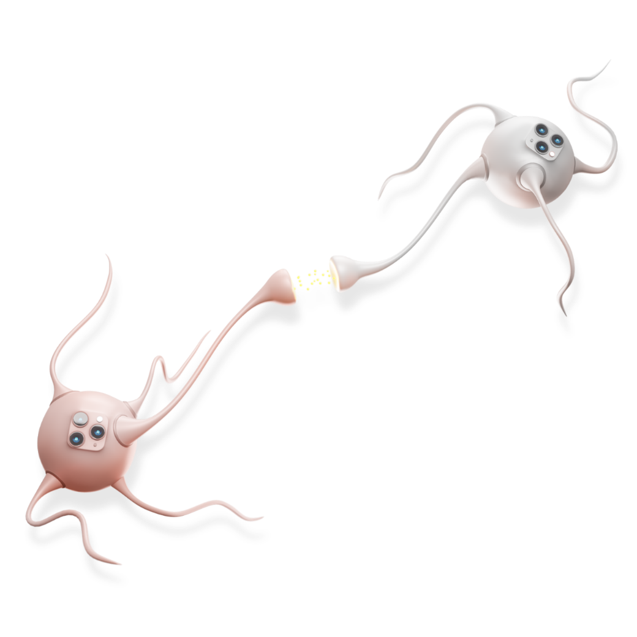

drcom
JQuery DRCOM FW - How to instructions

Slide 2
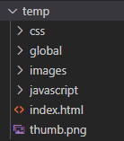
Structure in asset
In a asset, we have the folders: css, global, images, javascript, index.html and thumb.png
Css/main.css: This use to write css for each asset
Images: Include the images for each asset
Javascript/main.js: This use to code for each asset
Index.html: use to code for each asset
Thumb.png: this is default save file .png. Pls don’t save file thumb.jpg. And the size of thumb is 1024 x 768 px
JQuery DRCOM FW

Slide 3
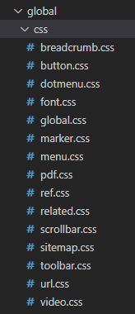
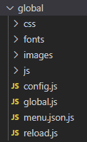
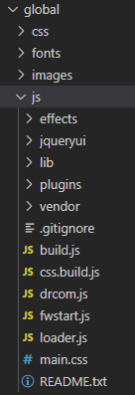
Structure of global in asset
Include the CSS files of global
JQuery DRCOM FW
Include the functions have already

Slide 4
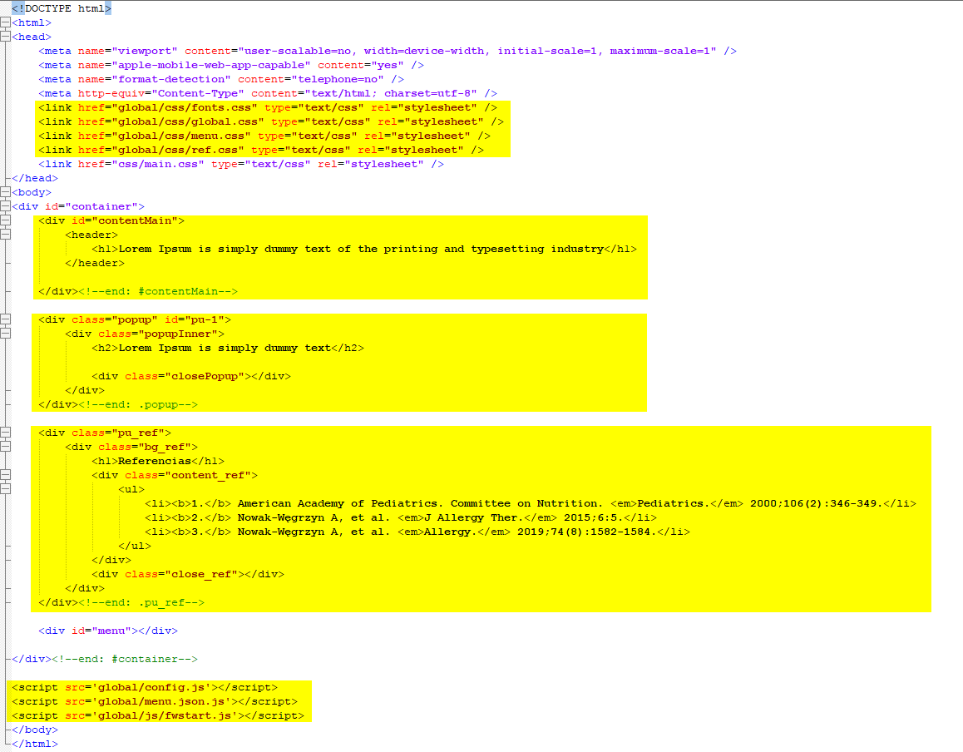
Present in HTML
In index.html:
This is the link the global
JQuery DRCOM FW
Use to write the code in here
Use to write the code for popup. If it has more 2 popup, you should put id for each div tag
Use to code the reference content
This is the links

Slide 5


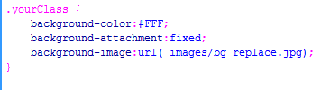

Notes in CSS
In main.css:
JQuery DRCOM FW

Slide 6
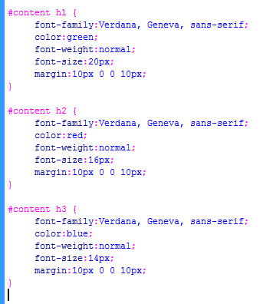
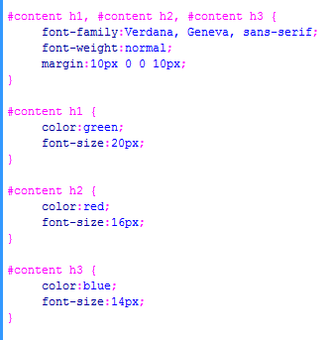
Notes in CSS
In main.css:
JQuery DRCOM FW

Slide 7
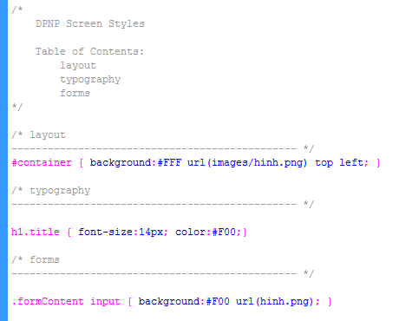
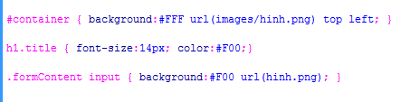
Notes in CSS
In main.css:
Group your styles into categories (ex. layout, typography, forms, so on) and visually separate them in your css file. A title and table of contents doesn't hurt either:
JQuery DRCOM FW

Slide 8
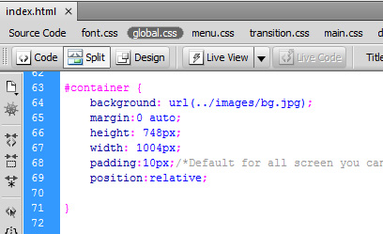
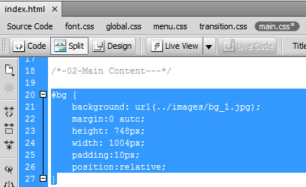
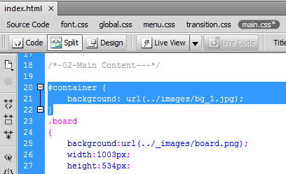
Notes in CSS
In main.css:
JQuery DRCOM FW

Slide 9
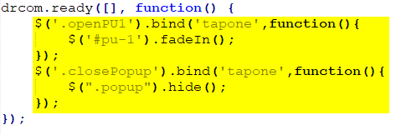
How to code in main.js
In main.js:
Coding in here
JQuery DRCOM FW

Slide 10
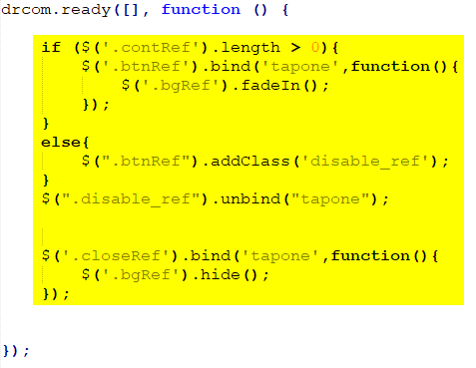
How to code in global.js
In global/global.js:
Coding in here
JQuery DRCOM FW

Slide 11
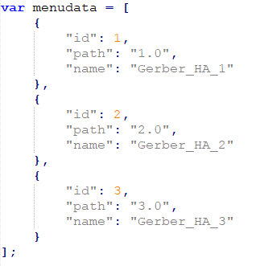
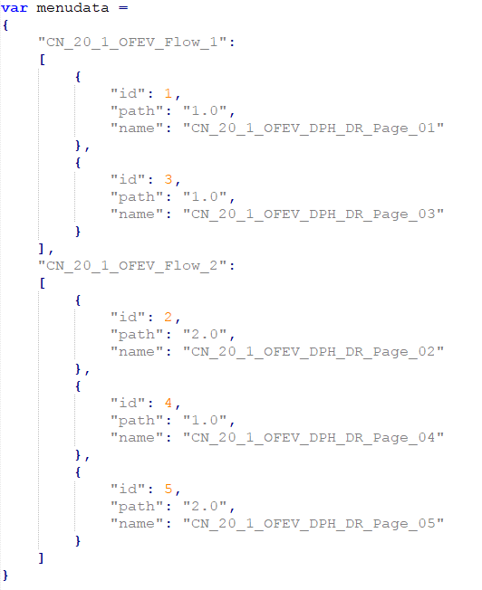
How to create menu for eDA
In global/menu.json:
This is the menu single flow
This is the menu multi flow
JQuery DRCOM FW

Slide 12
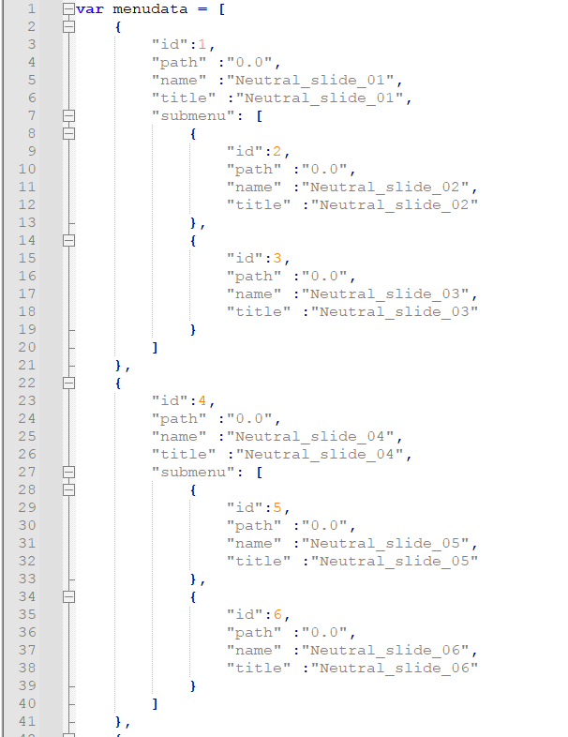
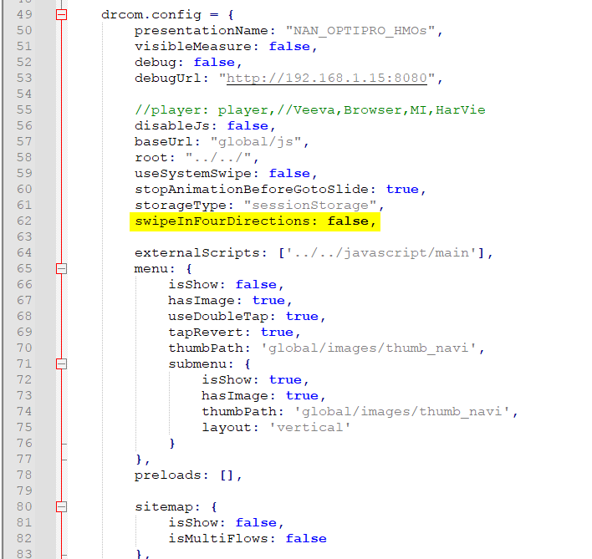
How to swipe up/dowm in a chapter
1
2
JQuery DRCOM FW
If you want to swipe up/down in chapter
1. In menu.json: add submenu
2. In config.js:
swipeInFourDirections: false
change to
swipeInFourDirections: true

Slide 13
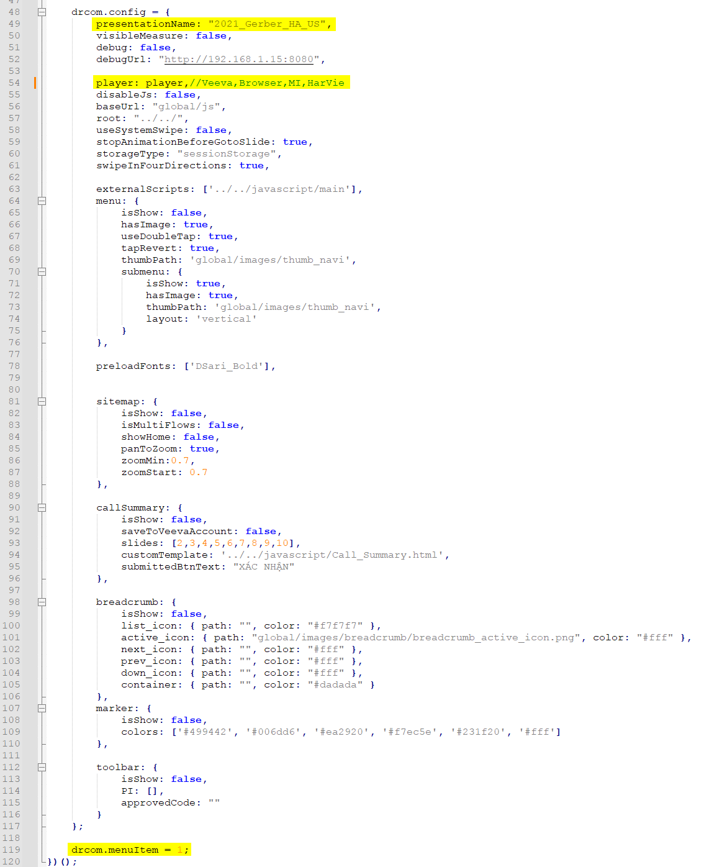
How to config for a eDA
The name presentation puts for each eDA
It should work when we upload on Veeva
JQuery DRCOM FW
This is id for each asset

Slide 14
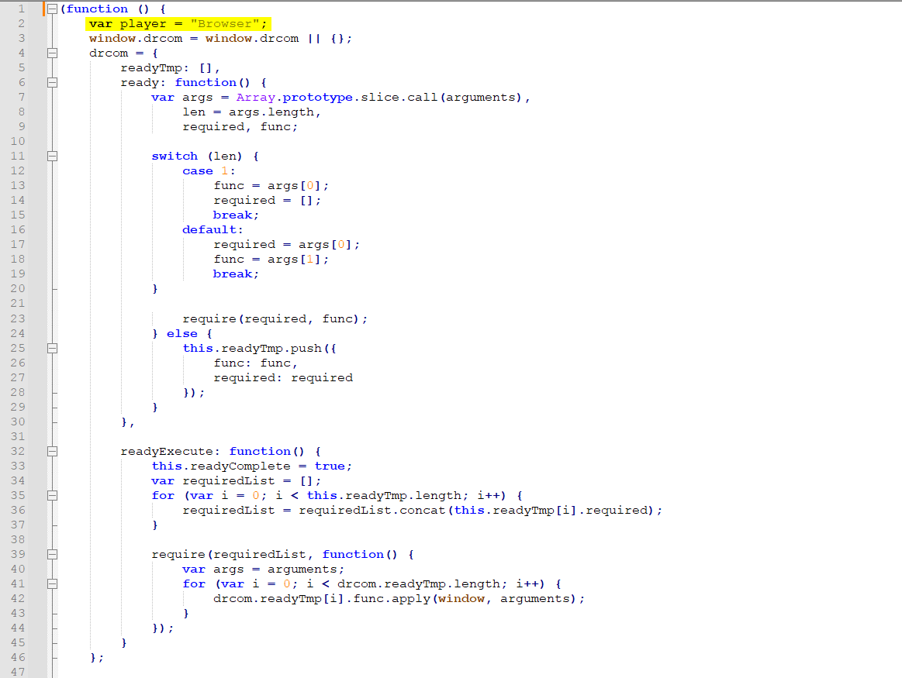
How to config uploading on Veeva
When uploading on SF, we need to change “Browser” to “Veeva”
JQuery DRCOM FW

Slide 15
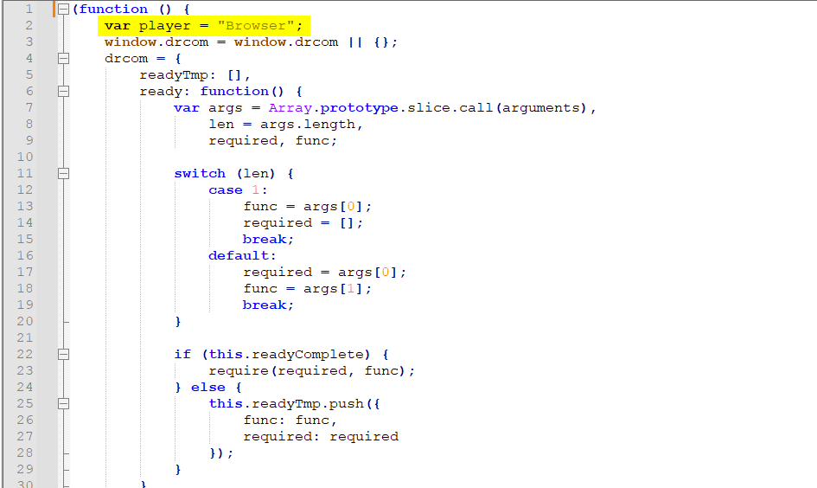
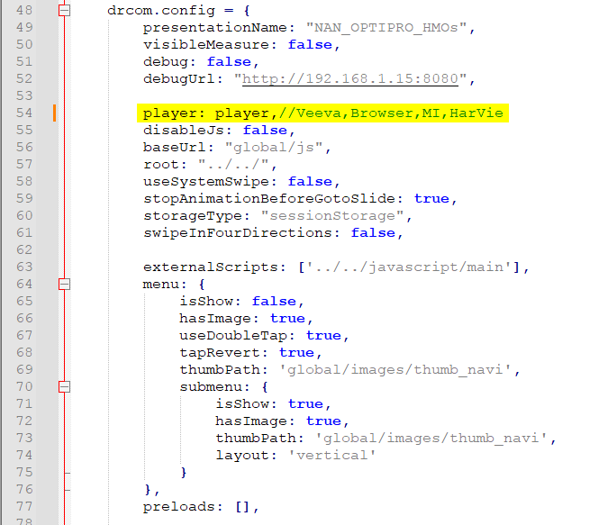
How to config uploading on Veeva Window
JQuery DRCOM FW
if eDa works on veeva window, we need adjust 2 place 1 and 2 in config.js file

Slide 16
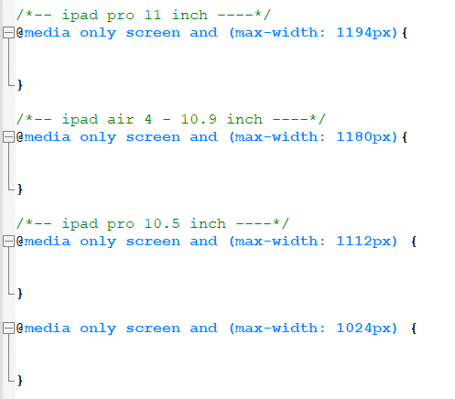
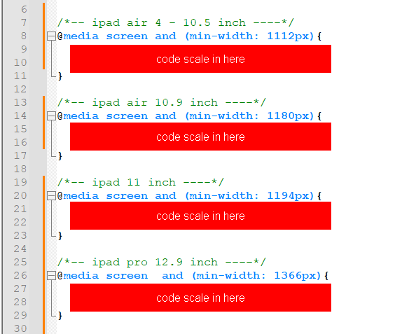
How to use responsive CSS
If the eDa made base on the size ipad Pro 12.9 inch, we use the media tag max-width
If the eDa made base on the size ipad 9.7 inch, we use the media tag min-width
Css scale in here
Css scale in here
JQuery DRCOM FW
Css scale in here
Css scale in here
Css scale in here
Css scale in here
Css scale in here
Css scale in here

Slide 17
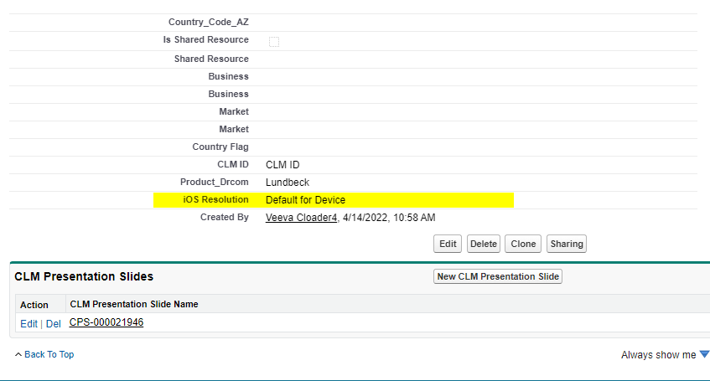
How to config responsive in Salesforce
With eDA work on more 2 devices, we need to choose
iOS Resolution: Default for Device
JQuery DRCOM FW

