Slide 1
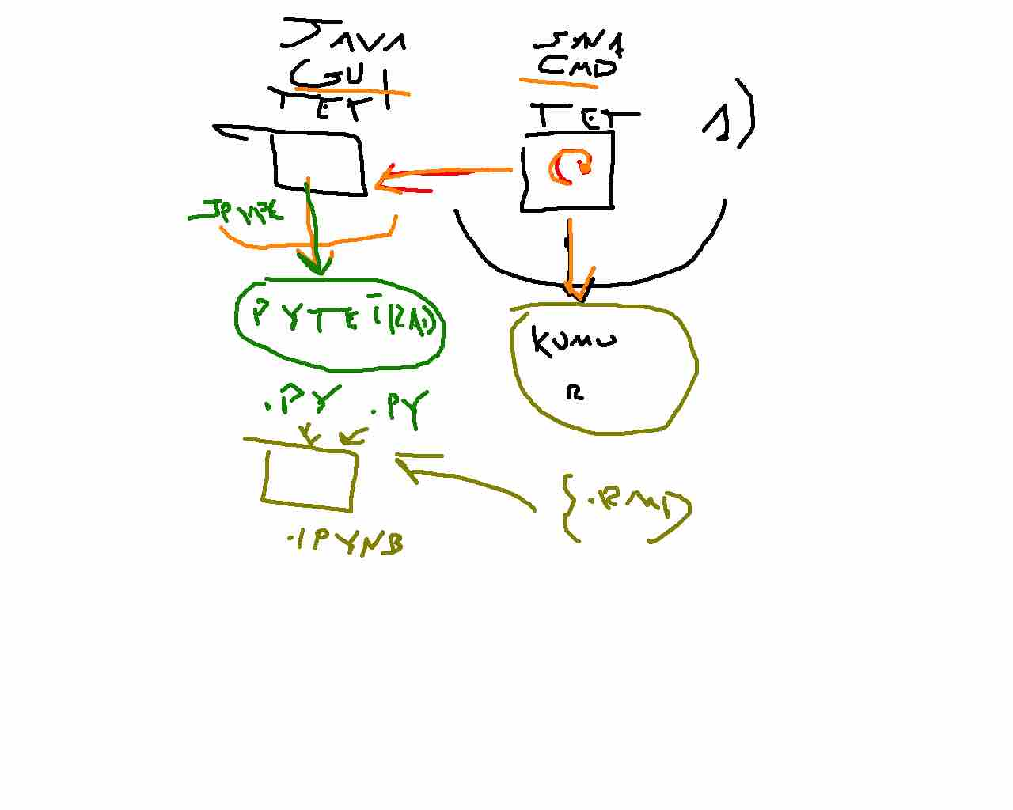

Slide 2
About
Diagram
Command Line Interface
Iteration 1
Pykumu is a Python module that serves as a wrapper over the Tetrad Java API (via JPype), providing an interface for causal discovery algorithms.
Project Config
Causal Graph Visualization
End-to-End Workflow
Folder Organization

Slide 3
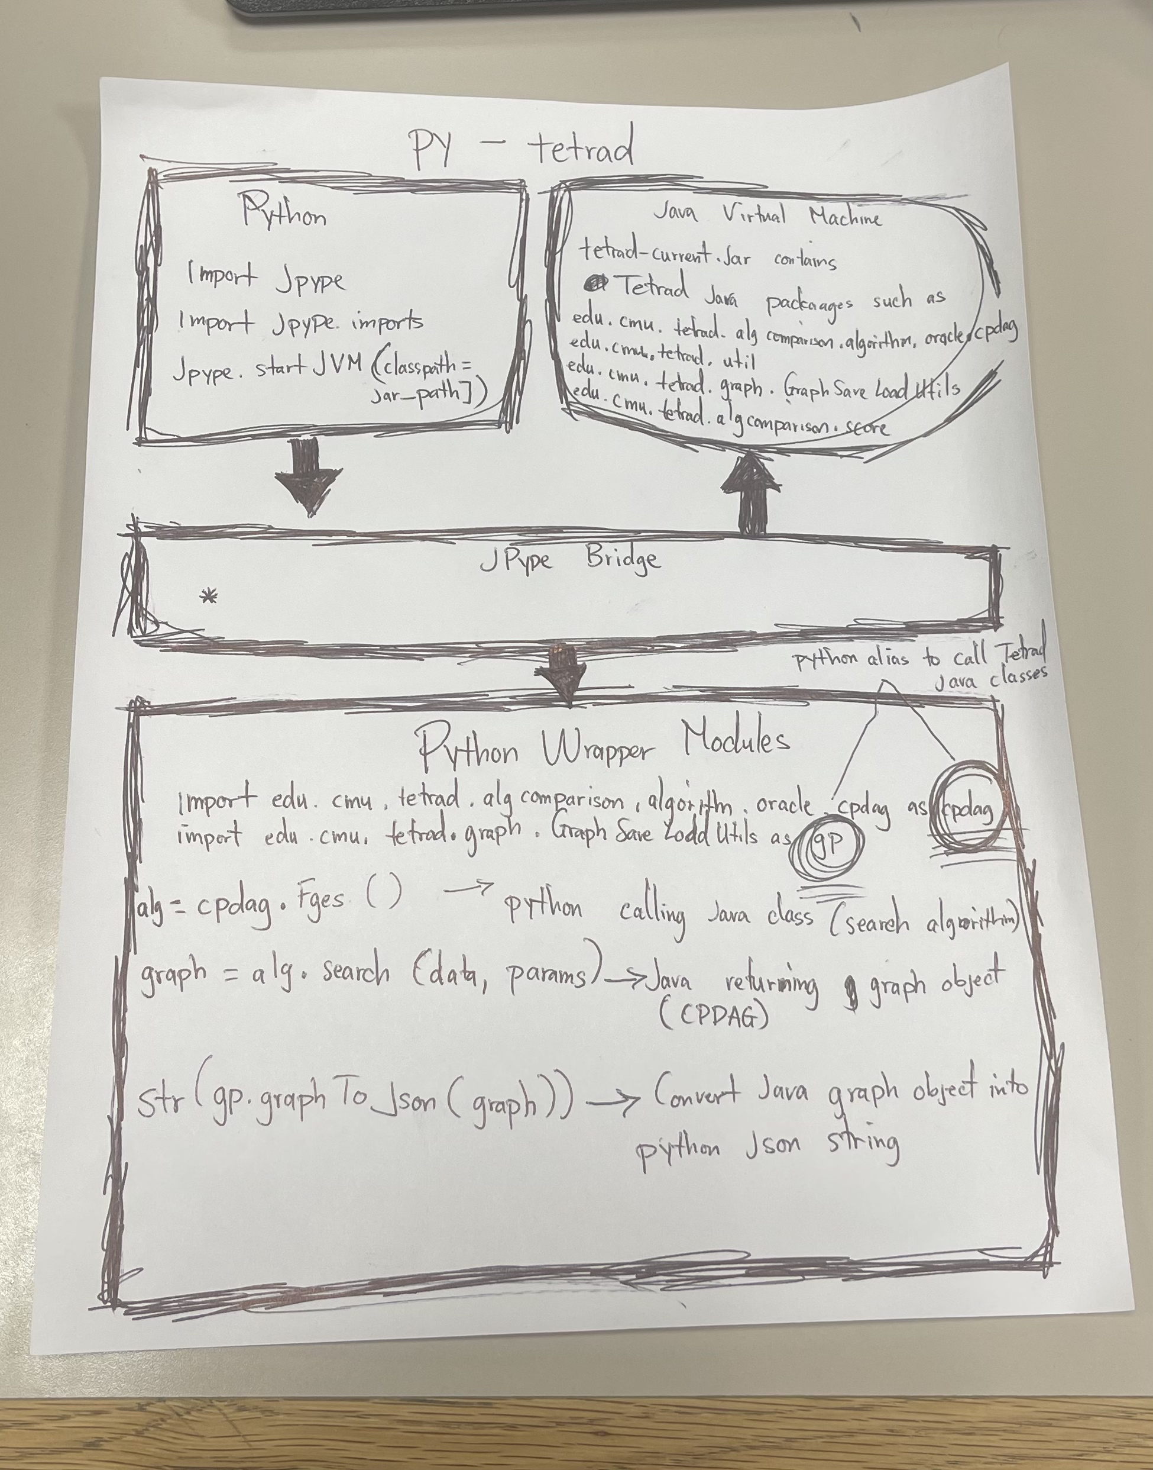

Slide 4
Causal Analysis Workflow
Iteration 3
Causal Discovery
Data Prep
Feature Engineering
Null Variable Calibration
Threshold Derivation
Edge Filtering
Graph Interpretation
Tetrad Java API
Pykumu API
cpdag.Fges
cpdag.Boss
SemBicScore
Parameters
Knowledge
BoxDataSet
GraphSaveLoad
Utils
run_fges()
run_boss()
use_sem_bic()
load_continuous
load_knowledge()
pandas_data_to
_tetrad()
get_json()
JPype
Imports Java classes into Python

Slide 5
Causal Analysis Workflow
Iteration 1
Data Prep
Feature Engineering
Null Variable Calibration
Threshold Derivation
Causal Discovery
Edge Filtering
Graph Interpretation
TetradSearch Class
Pykumu
Tetrad Java API
import edu.cmu.tetrad.algcomparison.algorithm.oracle.cpdag as cpdag
class TetradSearch:
def run_fges(self, …)
alg = cpdag.Fges(self.SCORE)
self.java = alg.search(...)
import api.TetradSearch as ts
search = ts.TetradSearch(data)
search.run_fges()
JPype
tetrad-current.jar contains Tetrad Java packages

Slide 6
Causal Analysis Workflow
Iteration 2
Causal Discovery
Data Prep
Feature Engineering
Null Variable Calibration
Threshold Derivation
Edge Filtering
Graph Interpretation
Pykumu
Tetrad Java API
import api.TetradSearch as ts
search = ts.TetradSearch(data)
search.run_fges()
JPype
tetrad-current.jar contains Tetrad Java packages
import edu.cmu.tetrad.algcomparison.algorithm.oracle.cpdag as cpdag
class TetradSearch:
def run_fges(self, …)
alg = cpdag.Fges(self.SCORE)
self.java = alg.search(...)
TetradSearch Class

Slide 7
Causal Analysis Workflow
Iteration 3
Causal Discovery
Data Prep
Feature Engineering
Null Variable Calibration
Threshold Derivation
Edge Filtering
Graph Interpretation
Pykumu
Tetrad Java API
import api.TetradSearch as ts
search = ts.TetradSearch(data)
search.run_fges()
JPype
tetrad-current.jar contains Tetrad Java packages
import edu.cmu.tetrad.algcomparison.algorithm.oracle.cpdag as cpdag
class TetradSearch:
def run_fges(self, …)
alg = cpdag.Fges(self.SCORE)
self.java = alg.search(...)
TetradSearch Class

Slide 8
About
Causal Analysis Workflow
Related Notebook
To identify causal relationships between software development activities, developer communication patterns, community smells, and security vulnerabilities using bootstrapped causal search with null variable thresholding.
issue_causal_analysis.ipynb
Iteration 2
Pykumu is a Python module that serves as a wrapper over the Tetrad Java API (via JPype), providing an interface for causal analysis algorithms.
Raw Data
Feature Engineering
Feature Engineering
- Clean up raw data by converting fields to numeric types, removing rows with missing data, filling in gaps with zero, and shortening column names for graph labels.
- Create time-lagged copies of each variable so the causal search can pick up relationships across time periods.
- Remove redundant and highly correlated variables, and drop CVEs that don't have enough time periods for reliable analysis.
- Normalize the data to satisfy scoring assumptions, and convert each CVE into its own binary indicator for individual vulnerability tracking.
- Generate shuffled null variables that have no real relationships, which serve as a baseline for filtering out edges formed by chance.
Pykumu
Tetrad Java API
Null Variable Search
Domain Knowledge Search
import api.TetradSearch as ts
search = ts.TetradSearch(data)
search.run_fges()
JPype
tetrad-current.jar contains Tetrad Java packages
import edu.cmu.tetrad.algcomparison.algorithm.oracle.cpdag as cpdag
class TetradSearch:
def run_fges(self, …)
alg = cpdag.Fges(self.SCORE)
self.java = alg.search(...)
Threshold Derivation
Apply Threshold
TetradSearch Class
1-PNEF Threshold
Command line interface
- Look at how often edges formed between null variables across all bootstrap runs to see how frequently random edges appear by chance.
- From that, derive the 1PNEF threshold, the cutoff point where edges below it are likely formed by random chance.
- Run a domain constrained causal search on only the real variables, with temporal rules that prevent future features from causing past features.
- Apply the 1PNEF threshold to filter out edges from the domain search that formed less often than the random baseline.

Slide 9
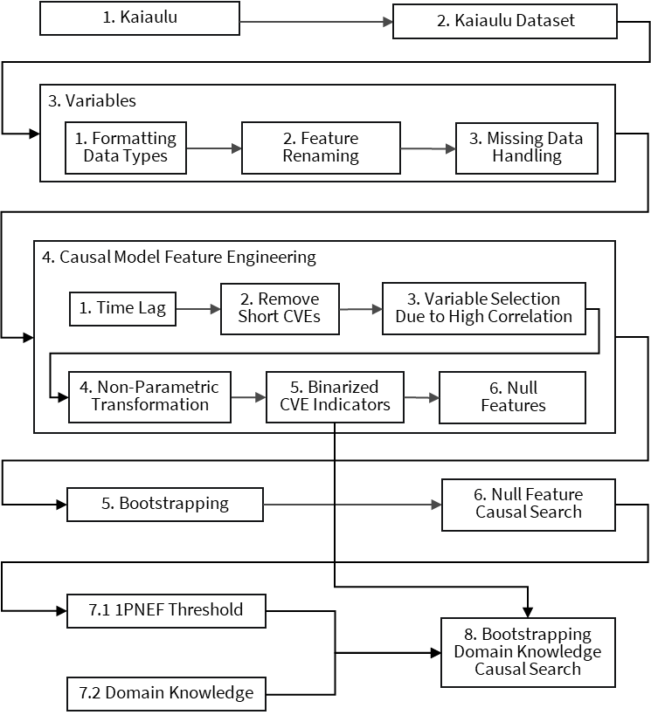
About
Causal Analysis Workflow
Related Notebook
To identify causal relationships between software development activities, developer communication patterns, community smells, and security vulnerabilities using bootstrapped causal search with null variable thresholding.
issue_causal_analysis.ipynb
Iteration 3
Pykumu is a Python module that serves as a wrapper over the Tetrad Java API (via JPype), providing an interface for causal analysis algorithms.
Feature Engineering
import edu.cmu.tetrad.algcomparison.algorithm.oracle.cpdag as cpdag
def run_fges(self, …)
alg = cpdag.Fges(self.SCORE)
self.java = alg.search(...)
- Clean up raw data by converting fields to numeric types, removing rows with missing data, filling in gaps with zero, and shortening column names for graph labels.
- Create time-lagged copies of each variable so the causal search can pick up relationships across time periods.
- Remove redundant and highly correlated variables, and drop CVEs that don't have enough time periods for reliable analysis.
- Normalize the data to satisfy scoring assumptions, and convert each CVE into its own binary indicator for individual vulnerability tracking.
- Generate shuffled null variables that have no real relationships, which serve as a baseline for filtering out edges formed by chance.
Pykumu
Tetrad Java API
import api.TetradSearch as ts
search = ts.TetradSearch(data)
search.run_fges()
/api
JPype
tetrad-current.jar contains Tetrad Java packages
import edu.cmu.tetrad.algcomparison.algorithm.oracle.cpdag as cpdag
class TetradSearch:
def run_fges(self, …)
alg = cpdag.Fges(self.SCORE)
self.java = alg.search(...)
1-PNEF Threshold
TetradSearch Class
- Look at how often edges formed between null variables across all bootstrap runs to see how frequently random edges appear by chance.
- From that, derive the 1PNEF threshold, the cutoff point where edges below it are likely formed by random chance.
- Run a domain constrained causal search on only the real variables, with temporal rules that prevent future features from causing past features.
- Apply the 1PNEF threshold to filter out edges from the domain search that formed less often than the random baseline.
Command line interface

Slide 10



Pykumu : : CHEAT SHEET
About
Causal Analysis Workflow
Data Input
Pykumu is a Python package that serves as a wrapper over the Tetrad Java API (via JPype), providing an interface for causal analysis algorithms. Pykumu is a fork of py-tetrad/pytetrad.
From an example of a dataset, see issue_social_smell_showcase.Rmd. Refer to cheatsheets/social-smells-cheatsheet.pdf
1. sailuh/kaiaulu
2. Dataset
API Initialization
Pykumu API
CVE_ID
x
After applying time lag and features, we initiate the API and turn the dataset into a Tetrad compatible format.
1. start()
Import jpype to start JVM and load Tetrad jar file.
2. load_continuous()
Convert pandas DataFrames into Tetrad data format and initialize search state.
x
t
t + 1
4. Indicator Features
edu.cmu…
Jpype
tetrad.py
algorithm.py
score.py
3. Time Lag
Tetrad Java API
Pykumu API
NV-ID
Jpype
run_fges()
causes
TetradSearch Class
Causal Analysis Function
TetradSearch.py
t
Ind. Ftr
t + 1
Causal search is run on dataset including null features, used to derive 1-PNEF.
1. use_sem_bic()
Configure SEM BIC score.
2. set_bootstrapping()
Configure bootstrapping parameters.
3. run_fges()
Performs Fast Greedy Equivalence Search (FGES) algorithm.
4. run_boss()
Performs Best Order Score Search (BOSS) algorithm.
5. get_json
Convert Tetrad graph object to JSON format.
5. Null Features
6. Causal Search
Pykumu wraps the Tetrad Java API through JPype, exposing individual modules in pykumu/api (data, score, algorithm, graph, knowledge, bootstrapping) that provide direct function level control over each step of the causal search pipeline. Pykumu expands on the TetradSearch API by breaking its single object, shared state pipeline into individual modules.
causes
n.edges < x%
7.1 1-PNEF Threshold
t + 1
t
Knowledge Box
8. Domain Knowledge Causal Search
Tier 1
Tier 2
Command Line Interface
Tier 3
7.2 Domain Knowledge
Pykumu API
<File_paths>
Domain Knowledge
mis_link
Causal search is ran again with domain knowledge applied, then resulting graph is filtered using 1-PNEF threshold.
1. load_knowledge()
Load domain knowledge constraints.
2. parse_graph()
Parse Tetrad JSON data into nodes, edgeset, and edge_type_probabilities datasets.
exec/
Output
Causal Search Output
code_dev
mis_link2
Exec scripts provides command line access to Pykumu API package, allowing its causal analysis capabilities to be accessed via the terminal or server side without writing Python code.
churn
commit
commit2
Kumu
CC BY SA Phuong Pham, Carlos Paradis, Adam Graham, Jared Seto • Kaiāulu package version 0.0.0.9700 (in development) • Updated: 2026-04

Slide 11
Pykumu : : CHEAT SHEET
About
Causal Analysis Workflow
Data Input
Pykumu is a Python package that serves as a wrapper over the Tetrad Java API (via JPype), providing an interface for causal analysis algorithms. Pykumu is a fork of py-tetrad/pytetrad.
From an example of a dataset, see issue_social_smell_showcase.Rmd. Refer to cheatsheets/social-smells-cheatsheet.pdf
1. sailuh/kaiaulu
2. Dataset
Import Tetrad
Pykumu API
CVE_ID
x
After applying time lag and features, jpype is imported to utilize API and turn the dataset into a Tetrad compatible format.
1. tetrad()
Import jpype to start JVM and load Tetrad jar file.
2. load_data()
Convert pandas DataFrames into Tetrad data format and initialize search state.
x
edu.cmu…
Jpype
tetrad.py
algorithm.py
score.py
t
t + 1
4. Indicator Features
Tetrad Java API
Pykumu API
3. Time Lag
Jpype
run_fges()
NV-ID
TetradSearch Class
causes
Causal Analysis Function
TetradSearch.py
Causal search is run on dataset including null features, used to derive 1-PNEF.
1. score_sem_bic()
Configure SEM BIC score.
2. bootstrapping()
Configure bootstrapping parameters.
3. algorithm_fges()
Performs Fast Greedy Equivalence Search (FGES) algorithm.
4. algorithm_boss()
Performs Best Order Score Search (BOSS) algorithm.
t
Ind. Ftr
t + 1
Pykumu wraps the Tetrad Java API through JPype, exposing individual modules in pykumu/api (data, score, algorithm, graph, knowledge, bootstrapping) that provide direct function level control over each step of the causal search pipeline. Pykumu expands on the TetradSearch API by breaking its single object, shared state pipeline into individual modules.
5. Null Features
6. Causal Search
causes
n.edges < x%
7.1 1-PNEF Threshold
t + 1
t
Knowledge Box
8. Domain Knowledge Causal Search
Tier 1
Command Line Interface
Tier 2
Tier 3
Domain Knowledge
.
7.2 Domain Knowledge
.
Causal search is ran again with domain knowledge applied.
1. load_knowledge()
Load domain knowledge constraints.
.
notebook/
Pykumu API
<File_paths>
.json
Tetrad GUI
File
Logging
Parse Graph
Graph
Edit
Pipelines
Window
Help
Causal graph output is converted and saved in JSON format that can be loaded and viewed in Tetrad GUI. Parsing graph data into nodes, edgeset, and edge_type_probabilities allows 1-PNEF to be applied.
1. get_json
Convert Tetrad graph object to JSON format.
2. parse_graph()
Parse Tetrad JSON data into nodes, edgeset, and edge_type_probabilities datasets.
Compare
Grid Search
Parametric Model
Simulation
exec/
Latent Cluster
Latent Structure
Knowledge
Updater
Exec scripts provides command line access to Pykumu API package, allowing its causal analysis capabilities to be accessed via the terminal or server side without writing Python code.
Regression
.json
Tetrad GUI
Kumu
CC BY SA Phuong Pham, Carlos Paradis, Adam Graham, Jared Seto • Kaiāulu package version 0.0.0.9700 (in development) • Updated: 2026-04

Slide 12
Pykumu : : CHEAT SHEET
About
Causal Analysis Workflow
Data Input
Pykumu is a Python package that serves as a wrapper over the Tetrad Java API (via JPype), providing an interface for causal analysis algorithms. Pykumu is a fork of py-tetrad/pytetrad.
From an example of a dataset, see issue_social_smell_showcase.Rmd. Refer to cheatsheets/social-smells-cheatsheet.pdf
1. sailuh/kaiaulu
2. Dataset
Import Tetrad
Pykumu API
CVE_ID
x
After applying time lag and features, jpype is imported to utilize API and turn the dataset into a Tetrad compatible format.
1. tetrad()
Import jpype to start JVM and load Tetrad jar file.
2. transform_pandas_to_tetrad()
Convert pandas DataFrames into Tetrad data format and initialize search state.
x
edu.cmu…
Jpype
tetrad.py
algorithm.py
score.py
t
t + 1
4. Indicator Features
Tetrad Java API
Pykumu API
3. Time Lag
Jpype
run_fges()
NV-ID
TetradSearch Class
causes
Causal Analysis Function
TetradSearch.py
Causal search is run on dataset including null features, used to derive 1-PNEF.
1. score_sem_bic()
Configure SEM BIC score.
2. bootstrapping()
Configure bootstrapping parameters.
3. algorithm_fges()
Performs Fast Greedy Equivalence Search (FGES) algorithm.
4. algorithm_boss()
Performs Best Order Score Search (BOSS) algorithm.
t
Ind. Ftr
t + 1
Pykumu wraps the Tetrad Java API through JPype, exposing individual modules in pykumu/api (data, score, algorithm, graph, knowledge, bootstrapping) that provide direct function level control over each step of the causal search pipeline. Pykumu expands on the TetradSearch API by breaking its single object, shared state pipeline into individual modules.
5. Null Features
6. Causal Search
causes
n.edges < x%
7.1 1-PNEF Threshold
t + 1
t
Knowledge Box
8. Domain Knowledge Causal Search
Tier 1
Command Line Interface
Tier 2
Tier 3
Domain Knowledge
.
7.2 Domain Knowledge
.
Causal search is ran again with domain knowledge applied.
1. load_domain_knowledge_constraints()
Load forbidden/required edges and temporal tiers from a file into Tetrad knowledge object.
.
notebook/
Pykumu API
<File_paths>
.json
Tetrad GUI
File
Logging
Causal Transform
Graph
Edit
Pipelines
Window
Help
Causal graph output is converted and saved in JSON format that can be loaded and viewed in Tetrad GUI. Parsing graph data into nodes, edgeset, and edge_type_probabilities allows 1-PNEF to be applied.
1. transform_tetrad_to_json()
Convert Tetrad graph object to JSON format.
2. transform_tetrad_to_network()
Parse Tetrad JSON data into nodes, edgeset, and edge_type_probabilities datasets.
Compare
Grid Search
Parametric Model
Simulation
exec/
Latent Cluster
Latent Structure
Knowledge
Updater
Exec scripts provides command line access to Pykumu API package, allowing its causal analysis capabilities to be accessed via the terminal or server side without writing Python code.
Regression
.json
Tetrad GUI
Kumu
CC BY SA Phuong Pham, Carlos Paradis, Adam Graham, Jared Seto • Kaiāulu package version 0.0.0.9700 (in development) • Updated: 2026-04

Slide 13
Pykumu : : CHEAT SHEET
About
Causal Analysis Workflow
Data Input
Pykumu is a Python package that serves as a wrapper over the Tetrad Java API (via JPype), providing an interface for causal analysis algorithms. Pykumu is a fork of py-tetrad/pytetrad.
From an example of a dataset, see issue_social_smell_showcase.Rmd. Refer to cheatsheets/social-smells-cheatsheet.pdf
1. sailuh/kaiaulu
2. Dataset
Import Tetrad
Pykumu API
CVE_ID
x
After applying time lag and features, jpype is imported to utilize API and turn the dataset into a Tetrad compatible format.
1. tetrad()
Import jpype to start JVM and load Tetrad jar file.
2. transform_pandas_to_tetrad()
Convert pandas DataFrames into Tetrad data format and initialize search state.
x
edu.cmu…
Jpype
tetrad.py
algorithm.py
score.py
t
t + 1
4. Indicator Features
Tetrad Java API
Pykumu API
3. Time Lag
Jpype
run_fges()
NV-ID
TetradSearch Class
causes
Causal Analysis Function
TetradSearch.py
Causal search is run on dataset including null features, used to derive 1-PNEF.
1. score_sem_bic()
Configure SEM BIC score.
2. bootstrapping()
Configure bootstrapping parameters.
3. algorithm_fges()
Performs Fast Greedy Equivalence Search (FGES) algorithm.
4. algorithm_boss()
Performs Best Order Score Search (BOSS) algorithm.
t
Ind. Ftr
t + 1
Pykumu wraps the Tetrad Java API through JPype, exposing individual modules in pykumu/api (data, score, algorithm, graph, knowledge, bootstrapping) that provide direct function level control over each step of the causal search pipeline. Pykumu expands on the TetradSearch API by breaking its single object, shared state pipeline into individual modules.
5. Null Features
6. Causal Search
causes
n.edges < x%
7.1 1-PNEF Threshold
t + 1
t
Knowledge Box
8. Domain Knowledge Causal Search
Tier 1
Command Line Interface
Tier 2
Tier 3
Domain Knowledge
.
7.2 Domain Knowledge
.
Causal search is ran again with domain knowledge applied.
1. load_domain_knowledge_constraints()
Load forbidden/required edges and temporal tiers from af.txt file into Tetrad knowledge object.
.
notebook/
Pykumu API
<File_paths>
.json
Tetrad GUI
File
Logging
Causal Transform
Graph
Edit
Pipelines
Window
Help
Causal graph output is converted and saved in JSON format that can be loaded and viewed in Tetrad GUI. Parsing graph data into nodes, edgeset, and edge_type_probabilities allows 1-PNEF to be applied.
1. transform_tetrad_graph_to_json()
Convert Tetrad graph object to JSON format.
2. parse_tetrad_json()
Parse Tetrad JSON data into nodes, edgeset, and edge_type_probabilities datasets.
Compare
Grid Search
Parametric Model
Simulation
exec/
Latent Cluster
Latent Structure
Knowledge
Updater
Exec scripts provides command line access to Pykumu API package, allowing its causal analysis capabilities to be accessed via the terminal or server side without writing Python code.
Regression
.json
Tetrad GUI
Kumu
CC BY SA Phuong Pham, Carlos Paradis, Adam Graham, Jared Seto • Kaiāulu package version 0.0.0.9700 (in development) • Updated: 2026-04

Slide 14
Pykumu : : CHEAT SHEET
About
Causal Analysis Workflow
API
Pykumu is a Python package that serves as a wrapper over the Tetrad Java API (via JPype), providing an interface for causal analysis algorithms. Pykumu is a fork of py-tetrad/pytetrad.
From an example of a dataset, see issue_social_smell_showcase.Rmd. Refer to cheatsheets/social-smells-cheatsheet.pdf
1. sailuh/kaiaulu
2. Dataset
Import Tetrad
Pykumu API
CVE_ID
x
After applying time lag and features, jpype is imported to utilize API and turn the dataset into a Tetrad compatible format.
1. tetrad_jvm_start()
Import jpype to start JVM and load Tetrad jar file.
2. transform_pandasdf_to_tetrad_boxdataset()
Convert pandas DataFrames into Tetrad BoxDataset and initialize search state.
x
edu.cmu…
Jpype
tetrad.py
algorithm.py
score.py
t
t + 1
4. Indicator Features
Tetrad Java API
Pykumu API
3. Time Lag
Jpype
run_fges()
NV-ID
TetradSearch Class
causes
Causal Search
TetradSearch.py
Causal search is run on dataset including null features, used to derive 1-PNEF.
1. score_sem_bic()
Configure SEM BIC score.
2. bootstrapping()
Configure bootstrapping parameters.
3. algorithm_fges()
Performs Fast Greedy Equivalence Search (FGES) algorithm.
4. algorithm_boss()
Performs Best Order Score Search (BOSS) algorithm.
t
Ind. Ftr
t + 1
Pykumu wraps the Tetrad Java API through JPype, exposing individual modules in pykumu/api (data, score, algorithm, graph, knowledge, bootstrapping) that provide direct function level control over each step of the causal search pipeline. Pykumu expands on the TetradSearch API by breaking its single object, shared state pipeline into individual modules.
5. Null Features
6. Causal Search
causes
n.edges < x%
7.1 1-PNEF Threshold
t + 1
t
Knowledge Box
8. Domain Knowledge Causal Search
Tier 1
Command Line Interface
Tier 2
Tier 3
Domain Knowledge
.
7.2 Domain Knowledge
.
Causal search is ran again with domain knowledge applied.
1. parse_knowledge_txt()
Load forbidden/required edges and temporal tiers from a .txt file into Tetrad knowledge object.
.
notebook/
Pykumu API
<File_paths>
.json
Tetrad GUI
File
Logging
Causal Graph Transform
Graph
Edit
Pipelines
Window
Help
Causal graph output is converted and saved in JSON format that can be loaded and viewed in Tetrad GUI. Parsing graph data into nodes, edgeset, and edge_type_probabilities allows 1-PNEF to be applied.
1. transform_graph_java_to_graph_json()
Convert Tetrad graph object to JSON format.
2. parse_graph_json()
Parse Tetrad JSON data into nodes, edgeset, and edge_type_probabilities datasets.
Compare
Grid Search
Parametric Model
Simulation
exec/
Latent Cluster
Latent Structure
Knowledge
Updater
Exec scripts provides command line access to Pykumu API package, allowing its causal analysis capabilities to be accessed via the terminal or server side without writing Python code.
Regression
.json
Tetrad GUI
Kumu
CC BY SA Phuong Pham, Carlos Paradis, Adam Graham, Jared Seto • Kaiāulu package version 0.0.0.9700 (in development) • Updated: 2026-04

Slide 15
Pykumu : : CHEAT SHEET
About
Causal Analysis Workflow
API
Pykumu is a Python package that serves as a wrapper over the Tetrad Java API (via JPype), providing an interface for causal analysis algorithms. Pykumu is a fork of py-tetrad/pytetrad.
From an example of a dataset, see issue_social_smell_showcase.Rmd. Refer to cheatsheets/social-smells-cheatsheet.pdf
1. sailuh/kaiaulu
2. Dataset
tetrad.py
Pykumu API
CVE_ID
x
After applying time lag and features, jpype is imported to utilize API and turn the dataset into a Tetrad compatible format.
1. tetrad_jvm_start()
Import jpype to start JVM and load Tetrad jar file.
2. transform_pandasdf_to_tetrad_boxdataset()
Convert pandas DataFrames into Tetrad BoxDataset and initialize search state.
x
edu.cmu…
Jpype
tetrad.py
algorithm.py
score.py
t
t + 1
4. Indicator Features
Tetrad Java API
Pykumu API
3. Time Lag
Jpype
run_fges()
NV-ID
TetradSearch Class
causes
causal.py
TetradSearch.py
Causal search is run on dataset including null features, used to derive 1-PNEF.
1. score_sem_bic()
Configure SEM BIC score.
2. bootstrapping()
Configure bootstrapping parameters.
3. algorithm_fges()
Performs Fast Greedy Equivalence Search (FGES) algorithm.
4. algorithm_boss()
Performs Best Order Score Search (BOSS) algorithm.
t
Ind. Ftr
t + 1
Pykumu wraps the Tetrad Java API through JPype, exposing individual modules in pykumu/api (data, score, algorithm, graph, knowledge, bootstrapping) that provide direct function level control over each step of the causal search pipeline. Pykumu expands on the TetradSearch API by breaking its single object, shared state pipeline into individual modules.
5. Null Features
6. Causal Search
causes
n.edges < x%
7.1 1-PNEF Threshold
t + 1
t
Knowledge Box
8. Domain Knowledge Causal Search
Tier 1
Command Line Interface
Tier 2
Tier 3
knowledge.py
.
7.2 Domain Knowledge
.
Causal search is ran again with domain knowledge applied.
1. parse_knowledge_txt()
Load forbidden/required edges and temporal tiers from a .txt file into Tetrad knowledge object.
.
notebook/
Pykumu API
<File_paths>
.json
Tetrad GUI
File
Logging
graph.py
Graph
Edit
Pipelines
Window
Help
Causal graph output is converted and saved in JSON format that can be loaded and viewed in Tetrad GUI. Parsing graph data into nodes, edgeset, and edge_type_probabilities allows 1-PNEF to be applied.
1. transform_graph_java_to_graph_json()
Convert Tetrad graph object to JSON format.
2. parse_graph_json()
Parse Tetrad JSON data into nodes, edgeset, and edge_type_probabilities datasets.
Compare
Grid Search
Parametric Model
Simulation
exec/
Latent Cluster
Latent Structure
Knowledge
Updater
Exec scripts provides command line access to Pykumu API package, allowing its causal analysis capabilities to be accessed via the terminal or server side without writing Python code.
Regression
.json
Tetrad GUI
Kumu
CC BY SA Phuong Pham, Carlos Paradis, Adam Graham, Jared Seto • Kaiāulu package version 0.0.0.9700 (in development) • Updated: 2026-04

Slide 16
Pykumu : : CHEAT SHEET
About
Causal Analysis Workflow
API
Pykumu is a Python package that serves as a wrapper over the Tetrad Java API (via JPype), providing an interface for causal analysis algorithms. Pykumu is a fork of py-tetrad/pytetrad.
From an example of a dataset, see issue_social_smell_showcase.Rmd. Refer to cheatsheets/social-smells-cheatsheet.pdf
1. sailuh/kaiaulu
2. Dataset
tetrad.py
Pykumu API
CVE_ID
x
After applying time lag and features, jpype is imported to utilize API and turn the dataset into a Tetrad compatible format.
1. tetrad_jvm_start()
Import jpype to start JVM and load Tetrad jar file.
2. transform_pandasdf_to_tetrad_boxdataset()
Convert pandas DataFrames into Tetrad BoxDataset and initialize search state.
x
edu.cmu…
Jpype
tetrad.py
algorithm.py
score.py
t
t + 1
4. Indicator Features
Tetrad Java API
Pykumu API
3. Time Lag
Jpype
run_fges()
NV-ID
TetradSearch Class
causes
causal.py
TetradSearch.py
Causal search is run on dataset including null features, used to derive 1-PNEF.
1. score_sem_bic()
Configure SEM BIC score.
2. bootstrapping()
Configure bootstrapping parameters.
3. algorithm_fges()
Performs Fast Greedy Equivalence Search (FGES) algorithm.
4. algorithm_boss()
Performs Best Order Score Search (BOSS) algorithm.
t
Ind. Ftr
t + 1
Pykumu wraps the Tetrad Java API through JPype, exposing individual modules in pykumu/api (data, score, algorithm, graph, knowledge, bootstrapping) that provide direct function level control over each step of the causal search pipeline. Pykumu expands on the TetradSearch API by breaking its single object, shared state pipeline into individual modules.
5. Null Features
6. Causal Search
causes
n.edges < x%
7.1 1-PNEF Threshold
t + 1
t
Knowledge Box
8. Domain Knowledge Causal Search
Tier 1
Command Line Interface
Tier 2
Tier 3
knowledge.py
.
7.2 Domain Knowledge
.
Causal search is ran again with domain knowledge applied.
1. parse_knowledge_txt()
Load forbidden/required edges and temporal tiers from a .txt file into Tetrad knowledge object.
.
notebook/
<File_paths>
Pykumu API
.json
Tetrad GUI
File
Logging
graph.py
Graph
Edit
Pipelines
Window
Help
Causal graph output is converted and saved in JSON format that can be loaded and viewed in Tetrad GUI. Parsing graph data into nodes, edgeset, and edge_type_probabilities allows 1-PNEF to be applied.
1. transform_graph_java_to_graph_json()
Convert Tetrad graph object to JSON format.
2. parse_graph_json()
Parse Tetrad JSON data into nodes, edgeset, and edge_type_probabilities datasets.
Compare
Grid Search
Parametric Model
Simulation
exec/
Latent Cluster
Latent Structure
Knowledge
Updater
Exec scripts provides command line access to Pykumu API package, allowing its causal analysis capabilities to be accessed via the terminal or server side without writing Python code.
Regression
.json
Tetrad GUI
Kumu
CC BY SA Phuong Pham, Carlos Paradis, Adam Graham, Jared Seto • Kaiāulu package version 0.0.0.9700 (in development) • Updated: 2026-04

Slide 17
Pykumu : : CHEAT SHEET
About
Causal Analysis Workflow
API
Pykumu is a Python package that serves as a wrapper over the Tetrad Java API (via JPype), providing an interface for causal analysis algorithms. Pykumu is a fork of py-tetrad/pytetrad.
From an example of a dataset, see issue_social_smell_showcase.Rmd. Refer to cheatsheets/social-smells-cheatsheet.pdf
1. sailuh/kaiaulu
2. Dataset
tetrad.py
Pykumu API
CVE_ID
x
After applying time lag and features, jpype is imported to utilize API and turn the dataset into a Tetrad compatible format.
1. tetrad_jvm_start()
Import jpype to start JVM and load Tetrad jar file.
2. transform_pandasdf_to_tetrad_boxdataset()
Convert pandas DataFrames into Tetrad BoxDataset and initialize search state.
x
edu.cmu…
Jpype
tetrad.py
algorithm.py
score.py
t
t + 1
Tetrad Java API
Pykumu API
3. Time Lag
4. Indicator Features (IF)
Jpype
run_fges()
nv-*
TetradSearch Class
causes
causal.py
TetradSearch.py
Causal search is run on dataset including null features, used to derive 1-PNEF.
1. score_sem_bic()
Configure SEM BIC score.
2. bootstrapping()
Configure bootstrapping parameters.
3. algorithm_fges()
Performs Fast Greedy Equivalence Search (FGES) algorithm.
4. algorithm_boss()
Performs Best Order Score Search (BOSS) algorithm.
t
IF
t + 1
Pykumu wraps the Tetrad Java API through JPype, exposing individual modules in pykumu/api (data, score, algorithm, graph, knowledge, bootstrapping) that provide direct function level control over each step of the causal search pipeline. Pykumu expands on the TetradSearch API by breaking its single object, shared state pipeline into individual modules.
5. Null Features
6. Causal Search
causes
n.edges < x%
7.1 1-PNEF Threshold
t + 1
t
Knowledge Box
8. Domain Knowledge Causal Search
Tier 1
Command Line Interface
Tier 2
Tier 3
knowledge.py
.
7.2 Domain Knowledge
.
Causal search is ran again with domain knowledge applied.
1. parse_knowledge_txt()
Load forbidden/required edges and temporal tiers from a .txt file into Tetrad knowledge object.
.
notebook/
<File_paths>
Pykumu API
.json
Tetrad GUI
File
Logging
graph.py
Graph
Edit
Pipelines
Window
Help
Causal graph output is converted and saved in JSON format that can be loaded and viewed in Tetrad GUI. Parsing graph data into nodes, edgeset, and edge_type_probabilities allows 1-PNEF to be applied.
1. transform_graph_java_to_graph_json()
Convert Tetrad graph object to JSON format.
2. parse_graph_json()
Parse Tetrad JSON data into nodes, edgeset, and edge_type_probabilities datasets.
Compare
Grid Search
Parametric Model
CLI
Simulation
exec/*.R
Latent Cluster
Latent Structure
Knowledge
Updater
Exec scripts provides command line access to Pykumu API package, allowing its causal analysis capabilities to be accessed via the terminal or server side without writing Python code.
Regression
.json
Tetrad GUI
Kumu
CC BY SA Phuong Pham, Carlos Paradis, Adam Graham, Jared Seto • Kaiāulu package version 0.0.0.9700 (in development) • Updated: 2026-04

Slide 18
Pykumu : : CHEAT SHEET
About
Causal Analysis Workflow
API
Pykumu is a Python package that serves as a wrapper over the Tetrad Java API (via JPype), providing an interface for causal analysis algorithms. Pykumu is a fork of py-tetrad/pytetrad.
Pykumu more closely interfaces with Kaiaulu but can use any other dataset. For an example of a dataset, see issue_social_smell_showcase.Rmd. Refer to cheatsheets/social-smells-cheatsheet.pdf
1. sailuh/kaiaulu
2. Dataset
tetrad.py
Pykumu API
CVE_ID
x
After applying time lag and features, jpype is imported to utilize API and turn the dataset into a Tetrad compatible format.
1. tetrad_jvm_start()
Import jpype to start JVM and load Tetrad jar file.
2. transform_pandasdf_to_tetrad_boxdataset()
Convert pandas DataFrames into Tetrad BoxDataset and initialize search state.
x
edu.cmu…
Jpype
tetrad.py
algorithm.py
score.py
t
t + 1
Tetrad Java API
Pykumu API
3. Time Lag
4. Indicator Features (IF)
Jpype
run_fges()
nv-*
TetradSearch Class
causes
causal.py
TetradSearch.py
Causal search is run on dataset including null features, used to derive 1-PNEF.
1. score_sem_bic()
Configure SEM BIC score.
2. bootstrapping()
Configure bootstrapping parameters.
3. algorithm_fges()
Performs Fast Greedy Equivalence Search (FGES) algorithm.
4. algorithm_boss()
Performs Best Order Score Search (BOSS) algorithm.
t
IF
t + 1
Pykumu wraps the Tetrad Java API through JPype, exposing individual modules in pykumu/api (data, score, algorithm, graph, knowledge, bootstrapping) that provide direct function level control over each step of the causal search pipeline. Pykumu uses an R Package architecture, like Kaiaulu, with API, Notebooks, and Scripts. Its scripts and Notebooks also support interfaces to other tools in the Sailuh tools ecosystem.
5. Null Features
6. Causal Search
causes
n.edges < x%
7.1 1-PNEF Threshold
t + 1
t
Knowledge Box
8. Domain Knowledge Causal Search
Tier 1
Command Line Interface
Tier 2
Tier 3
knowledge.py
.
7.2 Domain Knowledge
.
Causal search can be used with domain knowledge applied.
1. parse_knowledge_txt()
Load forbidden/required edges and temporal tiers from a .txt file into Tetrad knowledge object.
.
notebook/
<File_paths>
Pykumu API
.json
Tetrad GUI
File
Logging
graph.py
Graph
Edit
Pipelines
Window
Help
Parsing graph data into nodes, an edge set, and edge-type probabilities enables 1-PNEF to be applied. Causal search graph outputs can be saved as JSON, which can be loaded and viewed in the Tetrad GUI.
1. transform_graph_java_to_graph_json()
Convert Tetrad graph object to JSON format.
2. parse_graph_json()
Parse Tetrad JSON data into nodes, edgeset, and edge_type_probabilities datasets.
Compare
Grid Search
Parametric Model
CLI
Simulation
exec/*.R
Latent Cluster
Latent Structure
Knowledge
Updater
Exec scripts provides command line access to Pykumu API package, allowing its causal analysis capabilities to be accessed via the terminal or server side without requiring Python code knowledge.
Regression
.json
Tetrad GUI
Kumu
CC BY SA Phuong Pham, Carlos Paradis, Adam Graham, Jared Seto • Kaiāulu package version 0.0.0.9700 (in development) • Updated: 2026-04

Slide 19
Pykumu : : CHEAT SHEET
About
Causal Analysis Workflow
API
Pykumu is a Python package that serves as a wrapper over the Tetrad Java API (via JPype), providing an interface for causal analysis algorithms. Pykumu is a fork of py-tetrad/pytetrad.
Pykumu more closely interfaces with Kaiaulu but can use any other dataset. For an example of a dataset, see issue_social_smell_showcase.Rmd. Refer to cheatsheets/social-smells-cheatsheet.pdf
Pykumu API
1. sailuh/kaiaulu
2. Dataset
tetrad.py
x
After applying time lag and features, jpype is imported to utilize API and turn the dataset into a Tetrad compatible format.
1. tetrad_jvm_start()
Import jpype to start JVM and load Tetrad jar file.
2. transform_pandasdf_to_tetrad_boxdataset()
Convert pandas DataFrames into Tetrad BoxDataset and initialize search state.
CVE_ID
edu.cmu…
Jpype
tetrad.py
algorithm.py
score.py
x
Tetrad Java API
Pykumu API
t
t + 1
Jpype
run_fges()
3. Time Lag
4. Indicator Features (IF)
TetradSearch Class
nv-*
causal.py
TetradSearch.py
causes
Causal search is run on dataset including null features, used to derive 1-PNEF.
1. score_sem_bic()
Configure SEM BIC score.
2. bootstrapping()
Configure bootstrapping parameters.
3. algorithm_fges()
Performs Fast Greedy Equivalence Search (FGES) algorithm.
4. algorithm_boss()
Performs Best Order Score Search (BOSS) algorithm.
Pykumu wraps the Tetrad Java API through JPype, exposing individual modules in pykumu/api (data, score, algorithm, graph, knowledge, bootstrapping) that provide direct function level control over each step of the causal search pipeline. Pykumu uses an R Package architecture, like Kaiaulu, with API, Notebooks, and Scripts. Its scripts and Notebooks also support interfaces to other tools in the Sailuh tools ecosystem.
t
IF
t + 1
5. Null Features
6. Causal Search
causes
n.edges < x%
7.1 1-PNEF Threshold
Command Line Interface
t + 1
t
Knowledge Box
8. Domain Knowledge Causal Search
Tier 1
Tier 2
knowledge.py
.
Tier 3
Causal search can be used with domain knowledge applied.
1. parse_knowledge_txt()
Load forbidden/required edges and temporal tiers from a .txt file into Tetrad knowledge object.
.
7.2 Domain Knowledge
.
notebook/
<File_paths>
Pykumu API
graph.py
.json
Tetrad GUI
Parsing graph data into nodes, an edge set, and edge-type probabilities enables 1-PNEF to be applied. Causal search graph outputs can be saved as JSON, which can be loaded and viewed in the Tetrad GUI.
1. transform_graph_java_to_graph_json()
Convert Tetrad graph object to JSON format.
2. parse_graph_json()
Parse Tetrad JSON data into nodes, edgeset, and edge_type_probabilities datasets.
File
Logging
Graph
Edit
Pipelines
Window
Help
Compare
Grid Search
CLI
exec/*.R
Parametric Model
Simulation
Latent Cluster
Exec scripts provides command line access to Pykumu API package, allowing its causal analysis capabilities to be accessed via the terminal or server side without requiring Python code knowledge.
Latent Structure
Knowledge
Updater
Regression
.json
Tetrad GUI
Kumu
CC BY SA Phuong Pham, Carlos Paradis, Adam Graham, Jared Seto • Kaiāulu package version 0.0.0.9700 (in development) • Updated: 2026-04

