Slide 1
HANGMAN
The game for learn english
Thành viên nhóm 10:
Trần Thị Hương Phương Thanh
Nguyễn Tấn Lộc
Lý Phát Đạt
Vũ Đạo

Slide 2
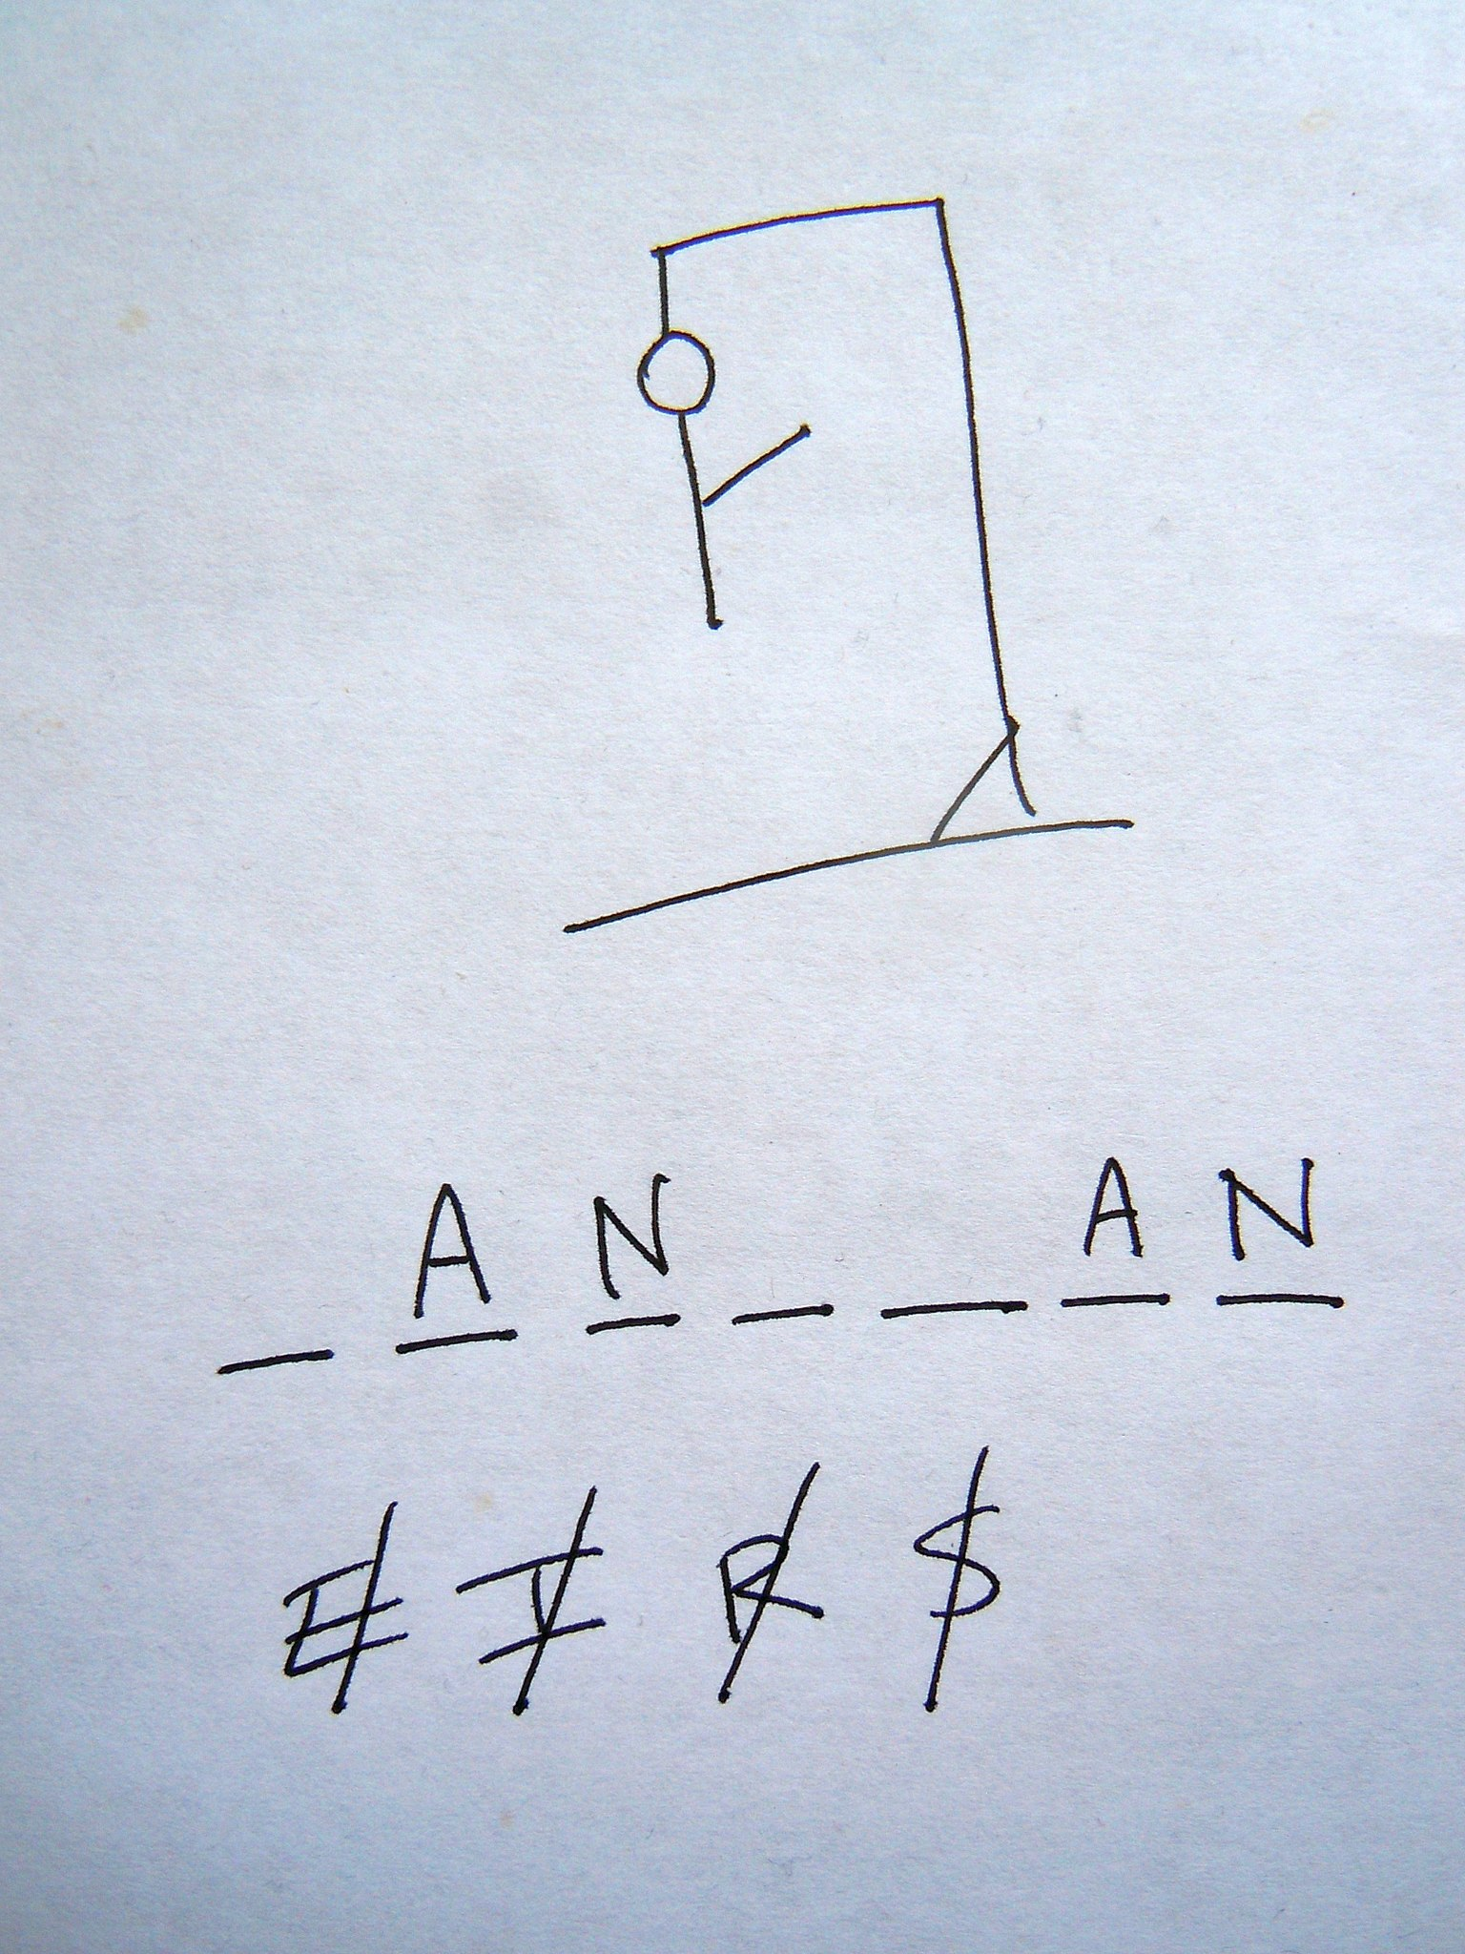

Slide 3
Tổng quan
1. Các thành phần của game
Class RandomWord
Class Word
Class Display
Class Game
Class Start
2. Demo gameplay

Slide 4
1. Các thành phần của game

Slide 5
dictionary.txt
Random_word
Start
Display
Hangman
Word
Game

Slide 6
Class RandomWord
class RandomWord
def initialize
filename = File.open('dictionary.txt')
word_list = File.readlines(filename)
@index = word_list.shuffle!
filename.close end
def pick_random_word
@words=@index.sample.strip
end
end

Slide 7
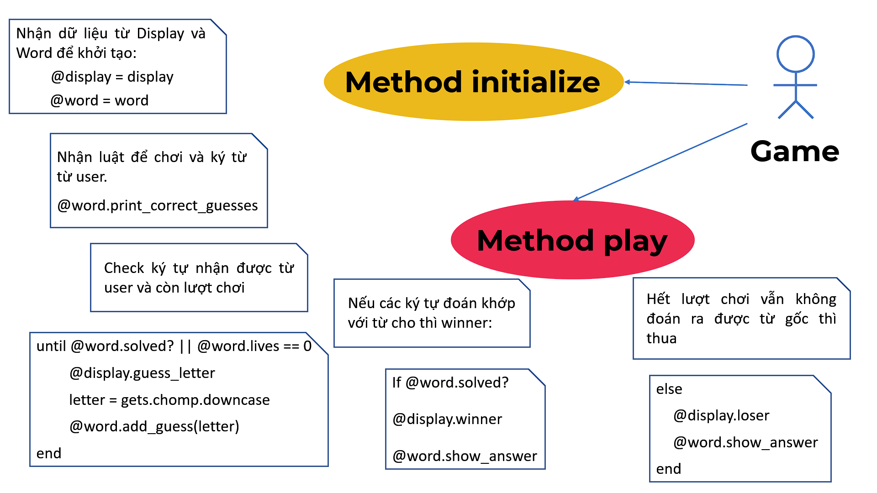
Class Word
class Word
require_relative 'display'
require_relative 'random_word' attr_reader :incorrect_guesses, :correct_guesses, :lives, :display
def initialize(word=RandomWord.new.pick_random_word, lives=8, display=Display.new)
@word = word
@incorrect_guesses = []
@correct_guesses = ["_"] * @word.length
@lives = lives
@display = display
end

Slide 8
Class Word
class Word
require_relative 'display.rb'
require_relative 'random_word' attr_reader :incorrect_guesses, :correct_guesses, :lives, :display
def initialize(word=RandomWord.new.pick_random_word, lives=8, display=Display.new)
@word = word
@incorrect_guesses = []
@correct_guesses = ["_"] * @word.length
@lives = lives
@display = display
end

Slide 9
Thêm ký tự đúng sai:
So sánh ký tự đoán khớp với các ký tự có trong từ cần đoán:
Methods_add_guess
+ add_correct_guess
+ add_incorrect_guess
add_guess(letter)
2
Hiển thị ký tự đúng sai:
+display_correct_guesses
Methods_display
3
+display_incorrect_guesses
Hiển thị từ cần dự đoán:
1
Word
show_answer
Nhận từ ngẫu nhiên đã chọn
ra từ Random_word
Methods_initialize
@word = word
và số lượt chơi: @lives = 8

Slide 10
Class Display
guess_letter
game_rules
winner
hanged_man
loser

Slide 11

Class Display
def game_rules
print %Q(
Welcome to Hangman!
To win, you need to guess the mystery word or you die.
You can have up to 8 incorrect guesses, before you're hanged.
Let's begin!)
end
def guess_letter
print %Q(
Guess a letter
>)
end

Slide 12
Class Display
def winner
print %Q(
You've guessed the word correctly.
You are a winner!)
end
def loser
print %Q(
You have run out of lives. You're dead!
You're a loser.
The game is over.)
end

Slide 13
Class Display
def hanged_man(lives)
case lives
when 7
print %Q(
+-----+
|
|
|
|
|
=======)
when 6
print %Q(
+-----+
| |
|
|
|
|
=======)
when 5
print %Q(
+-----+
| |
0 |
|
|
|
=======)
when 4
print %Q(
+-----+
| |
0 |
| |
|
|
=======)
when 3
print %Q(
+-----+
| |
0 |
/| |
|
|
=======)
when 2
print %Q(
+-----+
| |
0 |
/|\\ |
|
|
=======)
when 1
print %Q(
+-----+
| |
0 |
/|\\ |
\\ |
|
=======)
when 0
print """
+-----+
| |
0 |
/|\\ |
/ \\ |
|
======="""

Slide 14
Class Game
initialize
I
display
D
P
W
play
word

Slide 15
Class Game
def play
@display.game_rules
@word.print_correct_guesses
until @word.solved? || @word.lives == 0
@display.guess_letter
letter = gets.chomp.downcase
@word.add_guess(letter)
end
if @word.solved?
@display.winner
@word.show_answer
else
@display.loser
@word.show_answer
end
end
def initialize(display=Display.new, word=Word.new)
@display = display
@word = word end

Slide 16
Class Start
require 'game'
def play_game
while @play_again == "Y"
new_game = Game.new
new_game.play
self.play_again
@play_again = gets.chomp.upcase
end
self.exit_message
end
initialize
play_game
play_again
exit_message
def initialize(play_again="Y")
@play_again = play_again
end

Slide 17
Class Start
initialize
play_game
play_again
exit_message
def play_game
while @play_again == "Y"
new_game = Game.new
new_game.play
self.play_again
@play_again = gets.chomp.upcase
end.
self.exit_message
end
def initialize(play_again="Y")
@play_again = play_again
end

Slide 18
Class Start
initialize
play_game
play_again
exit_message
def play_game
while @play_again == "Y"
new_game = Game.new
new_game.play
self.play_again
@play_again = gets.chomp.upcase
end.
self.exit_message
end
def play_again
print %Q(
Play again?
>)
end
def initialize(play_again="Y")
@play_again = play_again
end

Slide 19
Class Start
def exit_message
print %Q(
Thanks for playing Hangman!
)
end
initialize
play_game
play_again
exit_message
def play_game
while @play_again == "Y"
new_game = Game.new
new_game.play
self.play_again
@play_again = gets.chomp.upcase
end.
self.exit_message
end
def play_again
print %Q(
Play again?
>)
end
def initialize(play_again="Y")
@play_again = play_again
end

Slide 20
Class Start
initialize
play_game
play_again
exit_message
def exit_message
print %Q(
Thanks for playing Hangman!
)
end
def initialize(play_again="Y")
@play_again = play_again
end

Slide 21
DEMO
DEMO
DEMO

Slide 22
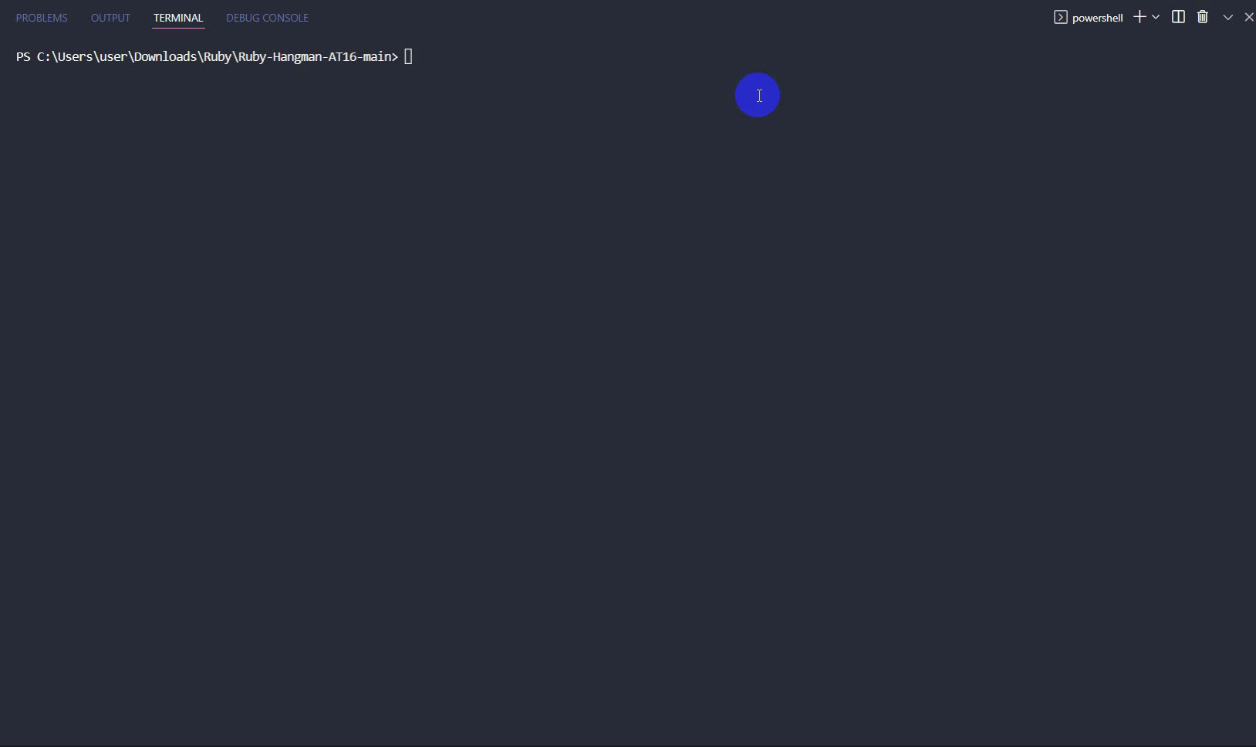

Slide 23
Demo Gameplay
https://github.com/phuongThanhKMA/Ruby-Hangman-AT16

Slide 24
Thank you!

