Slide 1

Global Mental Health Outcomes (2025)
A Data Analysis Project by Dương Ngọc Phượng

Slide 2

Project Overview: Unveiling Mental Health Insights
1
2
3
Dataset Source
Purpose
Goal
Kaggle's Global Mental Health Dataset 2025, featuring anonymous patient-level data.
Analyze global mental health data to identify key influencing factors.
Compare factors affecting outcomes to support evidence-based decision-making.

Slide 3

Key Variables for Analysis
Outcome
Demographic
Clinical
Categorized from Poor to Excellent.
Age, Gender, Country, Work Status.
Depression, Anxiety, Stress, Chronic Illness.
Lifestyle
Treatment
Sleep, Physical Activity.
Type, Duration.

Slide 4
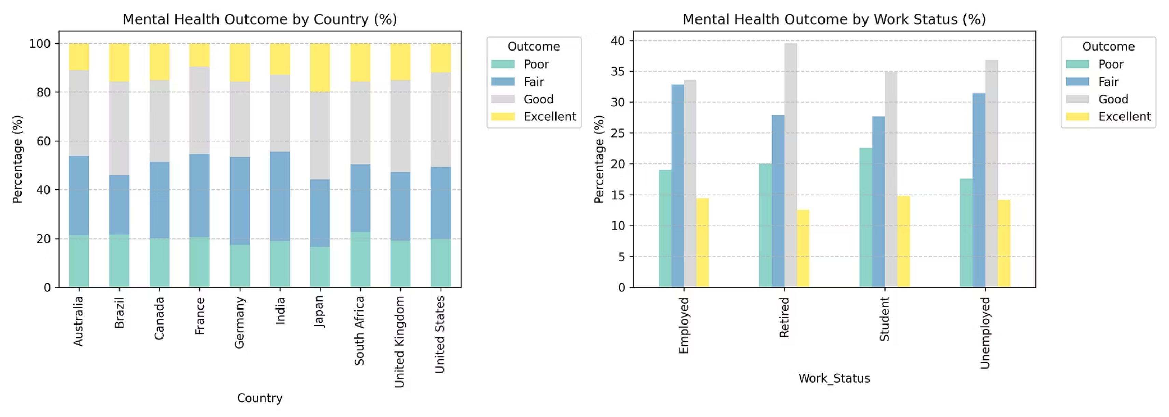
Demographic Factors
Country differences observed in outcome percentages.
Work status shows notable variation in mental health outcomes.

Slide 5
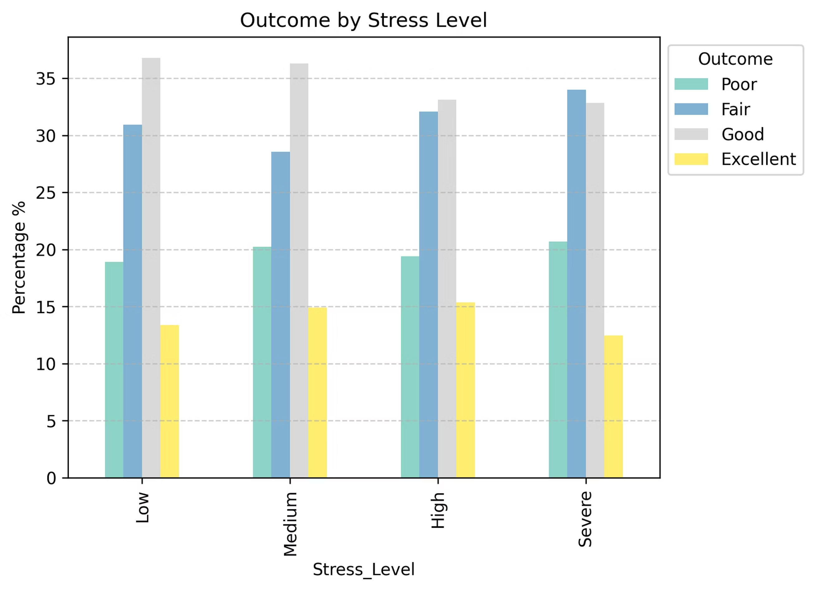
Clinical Factors
1
Stress Level Impact
Stress level is associated with mental health outcomes.
2
Direct Correlation
A negative relationship

Slide 6
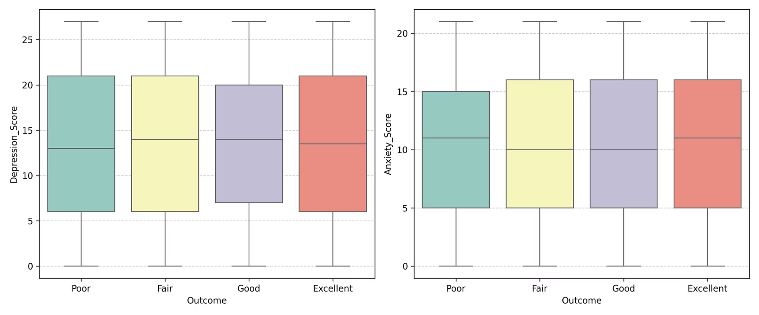
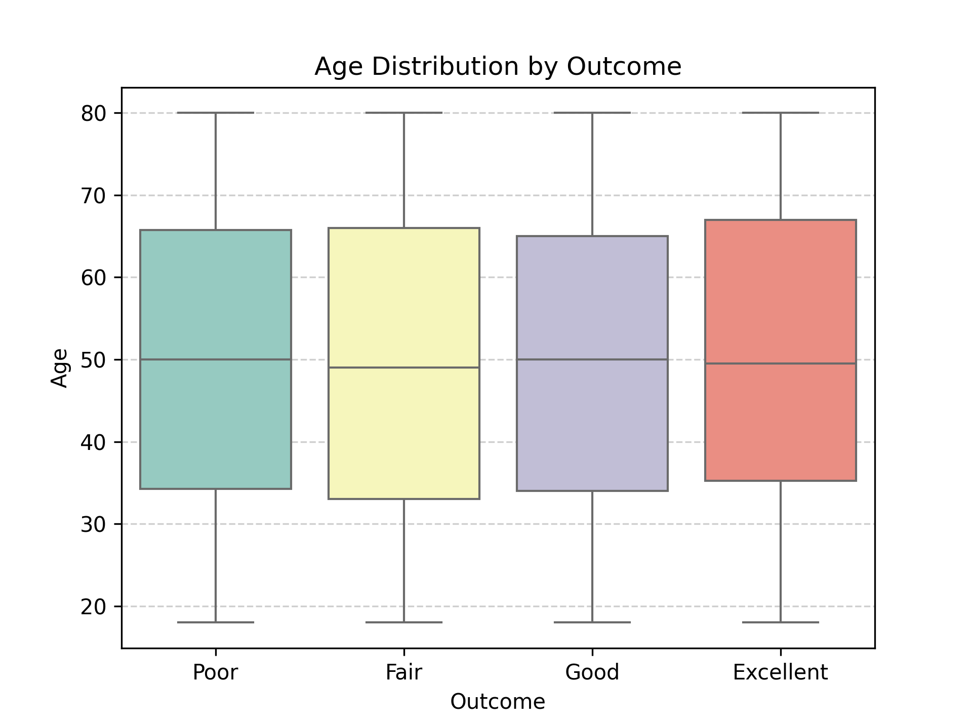
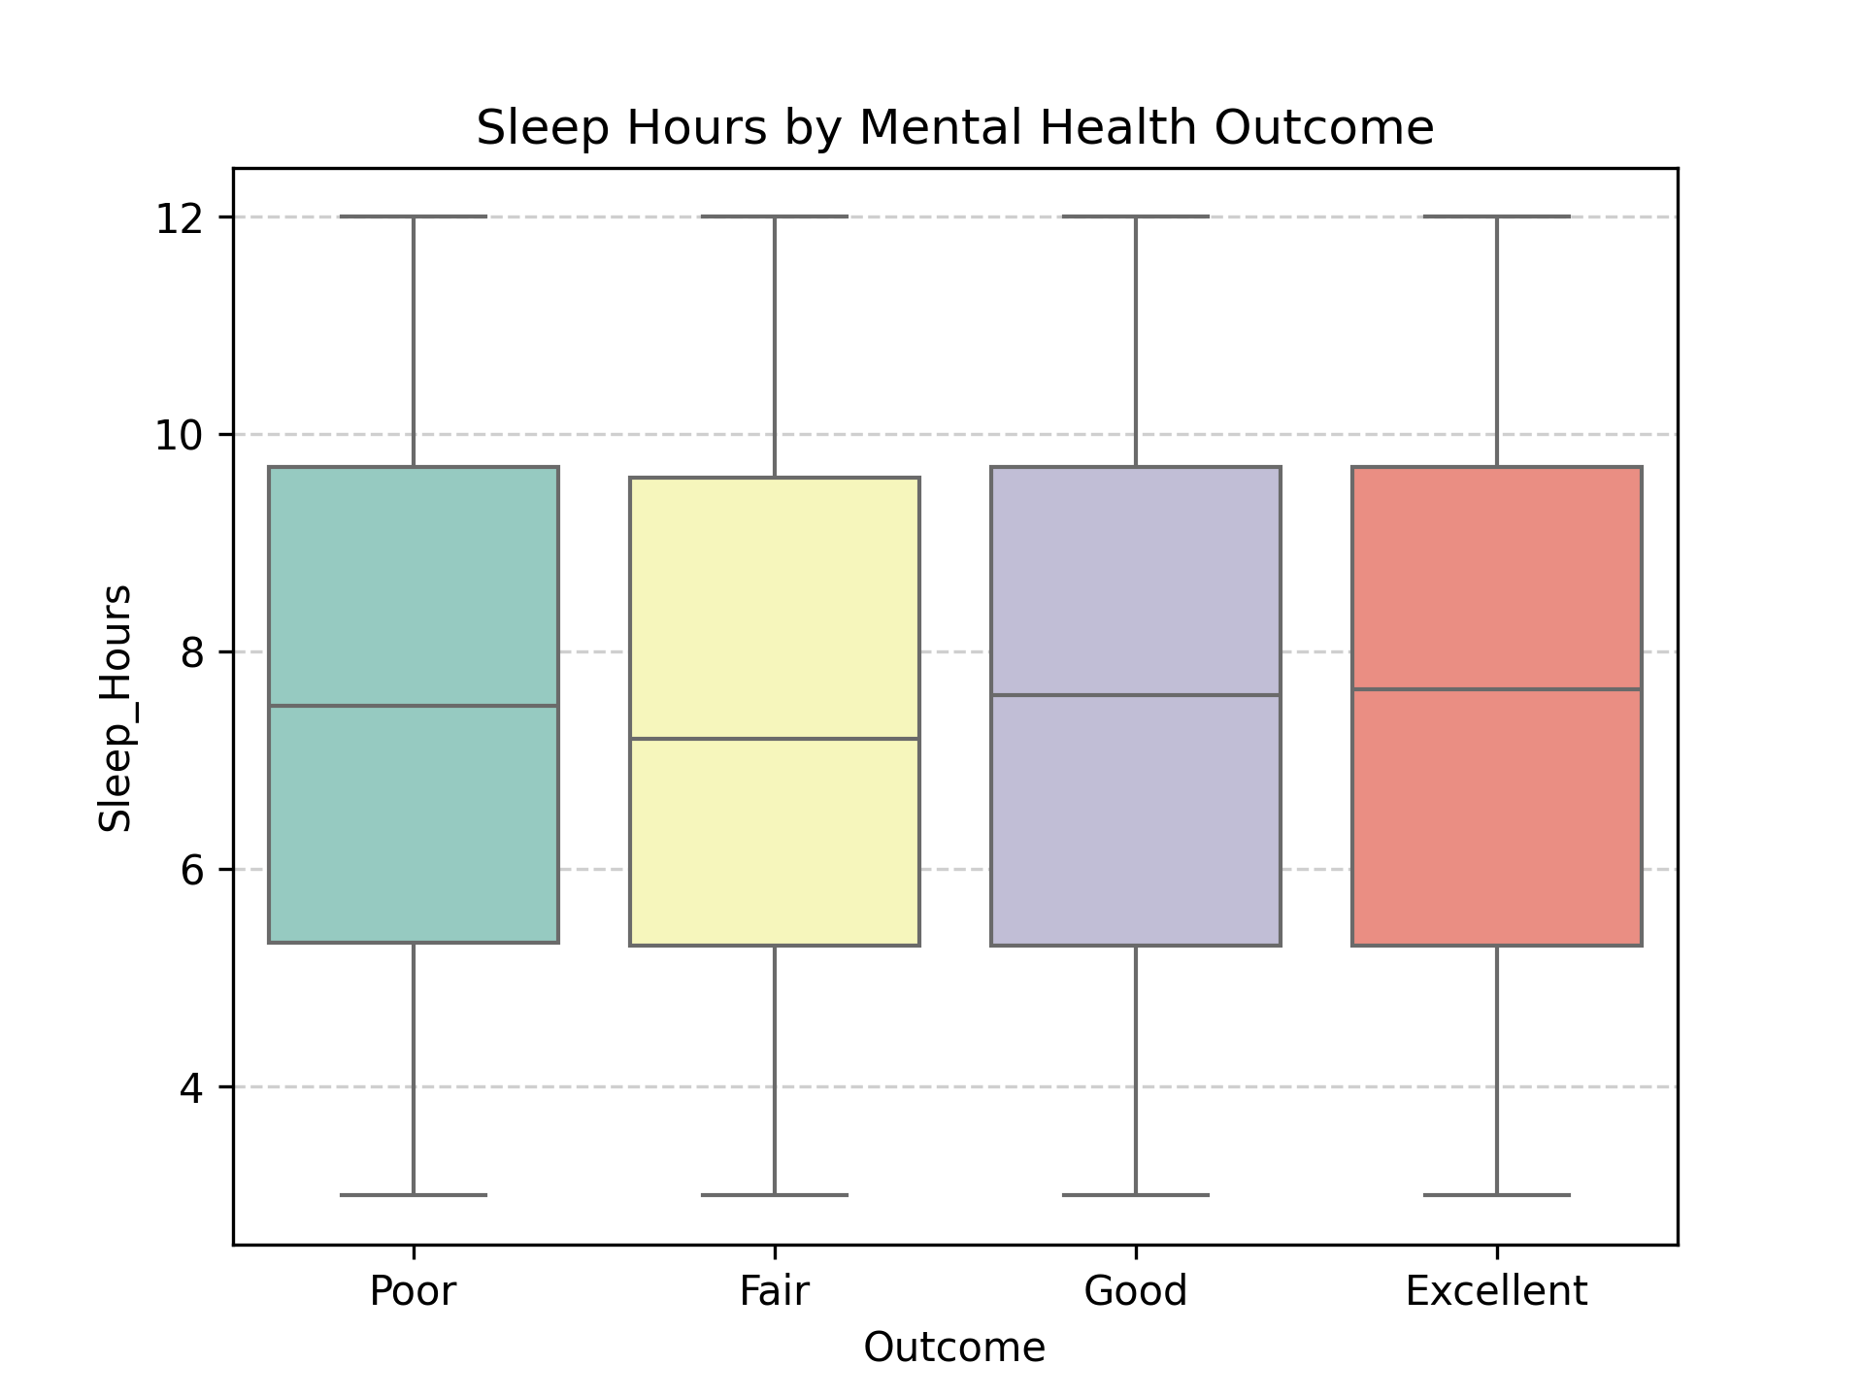
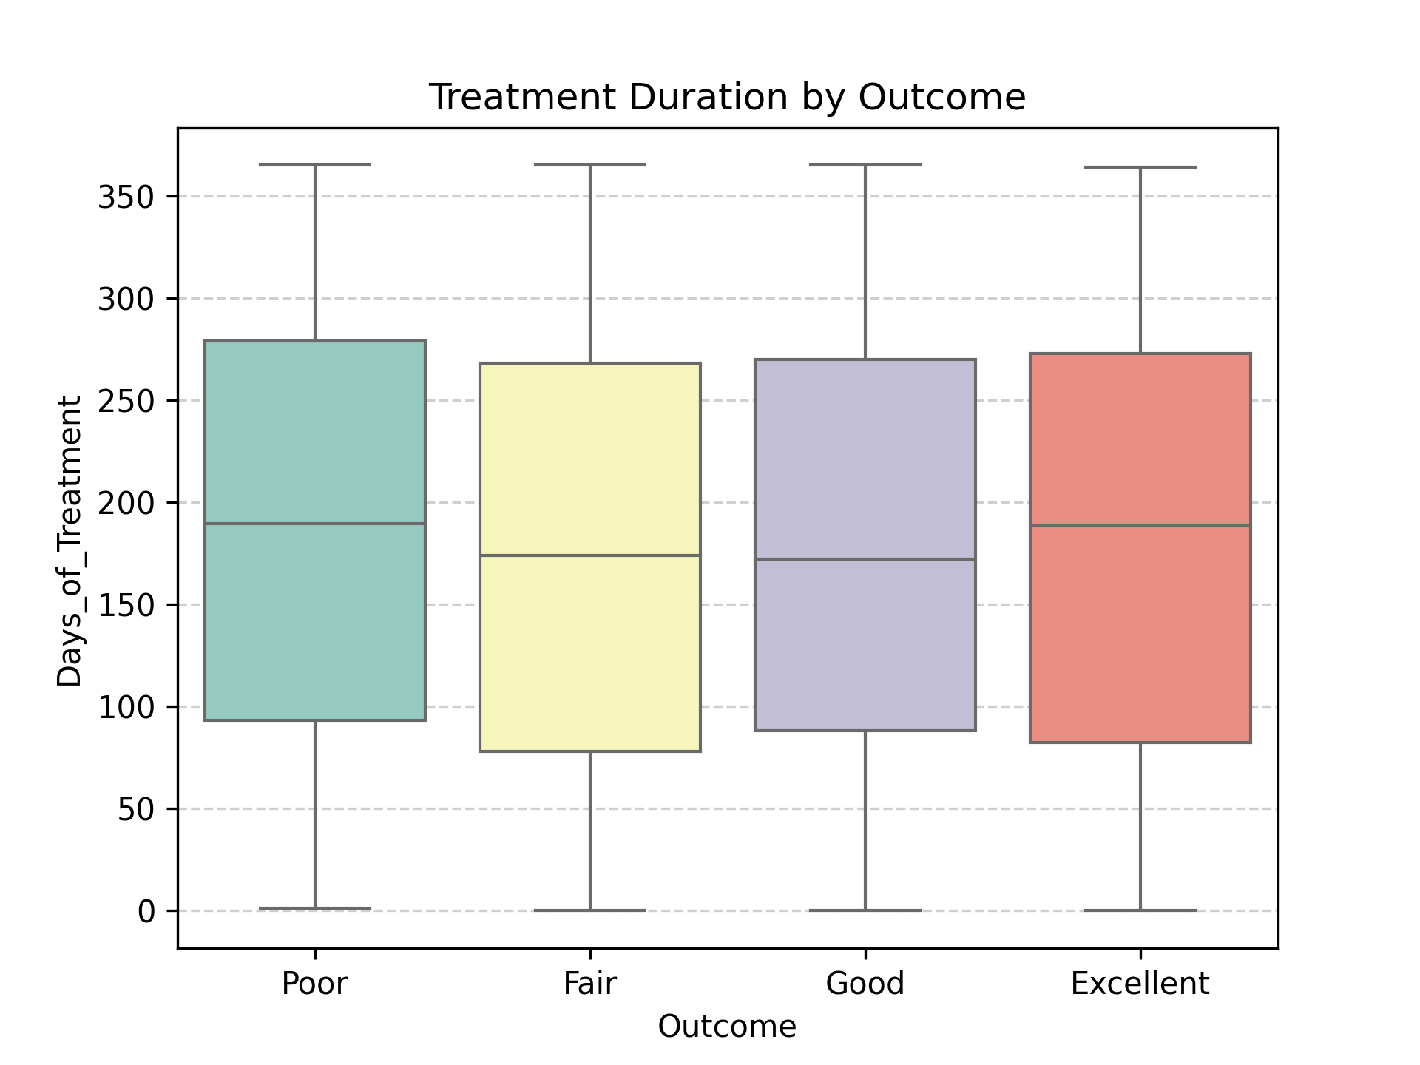
Numerical variables
The median & Interquaritile Range (IQR) are almost identical
All outcomes can occur at any range.
Numeric variables isn't a strong determinant of mental health outcomes in this dataset

Slide 7
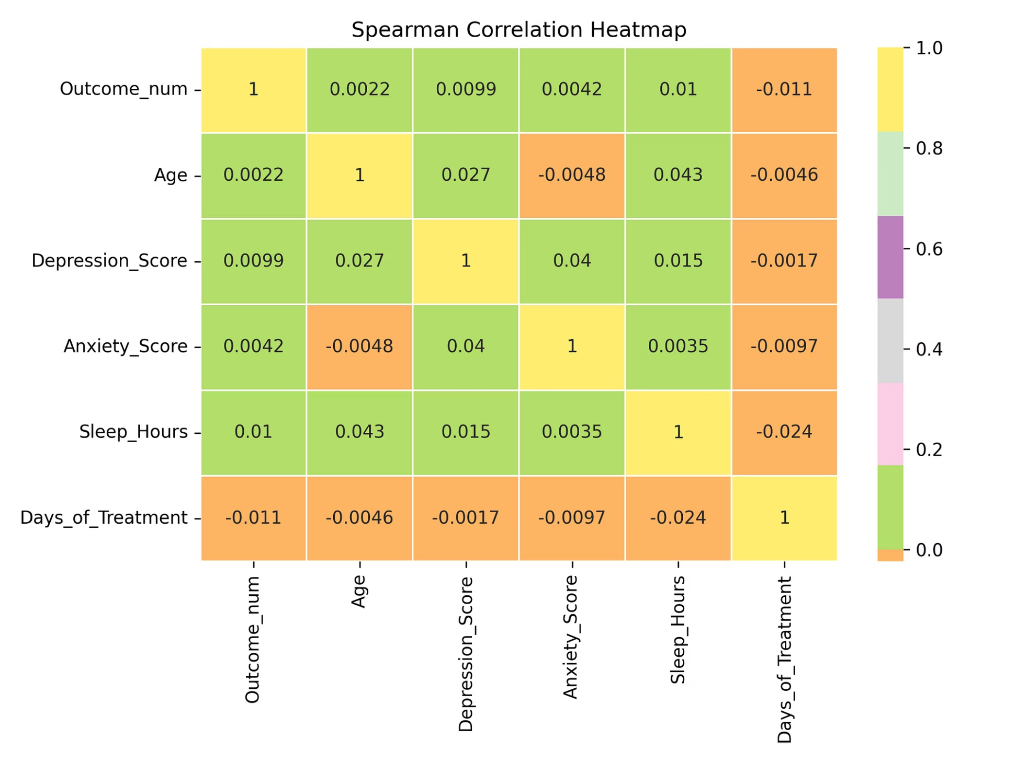
Correlation Analysis: Uncovering Relationships
Spearman correlation analysis reveals weak monotonic relationships between variables.
1
2
Weak Correlations
EDA Confirmation

Slide 8

Ordinal Logistic Regression Results
Using an ordinal logistic regression model
Outcome (Poor < Fair < Good < Excellent)
Other Variables
Odds Ratio
Most other variables did not show statistical significance in this multivariate analysis.
Country (Japan) shows a statistically significant odds ratio of approximately 1.56.

Slide 9

Limitations of the Study
This restriction limits our ability to fully explain variations in mental health outcomes across individuals and countries.
Observed Outcome
Measured Variables
Missing Socioeconomic Data
Missing Environmental Data
Limited Explanatory Power

Slide 10




Recommendations & Conclusion
Policy & Workplace Focus
Prioritize mental health policies and support in workplaces.
Target High-Risk Groups
Implement interventions for students and employed individuals.
Improve Data Collection
Include socioeconomic variables in future studies for comprehensive insights.

