Slide 1
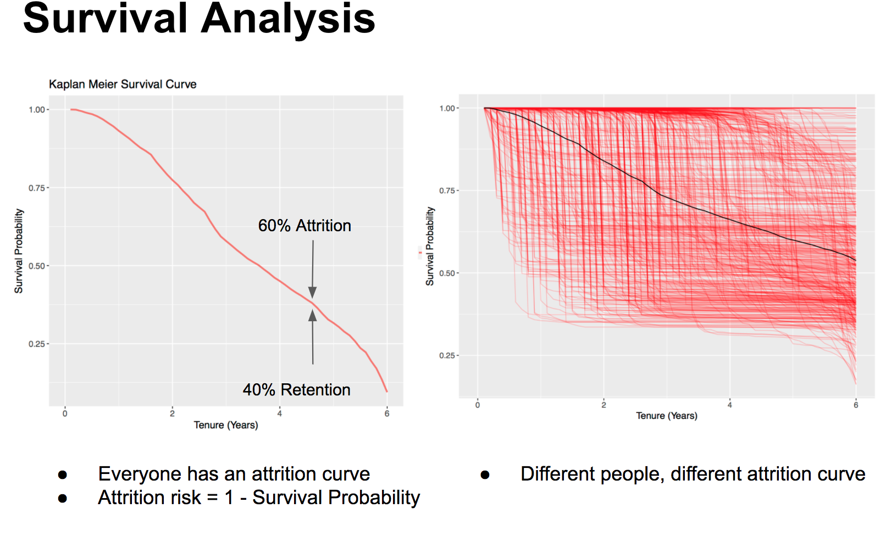
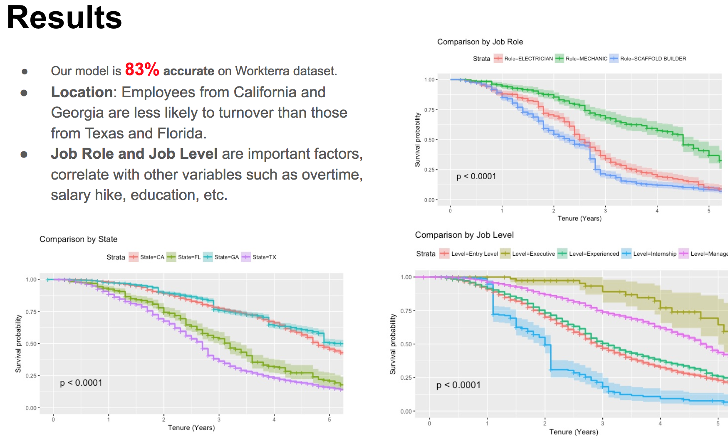
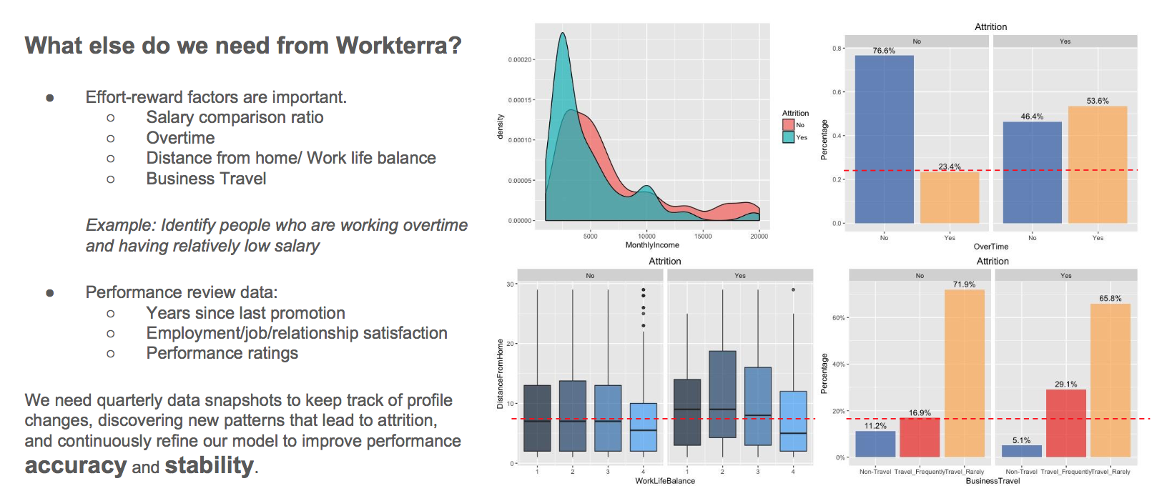
<Predicting Attrition Risk Using Workterra Data>
Faizan Javed and Phuong Hoang (Data Science R&D)
Reduce and prevent voluntary employee attrition
Identify individual/group with high attrition risk
Determine the corresponding factors leads to attrition.
Screenshots of the experiment results:

