Slide 1
POWERING GOOD IDEA CONTEST Project name: Funny Login
DNB QA&JDS
Sunday, August 8, 2021

Slide 2
About problem and issue
During the Covid-19 outbreak, work from home (WFH) is a reasonable choice to limit the infection. This is a plan to ensure the health and safety for all employees.
However, working from home for a long time will lead to the following problems:
Lack of interaction, mutual understanding between members in a team, a department, an organization
Miss a lot of new information about company
Lack of joyful working atmosphere

Slide 3


About idea
To improve the above problems when WFH, we recommend an interesting project called Funny Login
Oh Noez!
Your PC ran into a problem.
And you need to answer 3 questions to start
You can ignore this problem HERE

Slide 4
What is Funny Login?
Funny Login means creating some interesting questions about employees, companies or funny quiz at the time of login to PC.
The condition to login to PC is answering about 3 questions which appear on login screen, regardless of whether it is true or false.
Summarize the results every month and reward the employee having the most correct answers or the employee getting the best rating.
The company can evaluate the desire to integrate, research or feel employee’s emotion towards the company and the working environment through aggregated data.

Slide 5
About idea
Q1: About employee: “Who is this person?/ info relating this person?” (Show image of an employee and choose the correct answer)
Q2: About company: HVN news, next important event, newcomers if have, get idea from employee about improvement for project process or company or rate for manager, office or company…
Q3: Funny quiz, troll question

Slide 6
Demo
Login screen
Oh Noez!
Your PC ran into a problem.
And you need to answer 3 questions to start
You can ignore this problem HERE

Slide 7
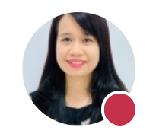

Demo
Question to interact within company
Question 1: Who is this person?
Please choose the correct answer:
1: Van Thi Ngoc Do
2: Binh Diep Cam Le
3: Binh Thi Phan
2: Binh Diep Cam Le
You can pass this question HERE

Slide 8

Demo
Pingo
Your answer is 2.
Ms Binh Diep Cam Le is Country Director, Resource Management of HVN.
Today is her birthday.
Do you want to send a sweet message to her?
Wish you always beautiful and safe during the pandemic
Send

Slide 9
Demo
Updating HVN news
Question 2: Which contest is this slogan “Powering Good – Unbound Space” for?
Please choose the correct answer:
1: CMMi Agile Transformation
2: HVN Innovation Contest 2021
3: Donate for COVID 19 crisis by Community Giving Portal
You can pass this question HERE

Slide 10
Demo
Pingo
Your answer is 2.
HVN Innovation Contest 2021 will start on July 12, 2021. This is an annual program to encourage all the employees of HVN to generate ideas to contribute to the happiness of our society and the growth of our organization toward a prosper.
Today is deadline for submit the Idea? Don’t miss to submit ☺

Slide 11
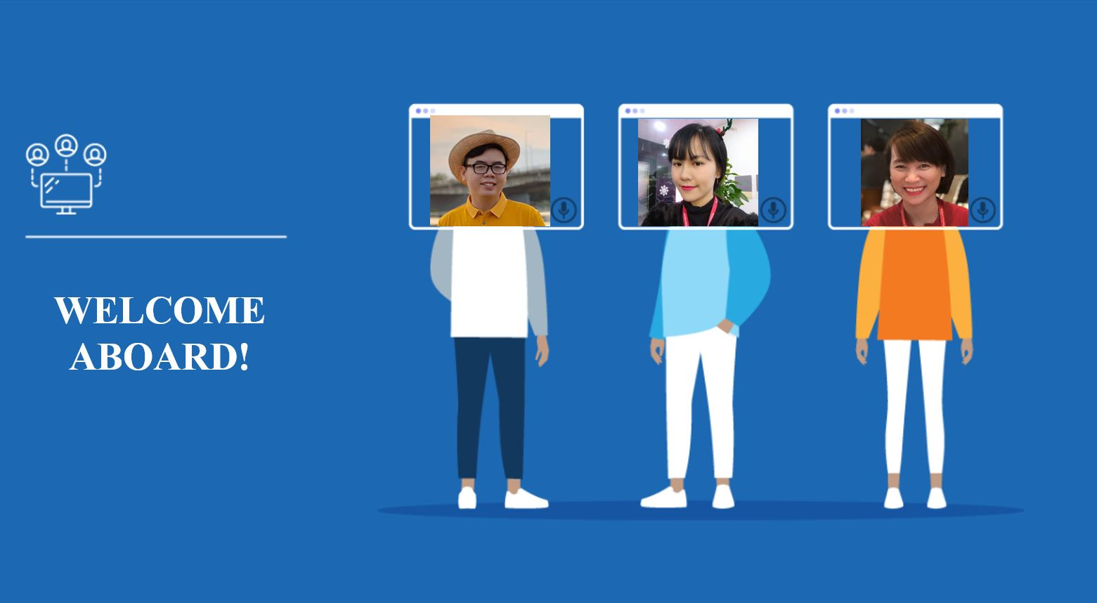
Demo
Updating welcome aboard
Question 1: Which contest is this slogan “Powering Good – Unbound Space” for?
Nguyen Van A,
Senior Consultant, EMB
Nguyen Thi B,
Bilingual Specialist II, JDS
Nguyen Thi C,
BrSE,
JDS

Slide 12
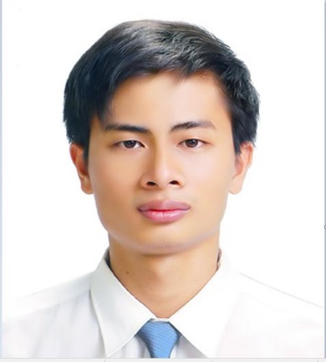
Demo
Rate for manager, office or company…
Question 3: How do you rate for Acting Branch Manager of Danang branch – Pham Hong Son?
Terrible
Bad
Alright
Good
Perfect
You can pass this question HERE

Slide 13


Demo
Thank you for rating.
Don’t miss your chance to send a greeting or say hello to him!
Hello boss, Friday comes! Live it with a laugh and enjoy it to the fullest. Good Morning Friday!
Send

Slide 14
Demo
Funny quiz
Question 4: Who works only one day in a year but never gets fired?
Please choose the correct answer:
1: Your boss
2: Sun Wukong
3: Santa Claus
3: Santa Claus
You can pass this question HERE
You can pass this question HERE

Slide 15


Demo
Success!
You are now logged in. Your day is just about to get better. Unless you’ve just had smiled.
Continue

Slide 16
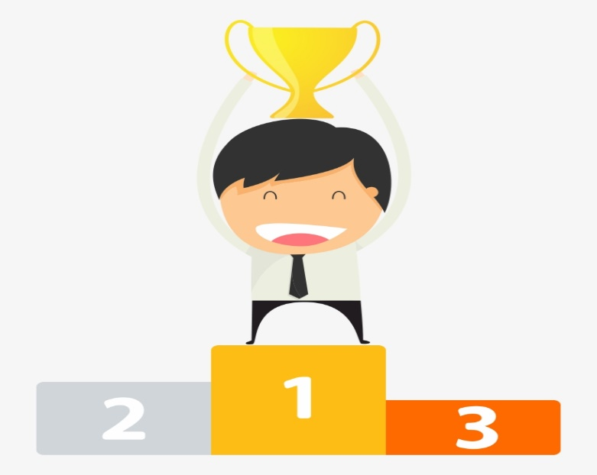

Demo
5. Funny report on the Monthly meeting (All Hand meeting)
Base on the data which is generated on monthly report, we will focus on the lacking information to have improvement action for interactive communication:
% correct answer of all employees <=50%: We need to update/share info closely next time.
% correct answer of all employees >=70%: Good interactive environment.
Congratulation for employees who get the most correct answers in a month on the Monthly meeting/ All hand meeting of division.
We have 3 employees with the highest rate.

Slide 17
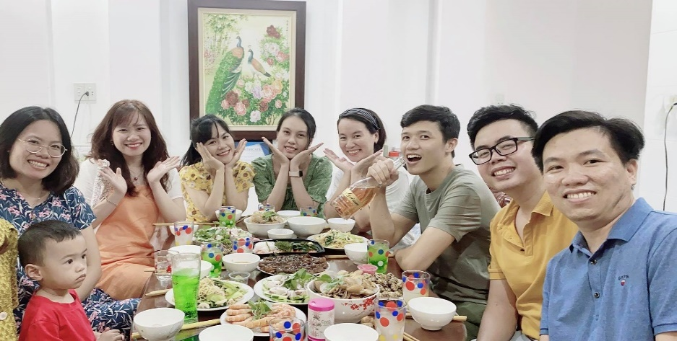
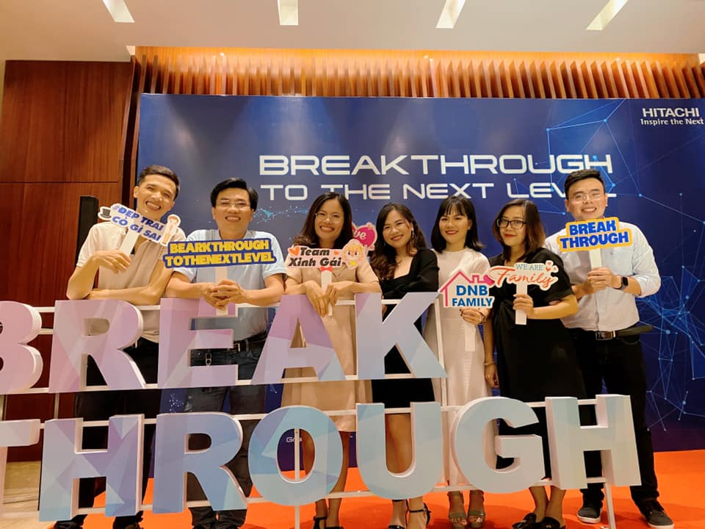
Team introduction
Name | BU (DNBQA-JDS)
Van Do | QA-PM CoE
Thanh T Nguyen | DNB JDS
Thanh Nguyen | DNB JDS
Dong Huynh | DNB JDS
Ha Hoang | DNB JDS
Binh Phan | DNB JDS
Tien Nguyen | DNB JDS

Slide 18
Key Milestones
Idea Creators
Initial and propose idea
Discuss and suggest information
Finalize scope and master plan
Submit idea
Submit Goal
Setup demo environment
Final testing
Prepare demo presentation
Submit package
15-23/Jul
25/Jul-13/Aug
13-15/Aug
18-24/Aug
Add text here
Running coders
Update feedbacks after Idea Creators round if have
Develop detail schedule
Develop design/ solution/ database.
Develop source code
Test
Award round
Improve comment/feedback after Round 3 if have
Update relating documents
Prepare the final round

Slide 19
Discuss
You can ignore these questions if you don’t have time
Must get data and info of employee with permission
Must make many questions and must classify
Depend on employee (level, department…) to ask what kind of question
What does the system base on to show the questions to the right person?
Who is responsible for collecting monthly and yearly answers? (rating, suggest…)
Others

Slide 20
Thank You

