Slide 1
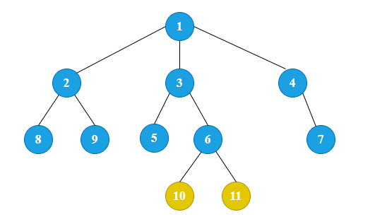
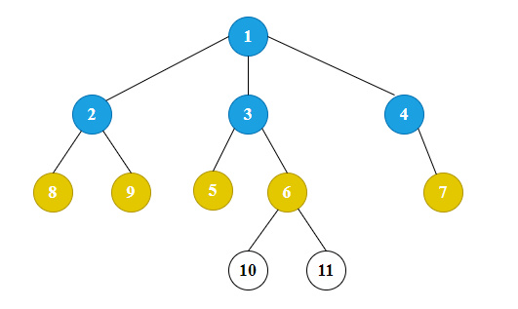
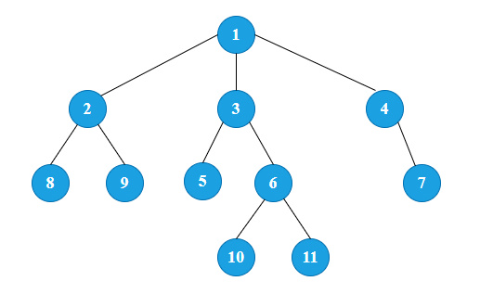
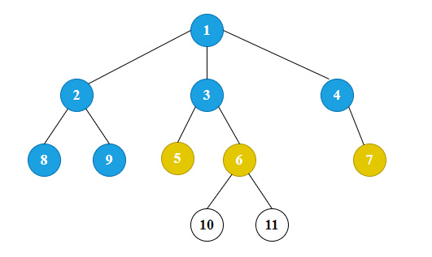
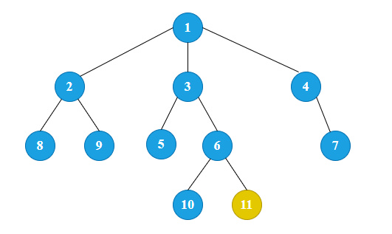
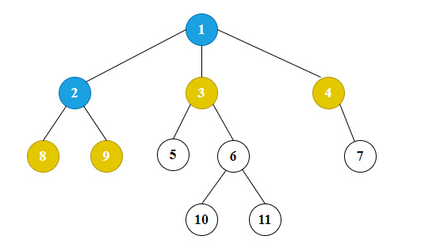
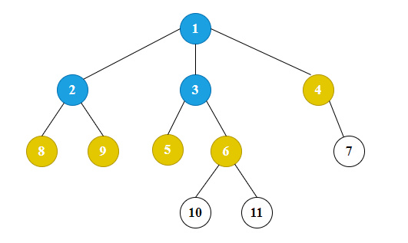
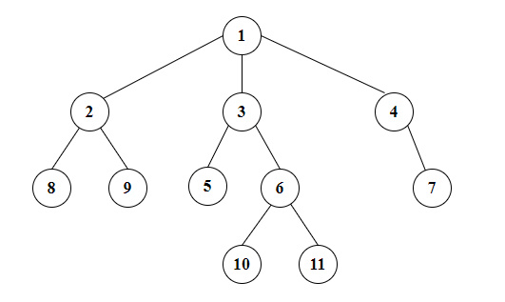
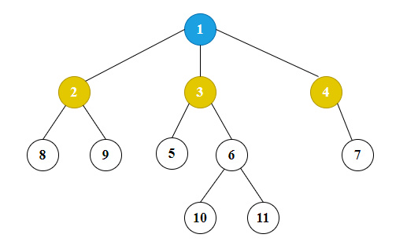
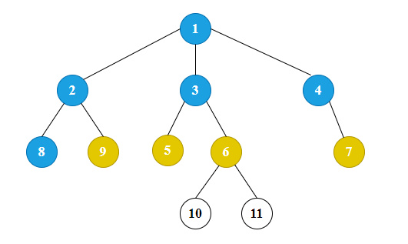
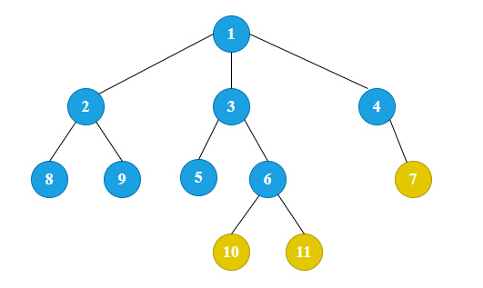
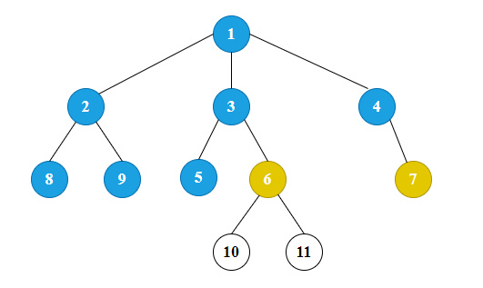
Đỉnh | Q | visited
1
1
2, 3, 4
1
2
3, 4, 8, 9
1, 2
3
4, 8, 9, 5, 6
1, 2, 3
4
8, 9, 5, 6, 7
1, 2, 3, 4
8
9, 5, 6, 7
1, 2, 3, 4, 8
9
5, 6, 7
1, 2, 3, 4, 8, 9
5
6, 7
1, 2, 3, 4, 8, 9, 5
6
7, 10, 11
1, 2, 3, 4, 8, 9, 5, 6
7
10, 11
1, 2, 3, 4, 8, 9, 5, 6, 7
10
11
1, 2, 3, 4, 8, 9, 5, 6, 7, 10
11
Rỗng
1, 2, 3, 4, 8, 9, 5, 6, 7, 10, 11

