Slide 1

Electricity Model – Delta Plant

Slide 2
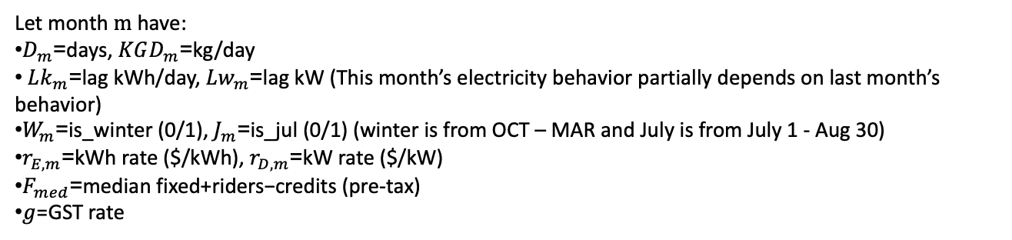
Electricity Cost
=
Energy (kWh)
Demand (kW)
Other Charges
+
+
Electricity consumed to operate equipment and production processes.
- Transformer Discount
- Sur % on Electricity Charge
- Deferral Rate Rider
- Trade Adjustment
- Credit Adjustment
Highest 15-minute peak power draw during the billing period.
Formula
Let month $m$have:
$D_{m}$=days, $KGD_{m}$=kg/day
$Lk_{m}$=lag kWh/day, $Lw_{m}$=lag kW (This month’s electricity behavior partially depends on last month’s behavior)
$W_{m}$=is_winter (0/1), $J_{m}$=is_jul (0/1) (winter is from OCT – MAR and July is from July 1 - Aug 30)
$r_{E,m}$=kWh rate ($/kWh), $r_{D,m}$=kW rate ($/kW)
$F_{med}$=median fixed+riders−credits (pre-tax)
$g$=GST rate
Cost=[rE x ​D x ​(2118.8567+0.2416 x KGD +0.4936 x Lk −996.7901 x W​+1469.7030 x J​)+rD x (340.7272+0.0133 x KGD ​+ 0.3915 x Lw​−102.0737 x W)+ F] x (1+g)

Slide 3
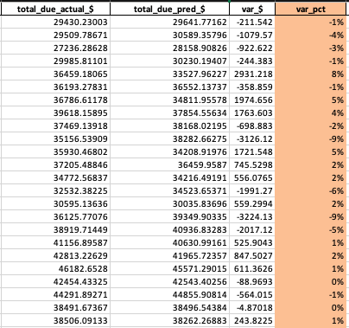
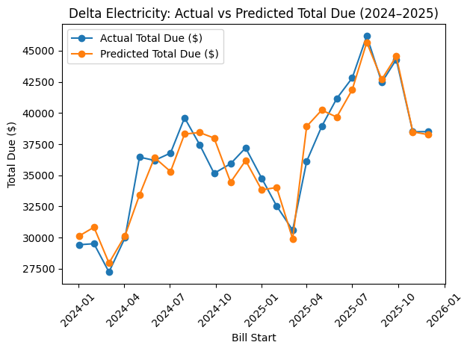

Slide 4
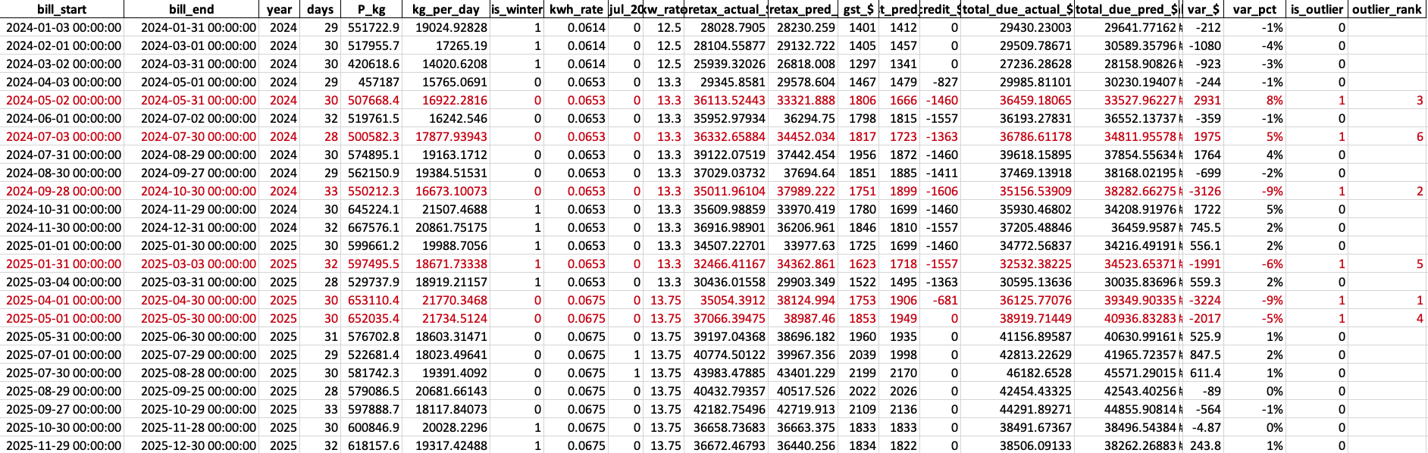
Month | Variance ($) | Production (kg) | Days | kg/day | 6M Avg kg/day | kW | kW/day | 6M Avg kW/day | Compressed? | Peak Intense?
2024-05 | +2,931 | 507,668 | 30 | 16,922 | 16,519 | 987 | 32.90 | 25.05 | No | Yes
2024-07 | +1,975 | 500,582 | 28 | 17,878 | 16,540 | 998 | 35.64 | 26.92 | No | Yes
2024-09 | -3,126 | 550,212 | 33 | 16,673 | 17,559 | 920 | 27.88 | 32.19 | No | No
2025-01 | -1,991 | 597,495 | 32 | 18,672 | 19,596 | 814 | 25.44 | 30.45 | No | No
2025-04 | -3,224 | 653,110 | 30 | 21,770 | 19,437 | 895 | 29.83 | 28.30 | Yes | No
2025-05 | -2,017 | 652,035 | 30 | 21,735 | 20,287 | 904 | 30.13 | 28.62 | No | No

Slide 5
September 2024
Production is slightly lower than normal
Peak Intensity -13%
Smooth operational month
Lower demand pressure
January 2025
Production stable
Peak intensity -16%
April 2025
Production compressed (+12%)
Peak stable
Higher throughput without demand spike
Operational inefficiency improvement
May 2025
Production slightly increased
Peak is controlled
May 2024
Production Intensity normal (+2%)
Peak Demand +31% above baseline
Cost spike driven by equipment concurrency
July 2024
Slightly higher production (+8%)
Peak demand +32% above baseline
=> Combined energy + demand effect

Slide 6
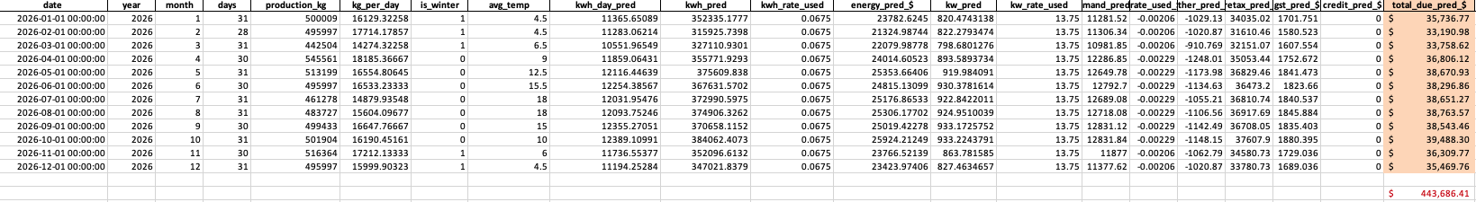
Assumption: The 2026 electricity forecast is production-driven, rate-stable, and operationally continuous, with other charges mirrored from 2025 behaviour.

Slide 7
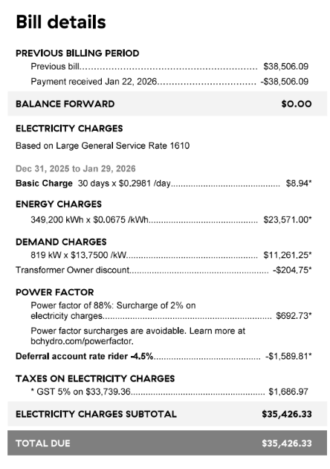
Total Cost/Day = $33,739.36/30 = $1124.64
Total Cost per Jan = $1124.64 x 31 = $34,864.0
Predicted Jan Bill = $34,035.02
Variance = $828.98 ~ 2% difference

Slide 8
2026 Cost Optimization Strategy
1. Improve Energy Intensity (kWh/kg)
Target 3 – 5% reductions
Actions:
- Reduce idle machine run time
- Smooth daily production load
Impact: $9k - 15K annual saving
2. Control Peak Demand
Target: Reduce monthly peak by 50-75 kW
Actions:
- Stagger equipment start time
- Avoid simultaneous high-load operations
Impact: $8 – 12K annual savings
3. Prevent Production Compression
Avoid high kg/day spike months
Spread production evenly across working days
Reduces demand spikes and energy intensity
Impact: $2k - $4k avoided variance
Initiative | Driver | Formula | Assumption | Estimated Annual Impact
Energy Intensity Reduction (3%) | kWh | Total kWh × 3% × $/kWh | 4,400,000 kWh × 3% × $0.0675 | ~$8,900
Energy Intensity Reduction (5%) | kWh | Total kWh × 5% × $/kWh | 4,400,000 kWh × 5% × $0.0675 | ~$14,850
Peak Reduction (50 kW) | kW | kW × Rate × 12 months | 50 × $13.75 × 12 | $8,250
Peak Reduction (75 kW) | kW | kW × Rate × 12 months | 75 × $13.75 × 12 | $12,375
Avoid 1 Compression Month | Demand spike avoided | Avg spike × demand rate | ~100 kW spike × $13.75 | ~$1,375 per event
Base Load Reduction (10%) | kWh | Base kWh × 10% × $/kWh × 12 | 1,000 kWh × 12 × $0.0675 | ~$810

