Slide 2
Topics
Graphical User Interfaces
Introduction to JavaFX
Creating Scenes
Displaying Images
More About the HBox, VBox, and GridPane Layout Containers
Button Controls and Events
Reading Input with TextField Controls
Displaying Alert Dialogs
Using Lambda Expressions to Handle Events
The BorderPane Layout Container
The ObserveableList Interface

Slide 3
Installing JavaFX
Starting with Java 11, JavaFX must be installed separately from the JDK
You can download the latest version of JavaFX from:
https://openjfx.io/
See Appendix F for help with installation

Slide 4
Compiling a JavaFX Application
Assuming you have setup JavaFX according to the instructions in Appendix F:
  Windows Command Line:
  macOS or Linux Terminal:
javac --module-path %PATH_TO_FX% --add-modules javafx.controls ProgramName.java
javac --module-path $PATH_TO_FX --add-modules javafx.controls ProgramName.java

Slide 5
Running a JavaFX Application
Assuming you have setup JavaFX according to the instructions in Appendix F:
  Windows Command Line:
  macOS or Linux Terminal:
java --module-path %PATH_TO_FX% --add-modules javafx.controls ProgramName
java --module-path $PATH_TO_FX --add-modules javafx.controls ProgramName

Slide 6
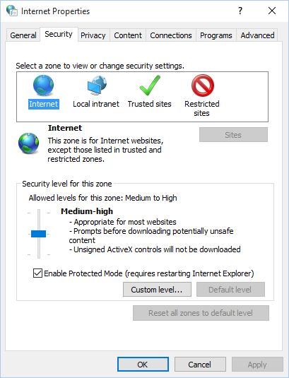
Graphical User Interfaces
Many Java applications use a graphical user interface or GUI (pronounced “gooey”).
A GUI is a graphical window or windows that provide interaction with the user.

Slide 7
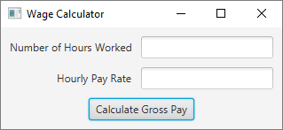
Graphical User Interfaces
A window in a GUI commonly consists of several controls that present data to the user and/or allow interaction with the application.
Some of the common GUI controls are buttons, labels, text fields, check boxes, and radio buttons.

Slide 8
Graphical User Interfaces
Programs that operate in a GUI environment must be event-driven.
An event is an action that takes place within a program, such as the clicking of a button.
Part of writing a GUI application is creating event listeners.
An event listener is a method that automatically executes when a specific event occurs.

Slide 9
Introduction to JavaFX
JavaFX is a Java library for developing rich applications that employ graphics.
You can use it to create:
  GUI applications, as well as applications that display 2D and 3D graphics
  standalone graphics applications that run on your local computer
  applications that run from a remote server
  applications that are embedded in a Web page

Slide 10
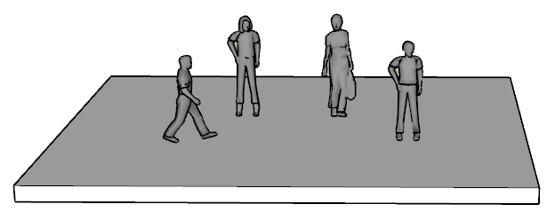
Introduction to JavaFX
JavaFX uses a theater metaphor to describe the structure of a GUI.
A theater has a stage
On the stage, a scene is performed by actors

Slide 11
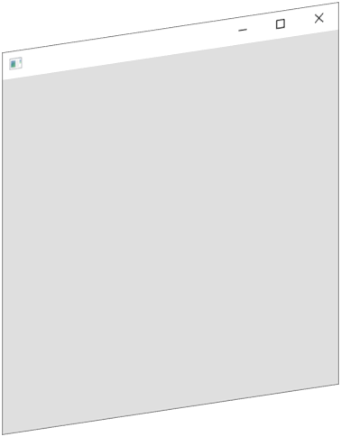
Introduction to JavaFX
In JavaFX, the stage is an empty window
Stage

Slide 12
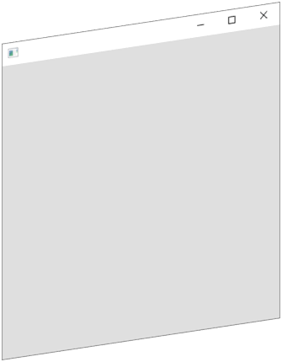




Introduction to JavaFX
The scene is a collection of GUI objects (controls) that are contained within the window.
You can think of the GUI objects as the actors that make up the scene.
Stage
Scene

Slide 13
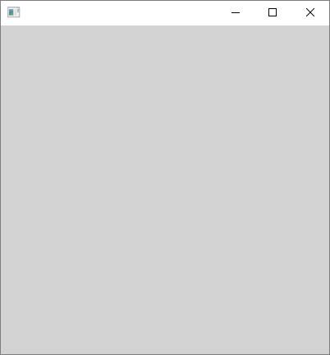
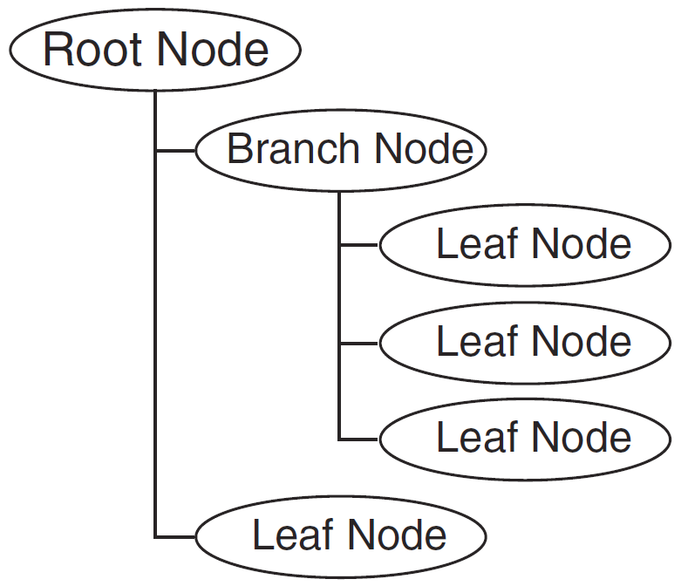
Introduction to JavaFX
In memory, the GUI objects in a scene are organized as nodes in a scene graph, which is a tree-like hierarchical data structure.
Stage
Scene

Slide 14
Introduction to JavaFX
The scene graph has three types of nodes:
  Root Node: There is only one root node, which is the parent of all the other nodes in the scene graph.
  Branch Node: A node that can have other nodes as children
  Leaf Node: A node that cannot have children

Slide 15
Introduction to JavaFX
The Application Class
  An abstract class that is the foundation of all JavaFX applications
  JavaFX applications must extend the Application class
  The Application class has an abstract method named start, which is the entry point for the application
  Because the start method is abstract, you must override it

Slide 16
General Layout of a JavaFX Program
Various import statements
A class that extends the Application class
A start method
A main method

Slide 17
import javafx.application.Application;
import javafx.stage.Stage;
import javafx.scene.Scene;
Other import statements…
public class ClassName extends Application
{
public static void main(String[] args)
{
// Launch the application.
launch(args);
}
@Override
public void start(Stage primaryStage)
{
// Insert startup code here.
}
}
Necessary import
statements

Slide 18
import javafx.application.Application;
import javafx.stage.Stage;
import javafx.scene.Scene;
Other import statements…
public class ClassName extends Application
{
public static void main(String[] args)
{
// Launch the application.
launch(args);
}
@Override
public void start(Stage primaryStage)
{
// Insert startup code here.
}
}
Necessary import
statements
A class that extends
the Application
class

Slide 19
import javafx.application.Application;
import javafx.stage.Stage;
import javafx.scene.Scene;
Other import statements…
public class ClassName extends Application
{
public static void main(String[] args)
{
// Launch the application.
launch(args);
}
@Override
public void start(Stage primaryStage)
{
// Insert startup code here.
}
}
Necessary import
statements
A static main method
that calls the inherited
launch method
A class that extends
the Application
class

Slide 20
import javafx.application.Application;
import javafx.stage.Stage;
import javafx.scene.Scene;
Other import statements…
public class ClassName extends Application
{
public static void main(String[] args)
{
// Launch the application.
launch(args);
}
@Override
public void start(Stage primaryStage)
{
// Insert startup code here.
}
}
Necessary import
statements
A static main method
that calls the inherited
launch method
A class that extends
the Application
class
A start method that
accepts a Stage
argument. This method
is called by the inherited
launch method.

Slide 21
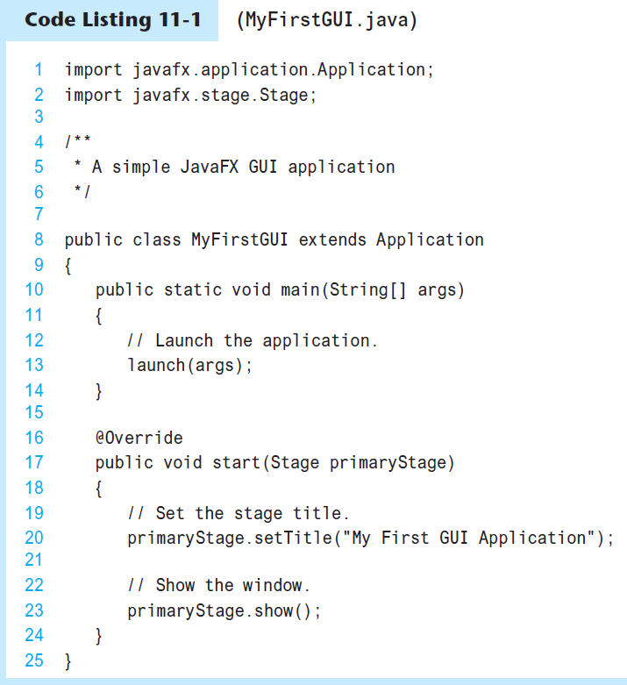
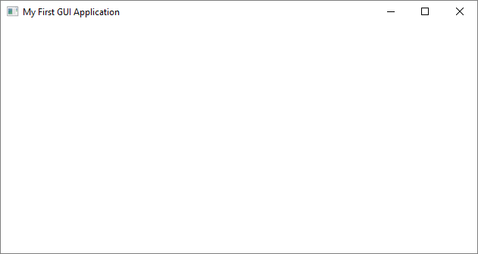
MyFirstGUI.java

Slide 22
Creating Controls
Process for creating a control:
  Import the class for the control from the necessary javafx package. Example:
  import javafx.scene.control.Label;
  Instantiate the class, calling the desired constructor. Example:
  Label messageLabel = new Label("Hello World");

Slide 23
Creating Controls
Another example: Creating a Button
  Import the Button class from the necessary javafx package:
  import javafx.scene.control.Button;
  Instantiate the class, calling the desired constructor:
  Button mybutton = new Button("Click Me");

Slide 24
Layout Containers
You use layout containers to arrange the positions of controls on the screen.
JavaFX provides many layout containers.
We will start with these:
  HBox: Arranges controls in a single horizontal row.
  VBox: Arranges controls in a single vertical row.
  GridPane: Arranges controls in a grid with rows and columns.

Slide 25
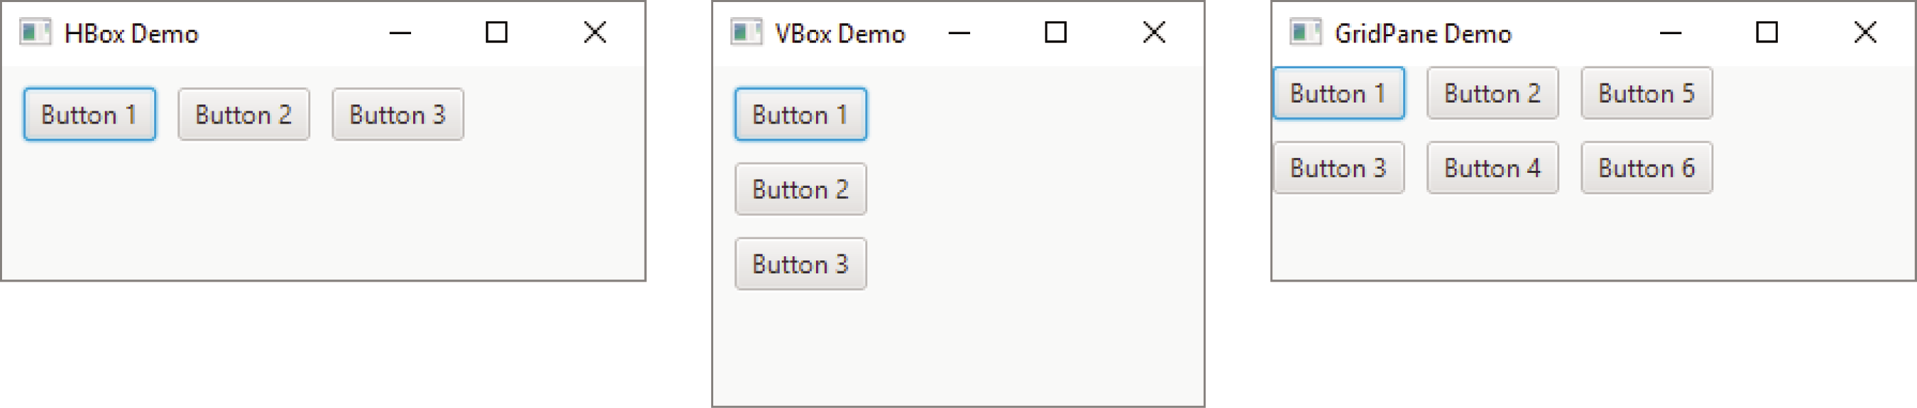
Layout Containers
The layout container classes are in the javafx.scene.layout package.

Slide 26
Adding Controls to a Layout Container
VBox
Button b1 = new Button("Button 1");
Button b2 = new Button("Button 2");
Button b3 = new Button("Button 3");
VBox vbox = new VBox(b1, b2, b3);

Slide 27
Creating a Scene
To create a scene, you instantiate the Scene class (in the javafx.scene package)
Then, you add your root node to the scene

Slide 28
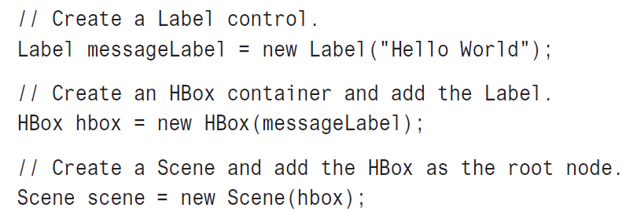
Creating a Scene

Slide 29
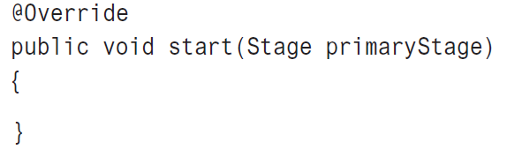
Adding the Scene to the Stage
Once you've created a Scene object, you add it to the application's stage.
The stage is an instance of the Stage class (from the javafx.stage package)
You do not have to instantiate the Stage class, however. It is created automatically, and passed as an argument to the start method.

Slide 30

import javafx.application.Application;
import javafx.stage.Stage;
import javafx.scene.Scene;
import javafx.scene.control.Label;
import javafx.scene.layout.VBox;
public class HelloWorld extends Application
{
public static void main(String[] args)
{
launch(args);
}
@Override
public void start(Stage primaryStage)
{
Label messageLabel = new Label("Hello World"); Make a Label control
VBox vbox = new VBox(messageLabel); Put the Label in a VBox
Scene scene = new Scene(vbox); Make the VBox the root node in the scene
primaryStage.setScene(scene); Set the scene to the stage
primaryStage.show(); Show the stage (display it)
}
}

Slide 31
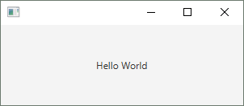
import javafx.application.Application;
import javafx.stage.Stage;
import javafx.scene.Scene;
import javafx.scene.control.Label;
import javafx.scene.layout.VBox;
import javafx.geometry.Pos;
public class HelloWorld extends Application
{
public static void main(String[] args)
{
launch(args);
}
@Override
public void start(Stage primaryStage)
{
Label messageLabel = new Label("Hello World");
VBox vbox = new VBox(messageLabel);
vbox.setAlignment(Pos.CENTER); Center-align the VBox
Scene scene = new Scene(vbox , 300, 100);
primaryStage.setScene(scene);
primaryStage.show();
}
}
Width
Height

Slide 32
Displaying Images
You need two JavaFX classes:
  The Image class, from the javafx.scene.image package
    Use this class to load an image into memory
  The ImageView class, also from the javafx.scene.image package
    Use this class to create a node that displays the image

Slide 33
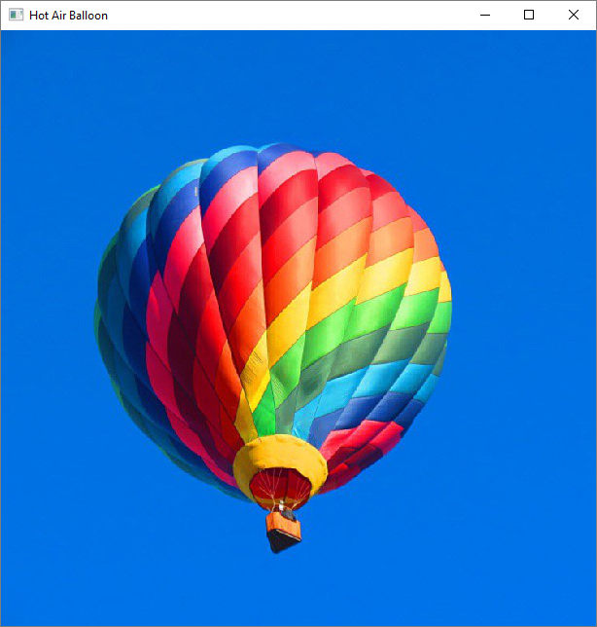
@Override
public void start(Stage primaryStage)
{
// Create an Image object.
Image image = new Image("file:HotAirBalloon.jpg");
// Create an ImageView object.
ImageView imageView = new ImageView(image);
// Put the ImageView in an HBox.
HBox hbox = new HBox(imageView);
// Create a Scene with the HBox as its root node.
Scene scene = new Scene(hbox);
// Add the Scene to the Stage.
primaryStage.setScene(scene);
// Set the stage title.
primaryStage.setTitle("Hot Air Balloon");
// Show the window.
primaryStage.show();
}

Slide 34
More About HBox and VBox Containers
To add spacing between the items in an HBox or VBox:
HBox hbox = new HBox(10, label1, label2, label3);
VBox vbox = new VBox(20, button1, button2, button3);
Spacing
Spacing

Slide 35
More About HBox and VBox Containers
Padding is space that appears around the inside edge of a container.
The HBox and VBox containers have a setPadding method.
You pass an Insets object as an argument to the setPadding method.
The Insets object specifies the number of pixels of padding.
The Insets class is in the javafx.geometry package.
hbox.setPadding(new Insets(10));

Slide 36
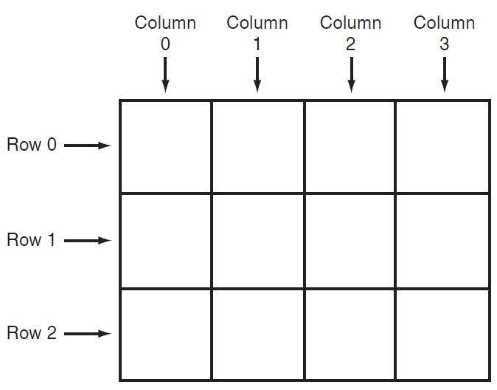
The GridPane Layout Container
Arranges its contents in a grid with columns and rows.
The columns and rows are identified by indexes.

Slide 37
The GridPane Layout Container
The GridPane class is in the javafx.scene.layout package.
First, you instantiate the GridPane class, using the no-arg constructor:
GridPane gridpane = new GridPane();
Then, you add controls to the container using the add method:
gridPaneObject.add(control, column, row);

Slide 38
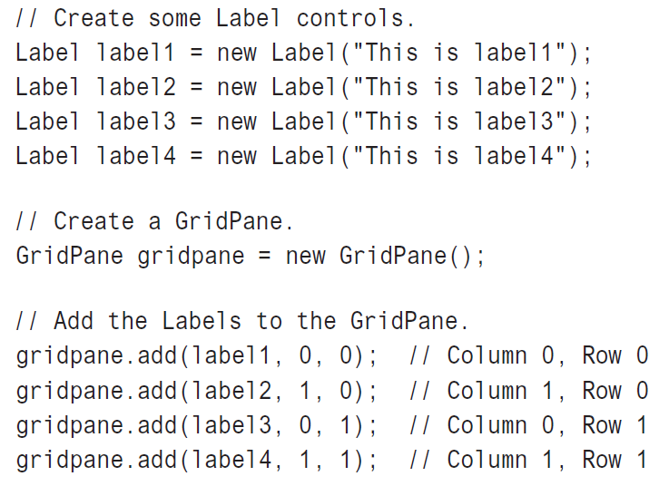
The GridPane Layout Container

Slide 39
The GridPane Layout Container
By default, there is no space between the rows and columns in a GridPane.
To add horizontal spacing between the columns in a GridPane, call the container's setHgap method.
To add vertical spacing between the rows in a GridPane, call the container's setVgap method.
GridPane gridpane = new GridPane();
gridpane.setHgap(10);
gridpane.setVgap(10);

Slide 40
The GridPane Layout Container
The GridPane container also has a setPadding method to set the padding around the container's inside edge:
GridPane gridpane = new GridPane();
gridpane.setPadding(new Insets(10));

Slide 41
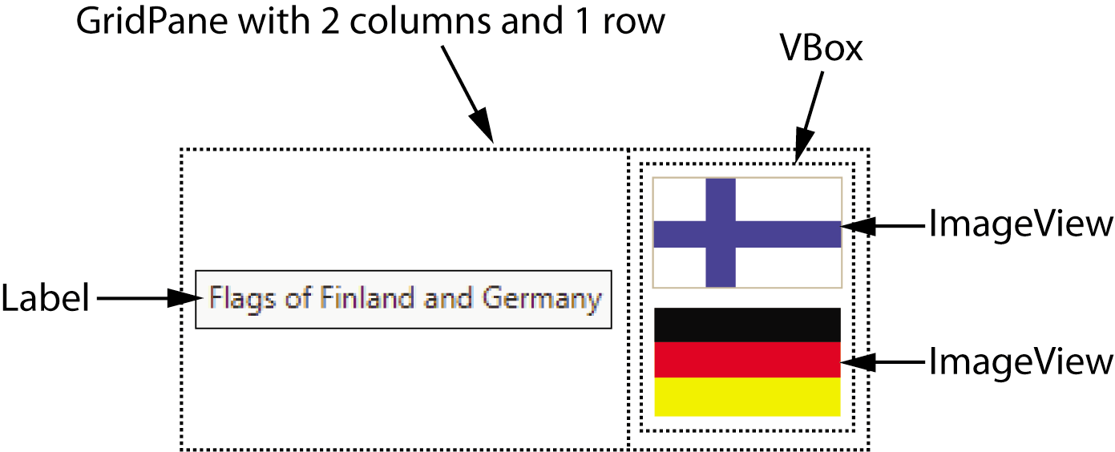
Using Multiple Layout Containers
To get the particular screen layout that you desire, you will sometimes have to nest layout containers.

Slide 42
Handling Events
An event is an action that takes place within a program, such as the clicking of a button.
When an event takes place, the control that is responsible for the event creates an event object in memory.
The event object contains information about the event.
The control that generated the event object is know as the event source.
It is possible that the event source is connected to one or more event listeners.

Slide 43
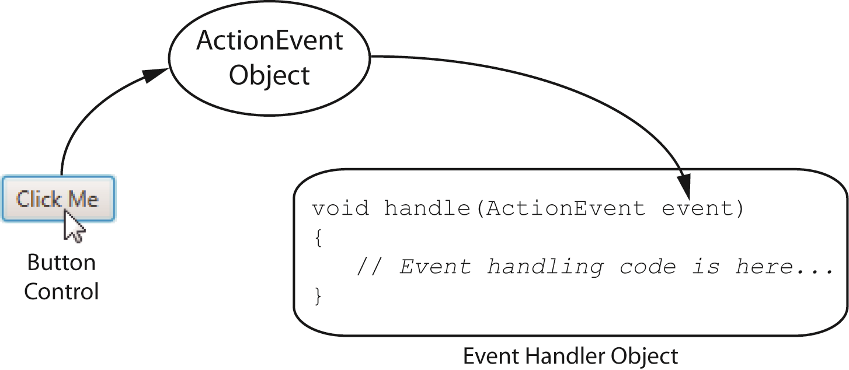
Handling Events

Slide 44
Event Objects
Event objects are instances of the Event class (from the javafx.event package), or one of its subclasses.
For example, a Button click generates an ActionEvent object. ActionEvent is a subclass of the Event class.

Slide 45
Event Handlers
Event handlers are objects.
You write event handler classes that implement the EventHandler interface (from the javafx.event package).
The EventHandler interface specifies a void method named handle that has a parameter of the Event class (or one of its subclasses).

Slide 46
Event Handlers
class ButtonClickHandler implements EventHandler<ActionEvent>
{
@Override
void handle(ActionEvent event)
{
// Write event handling code here.
}
}

Slide 47
Registering an Event Handler
The process of connecting an event handler object to a control is called registering the event handler.
Button controls have a method named setOnAction that registers an event handler:
  mybutton.setOnAction(new ButtonClickHandler());
When the user clicks the button, the event handler object’s handle method will be executed.

Slide 48
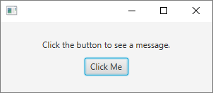
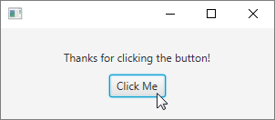
Event Handling Example
Let's look at an application that initially displays this screen:
When the user clicks the button, the screen changes to:

Slide 49
import javafx.application.Application;
import javafx.stage.Stage;
import javafx.scene.Scene;
import javafx.scene.layout.VBox;
import javafx.scene.control.Label;
import javafx.scene.control.Button;
import javafx.geometry.Pos;
import javafx.event.EventHandler;
import javafx.event.ActionEvent;
public class EventDemo extends Application
{
private Label myLabel;
public static void main(String[] args)
{
launch(args);
}
Continued…

Slide 50
@Override
public void start(Stage primaryStage)
{
// Create a Label and a Button.
myLabel = new Label("Click the button to see a message.");
Button myButton = new Button("Click Me");
// Register an event handler.
myButton.setOnAction(new ButtonClickHandler());
// Put the Label and Button in a VBox with 10 pixels of spacing.
VBox vbox = new VBox(10, myLabel, myButton);
vbox.setAlignment(Pos.CENTER);
// Create a Scene and display it.
Scene scene = new Scene(vbox, 300, 100);
primaryStage.setScene(scene);
primaryStage.show();
}
class ButtonClickHandler implements EventHandler<ActionEvent>
{
@Override
public void handle(ActionEvent event)
{
myLabel.setText("Thanks for clicking the button!");
}
}
}

Slide 51
Reading Input with TextField Controls
At runtime, the user can type text into a TextField control.
In the program, you can retrieve the text that the user entered.
The TextField class is in the javafx.scene.control package.
To create an empty TextField:
TextField myTextField = new TextField();

Slide 52
Reading Input with TextField Controls
To retrieve the text that the user has typed into a TextField control, call the control’s getText method.
The method returns the value that has been entered, as a String.
Example:
String input;
input = myTextField.getText();
See KiloConverter.java in your textbook

Slide 53
Displaying Alert Dialogs
Alert dialog: a small graphical window that pops up to display a message to the user
In JavaFX, you use the Alert class, which is in the javafx.scene.control package to display any of the following types of alert dialogs:
    Information Alert – Displays a simple message with an OK button
    Confirmation Alert – Use to ask the user for confirmation. An OK button and a Cancel button are displayed.
    Warning Alert – Displays a warning message. An OK button is displayed.
    Error Alert – Displays an error message. An OK button is displayed.

Slide 54
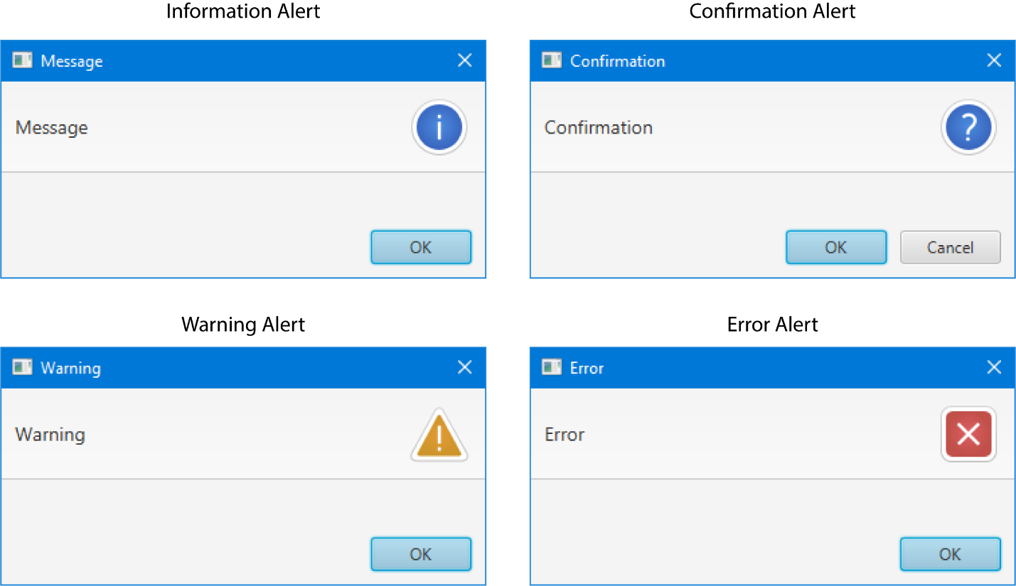
Alert Dialogs

Slide 55
The AlertType Enumeration
You use the Alert class and the AlertType enumeration together
The following values are in the AlertType enumeration:
    AlertType.INFORMATION
    AlertType.CONFIRMATION
    AlertType.WARNING
    AlertType.ERROR
    AlertType.NONE

Slide 56
Creating an Alert Dialog
First, create an instance of the Alert class, passing an AlertType enumeration to the constructor
Next, set the text of the message
Display the dialog
Alert alert = new Alert(AlertType.INFORMATION);
alert.setContentText("Hello!");
alert.showAndAwait();

Slide 57
Determining the Type of Button Clicked
The Information, Warning, and Error alert dialogs each display an OK button
The Confirmation alert dialog an OK and a Cancel button
The showAndWait method returns an object that can be used to determine which button was clicked
The data type of the object that is returned from the showAndWait method is Optional<ButtonType>

Slide 58
Determining the Type of Button Clicked
1 Alert alert = new Alert(AlertType.CONFIRMATION);
2 alert.setContentText("Are you sure?");
3 Optional<ButtonType> result = alert.showAndWait();
4
5 if (result.get() == ButtonType.OK)
6 {
7 // Code to execute when the OK button is clicked
8 }
9 else if (result.get() == ButtonType.CANCEL)
10 {
11 // Code to execute when the Cancel button is clicked
12 }

Slide 59
Modal and Modeless Dialogs
The showAndWait method displays a modal dialog
When the dialog is displayed, the calling code is blocked from execution until the dialog is dismissed
No statements appearing after the call to showAndWait will execute until the dialog is closed
statement;
statement;
alert.showAndWait();
statement;
statement;
statement;
These statements will not execute until the alert dialog is closed

Slide 60
Modal and Modeless Dialogs
The show method displays a modeless dialog
When the dialog is displayed, the statements appearing after the call to the show method will continue to execute while the dialog is displayed
statement;
statement;
alert.show();
statement;
statement;
statement;
These statements will execute immediately after the alert dialog is displayed

Slide 61
Customizing an Alert Dialog
You can use the setTitle and setHeaderText methods to customize the text displayed in a dialog's title bar and header area
Alert alert = new Alert(AlertType.INFORMATION);
alert.setTitle("Notification");
alert.setHeaderText("Attention!");
alert.setContentText("You have new mail");
alert.showAndWait();

Slide 62
Customizing an Alert Dialog
You can use the setGraphic method to customize the icon displayed in a dialog
Image image = new Image("file:email.png");
ImageView icon = new ImageView(image);
Alert alert = new Alert(AlertType.INFORMATION);
alert.setTitle("Notification");
alert.setGraphic(icon);
alert.setHeaderText("Attention!");
alert.setContentText("You have new mail");
alert.showAndWait();

Slide 63
Anonymous Inner Classes as Event Handlers
When an event handler class is instantiated only once, you can write it as an anonymous inner class.

Slide 64
import javafx.application.Application;
import javafx.stage.Stage;
import javafx.scene.Scene;
import javafx.scene.layout.VBox;
import javafx.scene.control.Label;
import javafx.scene.control.Button;
import javafx.geometry.Pos;
import javafx.event.EventHandler;
import javafx.event.ActionEvent;
public class EventDemo2 extends Application
{
private Label myLabel;
public static void main(String[] args)
{
launch(args);
}
Continued…

Slide 65
@Override
public void start(Stage primaryStage)
{
// Create a Label and a Button.
myLabel = new Label("Click the button to see a message.");
Button myButton = new Button("Click Me");
// Register an event handler.
myButton.setOnAction(new EventHandler<ActionEvent>()
{
@Override
public void handle(ActionEvent event)
{
myLabel.setText("Thanks for clicking the button!");
}
});
// Put the Label and Button in a VBox with 10 pixels of spacing.
VBox vbox = new VBox(10, myLabel, myButton);
vbox.setAlignment(Pos.CENTER);
// Create a Scene and display it.
Scene scene = new Scene(vbox, 300, 100);
primaryStage.setScene(scene);
primaryStage.show();
}
}

Slide 66
Lambda Expressions as Event Handlers
Recall that a functional interface is an interface that has one, and only one, abstract method.
The EventHandler interface has only one abstract method is a functional interface.
Any time you are writing Java code to instantiate an anonymous class that implements a functional interface, you should consider using a lambda expression instead.
A lambda expression is more concise than the code for instantiating an anonymous class.

Slide 67
import javafx.application.Application;
import javafx.stage.Stage;
import javafx.scene.Scene;
import javafx.scene.layout.VBox;
import javafx.scene.control.Label;
import javafx.scene.control.Button;
import javafx.geometry.Pos;
public class EventDemo3 extends Application
{
private Label myLabel;
public static void main(String[] args)
{
launch(args);
}
Continued…

Slide 68
@Override
public void start(Stage primaryStage)
{
// Create a Label and a Button.
myLabel = new Label("Click the button to see a message.");
Button myButton = new Button("Click Me");
// Register an event handler.
myButton.setOnAction(e ->
{
myLabel.setText("Thanks for clicking the button!");
});
// Put the Label and Button in a VBox with 10 pixels of spacing.
VBox vbox = new VBox(10, myLabel, myButton);
vbox.setAlignment(Pos.CENTER);
// Create a Scene and display it.
Scene scene = new Scene(vbox, 300, 100);
primaryStage.setScene(scene);
primaryStage.show();
}
}

Slide 69
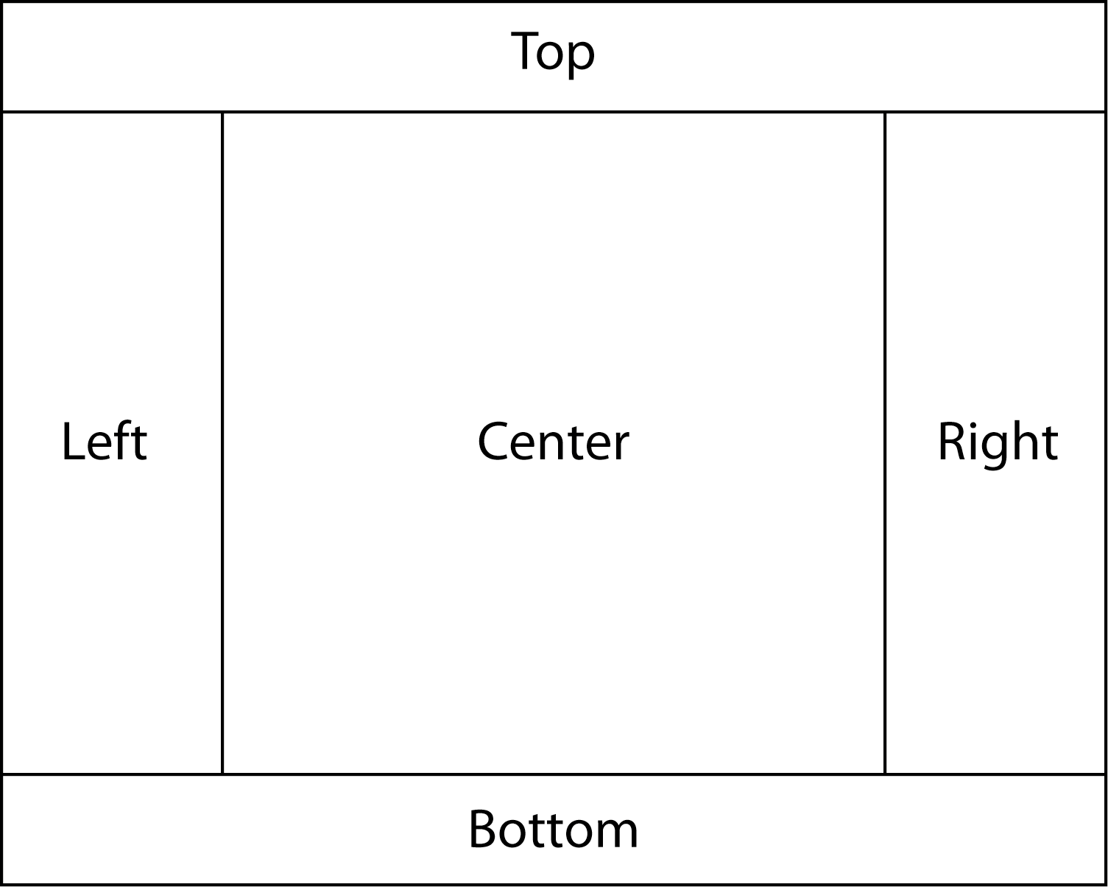
The BorderPane Layout Container
The BorderPane layout container manages controls in five regions:

Slide 70
The BorderPane Layout Container
Only one object at a time may be placed into a BorderPane region.
You do not usually put controls directly into a BorderPane region.
Typically, you put controls into another type of layout container, then you put that container into one of the BorderPane regions.

Slide 71
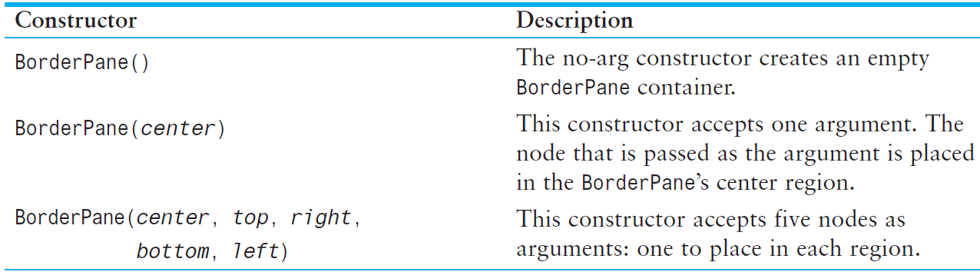
The BorderPane Layout Container
The BorderPane class is in the javafx.scene.layout package.
Summary of constructors:

Slide 72
The BorderPane Layout Container
The BorderPane class provides the following methods to add controls to specific regions:
  setCenter
  setTop
  setBottom
  setLeft
  setRight
See BorderPaneDemo1.java in your textbook.

Slide 73
The ObservableList Interface
Widely used in JavaFX
Learning a few basic ObservableList operations gives you more control over the JavaFX containers with which you will be working.

Slide 74
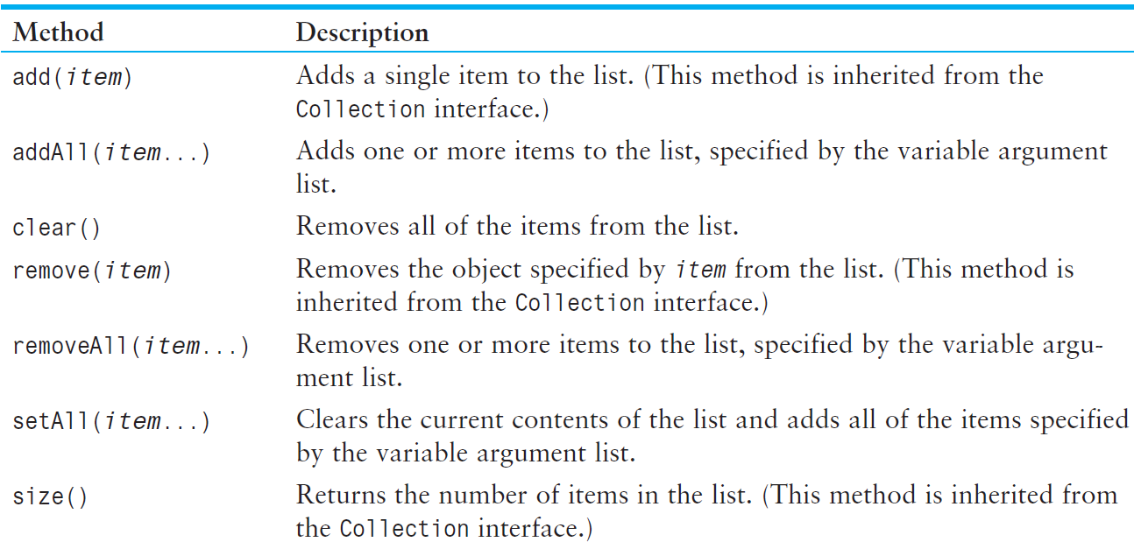
The ObservableList Interface
A few ObservableList methods:

Slide 75
The ObservableList Interface
For example, layout containers keep their children nodes in an ObservableList.
All layout containers have a method named getChildren() that returns their ObservableList of nodes.

Slide 76
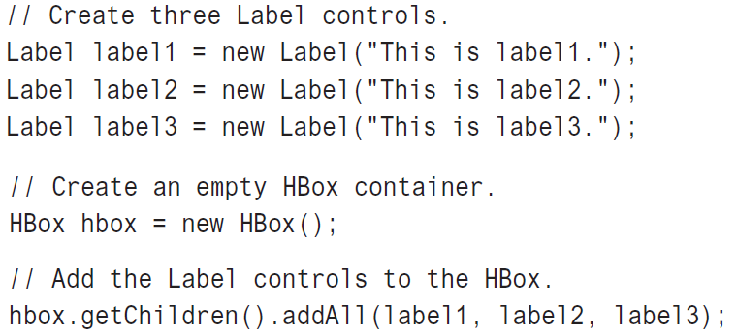
The ObservableList Interface
Example: creating an empty HBox, then using the ObservableList’s addAll method to add nodes to the HBox:

Slide 77
The ObservableList Interface
Example: removing label1 from the HBox:
hbox.getChildren().remove(label1);

