Slide 1
An Introduction to Spring integration

Slide 2
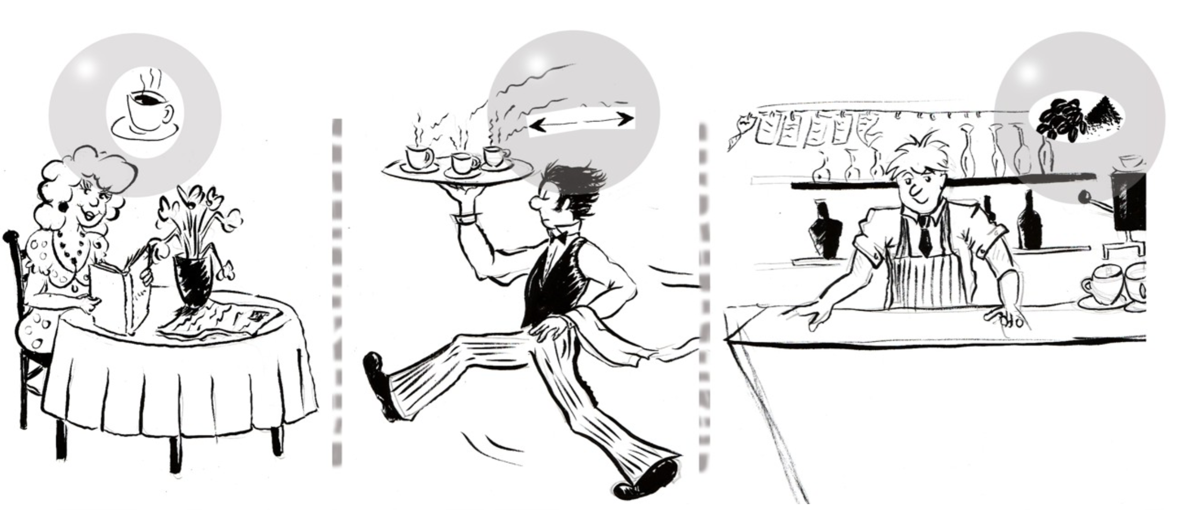
Café Sample

Slide 3
Café Sample
A customer orders a coffee
– and waits
The waiter walks to the barista and passes the order
– and waits
The barista walks to the coffee machine
– and waits
How about the next customer?

Slide 4
Characteristics
Transport
The waiter takes an order and moves it to the barista
Asynchronous
Different actors do different things in parallel
Translation
menu item => number => recipe
Routing
Orders arrive back at the proper table

Slide 5
Messaging
. A common strategies in the integration space
. Mainly encourages and supports sender-receiver decoupling
Messaging patterns
Some common problems that may have common solutions
Avoid reinventing the wheel
Any messaging system has a few building blocks to work with, such as Messages, Channels, Transformers, etc. These are identified as patterns.
Notes:
http://www.enterpriseintegrationpatterns.com/patterns/messaging/index.html

Slide 6
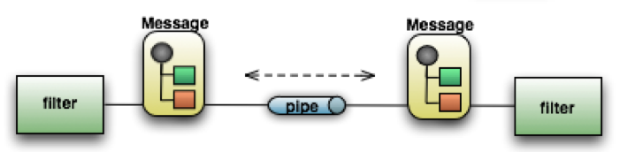
What is SI?
Light-weight messaging framework
Provides an adapter-based platform
Implement well-known Enterprise Application Integration (EAI) patterns.
Pipes and Filters at the core of Spring Integration’s architecture
Endpoint (Filter)
Channel (Pipe)
Message
Notes:
I. Messages
1. Header (Map<String, Object>) & Payload
2. Some predefined properties of header such as priority, reply-channel, error- channel, etc.
3. Payload – POJO (serializable)
II. Channels
1. The decoupling of the sender and receiver components is primarily achieved by using channels
2. 2 Modes: Point-to-Point (P2P) – pollable and Publish/Subscribe (Pub/Sub) – subscribable
3. Message buffering - the incoming messages are buffered in order to stop flooding the consumers
4. Clients choose the channels depending on delivery mode (P2P or Pub/Sub) and buffering or non-buffering semantics
III. Endpoints
1. The application code concentrates on implementing the business logic. The connection mechanism, the message sending and receiving and other aspects of messaging are hidden from the application -> Message Endpoints are components that separate business logic from the messaging framework
2. 2 types of endpoint consumers: Polling Consumer (to poll for messages in a timely fashion) and an Event-Driven Consumer (subscribe to a subscribable channel so it will be notified asynchronously when a message arrives at the channel )

Slide 7
References
Spring integration project
Enterprise Integration Patterns with Spring integration
Spring Integration and EIP Introduction
Messaging with Spring Integration
Integration Patterns With Spring integration
The Café sample
Book – Just Spring Integration

