Slide 1
Café Sample Application
A customer orders a coffee
– and waits
The waiter walks to the barista and passes the order
– and waits
The barista walks to the coffee machine
– and waits
How about the next customer?

Slide 2
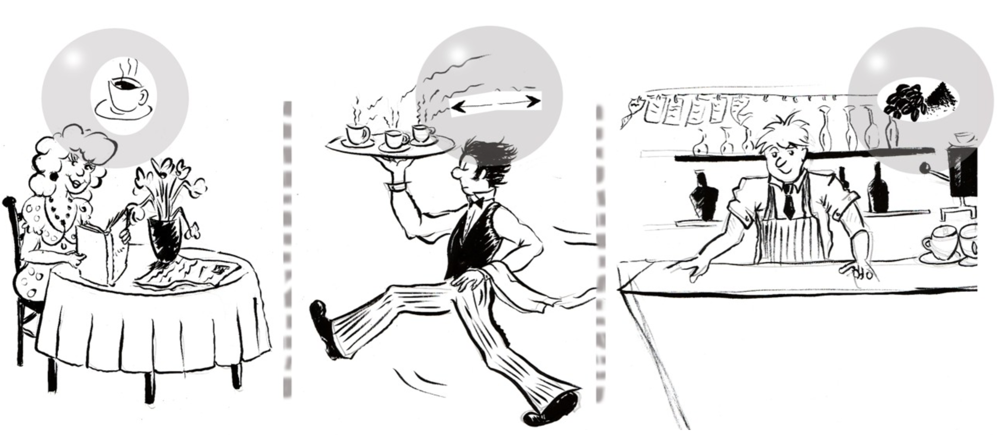

Slide 3
Messaging
Transport
The waiter takes an order and moves it to the barista
Asynchronous
Different actors do different things in parallel
Translation
menu item => number => recipe
Routing
Orders arrive back at the proper table

Slide 4
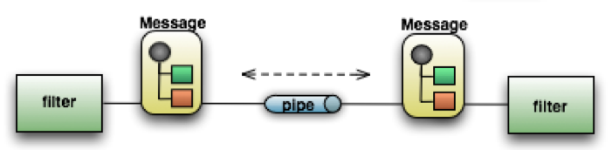
What is SI?
Light-weight messaging framework
Provides an adapter-based platform
Pipes and Filters at the core of Spring Integration’s architecture
Endpoint (Filter)
Channel (Pipe)
Message

