Slide 1
Introduction to Spring integration

Slide 2
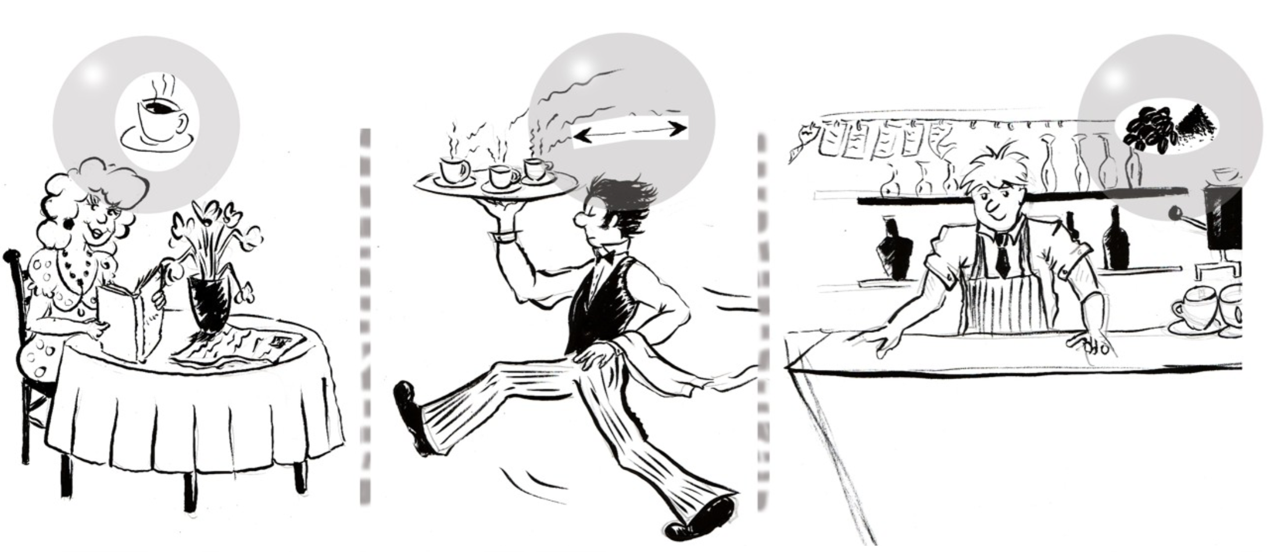
Café Sample

Slide 3
Café Sample
A customer orders a coffee
– and waits
The waiter walks to the barista and passes the order
– and waits
The barista walks to the coffee machine
– and waits
How about the next customer?

Slide 4
Characteristics
Transport
The waiter takes an order and moves it to the barista
Asynchronous
Different actors do different things in parallel
Translation
menu item => number => recipe
Routing
Orders arrive back at the proper table

Slide 5
Messaging
. A common strategies in the integration space
. Mainly encourages and supports sender-receiver decoupling
Messaging patterns
Some common problems that may have common solutions
Avoid reinventing the wheel
Any messaging system has a few building blocks to work with, such as Messages, Channels, Transformers, etc. These are identified as patterns.

Slide 6
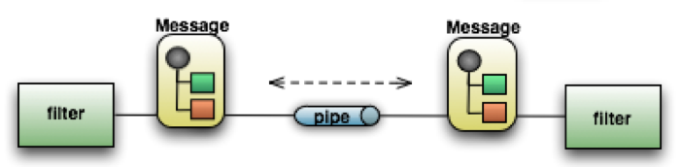
What is SI?
Light-weight messaging framework
Provides an adapter-based platform
Implement well-known Enterprise Application Integration (EAI) patterns.
Pipes and Filters at the core of Spring Integration’s architecture
Endpoint (Filter)
Channel (Pipe)
Message

Slide 7
References
Spring integration project
Enterprise Integration Patterns with Spring integration
Spring Integration and EIP Introduction
Messaging with Spring Integration
Integration Patterns With Spring integration
The Café sample
Book – Just Spring Integration

