Slide 1


enthusiasm for music
a free music platform for everyone by SESlay
21127004 – Trần Nguyễn An Phong
21127118 – Lâm Thanh Ngọc
21127135 – Diệp Hữu Phúc
21127173 – Nguyễn Thiên Thọ
21127677 – Võ Phạm Thanh Phương
member

Slide 2

enthusiasm for music
a free music platform for everyone by SESlay
21127173 – Nguyễn Thiên Thọ
21127004 – Trần Nguyễn An Phong
21127118 – Lâm Thanh Ngọc
21127135 – Diệp Hữu Phúc
21127677 – Võ Phạm Thanh Phương
member

Slide 3
management
Nguyễn Thiên Thọ | Project Manager Back-end Developer | Monitoring and controlling, arrange planning, timeline, document and human resources of the project. Following and reporting to ensure everyone successfully completes project tasks.
Trần Nguyễn An Phong | Business Analyst Database Developer | Analyze requirements and brainstorm with ideas for development based on requirements. Collecting and storing data for the project
Diệp Hữu Phúc | Back - End Developer Tester | Developing features and algorithms for the project. Testing and checking features for the project.
Võ Phạm Thanh Phương | Front - End Developer Tester | Building the website's interface. Testing and checking features for the project.
Lâm Thanh Ngọc | UI/UX Designer Front - End Developer | Building the website's interface. Designing a prototype and illustrating the design idea.

Slide 4
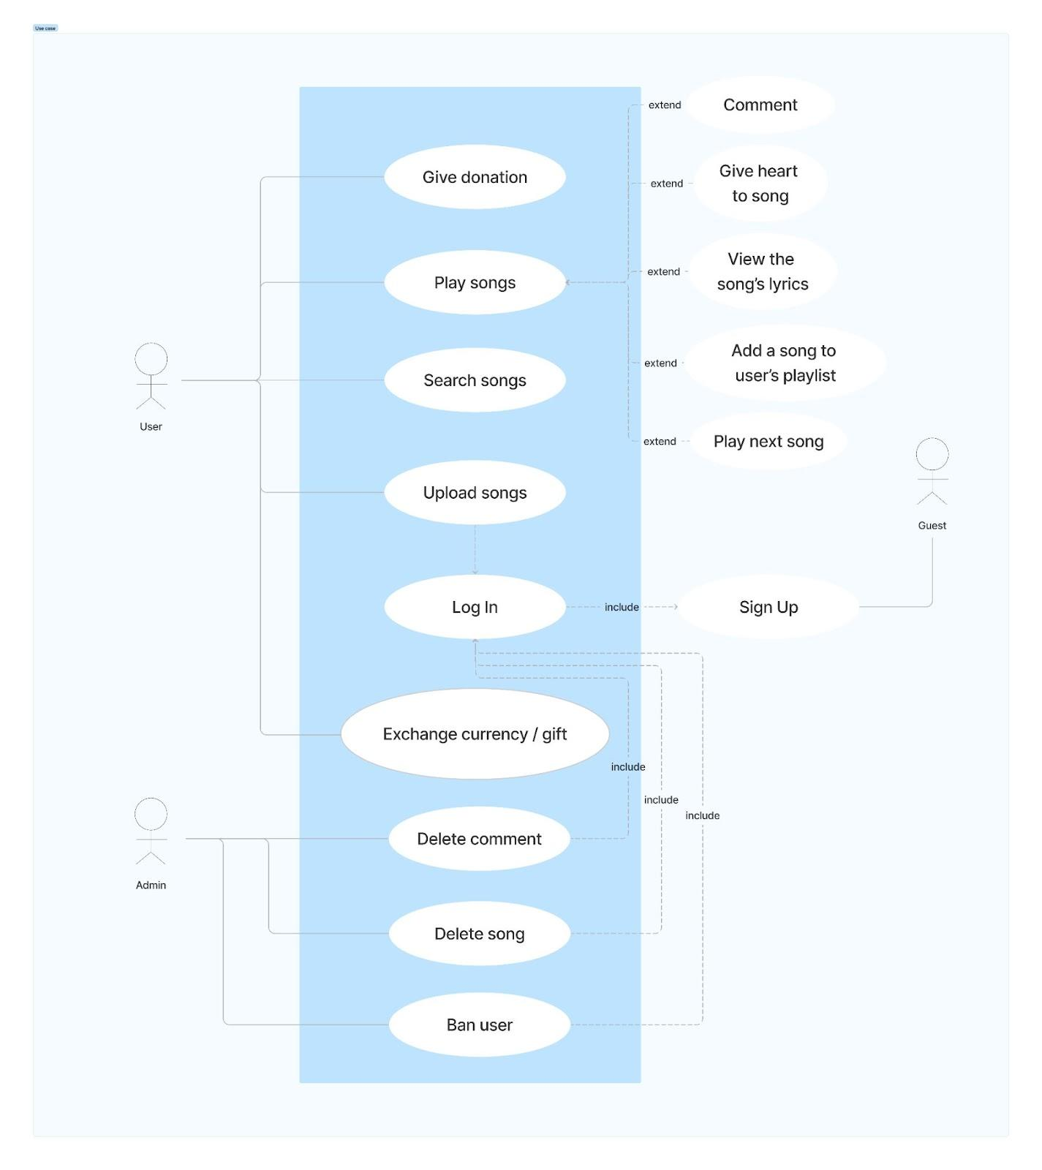
requirements
Product requirements | Usability requirements Efficiency requirements Reliability requirements Portability requirements
Portability requirements | Implementation requirements Standard requirements
External requirements | Interoperability requirements Ethical requirements Legislative requirements

Slide 5
testing
Software name | Purpose | Version | Type and other notes
Google Chrome | The environment to run the product (web), check compatibility | Version: 121.0.6167.16 (64-bit) | Internet Browser (Run on Window 11 version 23H2)
Firefox |  | Version: 120.0 (64-bit)
Safari |  | Version: 17.0 (64-bit) | Operating System (Run on MacOS bigSur version 20G1427)

Slide 6
analysis
Application environment: Web.
Programming language and platform: Javascript (Node.js, Express.js), HTML, CSS.
Database environment: MongoDB
Security: password must be encrypted before storing in the database.
Copyright requirement: Artists must make sure that the uploaded songs are their own products.
Responsive requirement: Laptop, PC, smartphone, tablet…

Slide 7
introduction
MUSEOS is a free platform with immense library of songs from artists all over the world. With the motto “music is the connection”, everyone can be an artist and let’s show the enthusiasm for music !
MUSEOS has many pages that support users, including:
- Home
- Login/Signup
- Profile
- Song
- Artist
Let’s have a look v

Slide 8
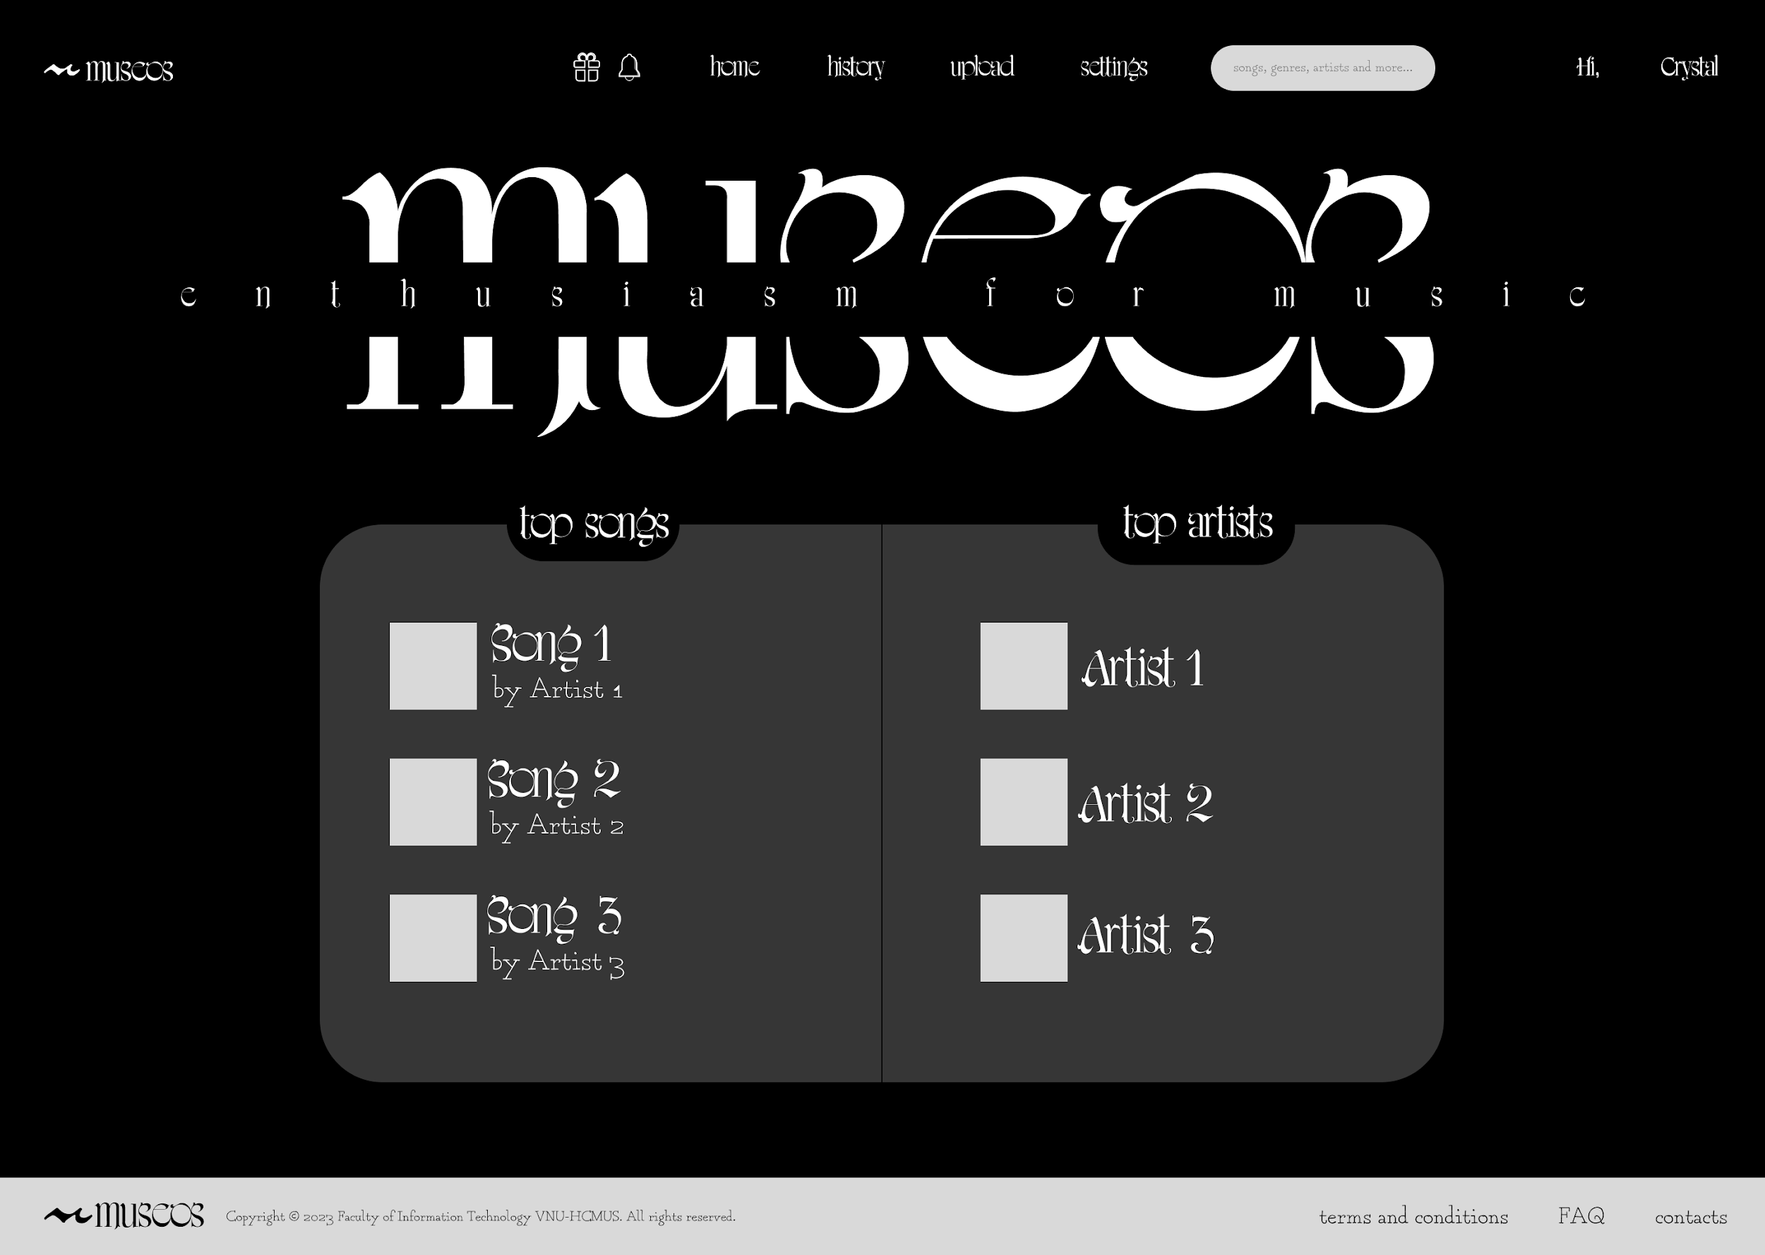
home

Slide 9
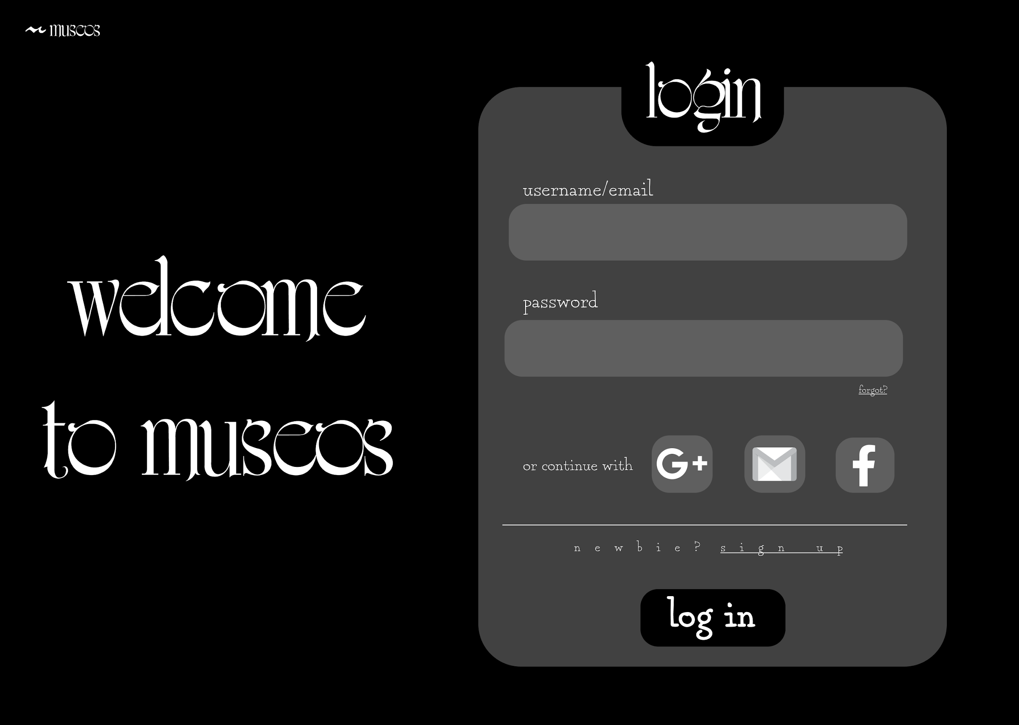
login

Slide 10
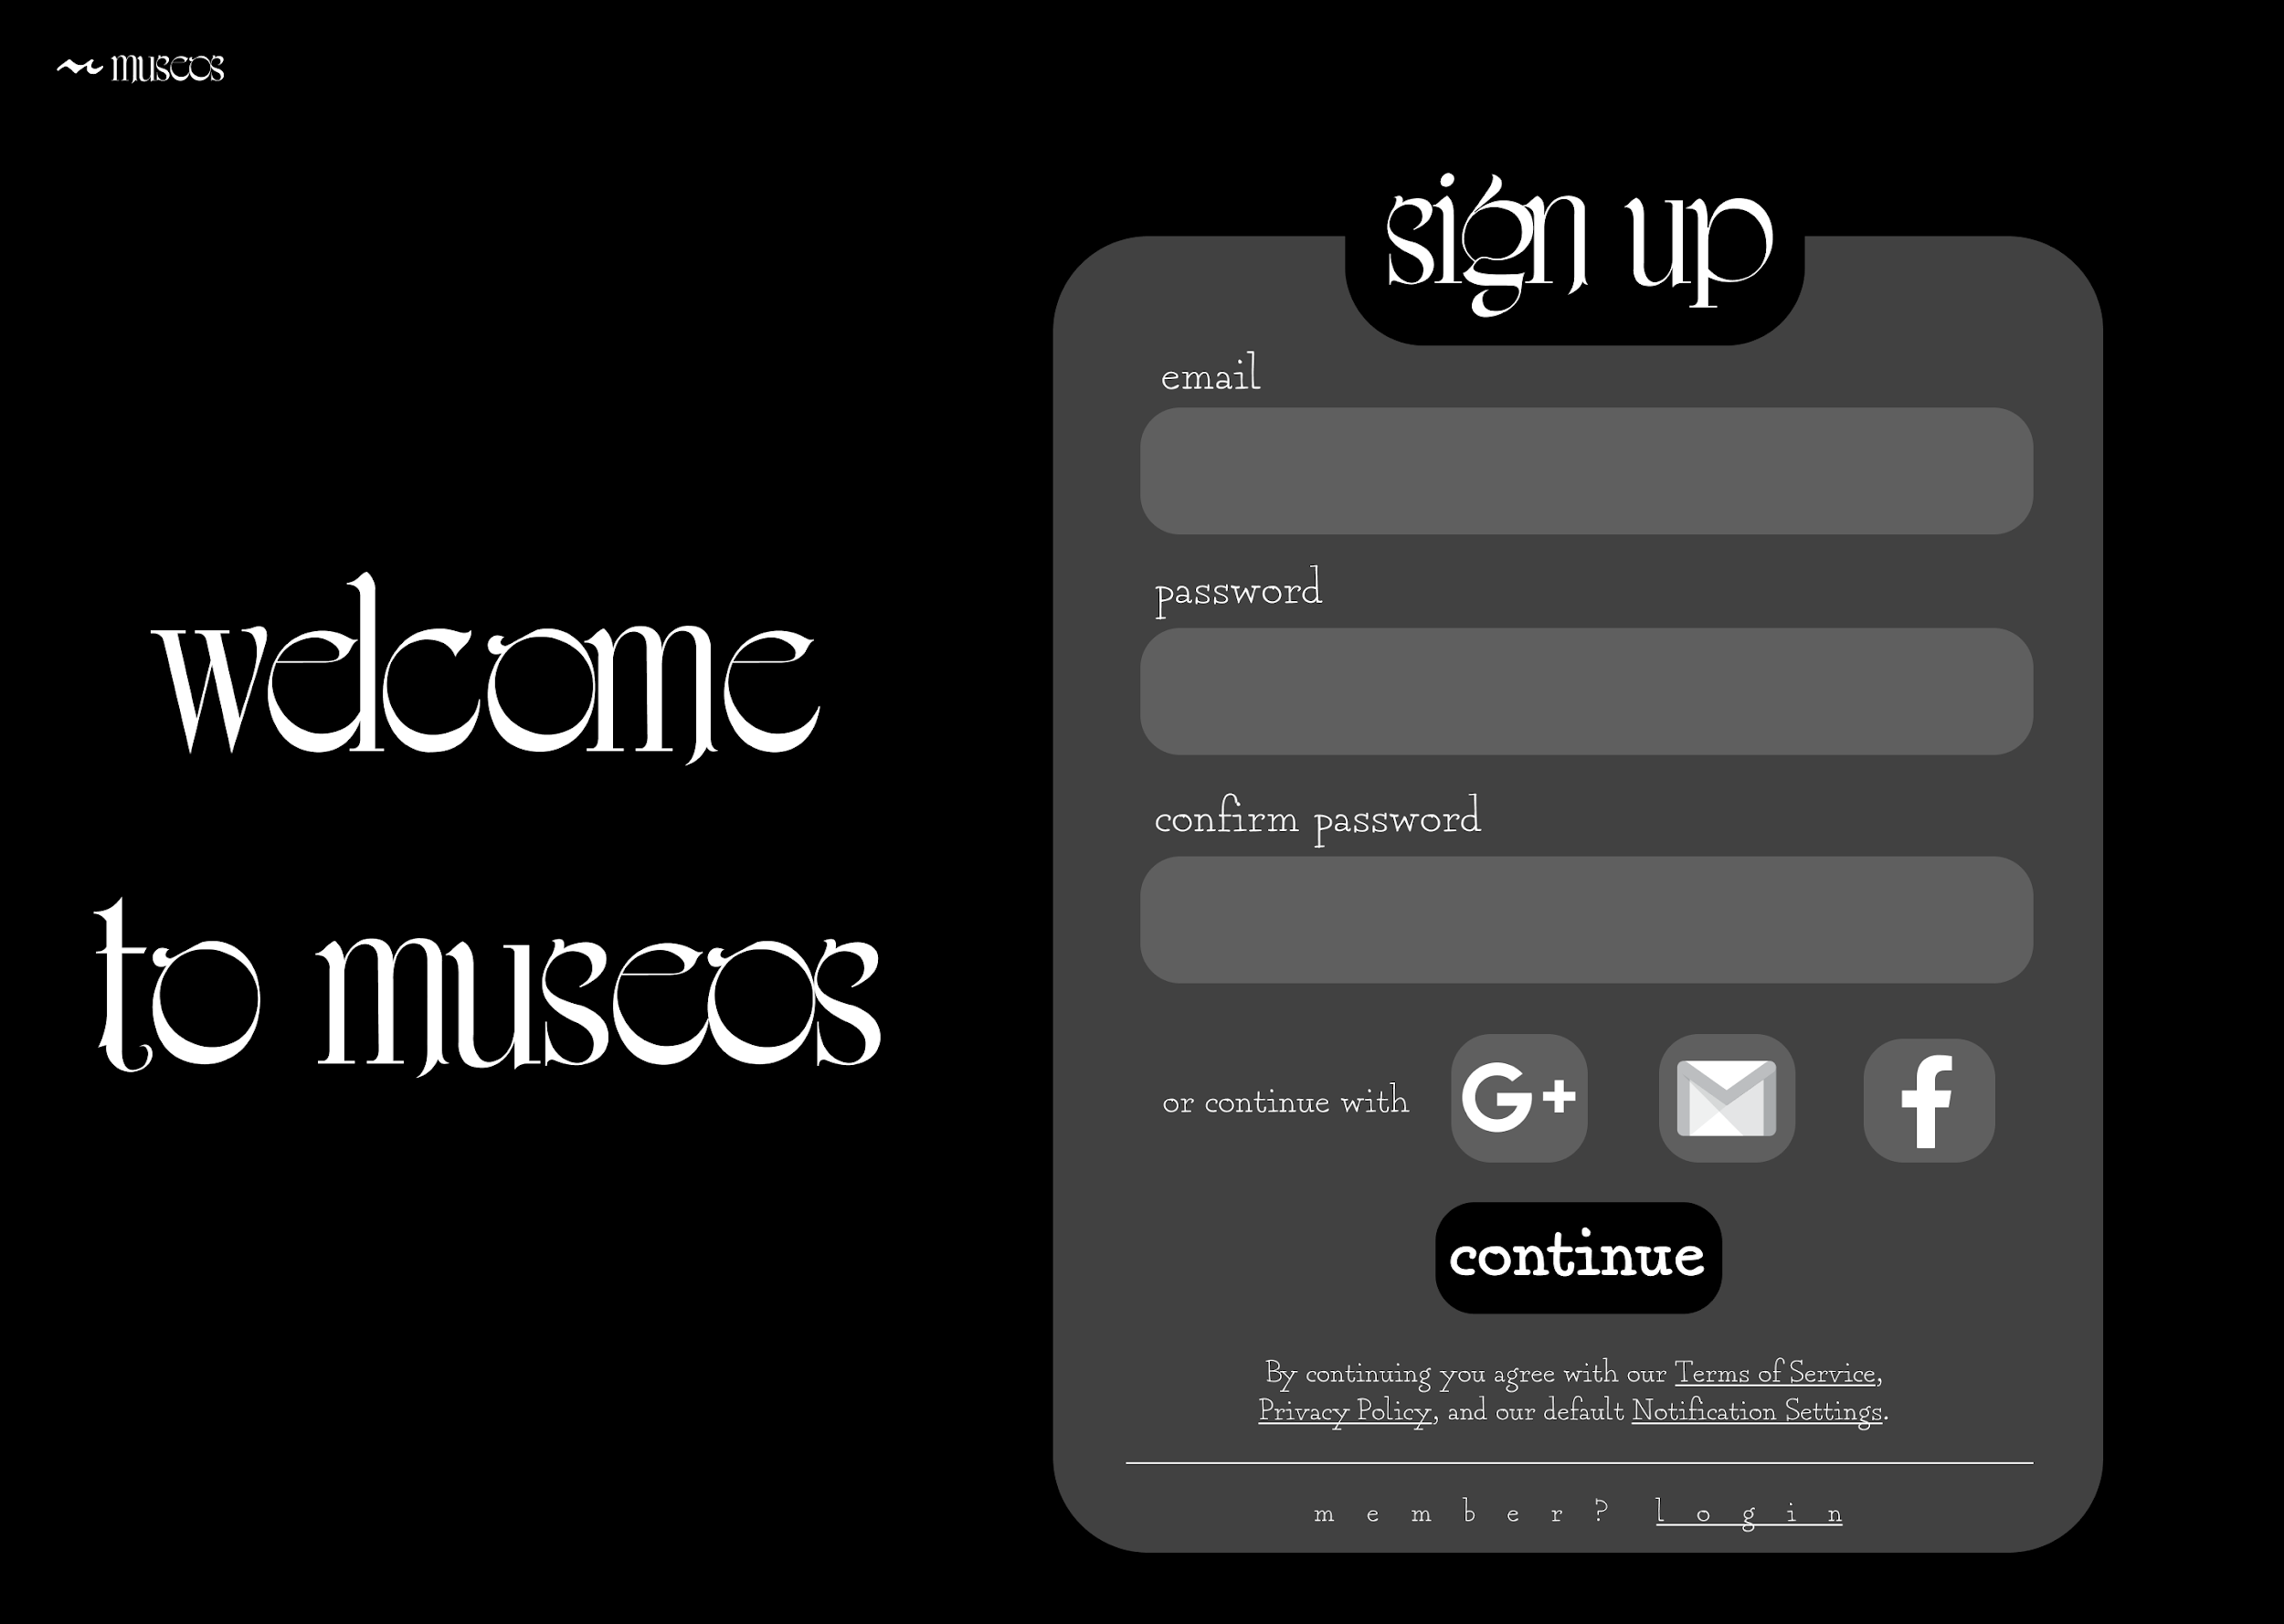
signup

Slide 11
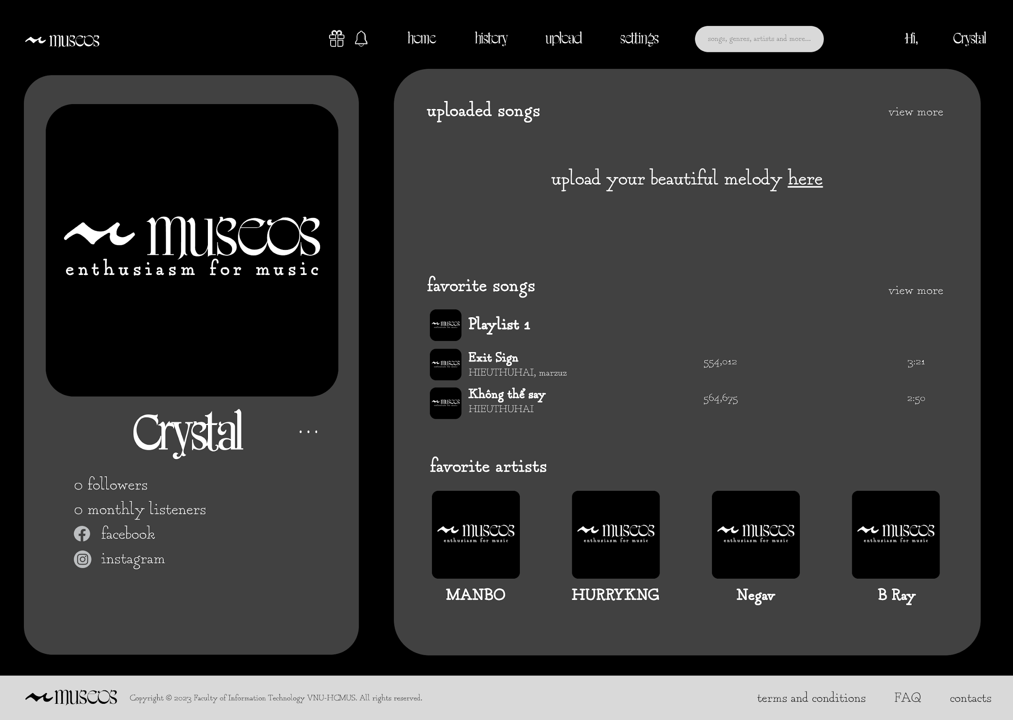
profile

Slide 12
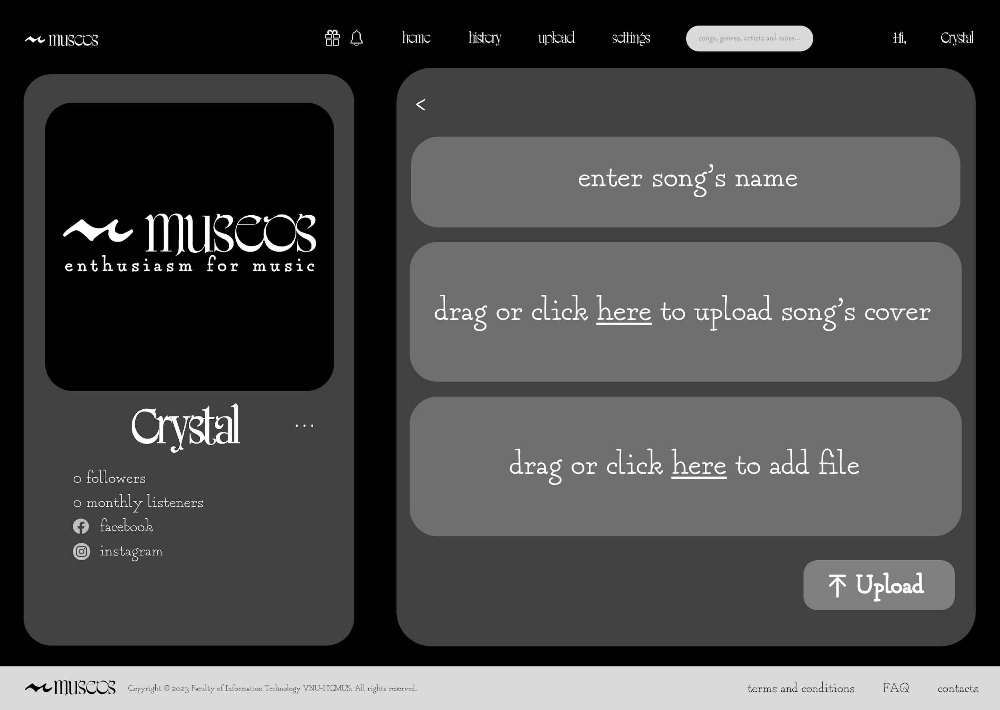
upload song

Slide 13
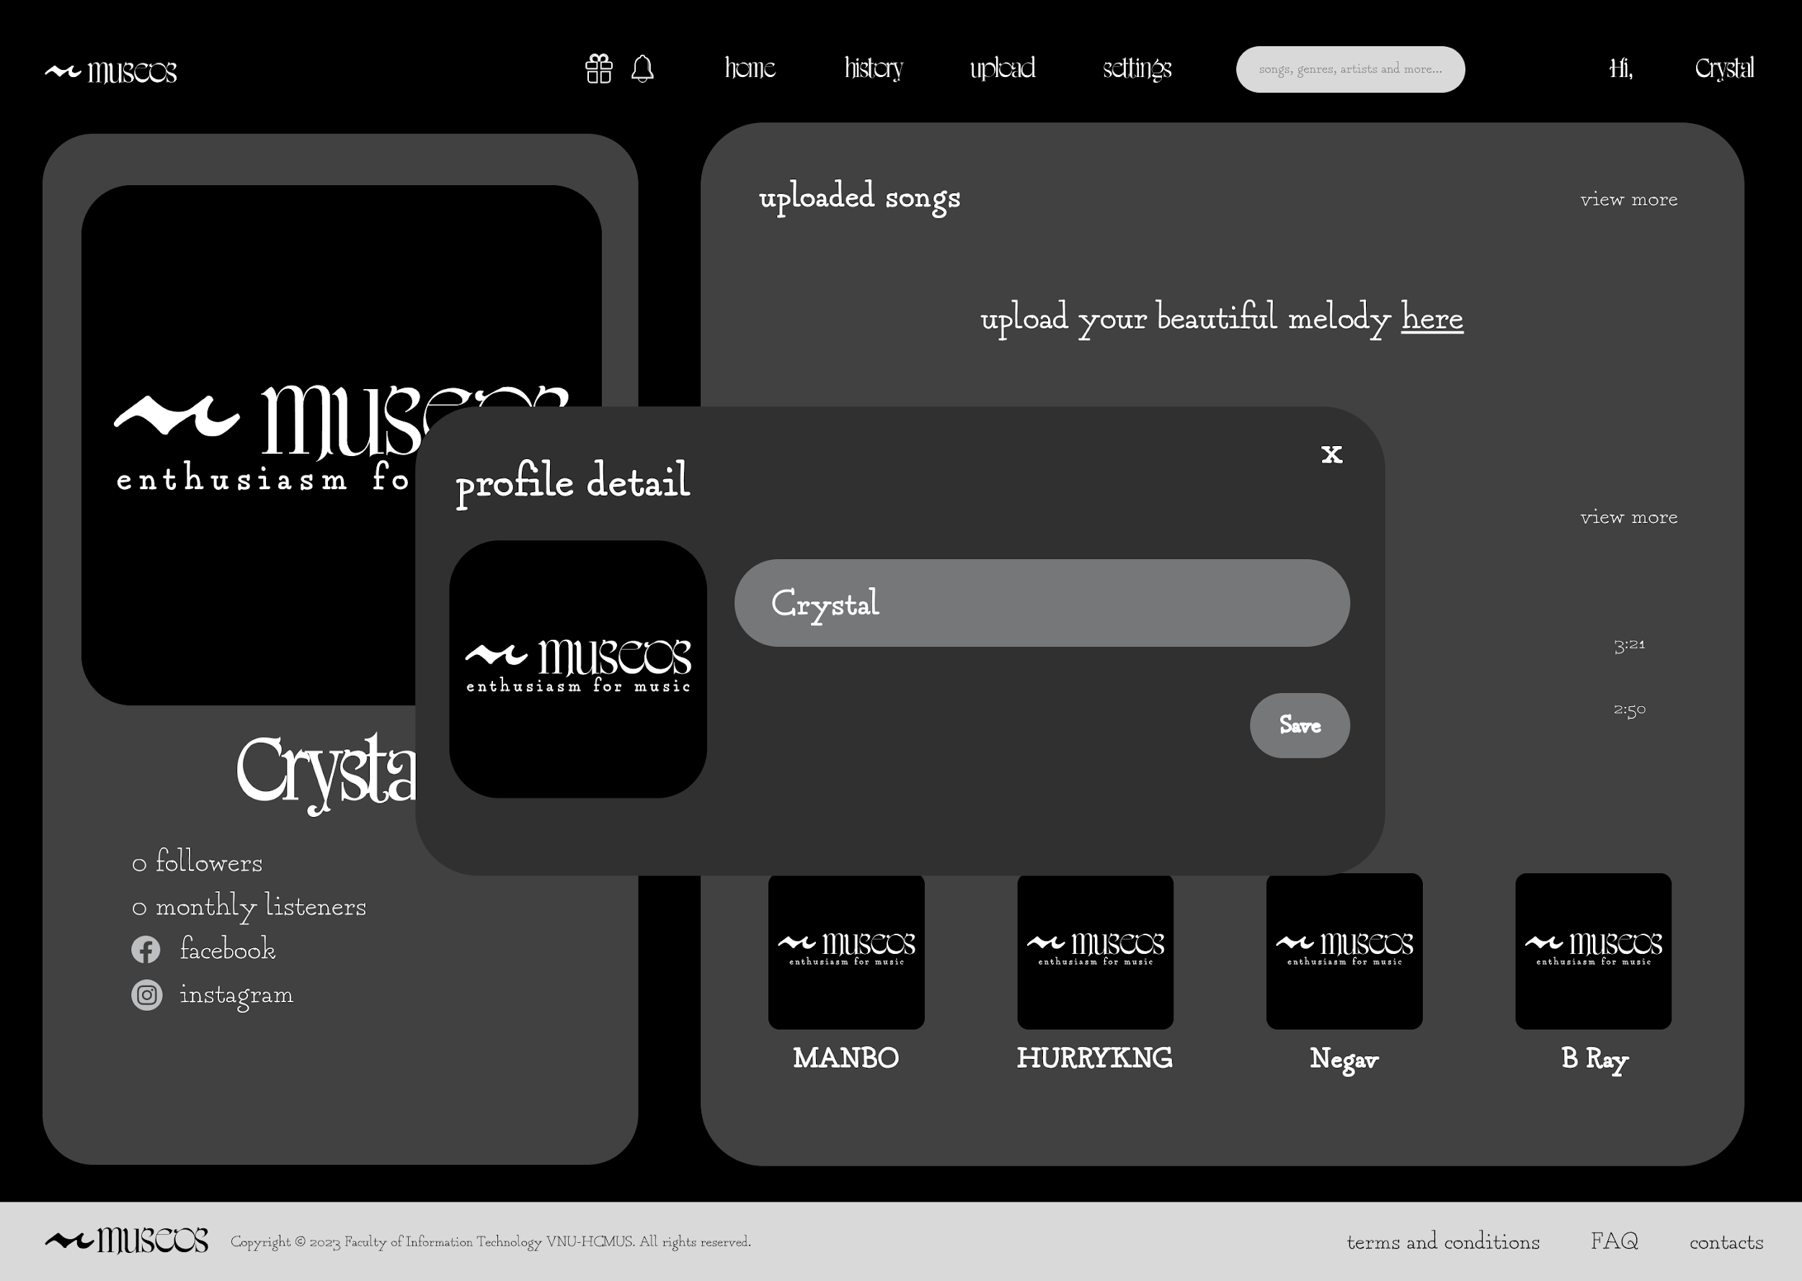
edit profile

Slide 14
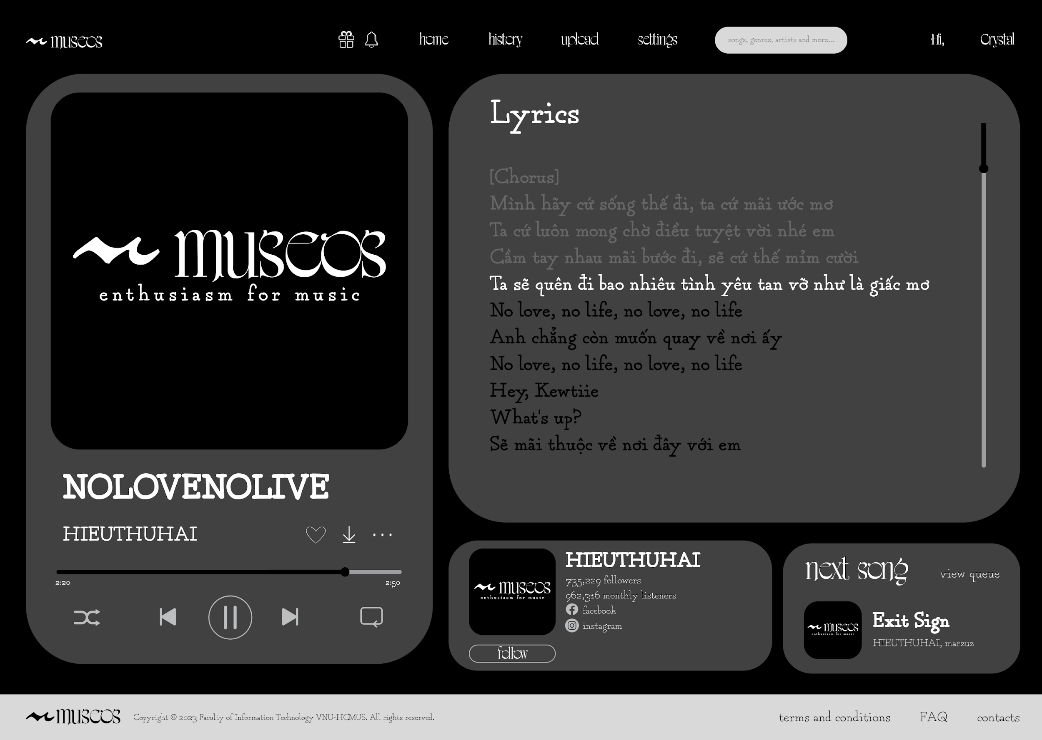
playing song

Slide 15
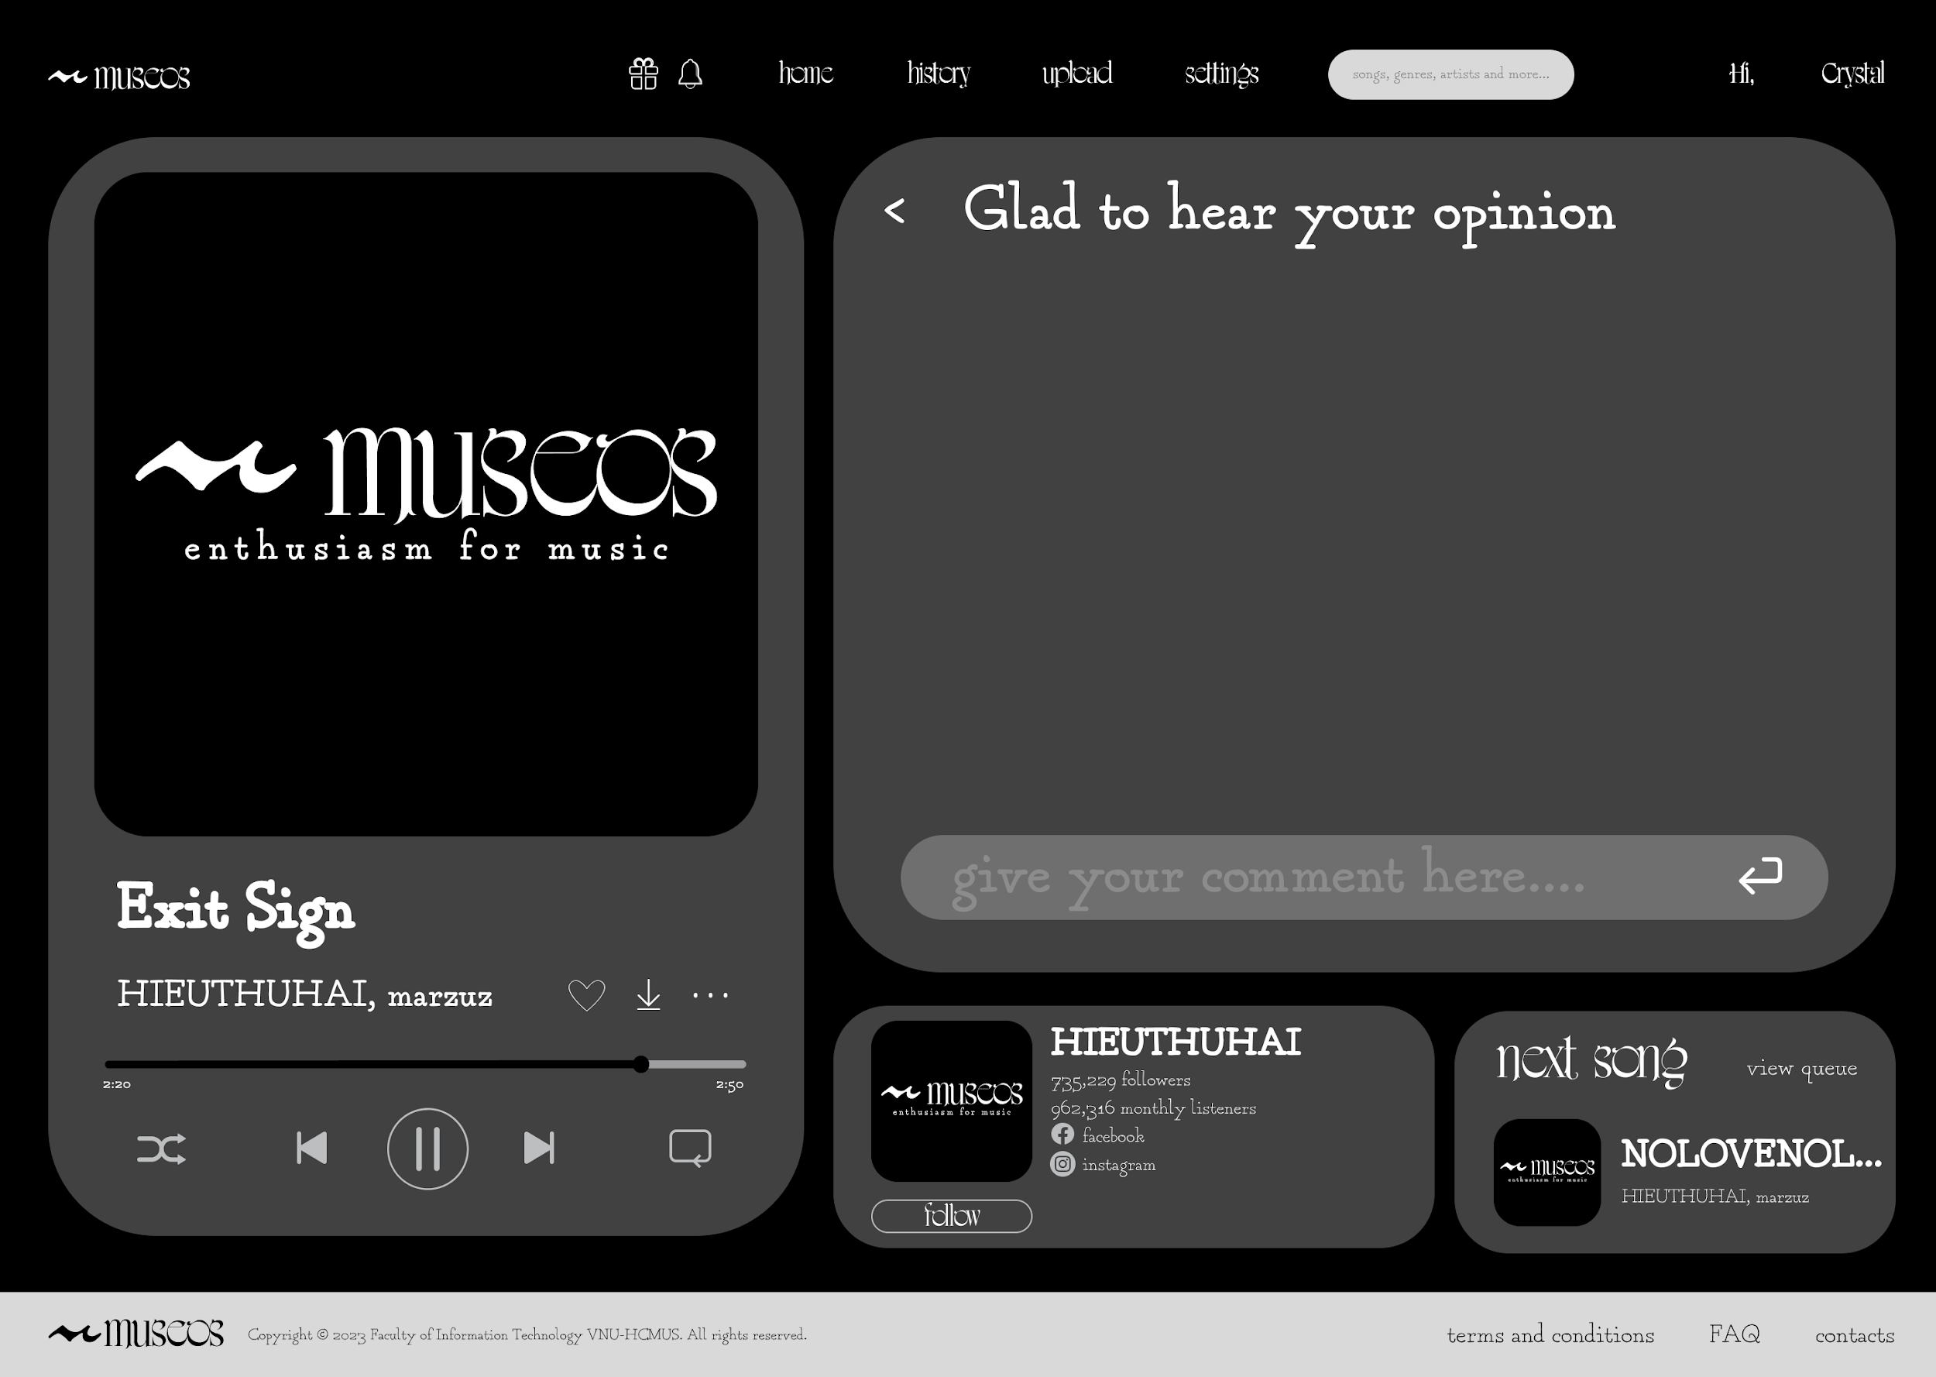
comment

Slide 16
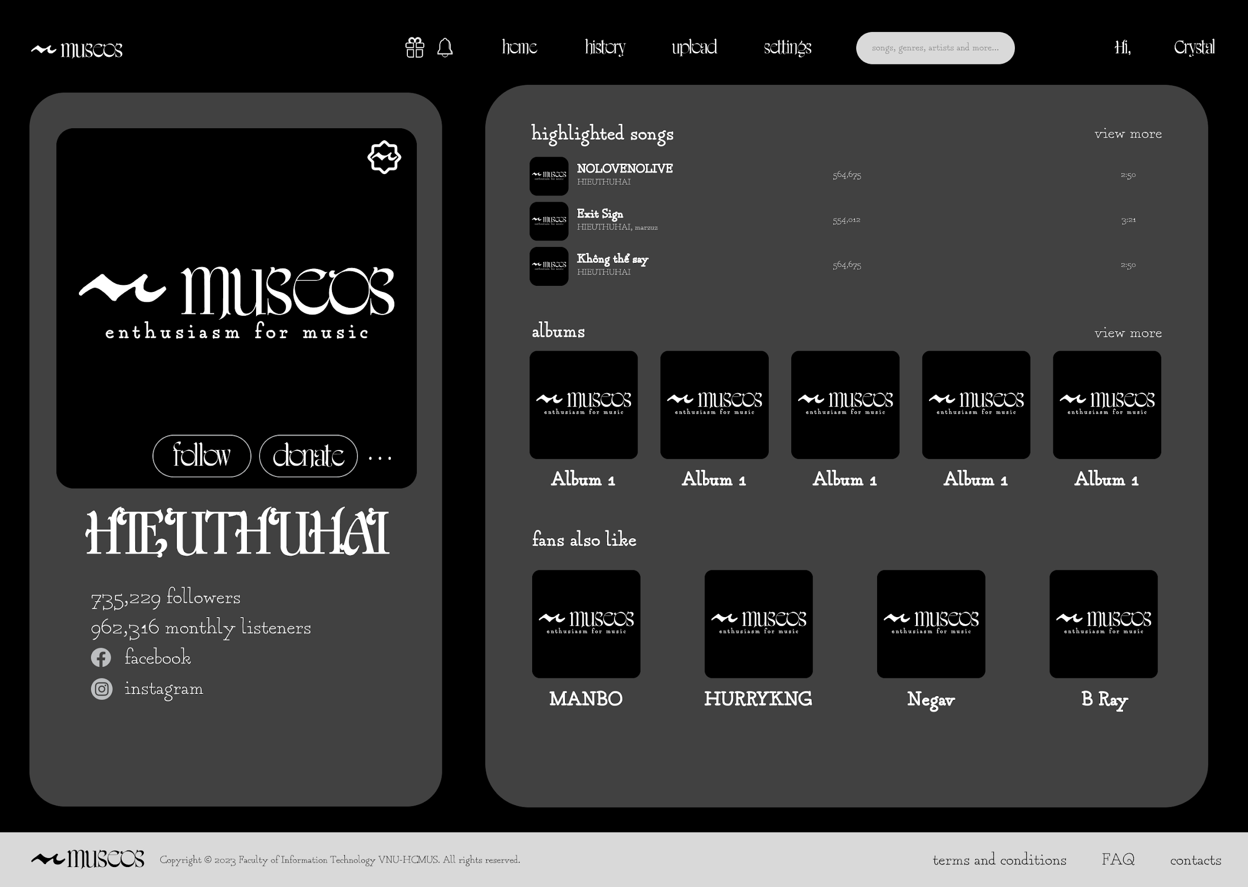
artist

Slide 17
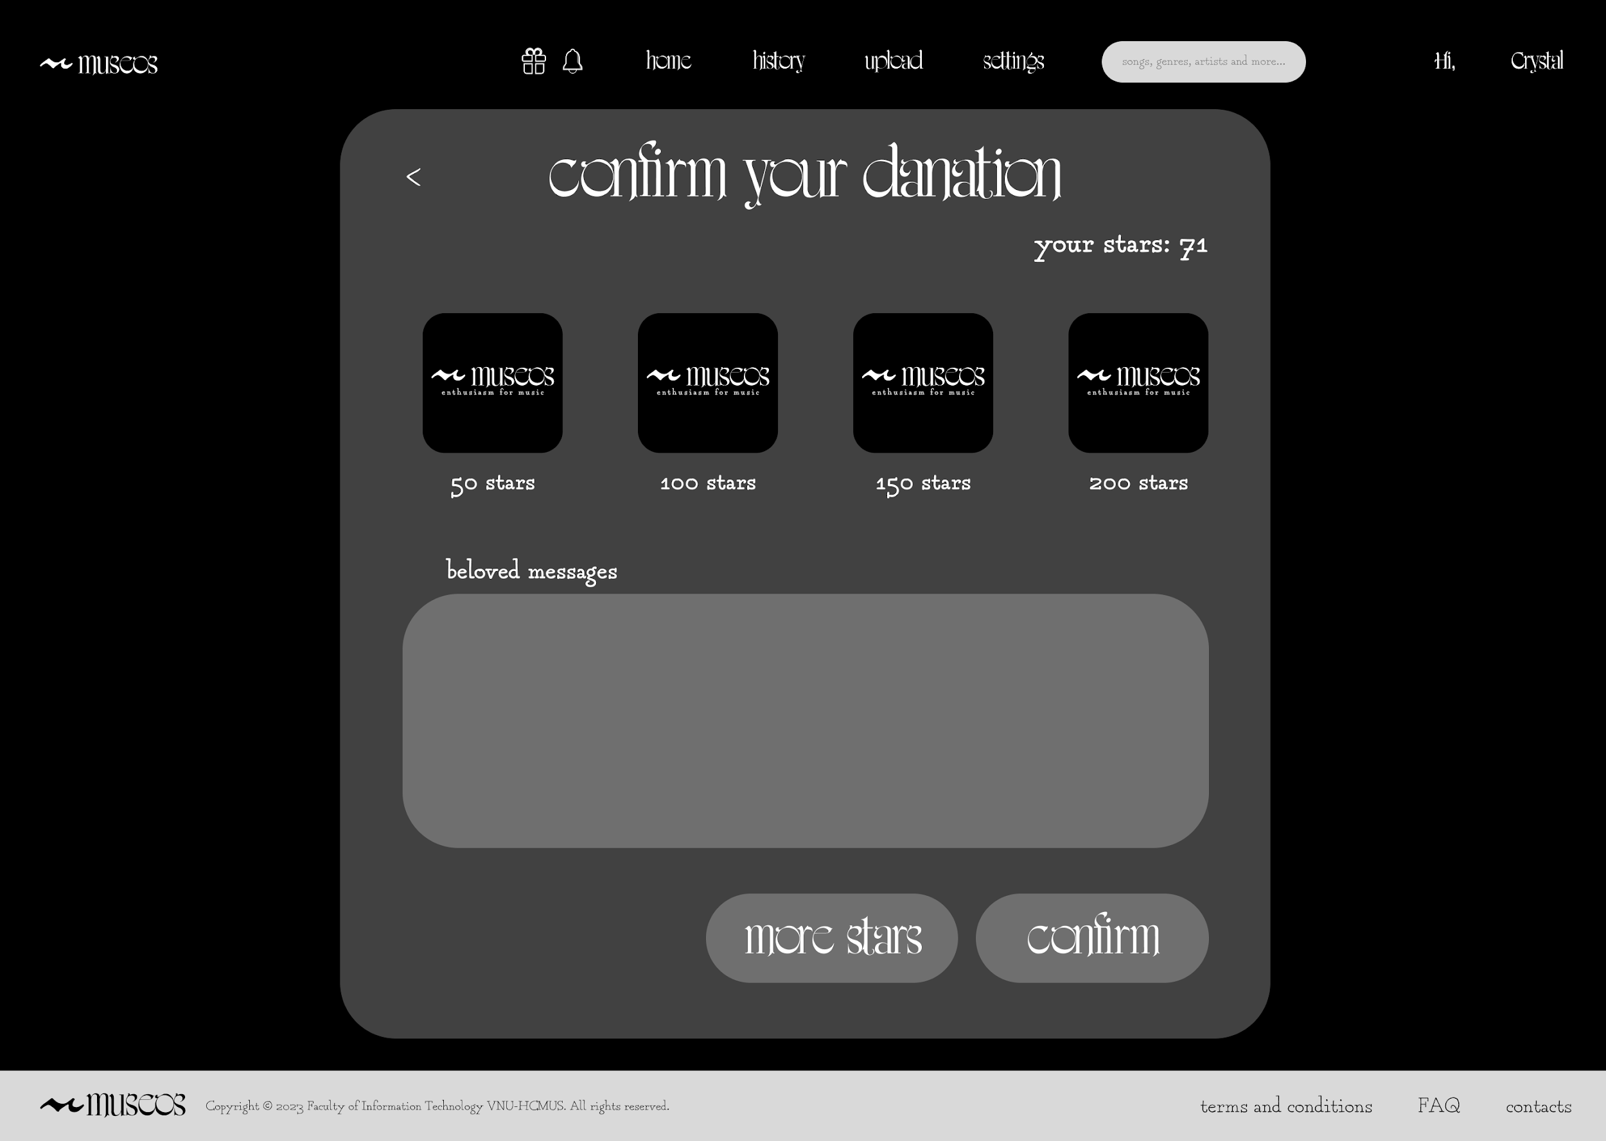
donate

Slide 18
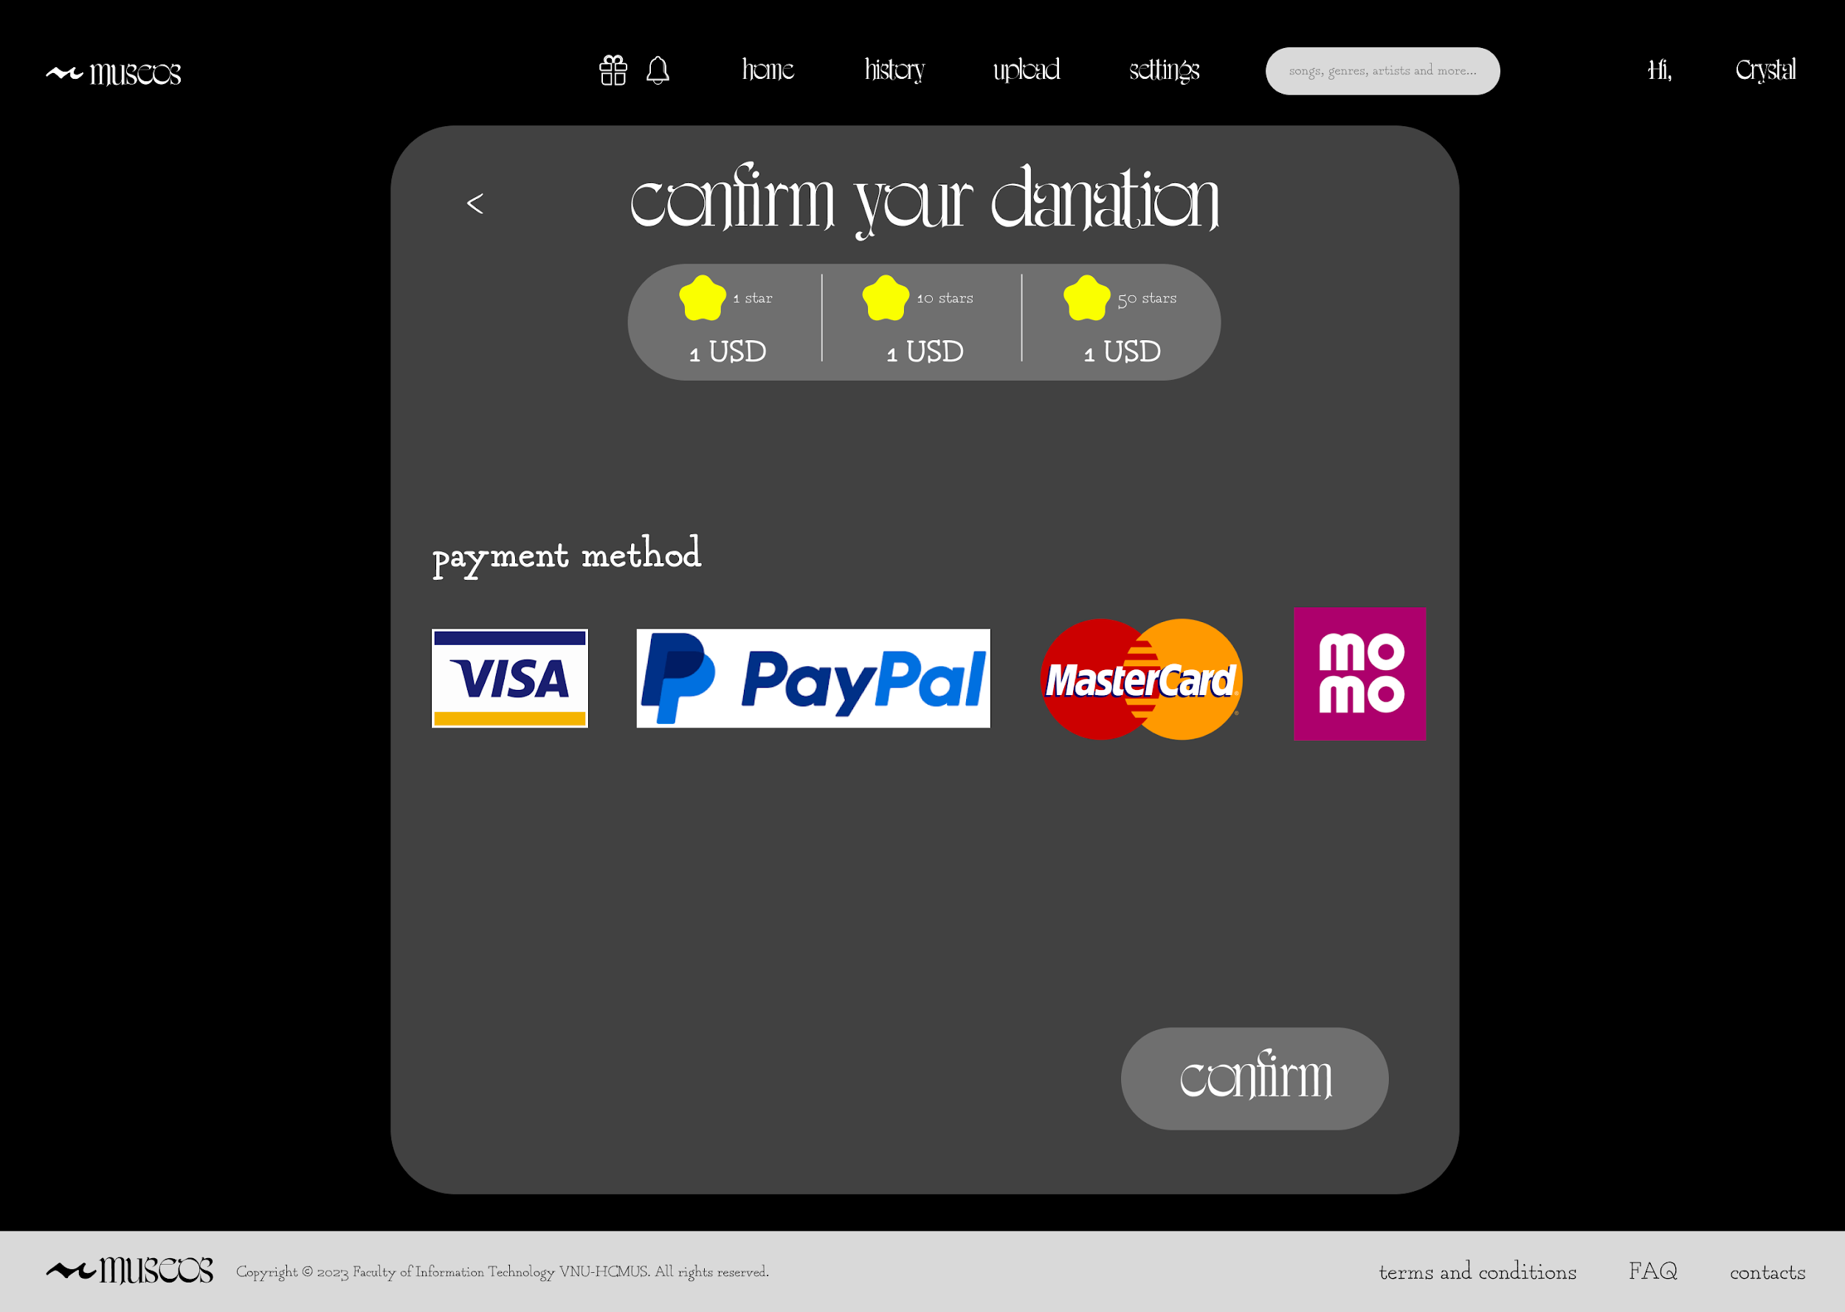
donate

