Slide 1
Course:
Algorithm Analysis and Design
Number of credits: 3
Slides
Dr. Tran Tuan Anh
Faculty of Computer Science and Engineering
Ho Chi Minh City University of Technology
VNU- Ho Chi Minh City

Slide 2
References
[1] Cormen, T. H., Leiserson, C. E, and Rivest, R. L., Introduction to Algorithms, The MIT Press, 2009.
[2] Levitin, A., Introduction to the Design and Analysis of Algorithms, 3rd Edition, Pearson, 2012.
[3] Sedgewick, R., Algorithms in C++, Addison-Wesley, 1998.
[4] Weiss, M.A., Data Structures and Algorithm Analysis in C, TheBenjamin/Cummings Publishing, 1993.

Slide 3
Course Outline
Basic concepts on algorithm analysis and design
Divide-and-conquer
Decrease-and-conquer
Transform-and-conquer
Dynamic programming and greedy algorithm
Backtracking algorithms
NP-completeness
Approximation algorithms

Slide 4
Course outcomes
1. Able to analyze the complexity of the algorithms (recursive or iterative) and estimate the efficiency of the algorithms.
2. Improve the ability to design algorithms in different areas.
3. Able to discuss on NP-completeness

Slide 5
Grading system
Midterm exam: 40%
Final exam: 60%

Slide 6
Chapter 1
Course: Algorithm Analysis and Design
BASIC CONCEPTS ON ALGORITHM ANALYSIS AND DESIGN

Slide 7
Outline
Recursion and recurrence relations
Analysis of algorithms
Analysis of iterative algorithms
Analysis of recursive algorithms
Algorithm design strategies
Brute-force algorithm design

Slide 8
1. Recursion
Recurrence relation
Example 1: Factorial function
N! = N.(N-1)! if N ≥ 1
0! = 1
The definition for a recursive function which contains some integer parameters is called a recurrence relation.
function factorial (N: integer): integer;
begin
if N = 0
then factorial: = 1
else factorial: = N*factorial (N-1);
end;

Slide 9
Recurrence relation
Example 2: Fibonacci number
Recurrence relation:
F_{N} = F_{N-1} + F_{N-2} for N ≥ 2
F₀ = F₁ = 1
1, 1, 2, 3, 5, 8, 13, 21, …
function fibonacci (N: integer): integer;
begin
if N <= 1
then fibonacci: = 1
else fibonacci: = fibonacci(N-1) + fibonacci(N-2);
end;

Slide 10
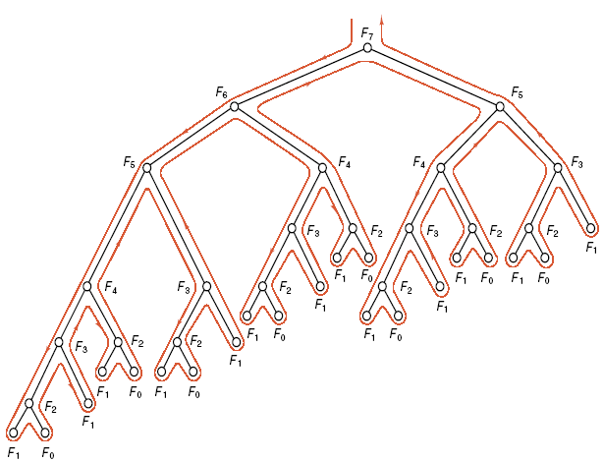
Fibonacci numbers – Recursive tree
computed
There exist several redundant computations when using recursive function to compute Fibonacci numbers.

Slide 11
By contrast, it is very easy to compute Fibonacci numbers by using an array in a non-recursive algorithm.
A non-recursive (iterative) algorithm often works more efficiently than a recursive algorithm. It is easier to debug an iterative algorithm than a recursive algorithm.
By using stack, we can convert a recursive algorithm to an equivalent iterative algorithm.
procedure fibonacci;
const max = 25;
var i: integer;
F: array [0..max] of integer;
begin
F[0]: = 1; F[1]: = 1;
for i: = 2 to max do
F[i]: = F[i-1] + F[i-2]
end;

Slide 12
2. Analysis of algorithms
For most problems, many different algorithms are available.
How one to choose the best algorithm?
How to compare the algorithms which can solve the same problem?
Analysis of an algorithm: estimate the resources used by that algorithm.
Resources: Memory space
Computational time
Computational time is the most important resource.

Slide 13
Two ways of analysis
The computational time of an algorithm is a function of N, the amount of data to be processed.
We are interested in:
The average case: the amount of time an algorithm might be expected to take on “typical” input data.
The worst case: the amount of time an algorithm would take on the worst possible input data.

Slide 14
Framework of complexity analysis
♦ Step 1: Characterize the data which is to be used as input to the algorithm and to decide what type of analysis is appropriate.
Normally, we concentrate on
- proving that the running time is always less than some “upper bound”, or
- trying to derive the average running time for a random input.
♦ Step 2: identify abstract operation upon which the algorithm is based.
Example: comparison is the abstract operation in sorting algorithm.
The number of abstract operations depends on a few quantities.
♦ Step 3: Proceed to the mathematical analysis to find average- and worst-case values for each of the fundamental quantities.

Slide 15
The two cases of analysis
It is not difficult to find an upper bound on the running time of an algorithm.
But the average case normally requires a sophisticated mathematical analysis.
In principle, the performance of an algorithm often can be analyzed to an extremely precise level of detail. But we are always interested in estimating in order to suppress detail.
In short, we look for rough estimates for the running time of our algorithm for purposes of classification of complexity.

Slide 16
Classification of Algorithm complexity
Most algorithms have a primary parameter, N, the number of data items to be processed.
Examples:
Size of the array to be sorted or searched.
The number of nodes in a graph.
All of the algorithms have running time proportional to the following functions
1. If the basic operation in the algorithm is executed once or a few times.
its running time is constant.
2. lgN (logarithmic) log₂N ≡ lgN
The algorithm gets slightly slower as N grows.

Slide 17
3. N (linear)
4. NlgN
5. N² (quadratic) in a double nested loop
6. N³ (cubic) in a triple nested loop
7. 2^{N} Few algorithms with exponential running time.
Some of algorithms may have running time proportional to
N^{3/2}, N^{1/2} , (lgN)² …

Slide 18
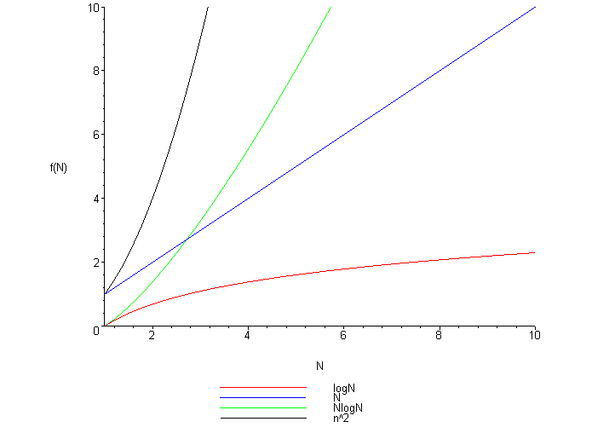

Slide 19
Computational Complexity
Now, we focus on studying the worst-case performance. We ignore constant factors in order to determine the functional dependence of the running time on the number of inputs.
Example: One can say that the running time of mergesort is proportional to NlgN.
The first step is to make the notion of “proportional to” mathematically precise.
The mathematical artifact for making this notion precise is called the O-notation.

Slide 20
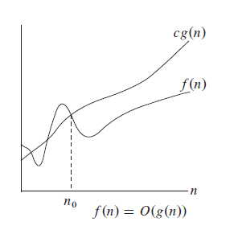
Definition: A function f(n) is said to be O(g(N)) if there exists constants c and n₀ such that f(n) is less than cg(n) for all n > n₀.

Slide 21
O Notation
The O notation is a useful way to state upper bounds on running time which are independent of both inputs and implementation details.
We try to provide both an “upper bound” and “lower bound” on the worst-case running time.
Providing lower-bound is a difficult matter.

Slide 22
Average-case analysis
For this kind of analysis, we have to
- characterize the inputs to the algorithm
- calculate the average number of times each instruction is executed,
- calculate the average running time of the algorithm.
But
- Average-case analysis requires detailed mathematical arguments.
- It’s difficult to characterize the input data encountered in practice.

Slide 23
Approximate and Asymptotic results
Often, the results of a mathematical analysis are not exact but are approximate: the result might be an expression consisting of a sequence of decreasing terms.
We are most concerned with the leading term of a mathematical expression.
Example: The average running time of the algorithm is:
a₀NlgN + a₁N + a₂
But we can rewrite as:
a₀NlgN + O(N)
For large N, we may not need to find the values of a₁ or a₂.

Slide 24
Approximate and Asymptotic results (cont.)
The O notation provides us with a way to get an approximate answer for large N.
Therefore, we can ignore some quantities represented by the O-notation when there is a well-specified leading (larger) term in the expression.
Example: If the expression is N(N-1)/2, we can refer to it as “about” N²/2.

Slide 25
3. Analysis of an iterative algorithm
Example 1 Given the algorithm that finds the largest element in an array.
procedure MAX(A, n, max)
/* Set max to the maximum of A(1:n) */
begin
integer i, n;
max := A[1];
for i:= 2 to n do
if A[i] > max then max := A[i]
end
Let denote C(n) the complexity of the algorithm when comparison (A[i]> max) is considered as basic operation. Let determine C(n) in the worst-case analysis.

Slide 26
Analysis of an iterative algorithm (cont.)
If the basic operation of the MAX procedure is comparison.
The number of times the comparison is executed is also the number of the body of the loop is executed: (n-1).
So, the computational complexity of the algorithm is O(n).
This also the complexity of the two cases: worst-case and average-case.
Note: If the basic operation is assignment (max := A[i]) then O(n) is the complexity of the worst-case.

Slide 27
Analysis of an iterative algorithm (cont.)
Example: Given the algorithm that checks whether all the elements in the array of n element is distinct.
function UniqueElements(A, n)
begin
for i:= 1 to n –1 do
for j:= i + 1 to n do
if A[i] = A[j] return false
return true
end
The worst-cases: the array with no equal elements or the array in which the two last elements are the only pair of equal elements. For such inputs, one comparison is made for each repetition of the innermost loop.

Slide 28
i = 1 j runs from 2 to n ⇒ n– 1 comparisons
i = 2 j runs from 3 to n ⇒ n – 2 comparisons
.
.
i = n -2 j runs from n-1 to n ⇒ 2 comparisons
i = n -1 j runs from n to n ⇒ 1 comparison
So, the total number of comparisons is:
1 + 2 + 3 + … + (n-2) + (n-1) = n(n-1)/2
The complexity of the algorithm in the worst-case is O(n²).

Slide 29
Analysis of an iterative algorithm (cont.)
Example 3 (String matching): Finding all occurrences of a pattern in a text.
The text is an array T[1..n] of length n and the pattern is an array P[1..m] of length m.
We say that pattern P occurs with the shift s in text T (that is, P occurs beginning at position s+1 in text T) if 0 ≤ s ≤ n – m and T[s+1..s+m] = P[1..m].

Slide 30
The naïve algorithm finds all valid shifts using a loop that check the condition P[1..m] = T[s+1..s+m] for each of the n – m + 1 possible values of s.
procedure NAIVE-STRING-MATCHING(T,P);
Begin
n: = |T|; m: = |P|;
for s:= 0 to n – m do
if P[1..m] = T[s+1,..,s+m] then
print “Pattern occurs with shift” s;
end

Slide 31
procedure NAIVE-STRING-MATCHING(T,P);
begin
n: = |T|; m: = |P|;
for s:= 0 to n – m do
begin
exit:= false; k:=1;
while k ≤ m and not exit do
if P[k] ≠ T[s+k] then exit := true
else k:= k+1;
if not exit then
print “Pattern occurs with shift” s;
end
end

Slide 32
Procedure NAIVE STRING MATCHING has two nested loops:
outer loop repeats n – m + 1 times.
inner loop repeats at most m times.
Therefore, the complexity of the algorithm in the worst-case is:
O((n – m + 1)m).

Slide 33
4. Analysis of recursive algorithms: Recurrence relations
There is a basic method to analyze recursive algorithms.
The nature of a recursive algorithm dictates that its running time for input of size N will depend on its running time for smaller inputs.
This translates to a mathematical formula called a recurrence relation.
To derive the computational complexity of a recursive algorithm, we solve its recurrence relation by using the substitution method.

Slide 34
Analysis of recursive algorithm by substitution method
Formula 1: Given a recursive program that loops through the input to eliminate one item. Its recurrence relation is as follows:
C_{N} = C_{N-1} + N N ≥ 2
C₁ = 1
We can derive its complexity using the substitution method:
C_{N} = C_{N-1} + N
= C_{N-2} + (N – 1) + N
= C_{N-3} + (N – 2) + (N – 1) + N
.
.
.
= C₁ + 2 + … + (N – 2) + (N – 1) + N
= 1 + 2 + … + (N – 1) + N
= N(N+1)/2
= N²/2

Slide 35
Example 2
Formula 2: Given a recursive program that halves the input in one step. Its recurrence relation is as follows: C_{N} = C_{N/2} + 1 N ≥ 2
C₁ = 1
We can derive its complexity using the substitution method.
Assume that N = 2^{n}
C(2^{n}) = C(2^{n-1}) + 1
= C(2^{n-2} )+ 1 + 1
= C(2^{n-3} )+ 3
.
. .
= C(2⁰ ) + n
= C₁ + n = n +1
C_{N} = n +1 = lgN +1
C_{N} ≈ lgN

Slide 36
Example 3
Formula 3. Given a recursive program that has to make a linear pass through the input, after it is split into two halves. Its recurrence relation is as follows:
C_{N} = 2C_{N/2} + N for N ≥ 2
C₁ = 0
We can derive its complexity using the substitution method.
Assume N = 2^{n}
C(2^{n}) = 2C(2^{n-1}) + 2^{n}
C(2^{n})/2^{n} = C(2^{n-1})/ 2^{n-1} + 1
= C(2^{n-2})/ 2^{n-2} + 1 +1
.
.
= n
⇒ C(2^{n} ) = n.2^{n}
C_{N} = NlgN
C_{N} ≈ NlgN

Slide 37
Example 4
Formula 4. Given a recursive program that halves the input into two halves with one step. Its recurrence relation is as follows:
C(N) = 2C(N/2) + 1 for N ≥ 2
C(1) = 0
Complexity analysis:
Assume N = 2^{n}.
C(2^{n}) = 2C(2^{n-1}) + 1
C(2^{n})/ 2^{n} = 2C(2^{n-1})/ 2^{n} + 1/2^{n}
=C(2^{n-1})/ 2^{n-1} + 1/2^{n}
=[C(2^{n-2})/ 2^{n-2} + 1/2^{n-1} ]+ 1/2^{n}
.
.
.
=C(2^{n-i})/ 2^{n -i} + 1/2^{n – i} ⁺¹ + … + 1/2^{n}

Slide 38
At last, when i = n -1, we obtain:
C(2^{n})/2^{n} = C(2)/2 + ¼ + 1/8 + …+ 1/2^{n}
= ½ + ¼ + ….+1/2^{n}
⇒ C(2^{n}) = 1 + 2 + 2² + … + 2^{n-1}
= 2^{n}-1
C(N) ≈ N
Some recurrence relations that seem similar may bring out different classes of complexity.

Slide 39
Steps of average-case analysis
For average-case analysis of an algorithm A, we have to do the following steps:
Determine the sampling space which represents the possible cases of input data (of size n). Assume that the sampling space is S = { I₁, I₂,…, I_{k}}
2. Determine a probability distribution p in S which represents the likelihood that each case of the input data may occur.
3. Calculate the total number of basic operations that the algorithm A excecute to deal with a case of input data in the sample space. Let v(I_{k}) denote the total number of basic operations executed by the algorithm A when input data belong to the case I_{k}.

Slide 40
Average-case analysis (cont.)
4. Calculate the average of the total number of basic operations by using the following formula:
C_{avg}(n) = v(I₁).p(I₁) + v(I₂).p(I₂) + …+v(I_{k}).p(I_{k}).
Thí dụ: Give an array A with n element. Find the location where the given value X occurs in array A.
begin
i := 1;
while i <= n and X <> A[i] do
i := i+1;
end

Slide 41
Example: Sequential Search
In the case that X is available in the array, assume that the probability of the first match occurring in the i-th position of the array is the same for every i and that probability is p = 1/n.
The number of comparisons to find X at the 1-th position is 1
The number of comparisons to find X at the 2nd position is 2
…
The number of comparisons to find X at the n-th position is n
Therefore, the total number of comparisons in the average is:
C(n) = 1.(1/n) + 2.(1/n) + …+ n.(1/n)
= (1 + 2 + …+ n).(1/n)
= (1+2+…+n)/n = n(n+1)/2.(1/n) = (n+1)/2.

Slide 42
Some useful formulas for the analysis of algorithms
There exists some useful summation formulas for the analysis of algorithms.
• Arithmetic series
S₁ = 1 + 2 + 3 + … + n
S₁ = n(n+1)/2 ≈ n²/2
S₂ = 1 + 2² + 3² + …+ n²
S₂ = n(n+1)(2n+1)/6 ≈ n³/3
• Geometric series
S = 1 + a + a² + a³ + … + a^{n}
S = (a^{n+1} -1)/(a-1)
If 0< a < 1, then
S ≤ 1/(1-a)
when n → ∞, S approaches 1/(1-a).

Slide 43
Some useful formulas (cont.)
• Harmonic sum
H_{n} = 1 + ½ + 1/3 + ¼ +…+1/n
H_{n} = log_{e} n + γ
γ ≈ 0.577215665 called Euler constant.
Another sequence that is very useful when analysing the operations on a binary tree:
1 + 2 + 4 +…+ 2^{m-1} = 2^{m} -1

Slide 44
5. Algorithm Design Strategy
An Algorithm Design Strategy is a general approach to solving problems algorithmically that is applicable to a variety of problems from different areas of computing.
Learning these strategies is very important for the following reasons:
  They provide guidance for designing algorithms for new problems.
  Algorithms are the cornerstone of computer science. Algorithm design strategies make it possible to classify and study algorithms.

Slide 45
Algorithm Design Strategy (cont.)
“Divide-and-conquer” is a typical example of an algorithm design strategy.
There exists many other well-known algorithm design strategies.
The set of algorithm design strategies constitute a collection of tools which help us in our studies and building new algorithms.
The algorithm design strategy that will be studied right now is the “brute-force” strategy.

Slide 46
The brute-force approach
Brute-force is a straightforward approach to solving a problem, usually directly based on the problem statement and definitions of the concepts involved.
“Just do it” would be another way to describe the prescription of the brute-force approach.
The brute-force strategy is the one that is easiest to understand and easiest to implement.
Sequential search) is an example of brute-force strategy.
Selection sort, NAÏVE-STRING-MATCHING are some other examples of brute-force strategy.

Slide 47
Even though brute-force is not a source of clever or efficient algorithms, it should not be overlooked due to the following reasons:
  Brute-force is applicable to a very wide variety of problems.
  For some important problems, the brute-force approach yields reasonable algorithms of some practical values.
  Clever and efficient algorithms are often more difficult to understand and more difficult to implement than brute-force algorithms.
  Brute-force algorithms can be used as a yardstick with which to judge more efficient algorithms for solving a problem.

