Slide 1
Chapter 2
Divide-and-conquer

Slide 2
Outline
“Divide-and-conquer” strategy
Quicksort
Mergesort
External sort
Binary search tree

Slide 3
Divide-and-conquer strategy
The best well-known general algorithm design strategy
Divide-and-conquer algorithms work according to the following steps:
  A problem’s instance is divided into several smaller instances of the same problem.
  The smaller instances are solved (typically recursively, though sometimes non-recursively).
  The solutions obtained for the smaller instances are combined to get a solution to the original problem.
Binary search is an example of divide-and-conquer strategy.
The divide-and-conquer strategy is diagrammed in the following figure, which depicts the case of dividing a problem into two smaller subproblems.

Slide 4
Divide-and-conquer
problem of size n
subproblem 1
of size n/2
subproblem 2
of size n/2
Solution of
subproblem 1
Solution of
subproblem 2
Solution to the original
problem

Slide 5
2. Quick sort
The basic algorithm of Quick sort was invented in 1960 by C. A. R. Hoare.
Quicksort exhibits the spirit of “divide-and-conquer” strategy.
Quicksort is popular because it is not difficult to implement.
Quicksort requires only about NlgN basic operations on the average to sort N items.
The drawbacks of Quick sort are that:
- it is recursive
- it takes about N² operations in the worst-case
- it is fragile.

Slide 6
Basic algorithm of Quicksort
Quicksort is a “divide-and-conquer” method for sorting. It works by partitioning the input file into two parts, then sorting the parts independently. The position of the partition depends on the input file.
The algorithm has the following recursive structure:
procedure quicksort1(left,right:integer);
var i: integer;
begin
if right > left then
begin
i:= partition(left,right);
quicksort(left,i-1);
quicksort(i+1,right);
end;
end;

Slide 7
Partitioning
The crux of Quicksort is the partition procedure, which must rearrange the array to make the following three conditions hold:
i) the element a[i] is in its final place in the array for some i
ii) all the elements in a[left], ..., a[i-1] are less than or equal to a[i]
iii) all the elements in a[i+1], ..., a[right] are greater than or equal to a[i]
Example:
59 56 52 55 58 51 57 54
52 51 53 56 55 58 59 57 54

Slide 8
Example of partitioning
Assume that we select the first or the leftmost as the element which will be placed at its final position ( This element is called the pivot element.
40 15 30 25 60 10 75 45 65 35 50 20 70 55
40 15 30 25 20 10 75 45 65 35 50 60 70 55
40 15 30 25 20 10 35 45 65 75 50 60 70 55
35 15 30 25 20 10 40 45 65 75 50 60 70 55
less than 40 sorted greater than 40
What is the complexity of partitioning ?

Slide 9
Quicksort
procedure quicksort2(left, right: integer);
var j, k: integer;
begin
if right > left then
begin
j:=left; k:=right+1;
//start partitioning
repeat
repeat j:=j+1 until (a[j] >= a[left]) or (j > right);
repeat k:=k-1 until a[k]<= a[left];
if j< k then swap(a[j],a[k])
until j>k;
swap(a[left],a[k]); //finish partitioning
quicksort2(left,k-1);
quicksort2(k+1,right)
end;
end;

Slide 10
Complexity Analysis: the best case
The best case that could happen in Quicksort would be that each partitioning stage divides the array exactly in half. This would make the number of comparisons used by Quicksort satisfy the recurrence relation:
C_{N} = 2C_{N/2} + N+1.
The 2C_{N/2} covers the cost of sorting the two subfiles; the N+1 is cost of examining each element in the first partitioning stage.
From Chapter 1, we know that this recurrence has the solution:
C_{N} ≈ N lgN.

Slide 11
Complexity Analysis: the worst-case
The worst-case of Quicksort happens when we apply Quicksort on an already sorted array.
In that case, the 1st element requires n+1 comparisons to find that it should stay at the first position. Besides, after partitioning, the left subarray is empty and the right subarray consists of n – 1 elements. So, in the next partitioning, the 2nd element requires n comparisons to find that it should stay at the second position. And the same situation continues like that.
Therefore, the total number of comparisons is as follows:
(n+1) + n + … + 2 = (n+2)(n+1)/2 -1=
(n² + 3n+2)/2 -1 = O(n²).
The complexity in the worst-case of Quicksort is O(n²).

Slide 12
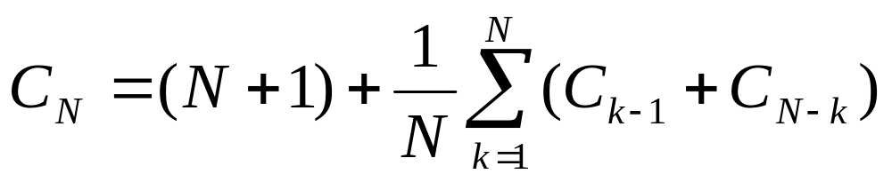
Average-case-analysis of Quicksort
The precise recurrence formula for the number of comparisons used by Quicksort for a random permutation of N elements is:
for N ≥ 2 and C₁ = C₀ = 0
The (N+1) term covers the cost of comparing the partitioning element with each of the others (two extra for where the pointers cross). The rest comes from the observation that each element k is likely to be partitioning element with probability 1/N after which we are left with random files with size k-1 and N-k, respectively.

Slide 13
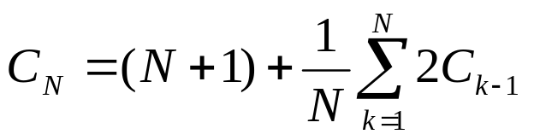
Note that, C₀ + C₁ + … + C_{N-1} is the same as
C_{N-1} + C_{N-2} +… + C₀, so we have
We can eliminate the sum by multiplying both sides by N and subtracting the same formula for N-1:
NC_{N} – (N-1) C_{N-1} = N(N+1) – (N-1)N + 2C_{N-1}
This simplifies the recurrence:
NC_{N} = (N+1)C_{N-1} + 2N

Slide 14
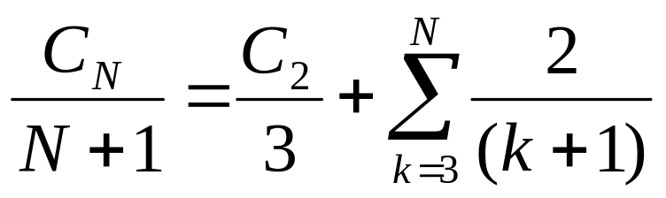
Dividing both sides by N(N+1) give the recurrence as follows:
C_{N}/(N+1) = C_{N-1}/N + 2/(N+1)
= C_{N-2} /(N-1) + 2/N + 2/(N+1)
……….
= 2/3 + 2[1/4 + 1/5 +1/6 + …+1/(N+1)]
= 2[1/3 +1/4 + 1/5 +1/6 + …+1/(N+1)]
= 2[1 +1/2+ 1/3 +1/4 + 1/5 + …+1/(N+1) - 3/2]
C_{N}/(N+1) ≈ 2(lnN – 3/2)
C_{N} ≈ (2lnN -3)(N+1)
Finally, we have:
C_{N} ≈ 2NlnN

Slide 15
Average-case-analysis of Quicksort (cont.)
Note that:
lnN = (log₂N).(log_{e}2) =0.69 lgN
2NlnN ≈ 1.38 NlgN.
The average number of comparisons in Quicksort is about only 38% higher that the best case.
Property. Quicksort uses about 2NlnN comparison on the average.

Slide 16
3. Mergesort algorithm
First, we examine a process, called merging, the operation of combining two sorted files to make one larger sorted file.
Merging
In many data processing environments a large (sorted) data file is maintained to which new entries are regularly added.
A number of new entries are appended to the (much larger) main file, and the whole thing is resorted.
This situation is suitable for merging.

Slide 17
Merging
Suppose that we have two sorted arrays a[1..M] and b[1..N]. We wish to merge into a third array c[1..M+N].
i:= 1; j :=1;
for k:= 1 to M+N do
if a[i] < b[j] then
begin c[k] := a[i]; i:= i+1 end
else begin c[k] := b[j]; j := j+1 end;
Note: The algorithm can use a[M+1] and b[N+1] as sentinels which values larger than all the other keys. Thanks to sentinels, when one array is exhausted, the loop simply moves the rest of the other array into the c array.

Slide 18
Complexity of merging two arrays
The input consists of M+N elements in both arrays a and b. Each comparison assigns one element to array c, which at last consists of M+N elements. Therefore, the total number of comparisons can not exceed M+N.
In other words, merging requires linear time:
O(N+M)

Slide 19
Mergesort
Once we have a merging procedure, we can use it as the basis for a recursive sorting procedure.
To sort a given file, divide it in half, sort the two halves (recursively), and then merge the two halves together.
Mergesort exhibits the spirit of divide-and-conquer strategy.
The following algorithm sorts the array a[l..r], using an auxiliary array b[l..r].

Slide 20
procedure mergesort(l, r: integer);
var i, j, k, m : integer;
begin
if r-l > 0 then
begin
m:=(r+l)/2; mergesort(l,m); mergesort(m+1, r);
for i := m downto 1 do b[i] := a[i];
for j := m+1 to r do b[r+m+1-j] := a[j];
for k := l to r do
if b[i] < b[j] then
begin a[k] := b[i] ; i := i+1 end
else begin a[k] := b[j]; j:= j-1 end;
end;
end;

Slide 21
A S O R T I N G E X A M P L E
A S
O R
A O R S
I T
G N
G I N T
A G I N O R S T
E X
A M
A E M X
L P
E L P
A E E L M P X
A A E E G I L M N O P R S T X
Example: Sorting an array of single characters

Slide 22
Complexity of Mergesort
Property 2.1: Mergesort requires about NlgN comparisons to sort any file of N elements.
For the recursive algorithm of mergesort, the number of comparisons is described by the recurrence:
C_{N} = 2C_{N/2} + N, with C₁ = 0.
We know from Chapter 1 that:
C_{N} ≈ N lg N
Property 2.2: Mergesort uses extra space proportional to N.

Slide 23
4. External Sorting
Sorting the large files stored in secondary storage is called external sorting. External sorting is very important in database management systems (DBMSs).
Block and Block Access
The operating system breaks the secondary storage into blocks with equal size. The size of blocks varies according to the operating systems, but in the range between 512 to 4096 bytes.
Two basic operations on the files in secondary storage:
- transfer a block from hard disk to a buffer in main memory (read)
- transfer a block from main memory to hard disk (write).

Slide 24
External Sorting (cont.)
When estimating the computational time of the algorithms that work on files in hard disks, we must consider the number of times we read a block to main memory or write a block to secondary storage.
Such operation is called block access or disk access.
block = page

Slide 25
External Sort-merge
The most commonly used technique for external sorting is the external sort-merge algorithm.
This external sorting method consists of two stages:
create runs
merge runs
This external sorting method also applies divide-and-conquer stragegy.
M: the number of pages in the buffer (memory-buffer) .

Slide 26
External-sort-merge algorithm
1. In the first stage, a number of sorted runs are created as follows:
i = 0;
repeat
read M blocks of the file, or the rest of the file, whichever is
smaller;
sort the in-memory part of the file;
write the sorted data to the run file R_{i};
i = i+1;
until the end of the file.
2. In the second stage, the runs are merged.

Slide 27
The merge stage
Here, the merge operation is a generalization of two-way merge used by the standard in-memory merge-sort algorithm. It merges N runs, so it is called n-way merge.
• General case:
In general, if the file is much larger than the buffer (the number of runs is larger than the number of pages in buffer)
N > M
it is not possible to allocate a page for each run during the merge stage. In this case, the merge operation proceeds in multiple passes.
Since there is enough memory for M-1 pages in buffer, each merge can take M-1 runs as input.

Slide 28
The merge stage [general case] (cont.)
The initial merge pass functions in this way:
It merges the first M-1 runs to get a single run for the next pass. Then, it merges the next M-1 runs similarly, and so on, until it has processed all the initial runs. At this point, the number of runs has been reduced by a factor of M – 1. If the reduced number of runs is still greater than or equal to M, another pass is made, with the runs created by the preceding pass as input.
The passes repeated as many times as required, until the number of runs is less than M; a final pass then generates the sorted output.

Slide 29
The merge stage (special case)
In this case, the number of runs, N, is less than M. We can allocate one page to each run and have space left to hold one page of output. The merge stage operate as follows:
Read one block of each of the N files R_{i} into a buffer page in memory;
repeat
choose the first tuple (in sort order) among all buffer pages;
write the tuple to the output, and delete it from the buffer page;
if the buffer page of any run R_{i} is empty and not end-of-file(R_{i})
then read the next block of R_{i} into the buffer page;
until all buffer pages are empty

Slide 30
An example of external merging using sort-merge
Assume: i) one record fits in a block
ii) buffer can hold at most 3 pages.
During the merge stage, two pages in buffer are used for input and one for output.
The merge stage requires two passes.

Slide 31
a 19
d 31 a 19
g 24 g 24 b 14 a 14
a 19 c 33 a 19
d 31 b 14 d 31 b 14
c 33 c 33 e 16 c 33
b 14 e 16 g 24 d 7
e 16 d 21
r 16 d 31 a 14 d 31
d 21 m 3 d 7 e 16
m 3 r 16 d 21 g 24
p 2 m 3 m 3
d 7 a 14 p 2 p 2
a 14 d 17 r 16 r 16
p 2
create runs merge pass-1 merge pass-2

Slide 32
Complexity of external-sort-merge algorithm
Let compute the block accesses cost for the external sort-merge.
b_{r} : the number of blocks containing records of the file.
The first stage reads every block of the file and writes them out, giving a total of 2b_{r} block accesses.
The initial number of runs: b_{r}/M.
The total number of merge passes: ⎡log _{M-1}(b_{r}/M)⎤
Each of these passes reads every block of the file once and write it out once.

Slide 33
Complexity of external-sort-merge algorithm (cont.)
The total number of block transfers for external sorting for the file is:
2b_{r} + 2b_{r} ⎡log_{M-1}(b_{r}/M)⎤ = 2b_{r}( ⎡log_{M-1} (b_{r}/M)⎤ +1)
create runs
merge passes

Slide 34
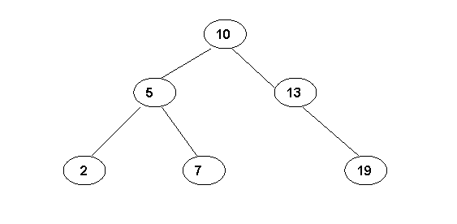
5. Binary search tree
Several problems using binary search tree can be solved by applying divide-and-conquer strategy.
In a binary search tree, each node has a record with a key value and all records with smaller keys are in the left subtree and all the records in the right subtree have larger (or equal) key values.

Slide 35
Initializing a binary search tree
type link = ↑ node;
node = record key, info: integer;
l, r: link end;
var t, head, z: link;
The empty tree is represented by having the right link of head point to z (dummy node).
procedure tree_init;
begin
new(z); z↑.1: = z; z↑.r: = z;
new(head); head↑.key: = 0; head↑.r: = z;
end;

Slide 36
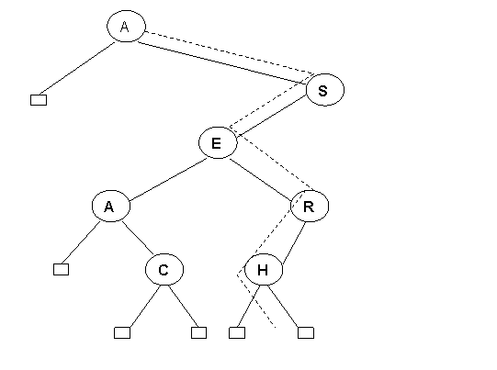
Insertion
To insert a node into the tree, we do an unsuccessful search for it, then attach it in place of z at the point at which the search terminated.
Insertion of P into a binary search tree.

Slide 37
Insertion (cont.)
procedure tree_insert (v: integer; x: link): link;
var p: link;
begin
repeat
p: = x;
if v < x↑.key then x: = x↑.1 else x: = x↑.r
until x = z;
new(x); x↑.key: = v;
x↑.1: = z; x↑.r: = z; /* create a new node */
if v < p↑. key then p↑.1: = x /* p denotes the parent of
the new node */
else p↑.r: = x;
tree_insert: = x
end

Slide 38
Insertion (cont.)
type link = ↑ node;
node = record key, info: integer;
l, r: link end;
var t, head, z: link;
function treesearch (v: integer, x: link): link; /* search the node with
the key v in the binary search tree x */
begin
while v <> x↑. key and x <> z do
begin
if v < x↑.key then x: = x↑.1
else x: = x↑.r
end;
treesearch: = x
end;

Slide 39
Complexity of a search in a binary search tree
Property 2.3: A search or insertion in a binary search tree requires about 2lnN comparisons, on the average, in a tree built from N random keys.
Proof:
Path length of a node: is the number of edges which are traversed from that node to the root +1.
For each node in a binary search tree, the number of comparisons required for the successful search of that node is also the path length of that node.
The sum of path lengths of all the nodes in a binary search tree is called the path length of that tree.

Slide 40

Proof (cont.)
Dividing the path length of the whole tree by N, we get the average number of comparisons for a successful search.
But if C_{N} denote the average path length of a binary search tree of N nodes, we have the recurrence
C_{N} = N + (1/N)
(C_{k-1} + C_{N-k})
with C₁ = 1. The N takes into account the fact that the root node contributes 1 to the path length of each of the nodes in the tree.
The rest of the expression comes from the observing that the key at the root is likely to be the k-th smallest, leaving random subtrees of size k-1 and N-k.

Slide 41
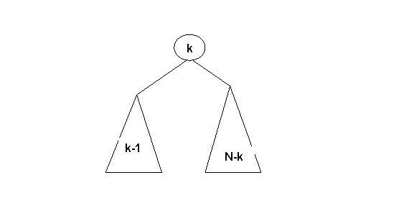
Proof (cont.)
This recurrence is very nearly the same recurrence we solve for analysis of Quicksort, and it can be solved in the same way to derived the stated result.
Therefore, the average path length of the tree consisting of N nodes is
C_{N} ≈ 2N lnN.
So the average path length of each node in the tree is 2lnN.
⇒ A search or insertion operation requires in average 2lnN comparisons in a tree with N nodes.

Slide 42
Complexity of the worst-case
Property 2.4: In the worst case, a search in a binary search tree with N keys can require N comparison.
The worst case happens when the binary search tree is degenerated into a linear linked list.

