Slide 1
Chapter 4
Transform-and-conquer

Slide 2
Outline
“Transform-and-conquer” strategy
Gaussian Elimination for solving system of linear equations
Heaps and heapsort
Horner’s rule for polynomial evaluation
String matching by Rabin-Karp algorithm

Slide 3
1. Transform-and-conquer strategy
Transform-and-conquer strategy works as two-stage procedures.
  First, in the transformation stage, the problem’s instance is modified to be more amenable to solution.
  Second, in the conquering stage, it is solved.
There are three major variants of this idea in the first-stage:
  Transformation to a simpler instance of the same problem – it is called instance simplification.
  Transformation to a different representation of the same instance – it is called representation change.
  Transformation to an instance of a different problem for which an algorithm is available – it is called problem reduction.

Slide 4
2. Gaussian Elimination for solving a system of linear equations
Given a system of n equations in n unknowns.
a₁₁x₁ + a₁₂x₂ + … + a_{1n}x_{n} = b₁
a₂₁x₁ + a₂₂x₂ + … + a_{2n}x_{n} = b₂
;
a_{n1}x₁ + a_{n2}x₂ + … + a_{nn}x_{n} = b_{n}
To solve the above system, we use the Gaussian elimination algorithm.
The idea of this algorithm: To transform a system of n linear equations in n unknowns to an equivalent system with an upper triangular coefficient matrix, a matrix with all zeros below its main diagonal.
The Gaussian Elimination algorithm is in the spirit of “instance simplification”..

Slide 5
a₁₁x₁ + a₁₂x₂ + … + a_{1n}x_{n} = b₁ a’₁₁x₁ + a’₁₂x₂ + … + a’_{1n}x_{n} = b’₁
a₂₁x₁ + a₂₂x₂ + … + a_{2n}x_{n} = b₂ a’₂₂x₂ + … + a’_{2n}x_{n} = b’₂
; ⇒
;
a_{n1}x₁ + a_{n2}x₂ + … + a_{nn}x_{n} = b_{n} a’_{nn}x_{n} = b’_{n}
How can we get from a system with an arbitrary coefficient matrix A to an equivalent system with an upper-triangular coefficient matrix A’?
We can do that through a series of the following elementary operations:
  Exchanging two equations of the system
  Replacing an equation with its nonzero multiple.
  Replacing an equation with a sum or difference of this equation and some multiple of another equation.

Slide 6
Example
2x₁ – x₂ + x₃ =1
4x₁ + x₂ – x₃ = 5
x₁ + x₂ + x₃ = 0
2 -1 1 1
4 1 -1 5 row 2 – (4/2) row 1
1 1 1 0 row 3 – (1/2) row 1
2 -1 1 1
0 3 -3 3 row 3 – (1/2) row 2
0 3/2 ½ -1/2
2 -1 1 1
0 3 -3 3
0 0 2 -2 ⇒ x₃ = (-2/2)= -1; x₂ = (3-(-3)x₃)/3 = 0;
x₁ = (1-x₃ – (-1)x₂)/2 = 1

Slide 7
Gaussian Elimination Algorithm
GaussElimination(A[1..n,1..n],b[1..n])
for i := 1 to n do A[i,n+1] := b[i];
for i := 1 to n -1 do
for j := i + 1 to n do
for k:= i to n+1 do
A[j,k] := A[j,k]-A[i,k]*A[j,i]/A[i,i];
Note: Vector b is added to be the (n+1)-th column of matrix A.
A difficulty: When A[i,i] = 0, the algorithm can not work. And when |A[i,i]| is so small and A[j,i]/A[i,i] becomes so large that A[j,k] might become distorted by a round-off-error.

Slide 8
Better Gaussian Elimination algorithm
To avoid the case of too small |A[i,i]|, we apply a technique called partial pivoting which is described as follows:
“At the i-th iteration, we look for a row with the largest absolute value of the coefficient in the i-th column, exchange it with the i-th row, and then use the new a[i,i] as the i-th iteration ‘s pivot.

Slide 9
Better Gaussian Elimination algorithm
BetterGaussElimination(A[1..n,1..n],b[1..n])
for i := 1 to n do A[i,n+1] := b[i];
for i := 1 to n -1 do
pivotrow := i;
for j := i+1 to n do
if |A[j,i]| > |A[pivotrow,i]| then pivotrow:= j;
for k:= i to n+1 do
swap(A[i,k], A[pivotrow,k]);
for j := i + 1 to n do
temp:= A[j,i]/A[i,i];
for k:= i to n+1 do
A[j,k] := A[j,k]-A[i,k]*temp;

Slide 10
Complexity of Gaussian Elimination algorithm
n-1 n n-1 n
C(n) = Σ_{i=1} Σ_{j=i+1}(n+1-i+1) = Σ_{i=1} Σ_{j=i+1}(n+2-i)
n-1 n-1
=Σ_{i=1} (n+2-i)(n-(i+1)+1) = Σ_{i=1} (n+2-i)(n-i)
= (n+1)(n-1)+n(n-2)+..+3.1
n-1 n-1 n-1
=Σ_{j=1}(j+2)j = Σ_{j=1} j² + Σ_{j=1} 2j
= (n-1)n(2n-1)/6 + 2(n-1)n/2
= n(n-1)(2n+5)/6 ≈ n³/3 = O(n³)
Note: After using Gaussian Elimination to transform the matrix A to an upper triangular coefficient matrix, we apply a backward substitution stage to get the values of the unknowns.

Slide 11
3. Heaps and heapsort
A priority-queue is a data structure that supports at least two following operations:
  insert a new item
  remove the largest item (the item with largest priority)
The difference between a priority-queue and a queue is that in a priority-queue when we remove one item from this data structure, that item is not the oldest item, but the item with the largest priority.

Slide 12
Implementation of priority-queue
The priority-queue as described above is an excellent example of an abstract data structure. There are two ways of implementing priority-queue:
1. Use an array to implement a priority-queue (To insert, we simply increment N, the number of items in the array, and put the new item into a[N], a constant-time operation. But remove requires scanning through the array to find the element with the largest key, which takes linear time.)
2. Use heap data structure.

Slide 13
Heap data structure
The data structure that can support the priority queue operations stores the records in an array in such a way that:
each key is larger than the keys at the two other specific positions. In turn, each of those keys must be larger than two more keys and so forth.
This ordering is very easy to see if we draw the array in a tree structure with lines down from each key to the two keys known to be smaller as in the figure in the next slide.
The keys in the tree satisfy the heap condition:
The key in each node should be larger than (or equal to) the keys in its children (if it has any). Note that this implies that the largest key is in the root.
This binary tree is called a “nearly complete binary tree”

Slide 14
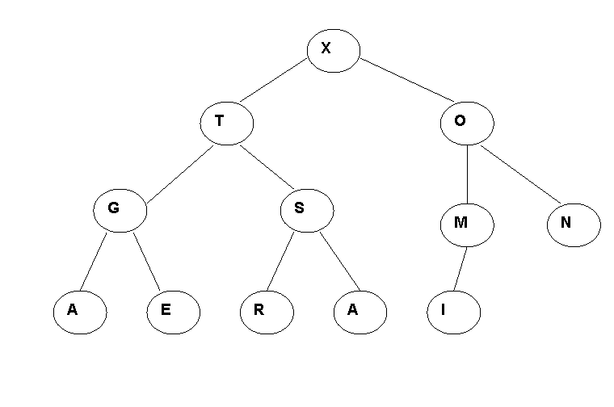
Example: Heap in binary tree representation
k 1 2 3 4 5 6 7 8 9 10 11 12
a[k] X T O G S M N A E R A I

Slide 15
Array representation of a heap
We can represent the tree representation of a heap as an array by putting the root at position 1, its children at positions 2 and 3, the nodes at the next level in positions 4, 5, 6 và 7, etc.
k 1 2 3 4 5 6 7 8 9 10 11 12
a[k] X T O G S M N A E R A I
It is easy to get from a node to its parent or children.
• The parent of the node in position j is in position j div 2.
• The two children of the node in position j are in positions 2j and 2j+1.

Slide 16
Paths on a heap
A heap is a nearly complete binary tree, represented as an array, in which every node satisfies the heap condition. In particular, the largest key is always in the first position in the array.
All of the algorithms operate along some path from the root to the bottom of the heap.
⇒ In a heap of N nodes, all paths have about lgN nodes on them.

Slide 17
Algorithms on Heaps
There are two important operations on heaps: insert a new item and remove the item with the largest key out of the heap.
1. Insert
This operation increases the size of the heap by one, N must be incremented.
Then the record to be inserted is put into a[N], but this may violate the heap property.
If the heap property is violated, then this violation can be fixed by exchanging the new node with its parent. This may, in turn, cause a violation, and thus can be fixed in the same way.

Slide 18
Insert operation
procedure upheap(k:integer)
var v: integer;
begin
v :=a[k]; a[0]:= maxint; // a[0] is sentinel element
while a[k div 2] <= v do
begin a[k]:= a[k div 2 ]; k:=k div 2 end;
a[k]:= v
end;
procedure insert(v:integer);
begin
N:= N+1; a[N] := v ; upheap(N)
end;

Slide 19


Insert (P) to the heap
M

Slide 20
Remove operation
The remove operation decrements N, the size of the heap.
But the largest element (a[1]) is to be removed and it is replaced by the element in a[N]. If the key of the root is small, it must be moved down to guarantee the heap condition.
The procedure downheap moves down the heap, exchanging the node at position k with the larger of its two children if necessary and stopping when the node at k is larger than both children or the bottom is reached.

Slide 21
Remove operation (cont.)
procedure downheap(k: integer);
label 0 ;
var j, v : integer;
begin
v:= a[k];
while k<= N div 2 do
begin
j:= 2*k;
if j < N then if a[j] < a[j+1] then
j:=j+1;
if v >= a[j] then go to 0;
a[k]:= a[j]; k:= j;
end;
0: a[k]: =v
end;
function remove: integer;
begin
remove := a[1];
a[1] := a[N]; N := N-1;
downheap(1);
end;

Slide 22



An example of remove
Before remove
M
After remove

Slide 23
Complexity of operations on a heap
Property 4.1: All of the basic operations insert, remove, downheap, upheap requires less than 2lgN comparisons when performed on a heap of N elements.
All these operation involve moving along a path between the root and the bottom of the heap, which includes no more than lgN elements for a heap of size N.
The factor of two comes from downheap, which makes two comparisons in its inner loop; the other operations require only lgN comparisons.

Slide 24
Heapsort
Idea: Heapsort consists of two steps (1) building a heap containing all the elements to be sorted and (2) removing them all in order.
N: the current size of the heap
M: the number of elements to be sorted.
N:=0;
for k:= 1 to M do
insert(a[k]); /* construct the heap */
for k:= M downto 1 do
a[k]:= remove; /*putting the element removed into the
array a */

Slide 25
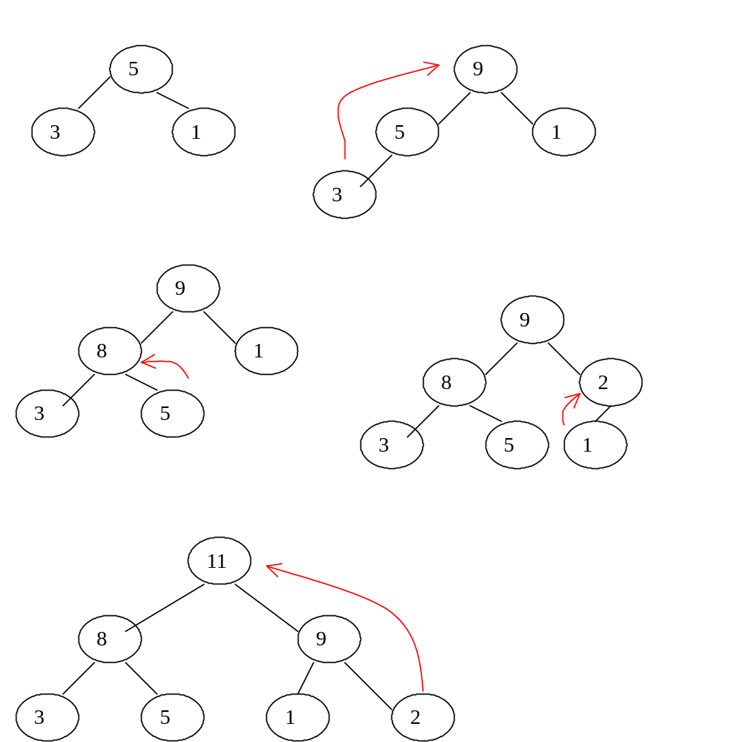
Sort the list of numbers 5, 3, 1, 9, 8, 2, 11 by heapsort

Slide 26
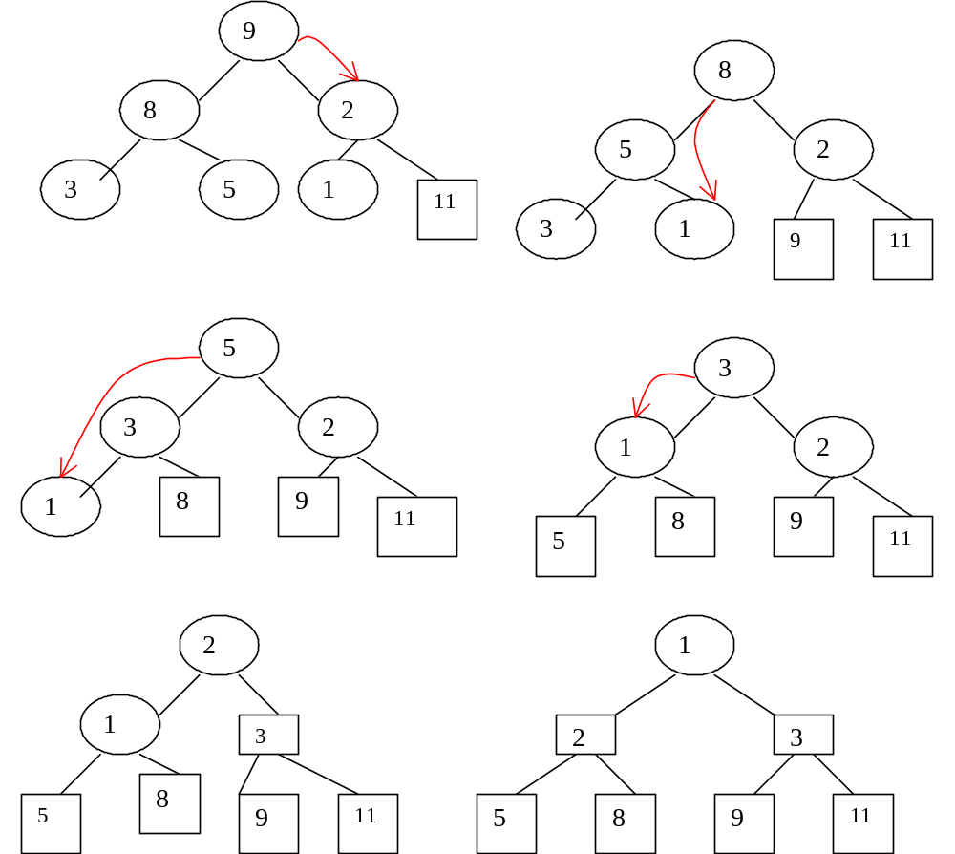

Slide 27
Complexity of heapsort
Property 4.2: Heapsort use less than 3MlgM comparisons to sort the array of M elements.
The above complexity comes from the heapsort algorithm and the properties of the two operations insert and remove on heap data structure.
The first for loop requires MlgM comparisons.
The second for loop requires 2MlgM comparisons.
In sum:
MlgM + 2MlgM = 3MlgM.
Heapsort is a typical example of transform-and-conquer strategy with representation-change technique.

Slide 28
4. Horner’s rule for polynomial evaluation
Consider the problem of computing the value of a polynomial
p(x) = a_{n}x^{n} + a_{n-1}x^{n-1} + … + a₁x + a₀ (4.1)
at a given point x.
G.H Horner, the British mathematician, 150 years ago, proposed an efficient method for evaluating a polynomial.
Horner’s rule is a good example of the representation change technique.
From (4.1) we can obtain a new formula by successively taking x as a common factor in the remaining polynomials of diminishing degrees.
p(x) = (…(a_{n}x + a_{n-1})x+…)x + a₀ (4.2)

Slide 29
Horner algorithm
Horner(P[0..n],x)
// Array P[0..n] stores the coefficients of the polynomial
p := P[n];
for j := n -1 down to 0 do
p := p*x + P[j];
return p;
The number of multiplications and the number of additions are given by n.
Just computing directly the single term a_{n}x^{n} would require n multiplications.
⇒ Horner’s rule is an optimal algorithm for polynomial evaluation.

Slide 30
5. String matching by Rabin-Karp algorithm
String matching: finding all occurrences of a pattern in a text.
The text is an array T[1..n] of length n and a pattern is an array P[1..m] of length m.
The elements of P and T are characters drawn from a finite alphabet Σ.
We say that pattern P occurs with shift s in text T (i.e. pattern P occurs beginning at position s+1 in text T) if 0 ≤ s ≤ n – m and T[s+1..s+m] = P[1..m].
If P occurs with shift s in T, then we call s a valid shift; otherwise, we call s an invalid shift.

Slide 31
The string matching problem is the problem of finding all valid shifts with which a given pattern P occurs in a given text T.
Text abcabaabcabac
Pattern abaabcabac
The shift: s = 3
The Rabin-Karp algorithm makes use of elementary number-theoretic notions such as the equivalence of two numbers after modulo a third number.

Slide 32
Rabin-Karp algorithm
For convenience, assume that Σ = {0, 1, 2, …, 9}, so that each character is a decimal digit. (In the general case, we can assume that, each character is a digit in radix-d notation, where d = |Σ |.)
We can view a string of k consecutive characters as representing a length-k decimal number. The character string “31415” corresponds to the decimal number 31.415.
Given a pattern P[1..m], let p denote its corresponding decimal value.
Given a text T[1..n], let t_{s} denote the decimal value of the length-m substring T[s+1...s+m], for s = 0, 1, .., n-m.
t_{s} = p if and only if T[s+1..s+m] = P[1..m] and s is a valid shift if and only if t_{s} = p

Slide 33
We can compute p in time O(m) using Horner’s rule:
p = P[m] + 10*(P[m-1] + 10*(P[m-2] + …
+ 10*(P[2] + 10*P[1])…))
The value t₀ can be similarly computed from T[1..m] in time O(m).
Note: t_{s+1} can be computed from t_{s}:
t_{s+1} = 10(t_{s} – 10^{m-1}T[s+1]) + T[s+m+1] (5.1)
Example: If m = 5 and t_{s} = 31415, then we wish to remove the highest digit T[s+1] = ‘3’ and bring in the new low-order digit ‘2’ to obtain:
t_{s+1} = 10(31415 – 10000.3) + 2 = 14152

Slide 34
Each execution of equation (5.1) takes a constant number of arithmetic operations.
The computation of t₁, t₂,…, t_{n-m} is about O(n-m).
Thus, p and t₀, t₁, …, t_{n-m} can all be computed in time O(m) +O(m) + O(n-m) ≈ O(n + m).
But p and t_{s} may be too large to work with conveniently. Fortunately, there is a simple cure for this problem. We compute p and the t_{s} ‘s modulo a suitable modulus q.
The modulus q is chosen as a prime such that 10q just fits within a computer word.
In general, with a d-ary alphabet {0, 1, …, d-1}, we choose q such that dq fits within a computer word.

Slide 35
Now the equation (5.1) becomes:
t_{s+1} = (d(t_{s} – hT[s+1]) + T[s+m+1])mod q (5.2)
where h = d^{m-1} (mod q)
However, t_{s} ≡ p (mod q) does not imply that t_{s} = p.
On the other hand, if t_{s} ≠ p (mod q) then we definitely have that t_{s} ≠ p, so that shift s is invalid.
We can use the test t_{s} ≡ p (mod q) as a fast way to rule out invalid shifts s.
Any shift s for which t_{s} ≡ p (mod q) must be tested further to see if s is really valid or we just have a spurious hit.
Rabin-Karp algorithm exhibits the spirit of transform-and-conquer

Slide 36
Example:
|2| 3| 5| 9| 0| 2| 3| 1| 4| 1| 5| 2| 6| 7| 3| 9| 9| 2| 1|
⎩ ______ ⎭
↓
| 7|
|2| 3| 5| 9| 0| 2| 3| 1| 4| 1| 5| 2| 6| 7| 3| 9| 9| 2| 1|
⎩ _______ ⎭ ⎩ ______ ⎭ ⎩ ______ ⎭
↓ ↓ ↓ ↓
| 8| 9| 3|11| 0| 1| 7| 8| 4| 5|10|11| 7| 9|11|
valid spurious
match match
| 3| 1| 4| 1| 5| 2|
⎩ ______ ⎭
↓ ↓
| 7| 8|
14152 = (31415 – 3 × 10000) × 10 + 2 (mod 13)
= 8 (mod 13)

Slide 37
procedure RABIN-KARP-MATCHER(T, P, d, q);
/* T is the text, P is the pattern, d is the radix and q is the prime */
begin
n: = |T|; m: = |P|;
h: = d^{m-1} mod q;
p: = 0; t₀ : = 0;
for i: = 1 to m do
begin
p: = (d*p + P[i])mod q;
t₀: = (d*t₀ + T[i])mod q
end
for s: = 0 to n – m do
begin
if p = t_{s} then /* there may be a hit */
if P[1..m] = T[s+1..s+m] then
Print “Pattern occurs with shift “s;
if s < n – m then
t_{s+1}: = (d(t_{s} –T[s + 1]h) + T[s+m+1])mod q
end
end
The running time of RABIN-KARP-MATCHER is O((n – m + 1)m) in the worst case, since the Rabin Karp verifies every valid shift.
In many applications, we expect few valid shifts and so the expected running time of the algorithm is O(n+m) plus the time required to process spurious hits.

Slide 38
Some notes on transform-and-conquer strategy
AVL-tree is a kind of binary search tree which is always kept in balance.
  The balance of AVL tree is kept by using one of the 4 rotations.
  As a balanced-tree, all operations on an AVL tree have a complexity of O(lgn), avoiding the worst-case of the binary search tree.
AVL-tree and Gaussian Elimination agorithm are examples of transform-and-conquer with the technique “instance simplification”.
Heapsort, Horner’rule and Rabin-Karp are examples of transform-and-conquer with the technique “ representation change”

