Slide 1
Chapter 6
Backtracking Algorithms
Backtracking algorithms
Branch-and-bound algorithms

Slide 2
Backtracking Algorithm
The task is to determine algorithm for finding solutions to specific problems not by following a fixed rule of computation, but by trial-and-error.
The common pattern is to decompose the trial-and-error process into partial tasks. Often these tasks are most naturally expressed in recursive terms and consists of the exploration of a finite number of subtasks.
We may view the entire process as a search process that gradually builds up and scans a tree of subtasks.

Slide 3
The Knight’s Tour Problem
Given is a n × n board with n² fields. A knight – being allowed to move according to the rules of chess – is placed on the field with initial coordinates x₀, y₀.
The problem is to find a covering of the entire board, if there exists one, i.e., to compute a tour of n² –1 moves such that every field of the board is visited exactly once.
The obvious way to reduce the problem of covering n² fields is to consider the problem of either
- performing a next move or
- finding out that none is possible.
Let us define an algorithm trying to perform a next move.

Slide 4
procedure try next move;
begin initialize selection of moves;
repeat
select next candidate from list of next moves;
if acceptable then
begin
record move;
if board not full then
begin
try next move; (6.3.1)
if not successful then erase previous recording
end
end
until (move was successful) ∨ (no more candidates)
end

Slide 5
Data representation
Let represent the board by a matrix, h.
type index = 1..n ;
var h: array[index, index] of integer;
h[x, y] = 0: field <x,y> has not been visited
h[x, y] = i: field <x,y> has been visited in the i-th move
(1≤ i ≤n²)
The condition “board not full” can be expressed as “i < n²”.
u, v: coordinates of possible move destination.
The predicate “acceptable” can be expressed as (1≤u≤n) ∧ (1≤v≤n) ∧ (h[u,v]=0)

Slide 6
procedure try(i: integer; x,y : index; var q: boolean);
var u, v: integer; q1 : boolean;
begin initialize selection for moves;
repeat let u, v be the coordinates of the next move ;
q1:= false;
if (1≤u≤n) ∧ (1≤v≤n) ∧ (h[u,v]=0) then
begin h[u,v]:=i;
if i < sqr(n) then (6.3.2)
begin
try(i + 1, u, v, q1); if ¬ q1 then h[u,v]:=0
end
else q1:= true
end
until q1 ∨ (no more candidates);
q:=q1
end

Slide 7
Given the current coordinate pair <x, y>, there are 8 potential candidates for coordinates <u, v> of the destination. They are numbered 1 to 8 as follows:
 | 3 |  | 2
4 |  |  |  | 1
 |  | ⊕
5 |  |  |  | 8
 | 6 |  | 7

Slide 8
The final refinement
A simple method of obtaining u, v from x, y is by addition of the coordinate differences stored in two arrays a and b.
Then an index k may be used to number the “next candidate”.
program knightstour (output);
const n = 5; nsq = 25;
type index = 1..n
var i,j: index; q: boolean;
s: set of index;
a,b: array [1..8] of integer;
h: array [index, index] of integer;

Slide 9
procedure try (i: integer; x, y: index; var q:boolean);
var k,u,v : integer; q1: boolean;
begin k:=0;
repeat
k:=k+1; q1:=false; u:=x+a[k]; v:=y+b[k];
if (u in s) ∧ (v in s) then
if h[u,v]=0 then
begin
h[u,v]:=i;
if i < nsq then
begin
try(i+1, u,v,q1);
if ¬ q1 then h[u,v]:=0
end
else q1:=true
end
until q1 ∨ (k =8);
q:=q1
end {try};

Slide 10
begin
s:=[1,2,3,4,5];
a[1]:= 2; b[1]:= 1;
a[2]:= 1; b[2]:= 2;
a[3]:= –1; b[3]:= 2;
a[4]:= –2; b[4]:=1;
a[5]:= –2; b[5]:= –1;
a[6]:= –1; b[6]:= –2;
a[7]:= 1; b[7]:= –2;
a[8]:= 2; b[8]:= –1;
for i:=1 to n do
for j:=1 to n do h[i,j]:=0;
h[1,1]:=1; try (2,1,1,q);
if q then
for i:=1 to n do
begin
for j:=1 to n do
write(h[i,j]:5);
writeln
end
else writeln (‘NO SOLUTION’)
end.

Slide 11
The recursive procedure is initiated by a call with the coordinates x₀, y₀ , from which the tour is to start. h[x₀,y₀]:= 1; try(2, x₀, y₀, q)
Figure 6.3.1 indicates a solution obtained with initial position <1,1> for n = 5.
1 | 6 | 15 | 10 | 21
14 | 9 | 20 | 5 | 16
19 | 2 | 7 | 22 | 11
8 | 13 | 24 | 17 | 4
25 | 18 | 3 | 12 | 23

Slide 12
From the above example, we come to a new “problem-solving” method:
The main feature is that
“steps toward the total solution are attempted and recorded that may later be taken back and erased in the recordings when it is discovered that the step does not possibly lead to the total solution, that the step leads to a “dead-end “. (This action is called bactracking).

Slide 13
The general pattern of backtracking algorithm
procedure try;
begin intialize selection of candidates;
repeat
select next;
if acceptable then
begin
record it;
if solution incomplete then
begin
try next step; (6.3.3)
if not successful then cancel recording
end
end
until successful ∨ no more candidates
end

Slide 14
If at each step the number of candidates to be investigated is fixed, say m : ⇒
procedure try (i: integer);
var k : integer;
begin k:=0;
repeat
k:=k+1; select k-th candidate;
if acceptable then
begin
record it;
if i<n then
begin
try (i+1); (6.3.4)
if not successful then
cancel recording
end
end
until successful ∨ (k=m)
end
It is invoked by the statement
try(1).

Slide 15
The eight queens problem
This problem was investigated by C.F. Gauss in 1850, but he did not completely solve it.
“Eight queens are to be placed on a chess board in such a way that no queen checks against any other queens”.
Using the schema at Figure 6.3.4 as a template, we obtain the following version of an algorithm for 8 queens problem:

Slide 16
procedure try (i: integer);
begin
initialize selection of positions for i-th queen;
repeat
make next selection;
if safe then
begin
setqueen;
if i < 8 then
begin
try (i + 1);
if not successful then remove queen
end
end
until successful ∨ no more positions
end

Slide 17
Rule of chess: A queen can attacks all other queens in either the same column, row or diagonal on the board
Data representation
How to represent 8 queens on the board?
var x: array[1..8] of integer;
a: array[1..8] of Boolean;
b: array[b1..b2] of Boolean;
c: array[c1..c2] of Boolean;
where
x[i] denotes the position of the queen in the i column
a[j] means no queen lies in the j-th row
b[k] means no queen occupies the k-th  diagonal
c[k] means no queen sits on the k-th  diagonal.

Slide 18
The choice for index bounds b1, b2, c1, c2 is dictated by the way that indices of b and c are computed. We note that in the  diagonal all fields have the same sums of their coordinates i +j, and that in a  diagonal, the coordinate differences (i – j ) are constant.
Given these data, the statement setqueen is refined as:
x[i]:=j; a[j]:=false; b[i+j]:=false;c[i-j]:=false;
The statement removequeen is refined as:
a[j] = true; b[i+j] = true ; c[i-j] := true
The condition safe is represented as:
a[j] ∧ b[i+j] ∧ c[i-j]

Slide 19
u = x + y
2
7
16
y
1
2
3
4
5
6
7
8
x
1 2 3 4 5 6 7 8
-7
-3
v = x - y
3
5
7

Slide 20
program eightqueeen1(output);
{find one solution to eight queens problem}
var i : integer; q: boolean;
a : array [1..8] of boolean;
b : array [2..16] of boolean;
c : array [–7..7] of boolean;
x : array [1..8] of integer;
procedure try(i: integer; var q: boolean);
var j: integer;
begin
j:=0;
repeat
j:=j+1; q:=false;
if a[j] ∧ b[i+j] ∧ c[i-j] then
begin
x[i]:=j;
a[j]:=false; b[i+j]:=false;
c[i-j]:=false;
if i<8 then
begin
try (i+1, q);
if ¬ q then
begin
a[j]:=true; b[i+j]:=true;
c[i-j]:=true
end
end
else q:=true
end
until q ∨ (j=8)
end {try};

Slide 21
begin
for i:= 1 to 8 do a[i]:=true;
for i:= 2 to 16 do b[i]:=true;
for i:= –7 to 7 do c[i]:=true;
try (1,q);
if q then
for i:=1 to 8 do
write (x[i]:4);
writeln
end
A computed solution for 8 queens problem is shown in the following figure:

Slide 22
1
2
3
4
5
6
7
8
H
 |  |  |  |  |  | H
 |  |  |  | H
 |  |  |  |  |  |  | H
 | H
 |  |  | H
 |  |  |  |  | H
 |  | H

Slide 23
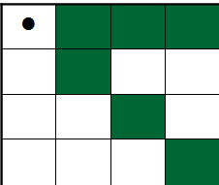
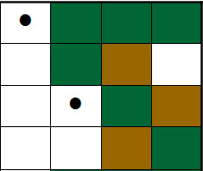
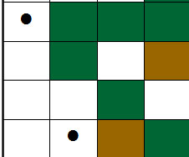
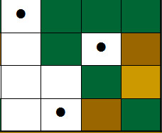
Four Queens Problem & BC

Slide 24
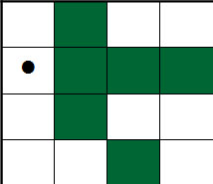
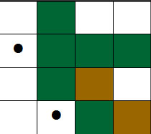
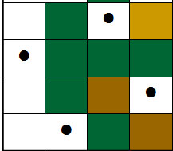
Four Queens Problem & BC

Slide 25
Extension: Finding all solutions
The extension is to find not only one, but all solutions to the posed problem.
Method: Once a solution is found and recorded, we proceed to the next candidate delivered by the systematic selection process.
The general schema is derived from (6.3.4) and shown as follows:

Slide 26
procedure try(i: integer);
var k: integer;
begin
for k:=1 to m do
begin
select k-th candidate;
if acceptable then
begin
record it;
if i<n then try (i+1) else print solution;
cancel recording
end
end
end

Slide 27
In the extended algorithm, to simplify the stopping condition of the selection process, the repeat statement is replaced by a for statement.
program eightqueens(output);
var i: integer;
a: array [1.. 8] of boolean;
b: array [2.. 16] of boolean;
c: array [–7.. 7] of boolean;
x: array [1.. 8] of integer;
procedure print;
var k : integer;
begin
for k : 1 to 8 do write(x[k]:4);
writeln
end {print};
procedure try (i:integer);
var j: integer;
begin
for j:=1 to 8 do
if a[j] ∧ b[i+j] ∧ c[i-j] then
begin
x[i]:=j;
a[j]:=false; b[i+j]:= false;
c[i-j]:=false;
if i < 8 then try(i+1) else print;
a[j]:=true; b[i+j]:= true;
c[i-j]:= true;
end
end {try};

Slide 28
begin
for i:= 1 to 8 do a[i]:=true;
for i:= 2 to 16 do b[i]:=true;
for i:= –7 to 7 do c[i]:=true;
try(1);
end.
The extended algorithm gives all 92 solutions for the 8 queens problem.
Actually, there are only 12 significantly different solutions.

Slide 29
The 12 solutions generated are listed in the following table:
x₁ x₂ x₃ x₄ x₅ x₆ x₇ x₈ N
=========================================================
1 5 8 6 3 7 2 4 876
1 6 8 3 7 4 2 5 264
1 7 4 6 8 2 5 3 200
1 7 5 8 2 4 6 3 136
2 4 6 8 3 1 7 5 504
2 5 7 1 3 8 6 4 400
2 5 7 4 1 8 6 3 72
2 6 1 7 4 8 3 5 280
2 6 8 3 1 4 7 5 240
2 7 3 6 8 5 1 4 264
2 7 5 8 1 4 6 3 160
2 8 6 1 3 5 7 4 336
The numbers N to the right indicate the frequency of execution of the test for safe fields. Its average over all 92 solutions is 161.

Slide 30
State space tree
To illustrate the working of backtracking algorithm, we construct a tree structure which records the executed selections. This tree structure is called state space tree or search tree.
The root node of the tree represents the original state before the start of the search process.
The nodes in the fist level represents the selections corresponding to the first component of the solution.
The nodes in the second level represents the selections corresponding to the second component of the solution, and so on.

Slide 31
A node in the state space tree is called promising if it corresponds to the partial solution which can lead to a complete solution; otherwise, it is called a non-promising solution.
Leaf nodes represent the dead-end situations or a complete solution.
Example: Given the following problem:
Set of variables: X, Y, Z.
Let assign values from the set of values {1,2} to the variables such that the assignment satisfies the following constraints: X = Y, X ≠ Z, Y > Z.
Solve this problem by backtracking algorithm.
The state-space tree for this problem is given in the following figure:

Slide 32
X =1
X =2
Y = 1
Y=2
Y = 1
Y=2
Z =1
×
×
Z =2
Z=2
Z=1
×
×
×
Figure 6.9 An example of state space tree
solution

Slide 33
Complexity of backtracking algorithm
Computational time of a backtracking algorithm is always exponential.
If each node in the state space tree has α children in average, and the length of the solution path is N, then the total number of nodes in the tree is computed as
1 + α¹ + α² + …+ α^{N} = (α^{N+1} -1)/(α-1)
When N is large enough, (α^{N+1} -1)/(α-1) is approximately equal to α^{N} . Since time complexity of backtracking algorithm is proportional to the number of nodes in the state space tree, the time complexity of this algorithm is proportional to α^{N} .

Slide 34
Branch-and-bound algorithm
Traveling Salesman Problem (TSP): Given a set of N cities, find the shortest route connecting them all, with no city visited twice.
This brings to mind another problem: given an undirected graph, is there any way to connect all the nodes with a simple cycle. This is known as Hamilton Cycle Problem (HCP).
To solve the problem HCP, we can modify the depth-first-search (DFS) algorithm to generate all simple paths which visit all vertices in the graph.

Slide 35
Exhaustive search: Modified DFS to generate all the simple paths
We need modify the precedure visit as follows:
procedure visit( k: integer);
var t: integer;
begin
id := id +1; val[k]:= id;
for t:= 1 to V do
if a[k, t] then
if val[t]= 0 then visit(t);
id := id –1; val[k] := 0
end;
This recursive procedure can generate all simple paths from a starting vertex.
Example:
id :=0;
for k:= 1 to V do val[k]:=0;
visit(1);

Slide 36
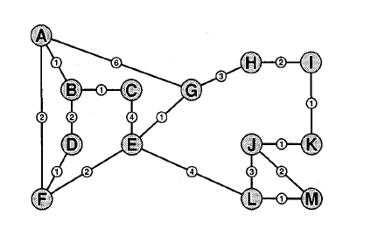
An instance of TSP
Figure 5.10

Slide 37
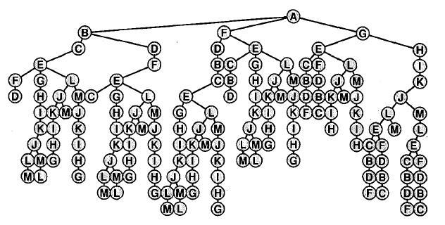
Exhaustive search to find all simple paths
Figure 5.11

Slide 38
From the algorithm generating all simple paths to the algorithm solving TSP
We can make the visit procedure above test for the existence of Hamilton cycle by having it test whether there is an edge from k to 1 when val[k]=V.
In the example above, there are 2 Hamilton cycles
  A F D B C E L M J K I H G
  A G H I K J M L E C B D F and two cycles are in fact the same.
The algorithm for finding Halmiton cycle can be modified to solve the TSP problem by keeping track of the cost of the current path and searching for the path with smallest cost among the found Hamilton cycles.

Slide 39
The idea of branch-and-bound
When applying a modified DFS algorithm to generate all simple paths, in searching the best path for TSP problem, there is an important pruning techque: we terminate the search as soon as it is determined that it can’t possibly be successful.
Suppose a path of cost x through the graph has been found. Then it is fruitless to continue along any path for which the cost so far is greater than x. This can be implemented simply by making no recursive calls in visit if the cost of the current partial path is greater than the cost of the best full path found so far.

Slide 40
The idea of branch-and-bound (cont.)
We clearly cannot miss the minimum-cost path by adhering to such a policy.
The technique of calculating bounds on partial solutions in order to limit the number of full solutions needing to be examined is called branch-and-bound.
This algorithm applies whenever costs are attached to paths and we are trying to minimize costs.

Slide 41
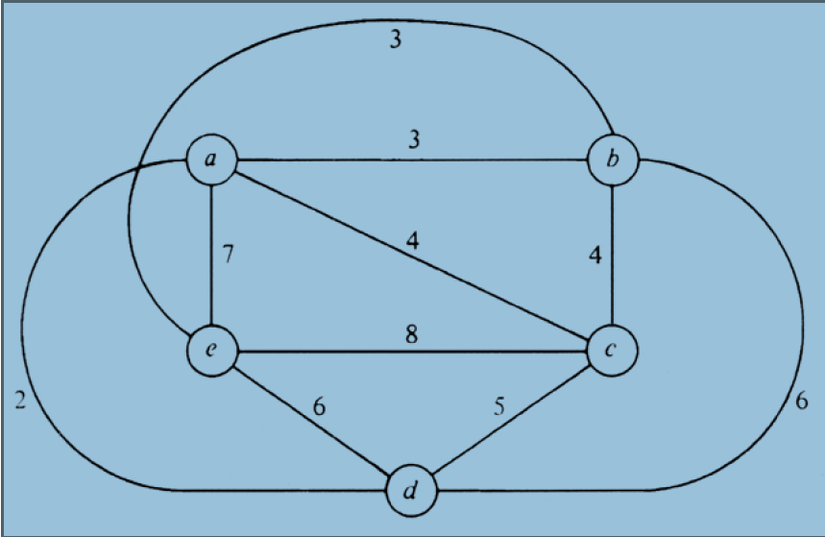
Example: Given a Traveling Salesman Problem as in the figure:
The working of branch-and-bound for solving this TSP problem is described in the two following figures.

Slide 42
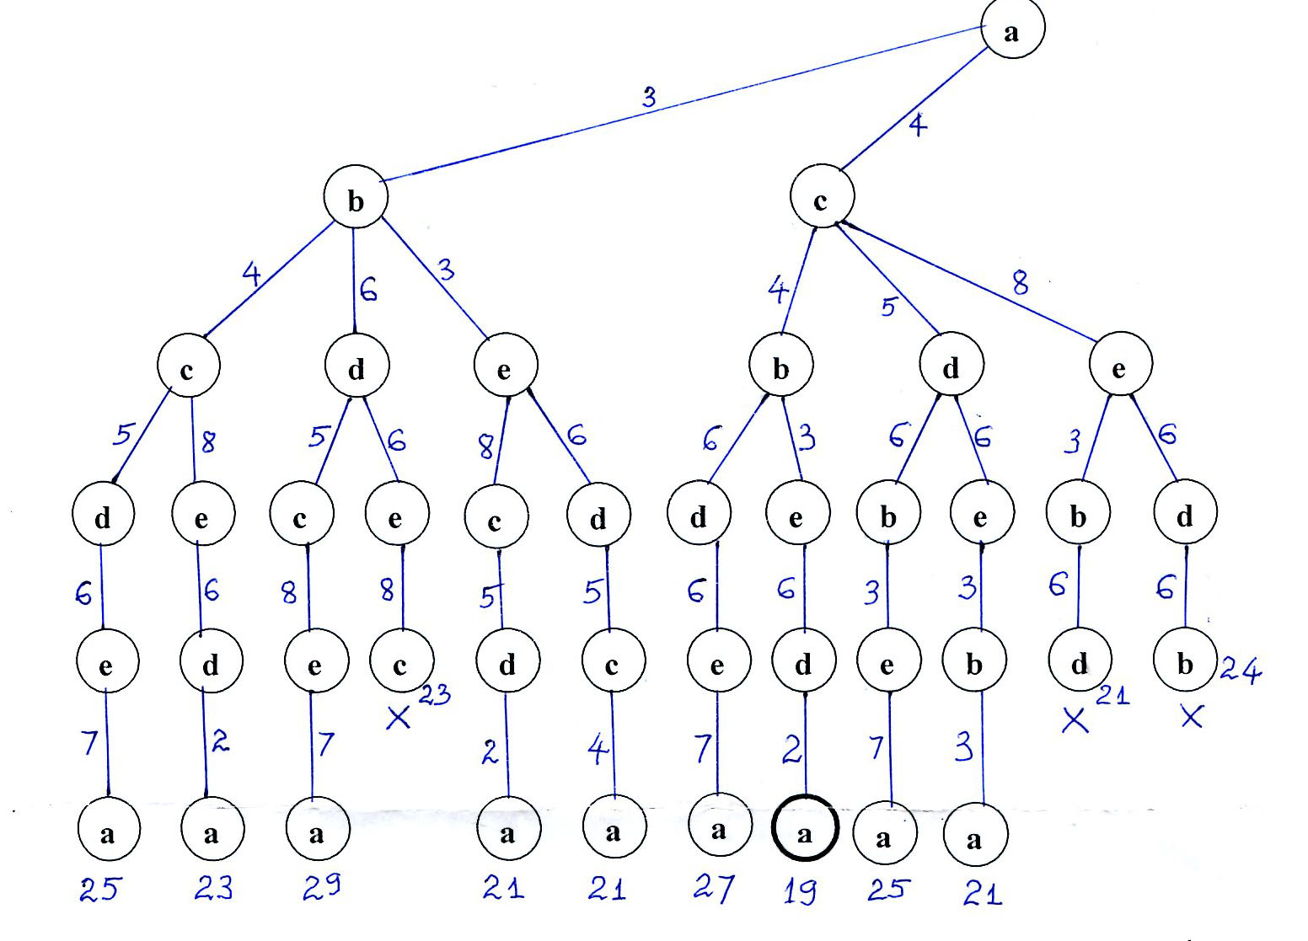

Slide 43
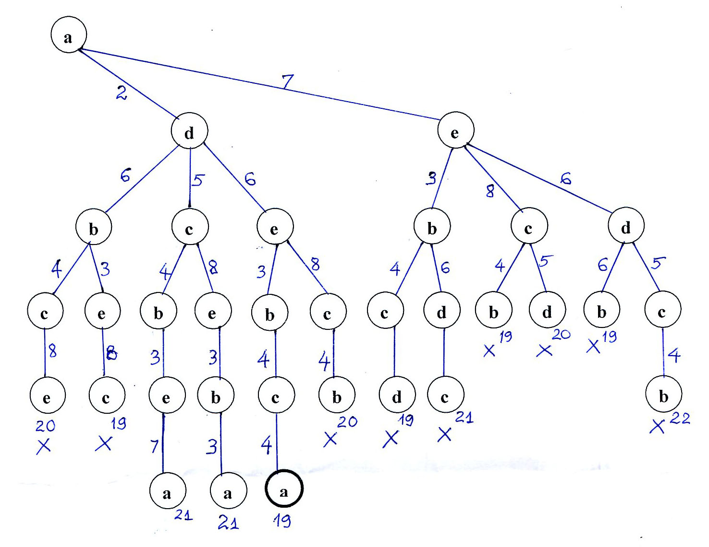

Slide 44
After applying branch-and-bound algorithm, we obtain two optimal solutions:
  a c b e d a
  a d e b c a
In fact, the two optimal solutions are the same.
The cost of the optimal tour: 19

Slide 45
References
[1] Sedgewick, R., Algorithms in C++, Addison-Wesley, 1998.
[2] Wirth, N., Algorithms + Data Structures = Programs, Prentice-Hall, 1976.

