Slide 1
Chapter 8
Approximation Algorithms

Slide 2
Outline
Why approximation algorithms?
The vertex cover problem
The set cover problem
TSP
Scheduling Independent tasks
Bin packing

Slide 3
Why Approximation Algorithms ?
Many problems of practical significance are NP-complete but are too important to abandon merely because obtaining an optimal solution is intractable.
If a problem is NP-complete, we are unlikely to find a polynomial time algorithm for solving it exactly, but it may still be possible to find near-optimal solution in polynomial time.
In practice, near-optimality is often good enough.
An algorithm that returns near-optimal solutions is called an approximation algorithm.

Slide 4
Performance bounds for approximation algorithms
i is an optimization problem instance
c(i) be the cost of solution produced by approximate algorithm and c*(i) be the cost of optimal solution.
For minimization problem, we want c(i)/c*(i) to be as small as possible.
For maximization problem, we want c*(i)/c(i) to be as small as possible.
An approximation algorithm for the given problem instance i, has a ratio bound of p(n) if for any input of size n, the cost c of the solution produced by the approximation algorithm is within a factor of p(n) of the cost c* of an optimal solution. That is
max(c(i)/c*(i), c*(i)/c(i)) ≤ p(n)

Slide 5
Note that p(n) is always greater than or equal to 1.
If p(n) = 1 then the approximate algorithm is an optimal algorithm.
The larger p(n), the worst algorithm
Relative error
  We define the relative error of the approximate algorithm for any input size as
  |c(i) - c*(i)|/ c*(i)
  We say that an approximate algorithm has a relative error bound of ε(n) if
  |c(i)-c*(i)|/c*(i)≤ ε(n)

Slide 6
1. The Vertex-Cover Problem
Vertex cover: given an undirected graph G=(V,E), then a subset V'⊆V such that if ∀(u,v)∈E, then u∈V' or v ∈V' (or both).
Size of a vertex cover: the number of vertices in it.
Vertex-cover problem: find a vertex-cover of minimal size.
This problem is NP-complete

Slide 7
Approximate vertex-cover algorithm
APPROX-VERTEX-COVER(G)
1. C ← ∅
2. E ← E[G]
3. while E ≠ ∅ do
4. let (u,v) be an arbitrary edge of E
5. C ← C ∪ {u,v}
6. remove from E every edge incident on either u or v
7. return
The running time of this algorithm is O(E).

Slide 8
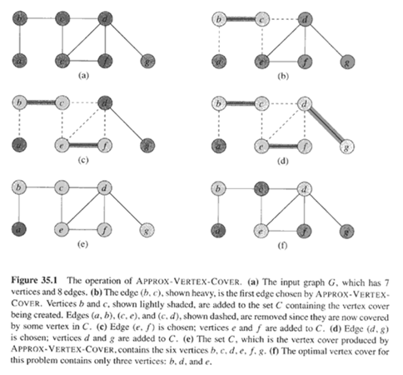

Slide 9
Theorem:
APPROXIMATE-VERTEX-COVER has a ratio bound of 2, i.e., the size of returned vertex cover set is at most twice of the size of optimal vertex-cover.
Proof:
  It runs in poly time
  The returned C is a vertex-cover.
  Let A be the set of edges picked in line 4 and C* be the optimal vertex-cover.
    Then C* must include at least one end of each edge in A and no two edges in A are covered by the same vertex in C*, so |C*|≥|A|.
    Moreover, |C|=2|A|, so |C|≤2|C*|.

Slide 10
The Set Covering Problem
The set covering problem is an optimization problem that models many resource-selection problems.
An instance (X, F) of the set-covering problem consists of a finite set X and a family F of subsets of X, such that every element of X belongs to at least one subset in F:
X = ∪ S
S∈F
We say that a subset S∈F covers its elements.
The problem is to find a minimum-size subset C ⊆ F whose members cover all of X:
X = ∪ S
S∈C
We say that any C satisfying the above equation covers X.

Slide 11
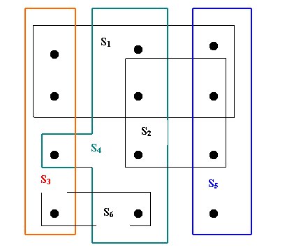
Figure 6.2 An instance {X, F} of the set covering problem, where X consists of the 12 black points and F = { S₁, S₂, S₃, S₄, S₅, S₆}. A minimum size set cover is C = { S₃, S₄, S₅}. The greedy algorithm produces the set C’ = {S₁, S₄, S₅, S₃} in order.

Slide 12
Applications of Set-covering problem
Assume that X is a set of skills that are needed to solve a problem and we have a set of people available to work on it. We wish to form a team, containing as few people as possible, s.t. for every requisite skill in X, there is a member in the team having that skill.
Assign emergency stations (fire stations) in a city.
Allocate sale branch offices for a company.
Schedule for bus drivers.

Slide 13
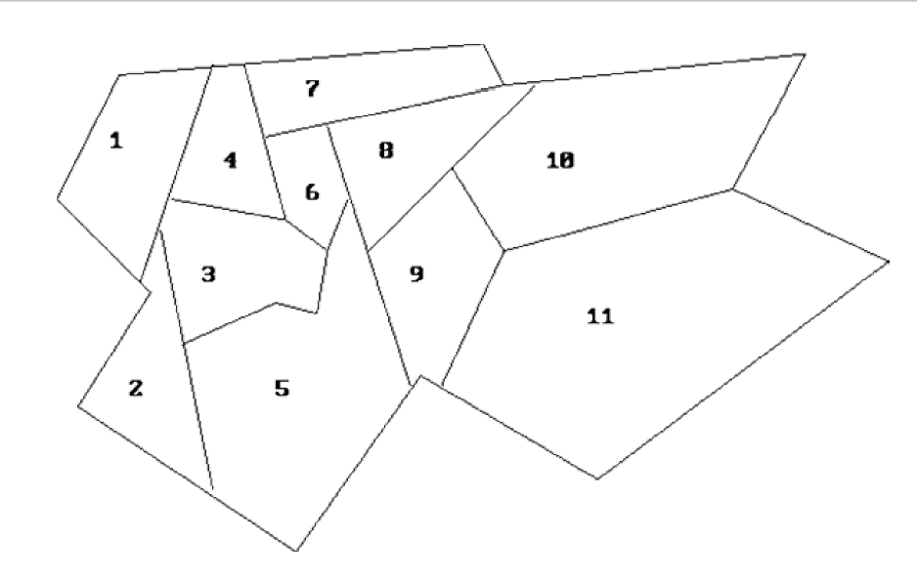
An Example: Fire stations
S1 = {x1, x2, x3, x4}
S2 = { x1, x2, x3, x4, x5}
S3 = { x1, x2, x3, x4, x5, x6}
S4 = { x1, x3, x4, x6, x7}
S5 = { x2, x3, x5, x6, x8, x9}
S6 = { x3, x4, x5, x6, x7, x8}
S7 = { x4, x6, x7, x8 }
S8 = { x5, x6, x7, x8, x9, x10}
S9 = { x5, x8, x9, x10, x11}
S10 = { x8, x9, x10, x11}
S11 = { x9, x10, x11}
The optimal solution:
S = {S3, S8, S9}
The map of a city

Slide 14
A greedy approximation algorithm
Greedy-Set-Cover(X, F)
1. U = X
2. C = ∅
3. while U != ∅ do
4. select an S∈F that maximizes | S ∩ U|
5. U = U – S
6. C = C ∪ {S}
7. return C
The algorithm GREEDY-SET-COVER can easily be implemented to run in time complexity in |X| and |F|. Since the number of iterations of the loop on line 3-6 is at most min(|X|, |F|) and the loop body can be implemented to run in time O(|X|.|F|), there is an implementation that runs in time O(|X|.|F|.min(|X|,|F|)) .

Slide 15
Ratio bound of Greedy-set-cover
Let denote the dth harmonic number
d
H_{d} = Σ_{i-1}1/i
Theorem: Greedy-set-cover has a ratio bound H(max{|S|: S ∈F})
Corollary: Greedy-set-cover has a ratio bound of (ln|X| +1)
(Refer to the text book for the proofs)

Slide 16
3. The Traveling Salesman Problem
Since finding the shortest tour for TSP requires so much computation, we may consider to find a tour that is almost as short as the shortest. That is, it may be possible to find near-optimal solution.
Example: We can use an approximation algorithm for the HCP. It's relatively easy to find a tour that is longer by at most a factor of two than the optimal tour. The method is based on
  the algorithm for finding the minimum spanning tree and
  an observation that it is always cheapest to go directly from a vertex u to a vertex w; going by way of any intermediate stop v can’t be less expensive.
  C(u,w) ≤ C(u,v)+ C(v,w)

Slide 17
APPROX-TSP-TOUR
The algorithm computes a near-optimal tour of an undirected graph G.
procedure APPROX-TSP-TOUR(G, c);
begin
select a vertex r ∈ V[G] to be the “root” vertex;
grow a minimum spanning tree T for G from root r, using Prim’s algorithm;
apply a preorder tree walk of T and let L be the list of vertices visited in the walk;
form the halmintonian cycle H that visits the vertices in the order of L.
/* H is the result to return * /
end
A preorder tree walk recursively visits every vertex in the tree, listing a vertex when its first encountered, before any of its children are visited.

Slide 18
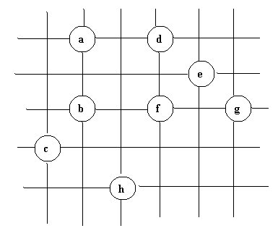
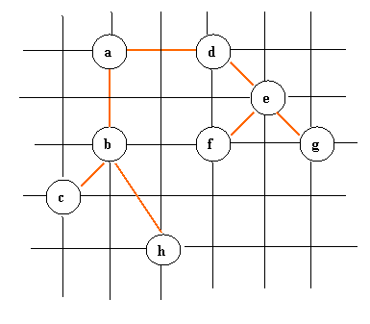
Thí dụ minh họa giải thuật APPROX-TSP-TOUR

Slide 19

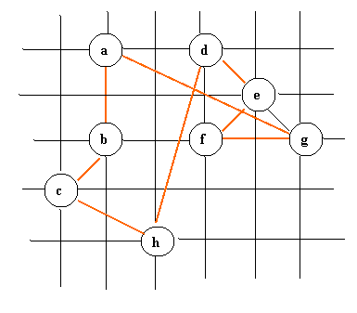
The preorder tree walk is not simple tour, since a node be visited many times, but it can be fixed, the tree walk visits the vertices in the order a, b, c, b, h, b, a, d, e, f, e, g, e, d, a. From this order, we can arrive to the hamiltonian cycle H: a, b, c, h, d, e ,f, g, a.

Slide 20
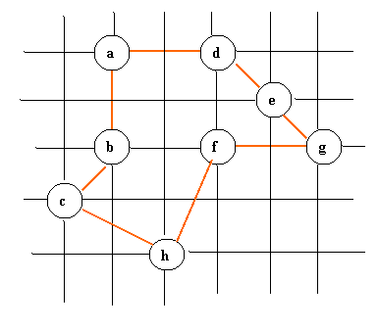
The optimal tour
The total cost of H is approximately 19.074. An optimal tour H* has the total cost of approximately 14.715.
The running time of APPROX-TSP-TOUR is the running time of the Prim algorithm. If the graph is implemented by adjacency matrix, it’s O(V²lgV)≈ O(E.lgV) since the input graph is a complete graph.

Slide 21
Ratio bound of APPROX-TSP-TOUR
Theorem: APPROX-TSP-TOUR is an approxima-tion algorithm with a ratio bound of 2 for the TSP with triangle inequality.
Proof: Let H* be an optimal tour for a given set of vertices. Since we obtain a spanning tree by deleting any edge from a tour, if T is a minimum spanning tree for the given set of vertices, then
c(T) ≤ c(H*) (1)
A full walk of T traverses every edge of T twice, we have:
c(W) = 2c(T) (2)
(1) and (2) imply that:
c(W) ≤ 2c(H*) (3)

Slide 22
But W is not a tour, since it visits some vertices more than once. By the triangle inequality, we can delete a visit to any vertex from W. By repeatedly applying this operation, we can remove from W all but the first visit to each vertex.
Let H be the cycle corresponding to this preorder walk. It is a hamiltonian cycle, since every vertex is visited exactly once. Since H is obtained by deleting vertices from W, we have
c(H) ≤ c(W) (4)
From (3) and (4), we conclude:
c(H) ≤ 2c(H*)
So, APPROX-TSP-TOUR returns a tour whose cost is not more than twice the cost of an optimal tour.

Slide 23
Scheduling independent tasks
An instance of the scheduling problem is defined by a set of n task times, t_{i}, 1≤ i ≤ n, and m, the number of processors.
Obtaining minimum finish time schedules is NP-complete.
The scheduling rule we will use is called the LPT (longest processing time) rule.
Definition: An LPT schedule is one that is the result of an algorithm, which, whenever a processor becomes free, assigns to that processor a task whose time is the largest of those tasks not yet assigned.

Slide 24
Example
Let m = 3, n = 6 and (t₁, t₂, t₃, t₄, t₅, t₆) = (8, 7, 6, 5, 4, 3). In an LPT schedule tasks 1, 2 and 3 respectively. Tasks 1, 2, and 3 are assigned to processors 1, 2 and 3. Tasks 4, 5 and 6 are respectively assigned to the processors 3, 2, and 1.
The finish time is 11. Since Σ t_{i} /3 = 11, the schedule is also optimal.
6 7 8 11
P1
P3
P3
1 6
2 5
3 4

Slide 25
Example
Let m = 3, n = 6 and (t₁, t₂, t₃, t₄, t₅, t₆, t₇) = (5, 5, 4, 4, 3, 3, 3). The LPT schedule is shown in the following figure. This has a finish time is 11. The optimal schedule is 9. Hence, for this instance |F*(I) – F(I)|/F*(I) = (11-9)/9=2/9.
4 5 8 11
9
P1
P2
P3
1 5 7
1 3
2 6
2 4
3 4
5 6 7
(a) LPT schedule
(b) Optimal schedule

Slide 26
While the LPT rule may generate optimal schedules for some problem instances, it does not do so for all instances. How bad can LPT schedules be relative to optimal schedules?
Theorem: [Graham] Let F*(I) be the finish time of an optimal m processor schedule for instance I of the task scheduling problem. Let F(I) be the finish time of an LPT schedule for the same instance, then
|F*(I)-F(I)|/F*(I) ≤ 1/3 – 1/(3m)
The proof of this theorem can be referred to the book
“Fundamentals of Computer Algorithms”, E. Horowitz and S. Sahni, Pitman Publishing, 1978.

Slide 27
Bin Packing
We are given n objects which have to be placed in bins of equal capacity L.
Object i requires l_{i} units of bin capacity.
The objective is to determine the minimum number of bins needed to accommodate all n objects.
Example: Let L = 10, n = 6 and (l₁, l₂, l₃, l₄, l₅, l₆) = (5, 6, 3, 7, 5,4)
The bin packing problem is NP-complete.

Slide 28
Four heuristics
One can derive many simple heuristics for the bin packing problem. In general, they will not obtain optimal packings.
However, they obtain packings that use only a “small” fraction of bins more than an optimal packing.
Four heuristics:
  First fit (FF)
  Best fit (BF)
  First fit Decreasing (FFD)
  Best fit Decreasing (BFD)

Slide 29
First-fit and Best-fit
First-fit
  Index the bins 1, 2, 3,… All bins are initially filled to level 0. Objects are considered for packing in the order 1, 2, …, n. To pack object i, find the least index j such that bin j is filled to the level r (r ≤ L – l_{i}). Pack I into bin j. Bin j is now filled to level r + l_{i}.
Best-fit
  The initial conditions are the same as for FF. When object i is being considered, find the least j such that bin j is filled to a level r (r ≤ L – l_{i}) and r is as large as possible. Pack i into bin j. Bin j is now filled to level r + l_{i}.

Slide 30
Example
3
6
2
4
5
(a) First Fit
1
5
3
2
4
6
(b) Best Fit
1

Slide 31
First-fit decreasing and Best-fit decreasing
First-fit decreasing (FFD)
  Reorder the objects so that l_{i} ≥ l_{i}+1, 1 ≤ i ≤ n. Now use First-fit to pack the objects.
Best-fit decreasing (BFD)
  Reorder the objects so that l_{i} ≥ l_{i}+1, 1 ≤ i ≤ n. Now use First-fit to pack the objects.

Slide 32
Example
3
4
6
2
5
1
(c) First Fit Decreasing and Best Fit Decreasing
FFD and BFD do better than either FF or BF on this instance. While FFD and BFD obtain optimal packings on this example, they do not in general obtain such a packings.

Slide 33
Theorem
Let I be an instance of the bin packing problem and let F*(I) be the minimum number of bins needed for this instance. The packing generated by either FF or BF uses no more than (17/10)F*(I)+2 bins. The packings generated by either FFD or BFD uses no more than (11/9)F*(I)+4 bins.
This proof of this theorem is long and complex (given by Johnson et al., 1974).

Slide 34
Appendix: A Taxonomy of Algorithm Design Strategies
Strategy name Examples
----------------------------------------------------------------------------------------
Bruce-force Sequential search, selection sort
Divide-and-conquer Quicksort, mergesort, binary search
Decrease-and-conquer Insertion sort, DFS, BFS
Transform-and-conquer heapsort, Gauss elimination
Greedy Prim’s, Dijkstra’s
Dynamic Programming Floyd’s
Backtracking
Branch-and-Bound
Approximate algorithms
Heuristics
Meta-heuristics

Slide 35
procedure MST-PRIM (G, w, r);
/* G = (V,E) is weighted graph with the weight function w, and r is an arbitrary root vertex */
begin
Q: = V[G]; /* Q is a priority queue */
for each u ∈ Q do key[u]: = ∞;
key[r]: = 0; p[r]: = NIL;
while Q is not empty do
begin
u: = EXTRACT-MIN(Q);
for each v ∈ Q and w(u, v) < key[v] then
/ * update the key field of vertice v */
begin
p[v] := u; key[v]: = w(u, v)
end
end
end;

