Slide 1

COMPANY CREDENTIALS
Facebook Messenger Chatbot
June 2019
Vuong Ta Van
Notes:
heavy

Slide 2
Facebook Messenger Chatbot
Introduction
Core Components
Demonstration

Slide 3
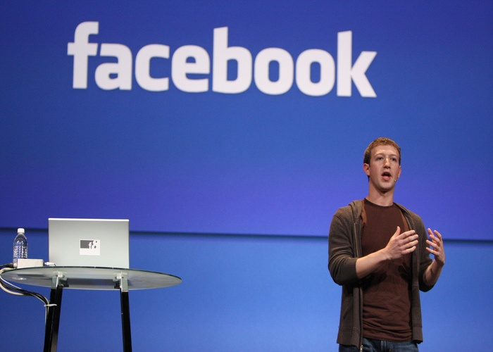
Introduction
Facebook

Slide 4
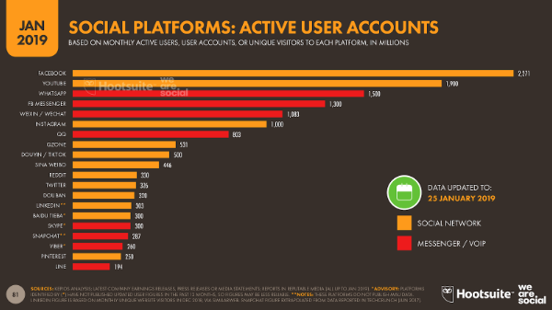
Introduction
Facebook

Slide 5
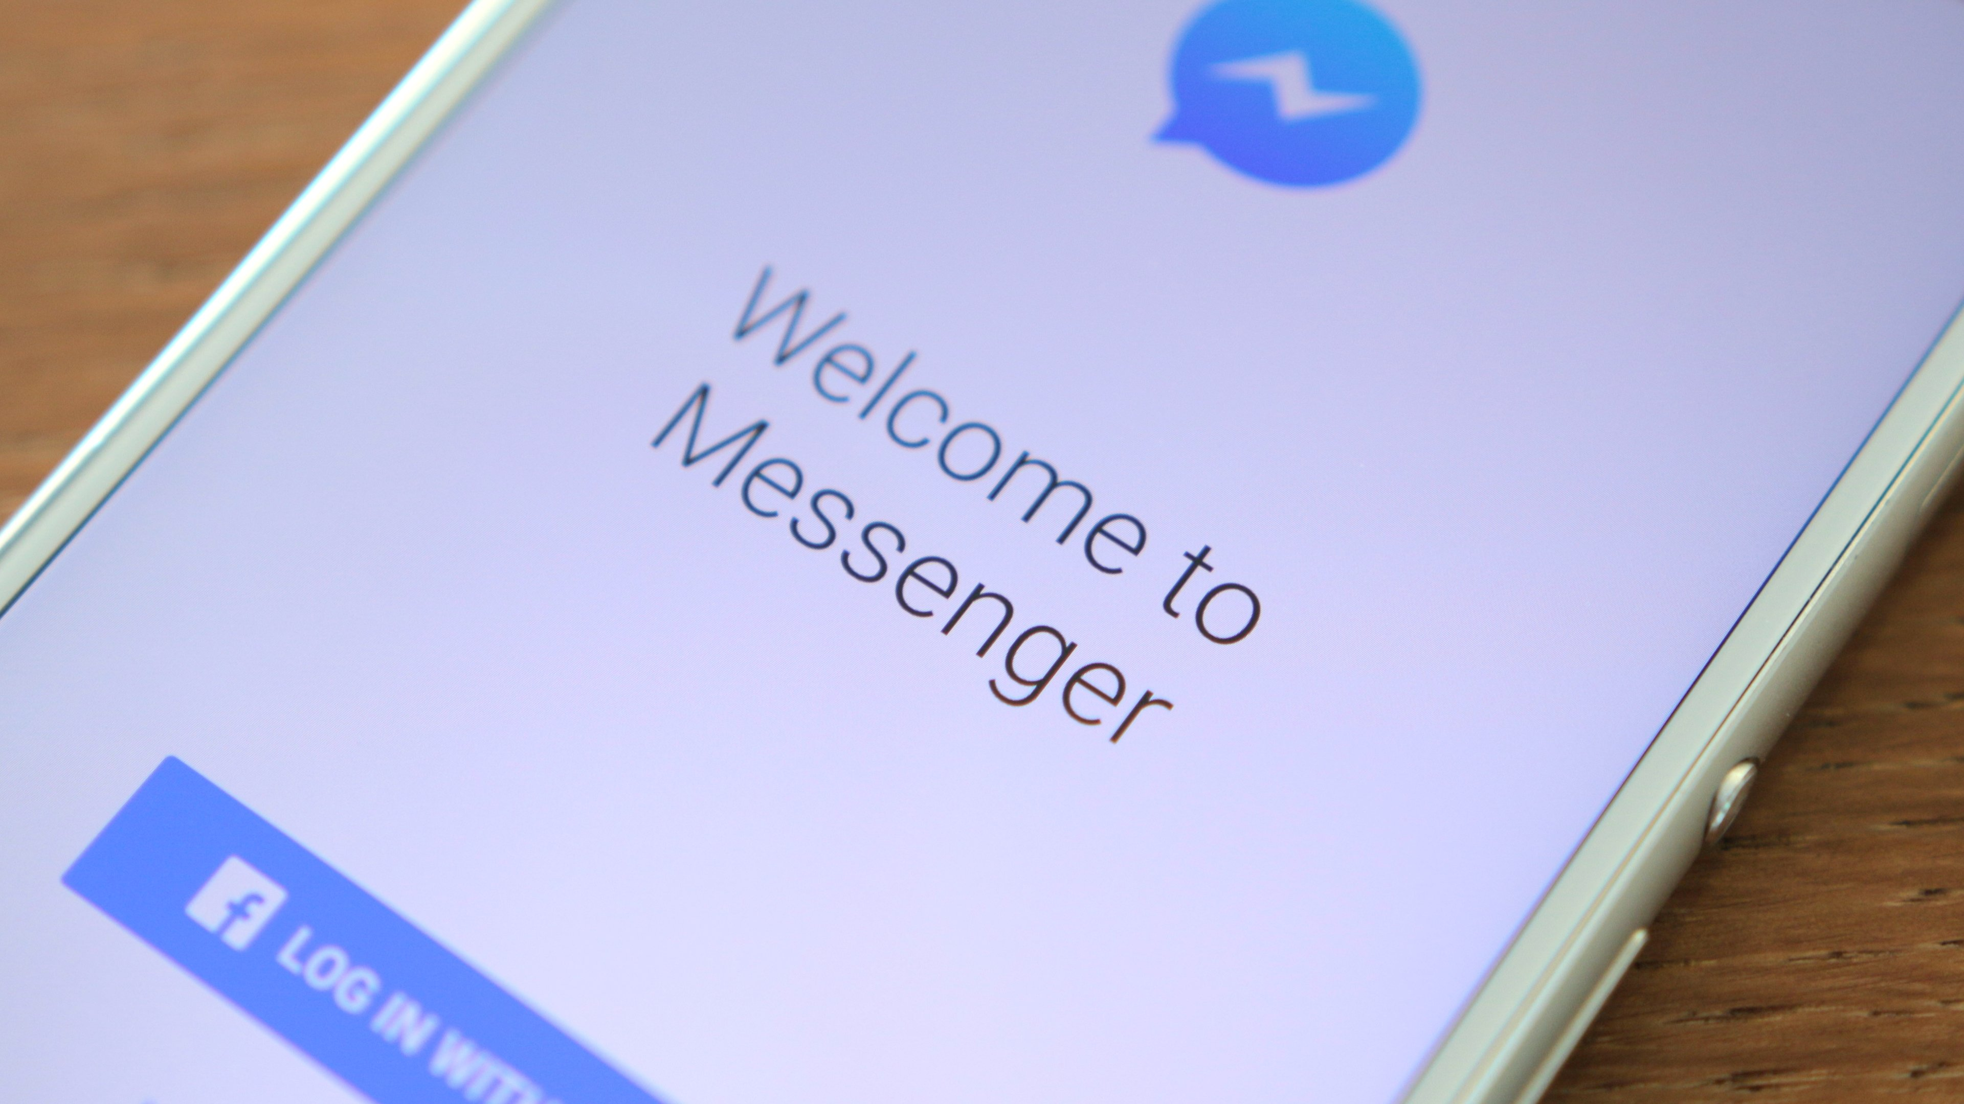
Introduction
Facebook Messenger

Slide 6
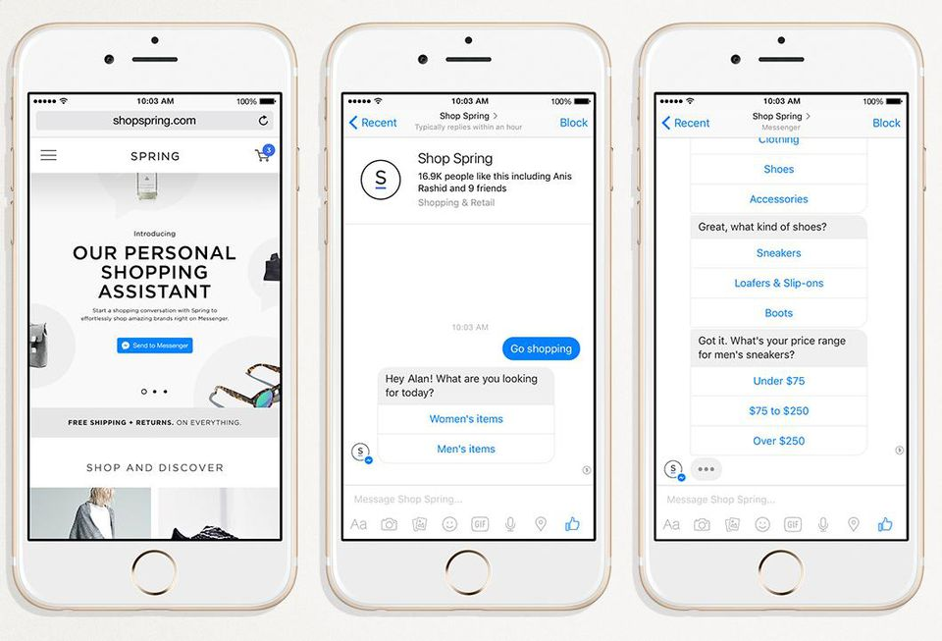
Introduction
Chatbot Messenger

Slide 7
Core Components
Messaging
Webhook
Webview
ID & Profile
Natural Language Process
Submit Bot

Slide 8
Core Platform
Messaging
Types
Send API
Text
Attachments

Slide 9
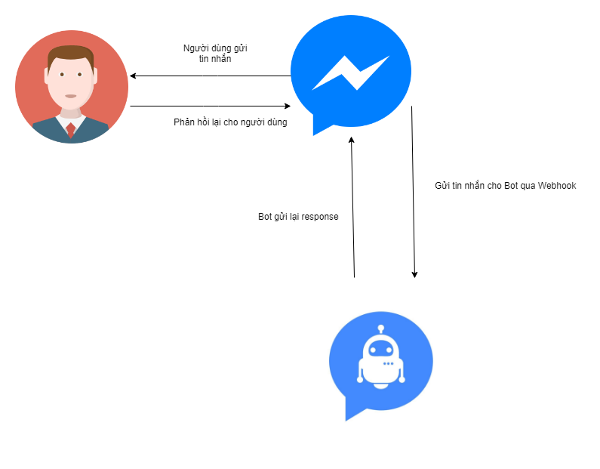
Core Platform
Webhook
200 OK Response

Slide 10
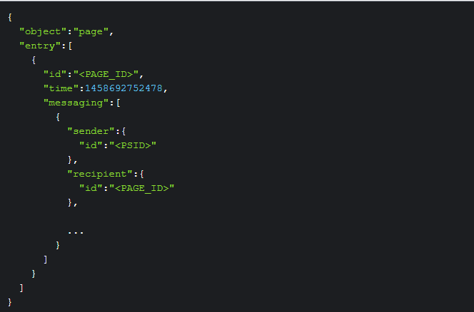
Core Platform
Webhook

Slide 11
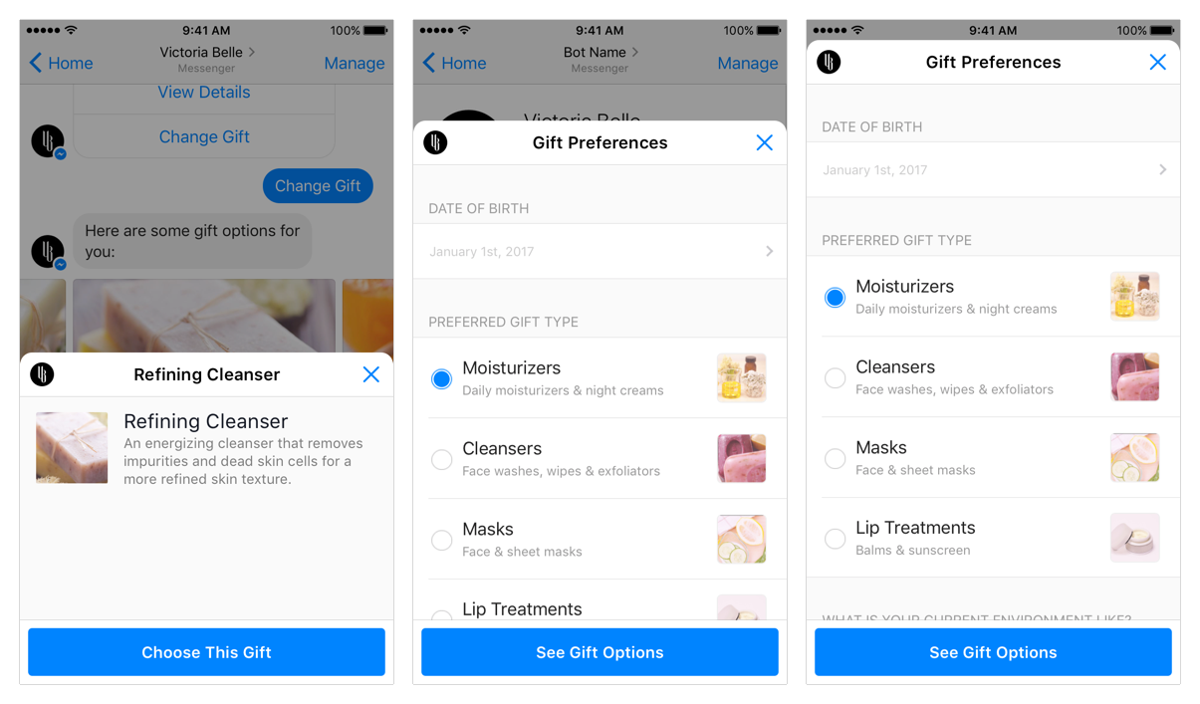
Core Platform
Webview

Slide 12
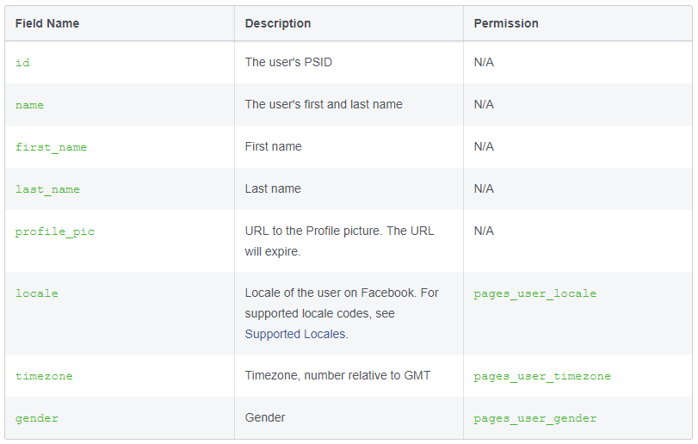
Core Platform
ID & Profile
PSID, ASID
Phone Number
User Profile

Slide 13

Core Platform
Natural Language Process

Slide 14
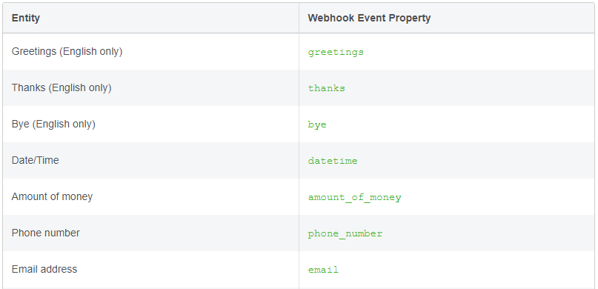
Core Platform
Natural Language Process

Slide 15
Core Platform
Submit Bot

Slide 16
Demo

Slide 17
References
https://developers.facebook.com/docs/messenger-platform
https://wearesocial.com/blog/2019/01/digital-2019-global-internet-use-accelerates

Slide 18
Q&A

