Slide 1

COMPANY CREDENTIALS
Facebook Message Chatbot
June 2019
Phuong Vuong Nguyen
Notes:
heavy

Slide 2
OUTLINE
Introduction
What is Chat Bot?
Core Components of Messenger Platform
Why use Facebook Messenger bot for business?

Slide 3



1. Introduction
One Build
All Platform
900M
Users
Conversational
Interface

Slide 4


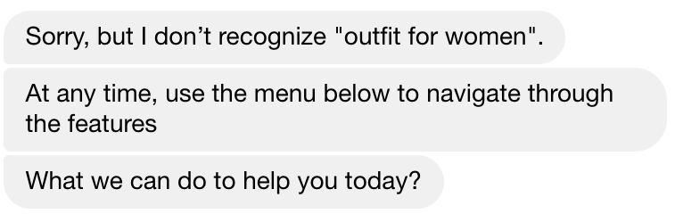
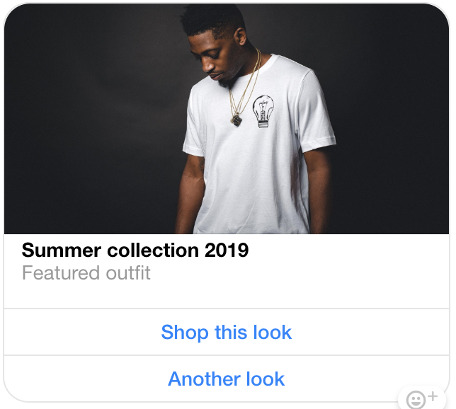
2. What is Chat Bot ?
Chatting with a bot is similar to chatting with a Facebook user.
A bot can send:
Text
Images
Templates

Slide 5
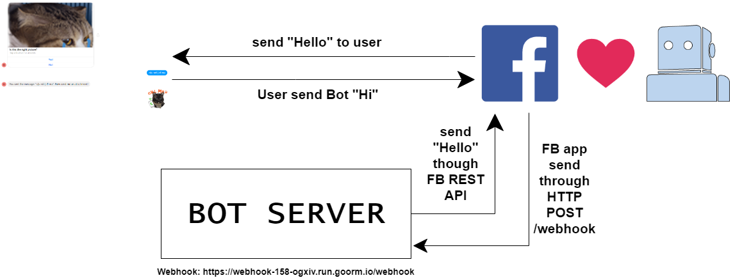
2. What is Chat Bot ?

Slide 6
2. Core Components of Messenger Platform
Messenger Platform contains 5 core :
IDs & Profile Information
APIs
Webhook
Webview
Natural Language Processing

Slide 7
2. Core Components of Messenger Platform
IDs & Profile Information
Provides a set of APIs to help you do everything from finding your current customers on messenger, to providing a consistent experience across multiple Facebook apps and Pages, to retrieving basic profile information to personalize messages and features offered by your bot.
PSID
(Page-Scoped ID)
- Assigned each people a PSID which unique.
- Included in the sender.id property of the webhook event.

Slide 8
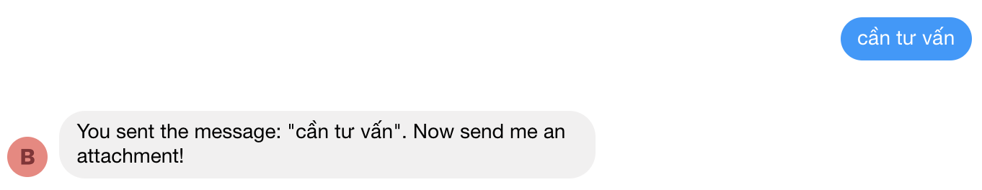
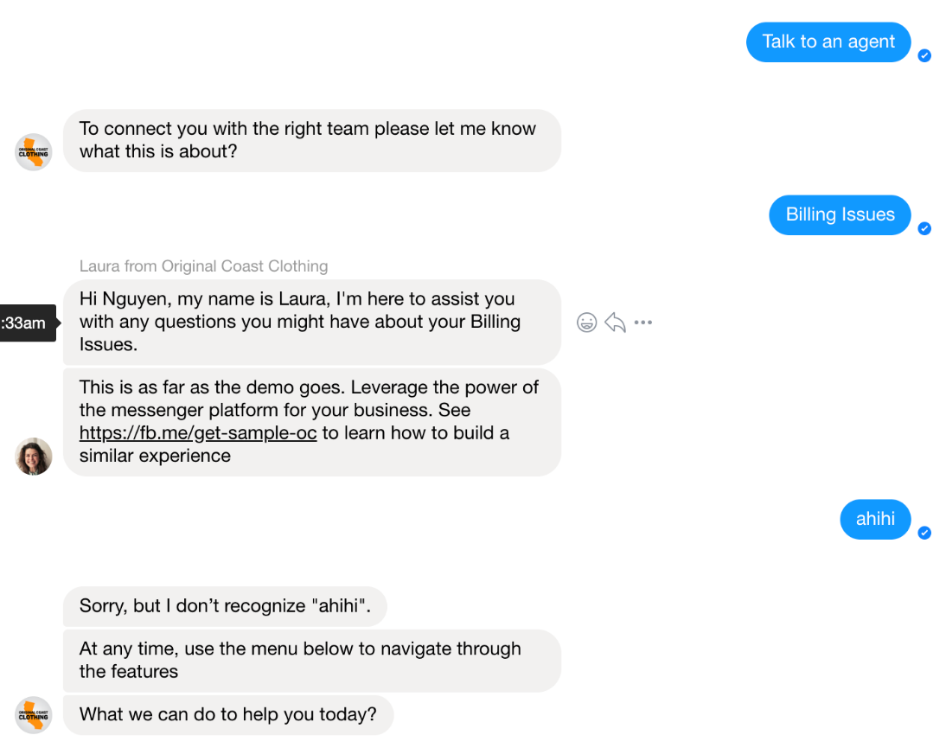
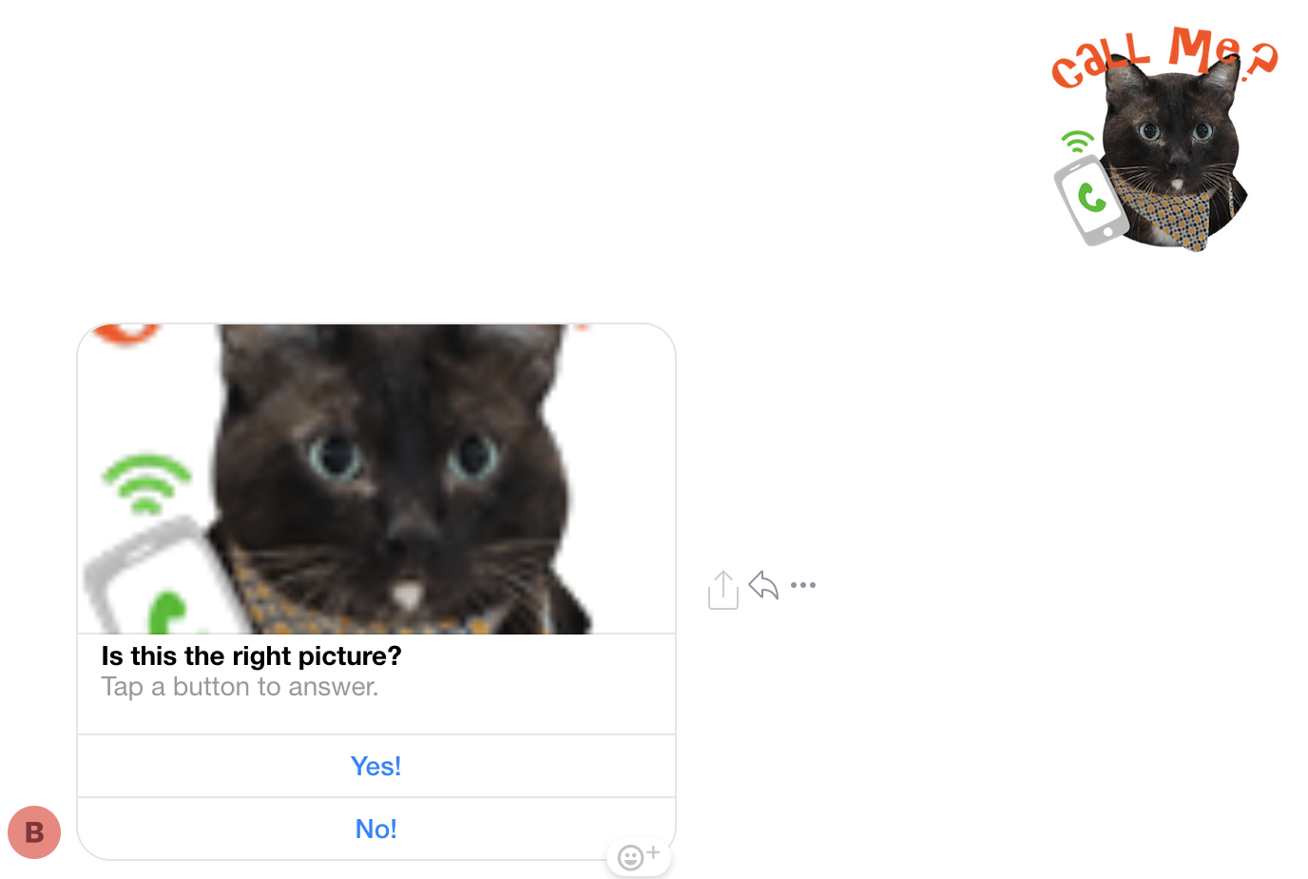
2. Core Components of Messenger Platform
APIs
MP provides a set of REST APIs (Representational State Transfer) that give you the tools you need to create awesome Messenger experiences.
Send API
Attachment Upload API
Handover Protocol API
- Send text, asset (image, video, file …)
-Asset can be uploaded from a URL or your local file system, including images, audio, videos, and files.
-Return an attachment_id that can be used for future requests.
- Enables more applications to collaborate for a Page by passing control of the conversation (thread) between Primary Receiver and Secondary Receiver apps.

Slide 9

2. Core Components of Messenger Platform
Webhook
MP sends an event to your webhook whenever an action occurs in a conversation with your bot. Your webhook is a single HTTPS POST requests (usually /webhook). This is where your bot processes and responds to all incoming webhook events.
Message
Messaging_options
Messaging_postbacks

Slide 10
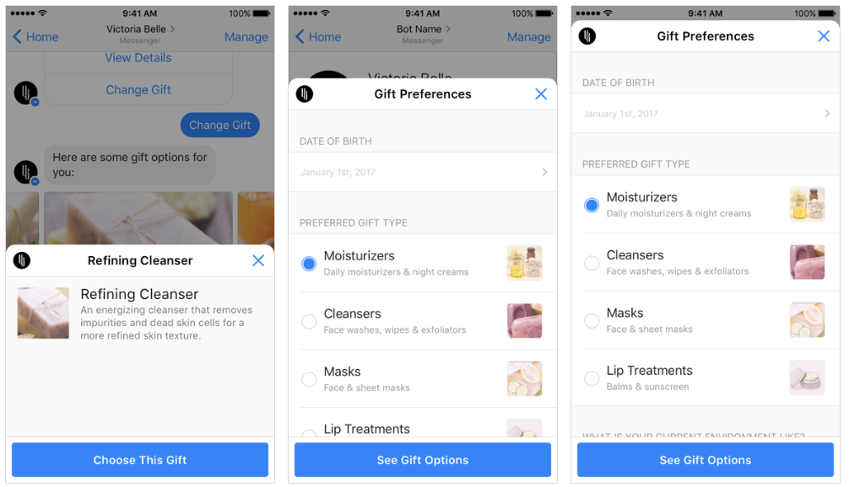
2. Core Components of Messenger Platform
Webview
Messenger webview is a standard webview that can be opened inside the Messenger app on mobile and web. It allows you to offer experiences and features that require a more complex user interface that might be difficult to create in-conversation, such as picking seats to book, or browsing available dates.
https://developers.facebook.com/docs/messenger-platform/webview

Slide 11

2. Core Components of Messenger Platform
Natural Language Processing
Brings the powerful Wit.ai natural language platform directly to your Messenger bots, allowing you to detect intent and meaning in messages sent to your bot

Slide 12
4. Why use Facebook Messenger bot for business?
Reach your audience directly
Save time and money on customer care
Identify leads
Handle e-commerce transactions
- Headliner Labs found that people are 3.5 times more likely to open a Facebook Message than a marketing email.
- Support 24/7
- identify their needs, ask basic questions and immediately direct high-quality leads to your human sales team.
Bots can do the selling.
Drop-off rates are lower than in a traditional ad-to-webpage pipeline

Slide 13
THANK YOU !

