Slide 1
Corsair SSD Toolbox Project

Slide 2
Supported Features
Corsair SSD Toolbox
x
Help
Info
Scan
Drive
Info
C:\ D:\
960.1 GB
Micron VSFBM0000123-84
Model Number:
Serial Number:
Firmware Version:
Configuration ID:
Drive Size:
ATA Version:
Features:
Temperature (F):
Total Host Reads (GB):
Total Host Writes (GB):
Over
Provision
F:\
120.0 GB
Samsung SS201787342-DA
S.M.A.R.T.
Status
Disk
Clone
Disk
Optimize
Secure
Wipe
Self
Test

Slide 3
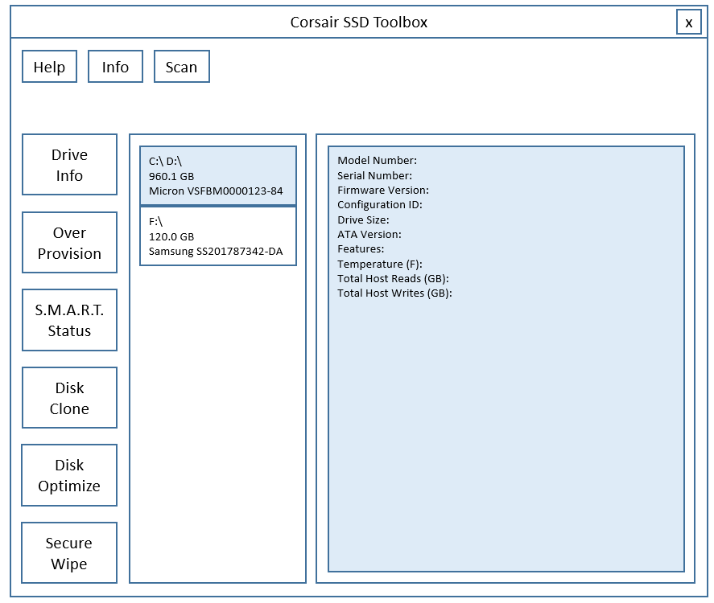
How to access SSD in Windows
GUI (QML/C++)
We will build
these software
Parameters
Direct call in C++
StorageAPI(C++, WinAPI)
Functions of StorageAPI:
+ Handle ATA Commands
+ Provide APIs to access drives from applications
+ Utilities (access partitions, features, …)
ATA
Command
Windows Drivers
Host Bus Adapter
ATA
Command
ATA
Command
SATA bus
SCSI bus
SCSI
Command
ATA command
embedded
in SCSI command
SSD
HDD
USB
Flash

Slide 4
GUI (QML/C++)
User click
“Stop”
void Gui::HandleStopScan() {
if (pScanInfo) pScanInfo->stop = true;
}
Function
Scan Drives
void Gui::HandleScanDrive() {
pScanInfo = new sScanInfo();
FreezeGui();
CreateThread(ScanDriveThreadFunc, (void*)info);
while(1) {
QCoreApplication::processEvent();
if (info->done == true) break;
ShowScanProgress(info-> progress)
}
ShowDriveInfo(info->dlst);
EnableGui();
delete pScanInfo;
}
Direct call in C++
User click
“Scan”
StorageAPI(C++, WinAPI)
namespace StorageAPI {
eRetCode ScanDrives(vector<sDriveInfo>& dlst);
eRetCode GetScanProgress(u8& prog)
eRetCode UpdateFirmware(const string& drvname, u8* data, u32 size);
eRetCode TrimDrive(const string& drvname);
eRetCode SecureErase(const string& drvname);
…
}
struct sSmartItem {
u8 id;
string name;
u8 curval;
u8 worst;
u8 threshold;
u32 rawval;
u32 status;
}
struct sSmartInfo {
vector<sSmartItem> slst;
}
enum eRetCode {
Ok,
ErrNoSpace,
ErrNoMem,
ErrNotSupport, ..
}
BackEnd
code
GUI code
struct sIdentifyInfo {
string model
string serial
string version
string confid
string ata
u64 cap;
u64 feature;
u64 thr, thw;
}
struct sScanInfo {
bool stop;
bool done;
u32 progress;
vector<sDriveInfo> dlst;
};
static sScanInfo* pScanInfo;
static void ScanDriveThreadFunc(void* param) {
sScanInfo* info = (sScanInfo*) param;
ret = StorageApi::ScanDrives(info->dlst);
while(!info->stop && !info->status) {
StorageApi::GetScanProgress(info->progress);
sleep(1ms);
}
info->done = true;
}
struct sDriveInfo {
string name;
u32 index;
sSmartInfo smart;
sIdentifyInfo info;
};

Slide 5
GUI (QML/C++)
User click
“Stop”
void Gui::HandleStopScan() {
if (pScanInfo) pScanInfo->stop = true;
}
Function
Scan Drives
void Gui::HandleScanDrive() {
pScanInfo = new sScanInfo();
FreezeGui();
CreateThread(ScanDriveThreadFunc, (void*)info);
while(1) {
QCoreApplication::processEvent();
if (info->done == true) break;
ShowScanProgress(info-> progress)
}
ShowDriveInfo(info->dlst);
EnableGui();
delete pScanInfo;
}
Direct call in C++
User click
“Scan”
StorageAPI(C++, WinAPI)
namespace StorageAPI {
eRetCode ScanDrives(vector<sDriveInfo>& dlst);
eRetCode GetScanProgress(u8& prog)
eRetCode UpdateFirmware(const string& drvname, u8* data, u32 size);
eRetCode TrimDrive(const string& drvname);
eRetCode SecureErase(const string& drvname);
…
}
struct sSmartItem {
u8 id;
string name;
u8 curval;
u8 worst;
u8 threshold;
u32 rawval;
u32 status;
}
struct sSmartInfo {
vector<sSmartItem> slst;
}
enum eRetCode {
Ok,
ErrNoSpace,
ErrNoMem,
ErrNotSupport, ..
}
BackEnd
code
GUI code
void Gui::ShowDriveInfo(vector<sDriveInfo>& dlst) {
foreach drv in dlst:
prtstr = StorageApi::GetPartsString(drv.name)
capstr = ToString(drv.info.cap)
mdlstr = drv.info.model;
drvstr = prtstr + capstr + mldstr;
ListWidget->addItem(drvlst);
}
struct sIdentifyInfo {
string model
string serial
string version
string confid
string ata
u64 cap;
u64 feature;
u64 thr, thw;
}
struct sDriveInfo {
string name;
u32 index;
sSmartInfo smart;
sIdentifyInfo info;
};

Slide 6
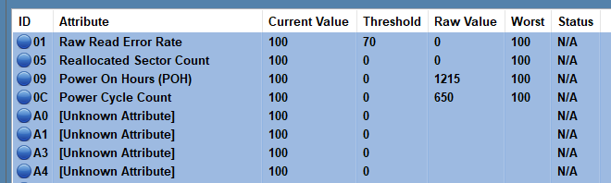
GUI (QML/C++)
void Gui::HandleViewSmart() {
// Display information from dlst (in Scan step)
foreach drv in dlst:
sSmartInfo& sm = drv.smart;
foreach item in sm.slst:
ShowSmartItem(row++, item);
}
Function
View SMART Status
User click
“SMART Status”
Direct call in C++
GUI code
StorageAPI(C++, WinAPI)
namespace StorageAPI {
eRetCode ScanDrives(vector<sDriveInfo>& dlst);
eRetCode GetScanProgress(u8& prog)
eRetCode UpdateFirmware(const string& drvname, u8* data, u32 size);
eRetCode TrimDrive(const string& drvname);
eRetCode SecureErase(const string& drvname);
…
}
struct sSmartItem {
u8 id;
string name;
u8 curval;
u8 worst;
u8 threshold;
u32 rawval;
u32 status;
}
struct sSmartInfo {
vector<sSmartItem> slst;
}
enum eRetCode {
Ok,
ErrNoSpace,
ErrNoMem,
ErrNotSupport, ..
}
BackEnd
code
void Gui::ShowSmartItem(u32 row, sSmartIte& item) {
TableWidget->addItem(row, col0, ToString(item.id));
TableWidget->addItem(row, col1, item.name)
TableWidget->addItem(row, col2, ToString(drv.curval));
TableWidget->addItem(row, col3, ToString(drv.worst));
TableWidget->addItem(row, col4, ToString(drv.threshold));
TableWidget->addItem(row, col5, ToString(drv.rawval));
TableWidget->addItem(row, col6, ToString(drv.status));
}
struct sIdentifyInfo {
string model
string serial
string version
string confid
string ata
u64 cap;
u64 feature;
u64 thr, thw;
}
struct sDriveInfo {
string name;
u32 index;
sSmartInfo smart;
sIdentifyInfo info;
};
Table Widget

Slide 7
Sample implementation
Function
Firmware Update
Use Case:
+ The user selects Corsair’s drive and clicks "Firmware Update".
GUI side:
+ Get model number and firmware version of selected drive. Discard if this is not Corsair’s drives. (*)
+ Get the updated version from Corsair’s website.
+ If there is new firmware for this drive (**), download the firmware and keep it in-memory (RAM) to prevent the end-user from modifying the firmware.
+ Verify the checksum value of the firmware. Discard it if it's not correct.
+ Call StorageApi::UpdateFirmware() with this firmware binary data.
+ Keep responsiveness to end-user’s activities.
(*) To do this, we need information about Corsair’s model string pattern, for example CRS0123XXXXX-YYY ?
(**) How to know this firmware version is newer than the other one ?
→ Confirm with PO

Slide 8
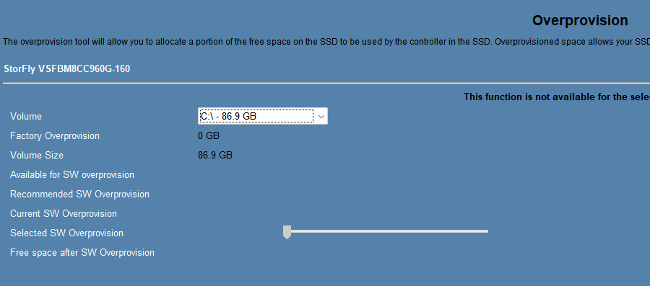
Sample implementation
User click
“Cancel”
void Gui::HandleStopChangeProvision() {
if (pProvInfo) pProvInfo->stop = true;
}
Function
Change OverProvision
User click
“Start”
void Gui::HandleStartChangeProvision() {
// Similar to ScanDrive function
// + Get ProvInfo(name, rate)
// + Create Worker Thread
// + Wait (also response to user’s activities)
// + Finish & report status
}
End-user select a Partition or PhysicalDevice ?
Confirm with PO
It doesn’t make sense if we select a partition here, because the Over-Provision feature affects the whole drive.

Slide 9
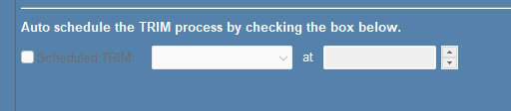
Sample implementation
User click
“Cancel”
void Gui::HandleStopChangeProv() {
if (pProvInfo) pProvInfo->stop = true;
}
Function
Optimize
void Gui::HandleStartChangeProv() {
// Similar to ScanDrive function
// + Get TrimInfo(name, time)
// + Create Worker Thread
// + Wait (also response to user’s activities)
// + Finish & report status
}
User click
“Start”
User may choose to run TRIM command later on selected drive.
We may:
1. Create a background process to wait and execute TRIM later
2. Use Windows Task Scheduler to create automated task
3. Think about other solutions ?
In option 2 above, we may need to support a configuration file so that the program will be able to know which drive it will run the TRIM process on.

Slide 10
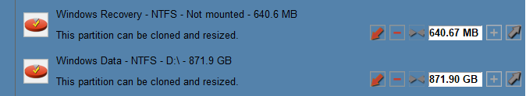
Sample implementation
User click
“Cancel”
void Gui::HandleStopClone() {
if (pCloneInfo) pCloneInfo->stop = true;
}
Function
DiskClone
void Gui::HandleStartClone() {
// Similar to ScanDrive function
// + Get CloneInfo(srcdrv, parts, orders, dstdrv)
// + Create Worker Thread
// + Wait (also response to user’s activities)
// + Finish & report status
}
User click
“Start”
[Down]/[Up]: Set clone size to Min/Max
[Minus]/[Plus]: Shrink/Expand partition size in target drive
[><]: Unknown feature. Confirm with PO ?
Clarify these items with the project owner:
+ Clone full source drive or some partitions ?
+ Clone old drive to address 0 of new drive or from an offset ? Which offset ?
+ Support to merge partitions from multiple drives ? Order of these partitions in target drive ?
+ Support shrinking partition or not ?
In the case of shrinking partitions, we need to access the file system (for example, the FAT table/NTFS master file table). This complicates the code a lot. The GUI team should study about this before hand.
For simplicity, we may copy sectors one-by-one from original drive to new target drive. But it is slow. Any better solution ? Copy block of 256 sectors ? Check other tools (clonezilla) ?

Slide 11
Sample implementation
User click
“Cancel”
void Gui::HandleStopSecureWipe() {
if (pWipeInfo) pWipeInfo->stop = true;
}
Function
Secure Wipe
User click
“Start”
void Gui::HandleStartSecureWipe() {
// Similar to above function
}
User click
“Cancel”
Function
Self-Test
void Gui::HandleStopSelfTest() {
if (pTestInfo) pTestInfo->stop = true;
}
User click
“Start”
void Gui::HandleStartSelfTest() {
// Similar to above function
}

Slide 12
Source code structure
Put GUI and StorageAPI in the same codebase
Compiler: MinGW ? MSBuild ? Static ? (follow iCUE team ?)
In the first step, I will provide a dummy version of StorageApi with necessary data structure and “empty” implementation only. So the GUI team will be able to develop and compile GUI functions without care about underlying work. Real feature will be implemented and integrated into source code later.
For now, the GUI team should design and implement code to enable the end-user to start and stop a working thread, update progress information to the end-user, and keep the GUI responsive.
namespace StorageAPI {
eRetCode ScanDrives(vector<sDriveInfo>& dlst);
eRetCode GetScanProgress(u8& prog)
eRetCode UpdateFirmware(const string& drvname, u8* data, u32 size);
eRetCode TrimDrive(const string& drvname);
eRetCode SecureErase(const string& drvname);
…
}
struct sSmartItem {
u8 id;
string name;
u8 curval;
u8 worst;
u8 threshold;
u32 rawval;
u32 status;
}
struct sSmartInfo {
vector<sSmartItem> slst;
}
struct sIdentifyInfo {
string model
string serial
string version
string confid
string ata
u64 cap;
u64 feature;
u64 thr, thw;
}
struct sDriveInfo {
string name;
u32 index;
sSmartInfo smart;
sIdentifyInfo info;
};
Necessary structures provided
eRetCode ScanDrives(vector<sDriveInfo>& dlst) {
for(int i = 0; i < 1000000; i++) {
val = i * i * i;
}
// for now, fill dlst with fake info
return OK;
}
Dummy implementation only

Slide 13
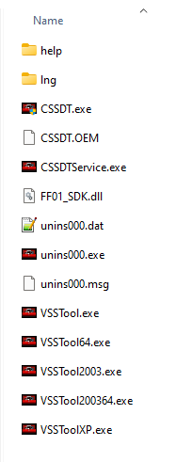
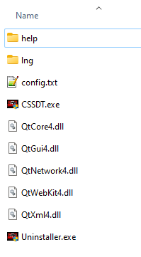
Deployment
CSSDT installation directory
New directory structure
1. Need to deploy Qt dlls here ? (confirm with iCUE team)
2. Need to build an installer/uninstaller ? (confirm with PO)

Slide 14
Others
Keywords in storage application software
+ HDD – Hard Disk Drive
+ SSD – Solid-State Drive
+ Nand Flash Memory
+ LBA: Logical Block Address.
+ Sector: 512 bytes unit.
+ Physical Drive vs Partitions.
+ Names of PhysicalDrive: /dev/sda in linux, or \\.\PhysicalDriveX in Windows (X from 0 -> 15).
+ Names of partitions: C:\, D:\
+ File system and Master file table.
+ Over-Provisioning.
+ TRIM Commands.
+ Secure-Erase/Secure-Wipe
+ S.M.A.R.T.: Self-Monitoring, Analysis, and Reporting Technology
+ SMART Attributes
+ Power Cycle

Slide 15
End

