Slide 1
Descriptive and inferential statistical methodologies have proven effective in creating a proactive ‘alarm’, accurately identifying Pump Failures with Horse Power (HP) and Pump Efficiency (PE) emerging as key variables of interest with deviations of 15 HP and > 3 % PE being our core signal thresholds.
Note: We’ve included a sample headline for you – you can feel free to use this or modify this as you see fit

Slide 2
Descriptive Analysis has enabled us to clearly identify particular signature abnormalities showing clear signature changes in both Rolling Standard Deviation and Rolling Mean Datasets when observed over the respective failure period of interest.
Note: We’ve included a sample headline for you – you can feel free to use this or modify this as you see fit

Slide 3
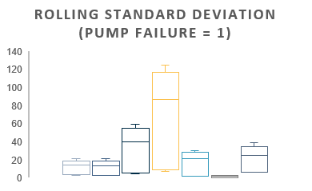
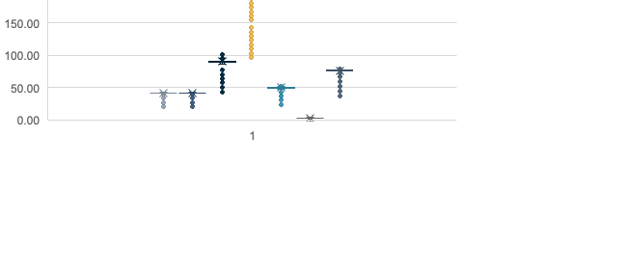
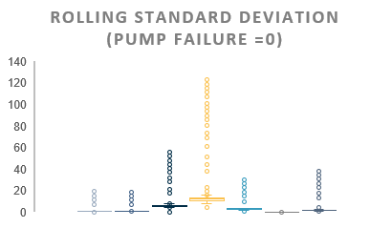

Further segmentation of the data via binary means (Pump Failure = 0 or 1) illustrated through <what plots have we used?>, show a clear signature difference between that of normal behaviour and that of Failure with Pump Torque, Pump Efficiency, Ambient Temperature showing the 3 largest variances.
Box Plot Rolling Mean (Pump Failure = 0)
Box Plot Rolling Standard Deviation( Pump Failure = 0)
Note: We’ve included a sample headline for you – you can feel free to use this or modify this as you see fit

Slide 4
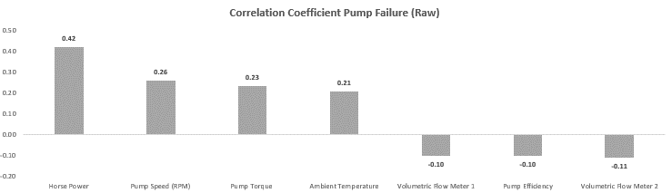
Correlation analyses across datasets yield interesting insights with Volumemetrics (-0.69) and Pump Efficiency (-0.70) negatively correlated with Pump Failure in the <Rolling Mean / Rolling Standard Deviation> Data, whilst horsepower(0.70, Volumemetrics 1(0.66) show a subsequently strong <positive/negative> correlation in the <Rolling Mean / Rolling Stdev> Dataset.
Note: We’ve included a sample headline for you – you can feel free to use this or modify this as you see fit

Slide 5
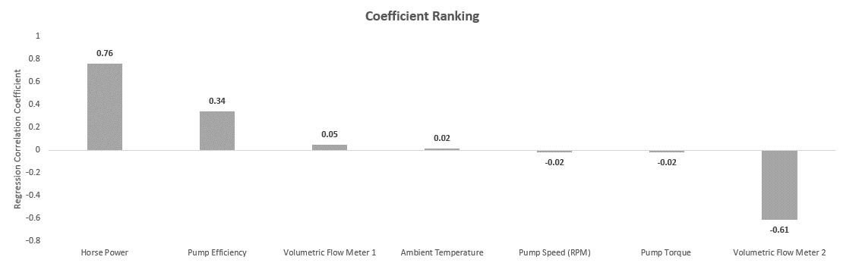
Lastly, analysis of the model fit reveals that with a R Squared of 0.77 , a linear model is a <good/bad> fit for the data with variables X, Y and Z having the largest coefficients, indicative that these variables have the most immediate relationship with respect to Pump Failure behaviour.

