Slide 1


PHUSE Open Data Repository (“PODR”):
Connecting from Tableau.
© 2007-2020 NIHPO, Inc. Licensed to PHUSE for non-commercial purposes only. Comments: Jose.Lacal@NIHPO.com

Slide 2
Agenda
Downloading Tableau Desktop
Connecting to PHUSE’s PODR
Selecting Tables
Building your Analysis
Contact
© 2007-2020 NIHPO, Inc. Licensed to PHUSE for non-commercial purposes only. Comments: Jose.Lacal@NIHPO.com

Slide 3
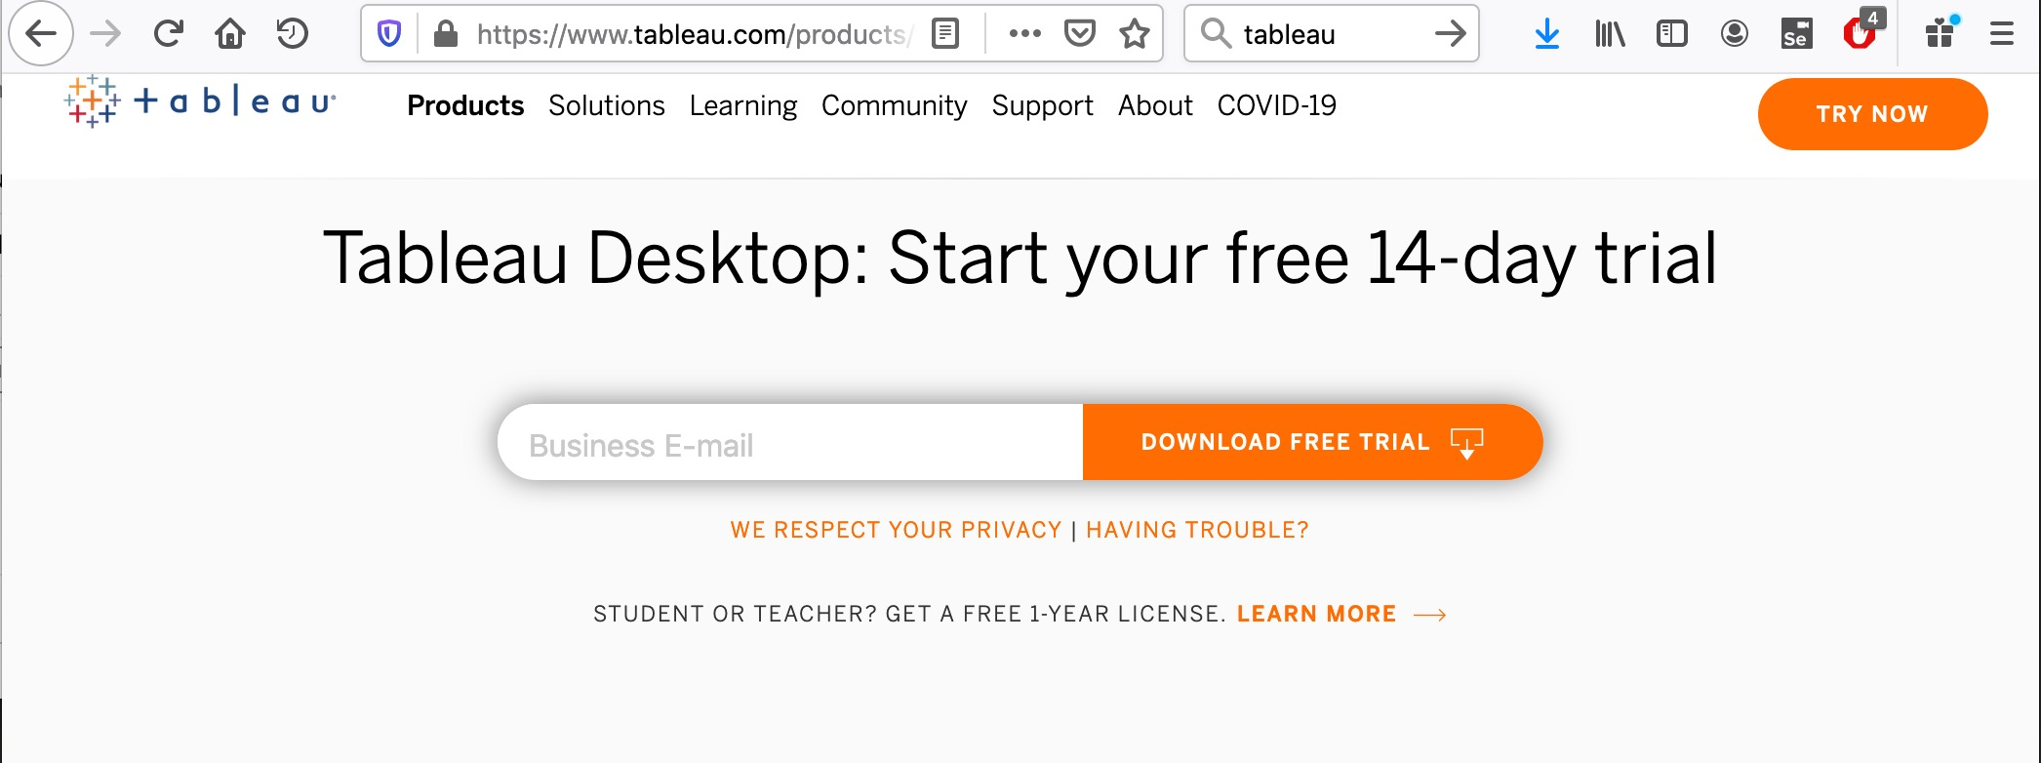
Downloading Tableau Desktop
https://www.tableau.com/products/trial
© 2007-2020 NIHPO, Inc. Licensed to PHUSE for non-commercial purposes only. Comments: Jose.Lacal@NIHPO.com

Slide 4
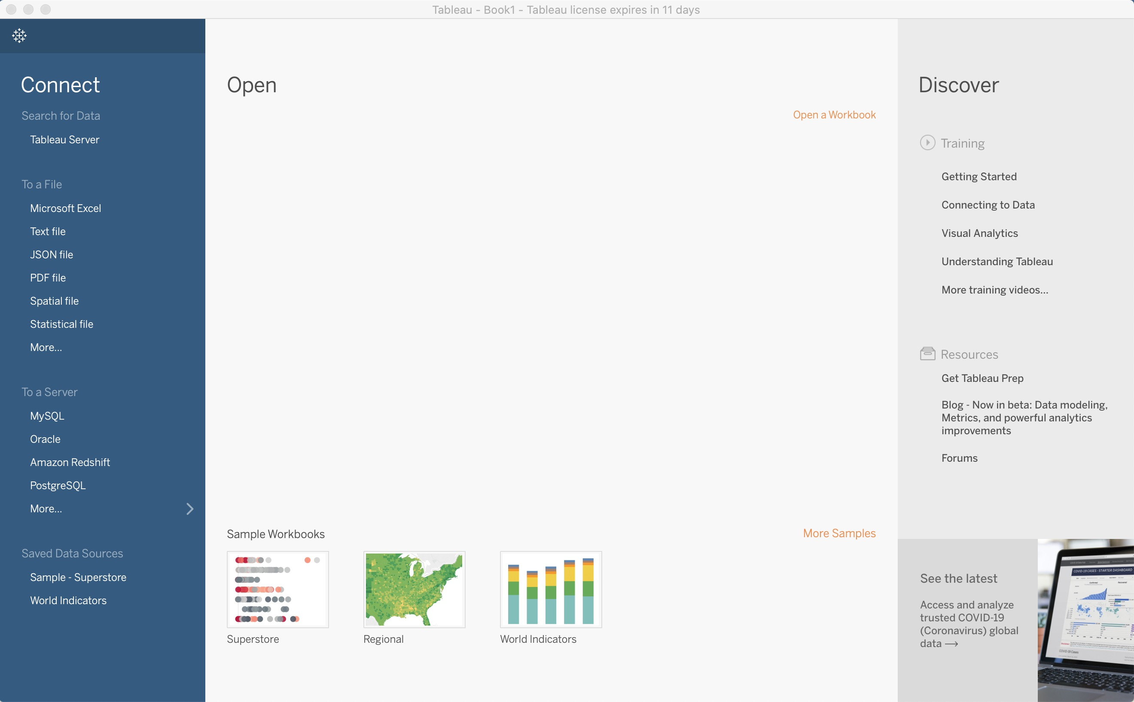
Connecting to PHUSE’s PODR
This is the initial
screen after you
launch Tableau.
© 2007-2020 NIHPO, Inc. Licensed to PHUSE for non-commercial purposes only. Comments: Jose.Lacal@NIHPO.com

Slide 5
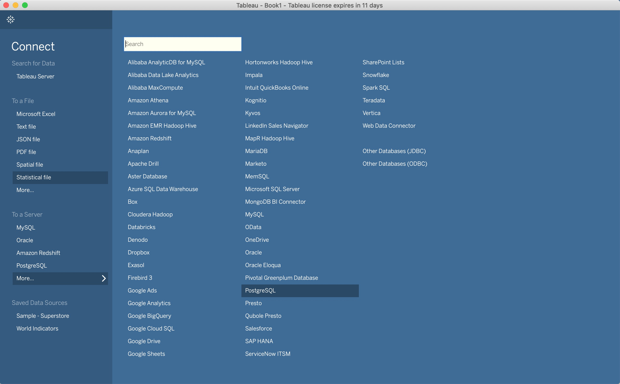
Connecting to PHUSE’s PODR
01. Click on "More"
under "To a Server"
02. Select
"PostgreSQL"
© 2007-2020 NIHPO, Inc. Licensed to PHUSE for non-commercial purposes only. Comments: Jose.Lacal@NIHPO.com

Slide 6
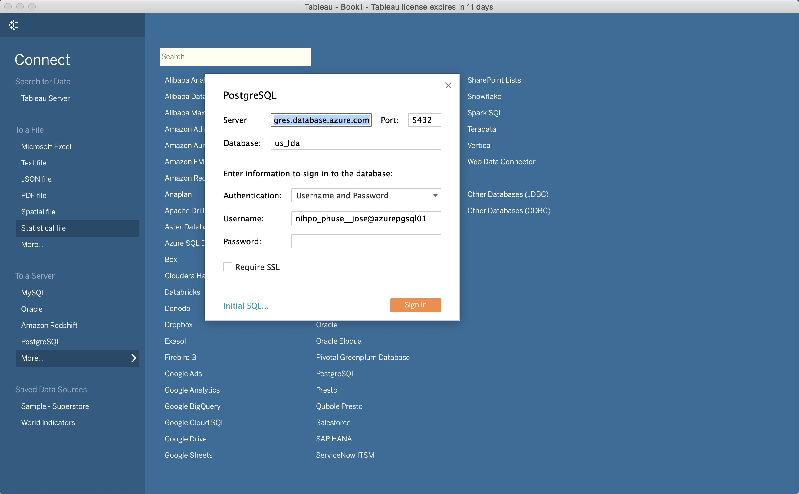
Connecting to PHUSE’s PODR
01. Enter values
provided to you:
* Server name
* Port number
* Database
02. Uncheck
"Require SSL"
03. Click on
"Sign In"
© 2007-2020 NIHPO, Inc. Licensed to PHUSE for non-commercial purposes only. Comments: Jose.Lacal@NIHPO.com

Slide 7
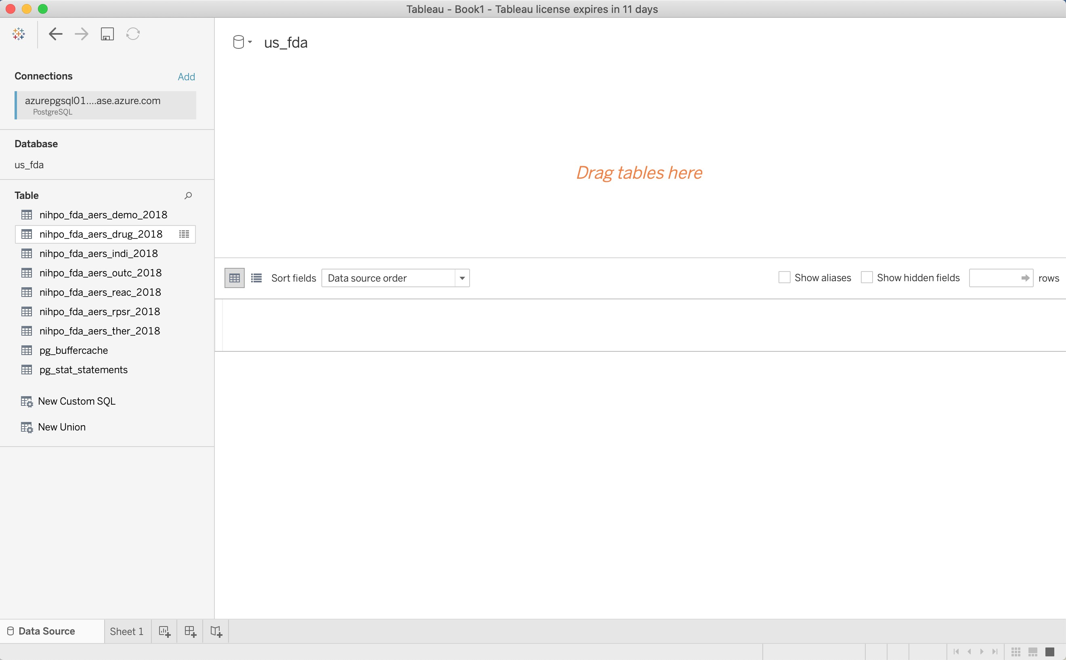
Connecting to PHUSE’s PODR
01. These are the
individual tables
you have been
given access to.
© 2007-2020 NIHPO, Inc. Licensed to PHUSE for non-commercial purposes only. Comments: Jose.Lacal@NIHPO.com

Slide 8
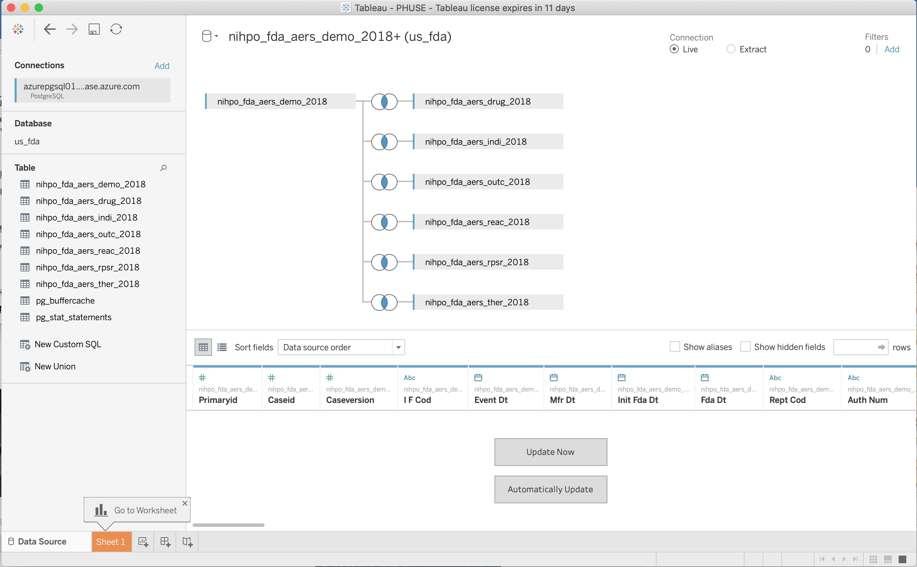
Selecting Tables
01. Drag the demo
table to the central
canvas.
02. Drag the other
06 tables to the
central canvas.
03. Click on the
"Update Now"
button.
© 2007-2020 NIHPO, Inc. Licensed to PHUSE for non-commercial purposes only. Comments: Jose.Lacal@NIHPO.com

Slide 9
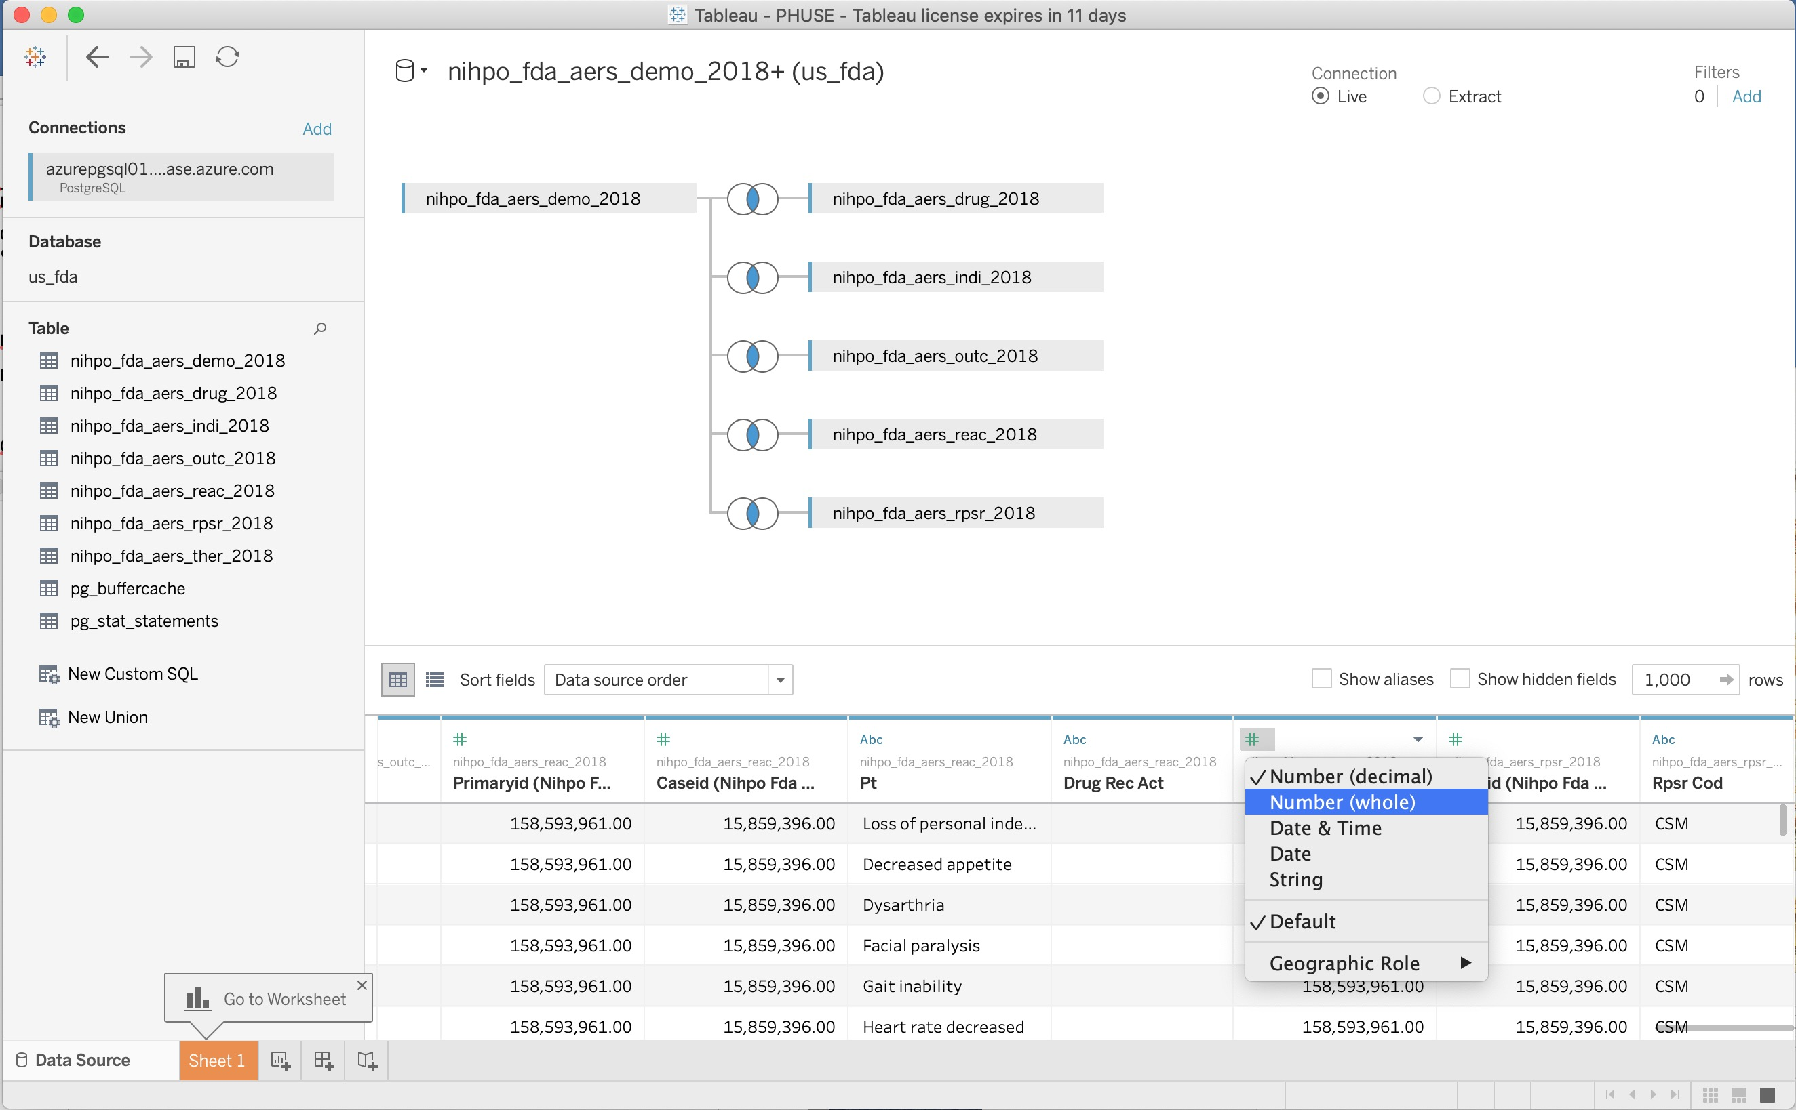
Selecting Tables
02. You may need
to adjust the field
types per column.
01. Notice the data
is presented per
record across all
07 tables.
© 2007-2020 NIHPO, Inc. Licensed to PHUSE for non-commercial purposes only. Comments: Jose.Lacal@NIHPO.com

Slide 10
Building your Analysis
01. Click on
"Sheet 1".
© 2007-2020 NIHPO, Inc. Licensed to PHUSE for non-commercial purposes only. Comments: Jose.Lacal@NIHPO.com

Slide 11
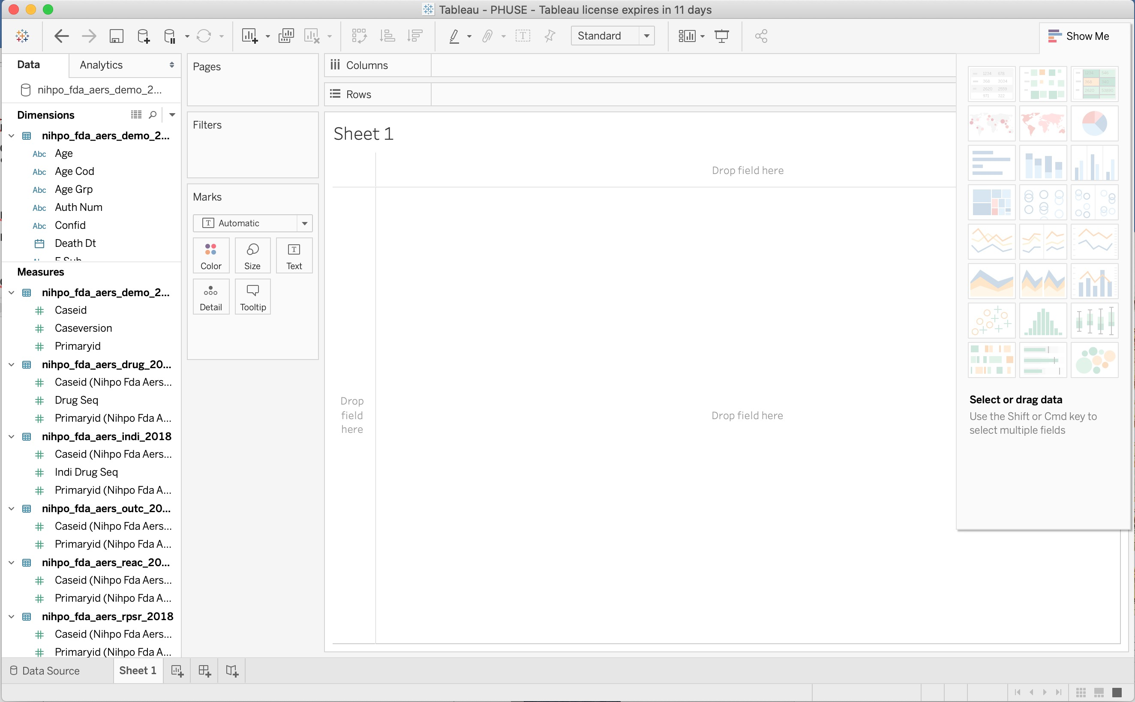
Building your Analysis
01. Drag from the
"Dimensions" left
panel to central
canvas.
02. Drag from the
"Measures" left
panel to central
canvas.
© 2007-2020 NIHPO, Inc. Licensed to PHUSE for non-commercial purposes only. Comments: Jose.Lacal@NIHPO.com

Slide 12
Contact
Jose C. Lacal
CTO
NIHPO, Inc.
Jose.Lacal@NIHPO.com
+1 (561) 777-2577
© 2007-2020 NIHPO, Inc. Licensed to PHUSE for non-commercial purposes only. Comments: Jose.Lacal@NIHPO.com

