Slide 1
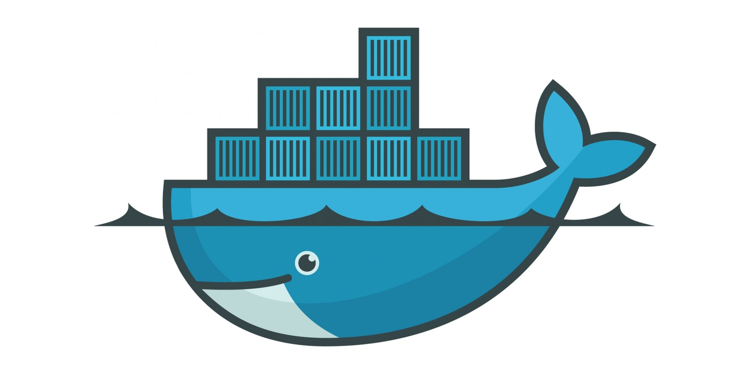
R Validation group: Docker overview

Slide 2
R Validation group: Index
3 → Dockerfiles, Images and Containers I
4 →Dockerfiles, Images and Containers II
5 →Dockerfiles, Images and Containers III
6 →Dockerfiles, Images and Containers IV
7 →Requirements

Slide 3
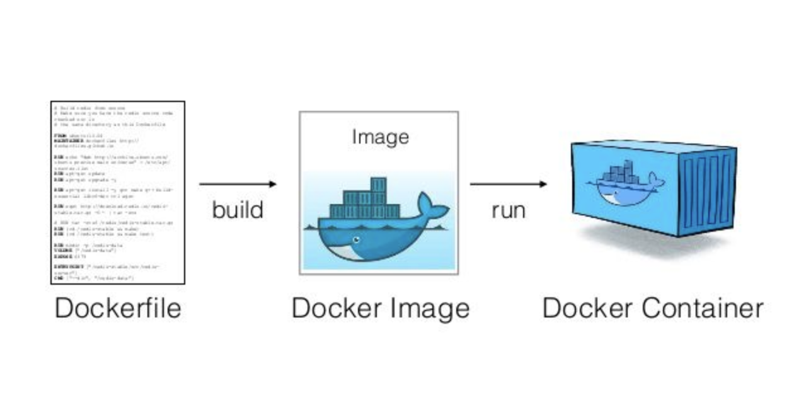
R Validation group: Dockerfiles, Images and Containers I.

Slide 4
R Validation group: Dockerfiles, Images and Containers II.
Dockerfiles:
      Docker can build images automatically by reading the instructions from a Dockerfile.
      A Dockerfile is a text document that contains all the commands a user could call on the command line to assemble an image. Using docker build users can create an automated build that executes several command-line instructions in succession.
      Providing the Dockerfile, as well as the available information of any of the employed parent images would cover the entire specifications of the host OS for the R program.

Slide 5
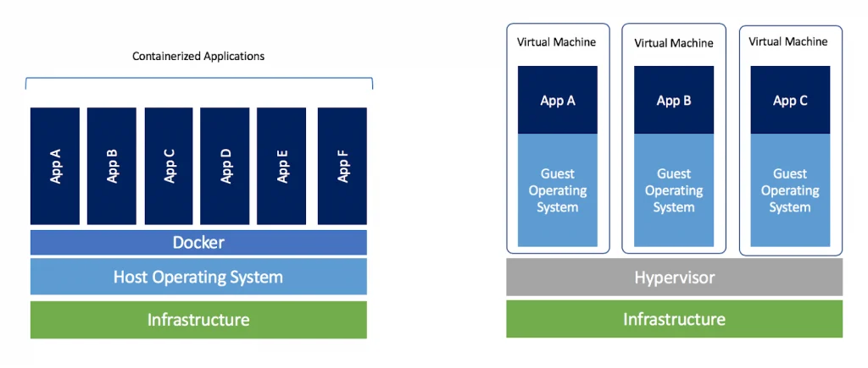
R Validation group: Dockerfiles, Images and Containers III.
Containers:
A container is a standard unit of software that packages up code and all its dependencies so the application runs quickly and reliably from one computing environment to another.

Slide 6
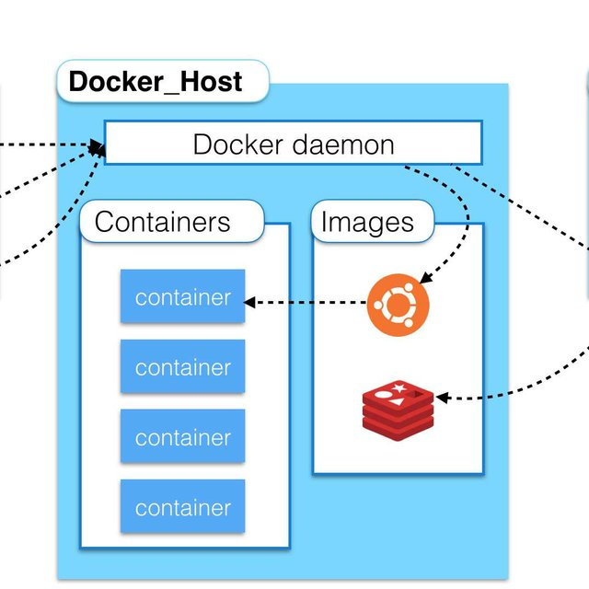
R Validation group: Dockerfiles, Images and Containers IV.
Images:
    Docker images act as a set of instructions to build a Docker container,
    like a template, or mold, which guarantees replicability in every iteration.
    It would actually be the main object of validation, being the constant
    “frozen” element of the trio.

Slide 7
R Validation group: Requirements I.
GNU/Linux distributions: [https://docs.docker.com/engine/]
CentOS
Debian
Fedora
Ubuntu
macOS: [https://docs.docker.com/docker-for-mac/install/]
With Intel chip:
The version of macOS must be 10.14 or newer. That is, Mojave, Catalina, or Big Sur. We recommend upgrading to the latest version of macOS.
With Apple silicon:
You must install Rosetta 2 as some binaries are still only designed for the older Darwin/AMD64 architecture.
To install Rosetta 2 manually from the command line, run the following command in Terminal:
softwareupdate --install-rosetta
Windows 10 and above [https://docs.docker.com/docker-for-windows/install/]

