Slide 1
How CI/CD Enhances the Development of R Packages in the Pharmaverse

Slide 2
What is CI/CD?
Continuous Integration (CI): Frequent merging of several small changes into a main branch
Continuous Delivery (CD): Repeatable deployment process when deciding to deploy
CI/CD bridges the gaps between development and operation activities and teams by enforcing automation in building, testing and deployment of {pharmaverse} R packages.

Slide 3

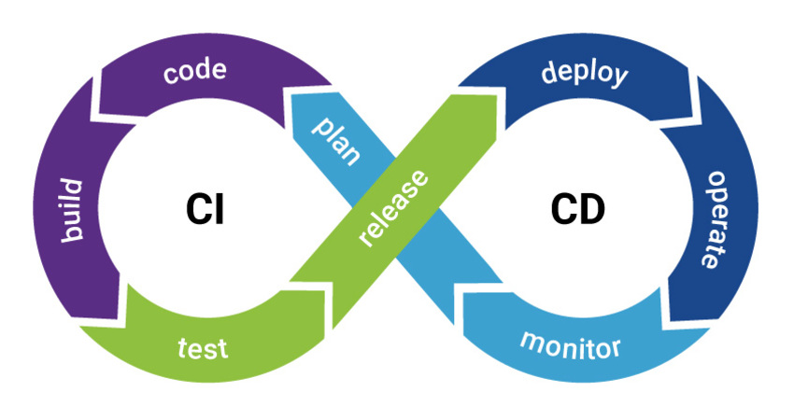

Slide 4
Wikipedia: CI/CD {pharmaverse}
Does it help?
…Yes! Yes, it does!!
XKCD
How does CI/CD help R packages?
Catch issues (bugs) early on
User base on multiple OSes and multiple R versions
Faster turnaround on Code Review
Multiple Contributors on your R Package
Enforce style conventions and preferences
Measure test coverage for new code
Keep docs up-to-date
And we can just keep going!
We covered a lot of custom CI/CD actions for R packages in the R/Pharma Workshop in 2022: Intro to CI/CD for R Packages

Slide 5
Two Case Studies

Slide 6
Case Study - admiral
About admiral

Slide 7
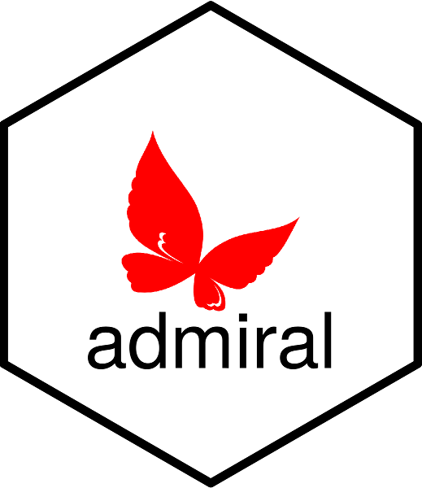
Provide an open source, modularized toolbox that enables the pharmaceutical programming community to develop ADaM datasets in R.
ADaM is one of the required standards for data submission to FDA (U.S.) and PMDA (Japan) for clinical trials
Links
CDISC
https://github.com/pharmaverse/admiral
Issue 1: Checking ADaM Template code
Issue 2: Common CI/CD workflows for the admiral family of packages

Slide 8
Issue 1 - How to Check our Template Code

Slide 9
Create a reference files to build common ADaM datasets that shows users how to implement our functions
Way less text than a Vignette - Code is ready to go and build a dataset
Where we store this code is not checked by R-CMD
How to ensure code stays up to date with deprecated functions or unforeseen bugs get in from functions working together?
CI/CD for the win!

Slide 10
Solution 1 - CI/CD for Templates

Slide 11
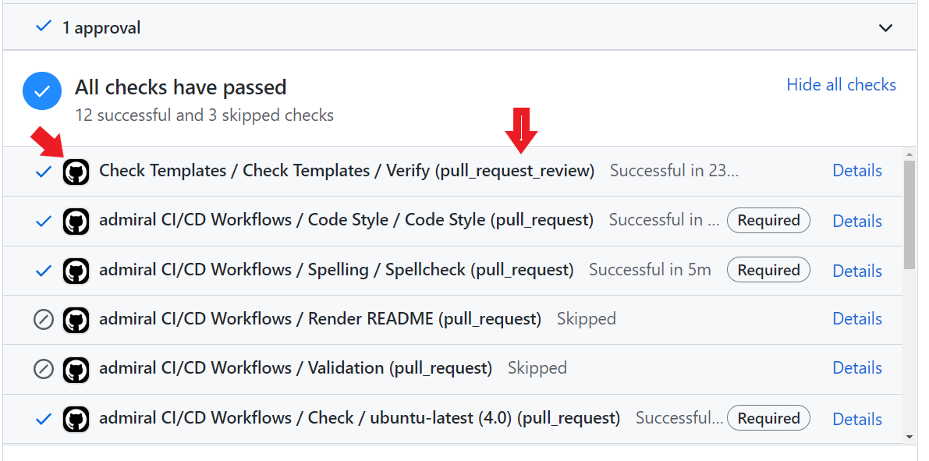
Dedicated CI/CD workflow that executes the Template code
Once a Code Review is completed the Check Template Workflow is executed
If any errors or warnings are detected the CI/CD check fails and the contributor must fix the error or warning.
.github/workflows/check-templates.yml

Slide 12
Issue 2 - admiral upstream and downstream dependencies

Slide 13
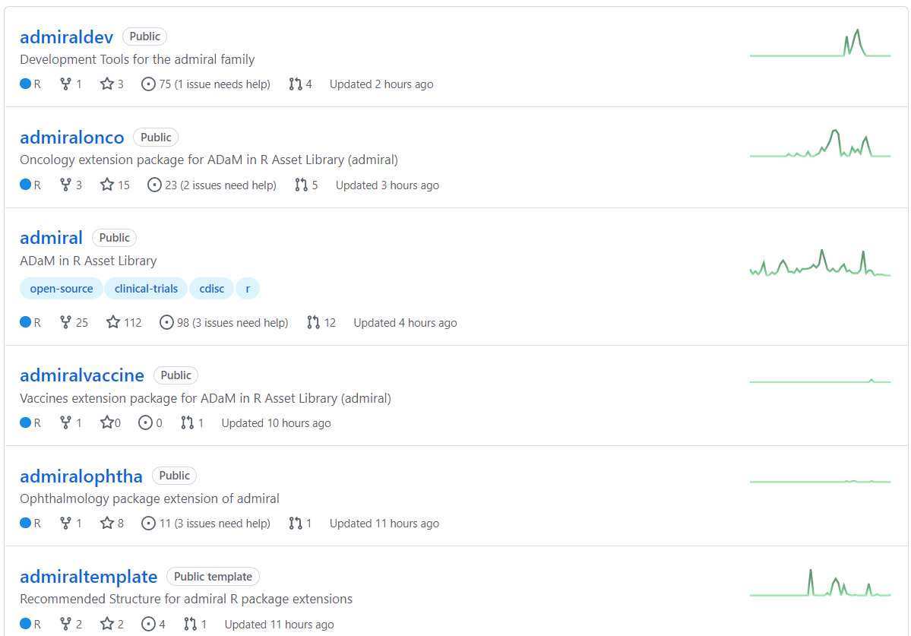
As you can imagine there can be a lot of different types of ADaMs!
Extension packages focus on specific disease areas like oncology
The admiral family has a package for developers, template R package repo and dummy data
Eek!! How to keep this all in line!

Slide 14
Solution 2 - Common CI/CD workflows for admiral upstream and downstream dependencies

Slide 15
Using {admiralci}, we have a common set of CI/CD workflows
Developers moving between packages are familiar with these workflows
Common documentation between packages for CI/CD workflows - easy to maintain and provide to new contributors

Slide 16
Case Study - NEST
About NEST

Slide 17
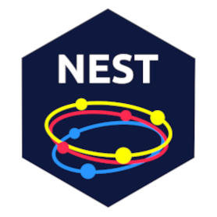
A collection of R packages for creating TLGs/TFLs and exploratory clinical trials data visualization
tern and rtablesfor creating TLGs
teal for creating exploratory web applications for analyzing clinical trial data
Links
rtables
tern
teal

Slide 18
Use Case 1 - Integration Testing
An in-development package must be tested against the latest versions of upstream dependencies
Monorepo emulation via a git branch naming strategy is achieved by using
the staged.dependencies R package
and the staged.dependencies GitHub Action
Testing as a cohort can be done at any stage (eg. development, pre-release, release)
Use Case 2 - Web Application Testing & Deployment

Slide 19
Analysts create Shiny web apps via the teal framework for analyzing data
Apps are tested via a CI pipeline that uses the shinytest2 R package
Apps deployed to an Posit Connect Server instance via a CD pipeline
With the help of the rsconnect and connectapi R packages

Slide 20
Use Case 3 - Validating R Packages

Slide 21
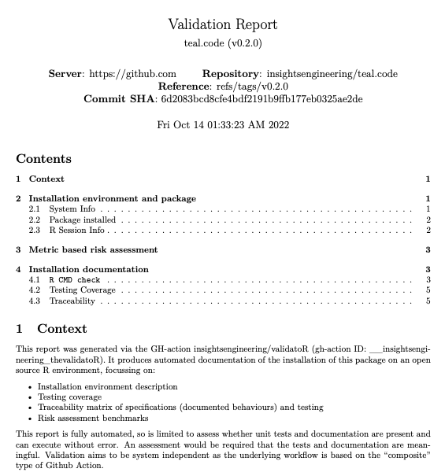
R packages are validated by an internal validation team that uses CI/CD pipelines to automatically
accept new package submissions via a form
running tests against the new package to ensure package integrity
enforcing criteria to ensure that the package meets regulatory requirements
Also validated externally via an open source project called thevalidatoR

Slide 22
Additional Materials
Further Reading
GitHub Actions
GitLab CI
Advanced Examples
r-lib/actions
{admiralci}
Docker
Presentation built with Quarto
R/Pharma 2022 CI/CD Workshop
This Presentation

